Slide 1
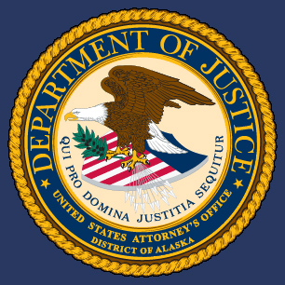
TCC 38th Annual Tribal Court Conference
Savanna’s Act and Missing & Murdered Indigenous Persons-Tribal Community Response Plan
Lane Tucker
United States Attorney
District of Alaska
Lane.Tucker@usdoj.gov
Ingrid Cumberlidge
US DOJ MMIP Coordinator
US Attorney’s Office-District of Alaska
Ingrid.Cumberlidge@usdoj.gov
USAAK.MMIP@usdoj.gov

Slide 2
Savanna’s Act Guidance
25 U.S.C. § 5704
Guidelines for Responding to Cases of Missing or Murdered Indigenous Persons

Slide 3
Savanna’s Act Consultation
Develop guidelines in consultation with:
  Tribes
  Tribal, Local, State, and Federal Law Enforcement
  Medical Examiners
  Victim Service Providers

Slide 4
Savanna’s Act Goals
Clarify the responsibilities of Federal, State, Tribal, and local law enforcement agencies with respect to responding to cases of missing and murdered Indigenous People;
Increase coordination and communication among law enforcement agencies, including Medical Examiner and coroner offices;
Empower Tribal governments with the resources and information necessary to effectively respond to cases of missing and murdered Indigenous People;
Increase the collection of data related to missing or murdered Indigenous People.

Slide 5
Savanna’s Act Guidelines, Protocols, Policy Areas,
25 U.S.C. § 5704
guidelines on inter-jurisdictional cooperation among law enforcement agencies at the Tribal, Federal, State, and local levels, including inter-jurisdictional enforcement of protection orders and detailing specific responsibilities of each law enforcement agency;

Slide 6
Savanna’s Act Guidelines, Protocols, Policy Areas
Jurisdictional Cooperation
Lead Investigative Agency maintains the file.
Lead Investigative Agency communicates with all law enforcement in the area.
Tribes encourage and supported in developing your Tribal Community Response Plan to MMIP.
Report MMIP as soon as possible.
Lead LE as appropriate seek AST and Federal investigative assistance.
Federal Resource Coordinator: US Attorney Tribal Liaison and MMIP Coordinator will provide coordination and support to seek State and Federal LE support.
Tribal Court Orders Full Faith and Credit.
Encourage Tribal public safety funding opportunities.

Slide 7
Savanna’s Act Guidelines, Protocols, Policy Areas,
25 U.S.C. § 5704
best practices in conducting searches for missing Indigenous People;

Slide 8
Savanna’s Act Guidelines, Protocols, Policy Areas
Best Practices for Conducting Searches
All Law enforcement encouraged to review and develop missing protocols.
AST to activate search and rescue support.
DPS-AST to active Amber and Silver Alert.
Consider FEMA (Federal Emergency Management Agency) IPAWS (Integrated Public Alert and Warning System)
Tribes encouraged to:
Identify volunteers/staff
Identify command/coordination center
Plan for and coordinate food and water
Coordinate Tribal/village leadership if no law enforcement in the community and notify AST as soon as possible.
Designate a method to disseminate information via VHF radio….

Slide 9
Savanna’s Act Guidelines, Protocols, Policy Areas,
25 U.S.C. § 5704
standards on the collection, reporting, and analysis of data and
information on missing persons and unidentified human remains, and information on culturally appropriate identification and handling of human remains identified as Indigenous, including guidance stating that all appropriate information related to missing or murdered Indigenous persons be
entered in a timely manner into applicable databases;

Slide 10
Savanna’s Act Guidelines, Protocols, Policy Areas
Data Standards and Handling Human Remains
Enter data into the Alaska Public Safety Information Network to ensure national databases are notified and recorded in.
Collect AK Native Village/Tribe data.
Next of Kin Notification
Work with Medical Examiner to support remains identification.
Use state and national DNA and other databases to support Identification.
If DPS ships remains for ME Exam they return it and cover the basic cost.
Medical Examiners will seek prior family/tribal approval for any additional remains handling cost before incurring them.
Medical Examiners and Law Enforcement encourage to participate in joint training.
Medical Examiners encourage to find ways to consider questioned findings.
Notes:
o

Slide 11
Savanna’s Act Guidelines, Protocols, Policy Areas,
25 U.S.C. § 5704
4. guidance on which law enforcement agency is responsible for inputting information into appropriate databases if the Tribal law enforcement agency does not have access to those databases;

Slide 12
Savanna’s Act Guidelines, Protocols, Policy Areas
Law Enforcement Entry Into Databases
  Enter data into appropriate databases: (may Include)
    APSIN
    NCIC
    Combined DNA Index System (CODIS)
    Next Generation Identification System
    Violent Criminal Apprehension Program
    NamUs
    NCMEC
Federal, State, and local governments should add fields for Alaska Native Villages and Tribes to relevant databases on or before January 1, 2032.
Encourage to allow multiple selections.
Tribes/AK Native Villages without law enforcement encouraged to report to DPS AST to enter into Alaska Public Safety Information Network to ensure data is entered.
Tribes can check data at https://dps.alaska.gov/AST/ABI/MissingPerson
Encourage all eligible Indian Tribes to apply for the Tribal Access Program for National Crime Information (TAP) (VAWA 2022 Sec. 802)
Notes:
o

Slide 13
Savanna’s Act Guidelines, Protocols, Policy Areas,
25 U.S.C. § 5704
5. guidelines on improving law enforcement agency response rates and follow-up responses to cases of missing or murdered Indians; and

Slide 14
Savanna’s Act Guidelines, Protocols, Policy Areas
Improve Law Enforcement Response & Follow-Up
Law Enforcement Best Practices
Tribes Invited to develop MMIP Tribal Community Response Plans
Report MMIP as soon as possible.
Coordinate with AST for Search and Rescue support.
Coordinate with AST for Investigative support.
Support Communication and community outreach.
Support VAWA pilot projects.
Law Enforcement and tribes with out LE can seek Federal Support.
Alaska Native Recruitment across Law Enforcement
Support increased Law Enforcement.
Support increased Victim Services.
Encourage regional cultural education.
Multi-disciplinary case review team.
Support regular training.

Slide 15
Savanna’s Act Guidelines, Protocols, Policy Areas,
25 U.S.C. § 5704
guidelines on ensuring access to culturally appropriate victim services for victims and their families.

Slide 16
Savanna’s Act Guidelines, Protocols, Policy Areas
Culturally Appropriate Victim Services
Tribes Invited to develop MMIP Tribal Community Response Plans with tribal/tribal agency Victim Services contacts.
All law enforcement should invite Victim Services to be a part of Multi-Disciplinary teams.
Coordination of rural law enforcement with local Victim Services:
  Cultural awareness
  Communication
  Advocacy access
Law Enforcement seek CDVSA and other Victim Services agency support .
Victim Services support from the event to prosecution.
Support increased access to Victim Services resources.
Support cross training with Law Enforcement and Victim Services.
Encourage regional cultural education.
Cultural and Trauma Informed Training.

Slide 17
Alaska MMIP - Statewide Working Group Stakeholders/Providers/LE: Resources & Response
Statewide, Tribal MMIP Focus, Stakeholders, and Multidisciplinary Providers. (September – bi-monthly)
Federal Law Enforcement Partners: FBI, USMS, USCG, BIA-MMU & HHS, and USA
Alaska State Troopers
  Village Public Safety Officer Regional Supervisors (2-tribal)
Alaska Department of Law
Municipal Law Enforcement
Victims and Advocacy Services (1 – tribal)
Tribal Members & TCRP Pilot Site Members (7 – tribal)

Slide 18
Goal of the Alaska – MMIP Pilot Projects
To establish a plan for tribal communities to collectively use their resources effectively in supporting an emergent MMIP case, ongoing case, and cold case response
To support a multidisciplinary approach to raise MMIP awareness, prevention efforts, training, & response capacity
To Identify and respond to root causes (i.e. historical trauma, substance use, domestic violence, danger of media & travel…): support prevention, treatment, repair of harm

Slide 19
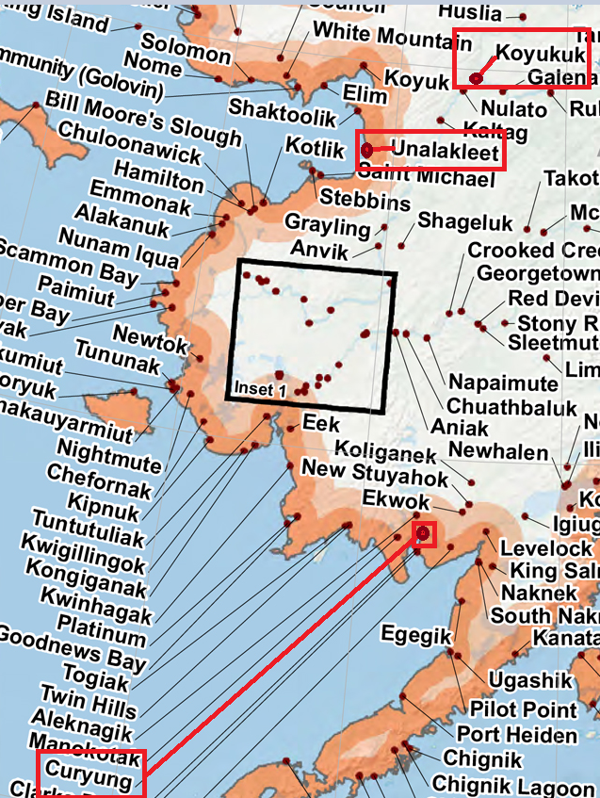
3 Pilot Project Volunteer
Alaskan Tribes
Share experiences in the Pilot Project

Slide 20
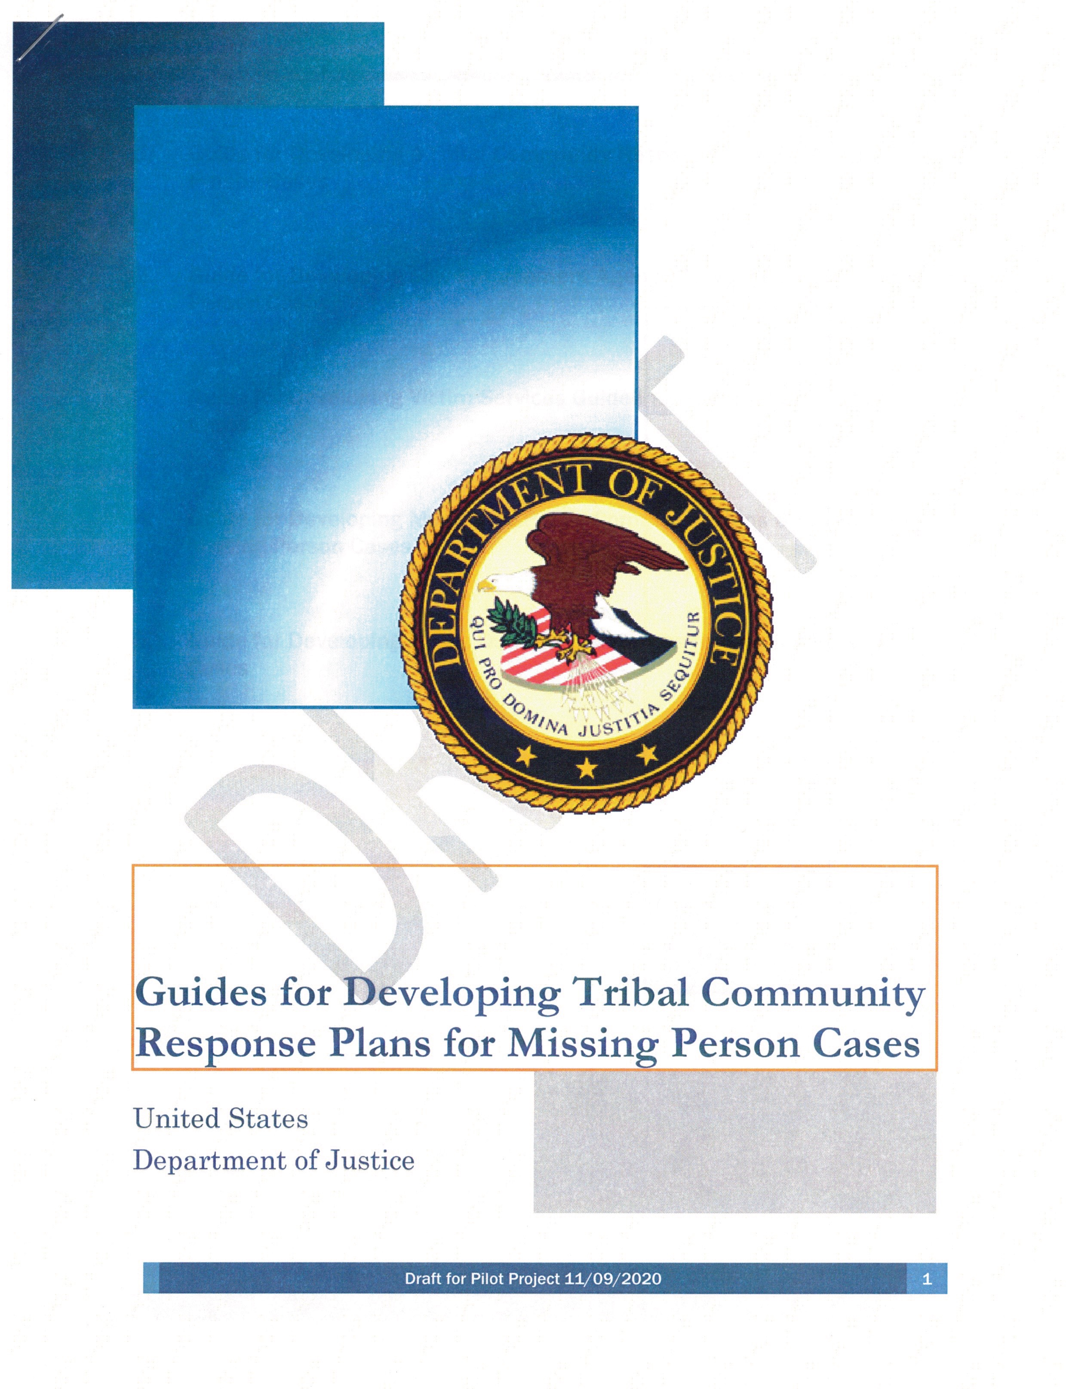
AK – MMIP Pilot Project is Comprised of Five Guides
Law Enforcement
Victim Services
Public and Media Communications
Community Outreach

Slide 21
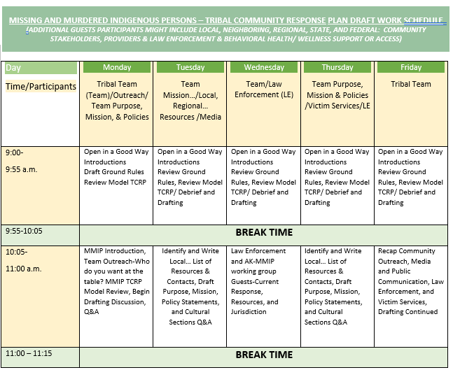
Working Together
5 Days
4+ Hours
Tribal Team
Stakeholders Providers
Law
Enforcement

Slide 22

Working Together
5 Days
4+ Hours
Tribal Team
Stakeholders Providers
Law
Enforcement

Slide 23
Alaska MMIP - Pilot Program, 3 Volunteer Tribes
Develop 3 Community Action Models
  (Tribal Community Response Plans)
  Communities with no law enforcement (LE)
  Communities with limited LE (VPSO, TPO…)
  Hub Communities with municipal and/or state law enforcement
Adopted: Curyung Tribal Council of Dillingham
Native Village of Unalakleet
In Progress: Koyukuk Native Village
One Model

Slide 24
Missing & Murdered Indigenous Persons
Tribal Community Response Plan Model - Goals
The Plan belongs to and is lead by participating Alaska Tribes and Villages.
The Model is a backbone to the tribal team’s capacity building work.
The Model is not the final plan document: collaboration/relationships building
Find Solutions
Identify Resources
Build Response Capacity, Contacts, Understanding, and Collaboration
Increase Reporting/Response
Increasing Cultural Understanding
Foster Supportive Relationships & Good Communication
Build Trust
Resolve Conflicts /Roadblocks
Recognize Historical and Residual/Secondary Trauma
Learn from Each Other

Slide 25
Alaska Missing and Murdered Indigenous Persons:
NCJTC - Child Abduction Tabletop Exercise in Indian Country – Tribal Community Response Plan
Curyung Tribal Council of Dillingham
Native Village of Unalakleet
  Scenario Based: Child (14 or 16 goes missing)
  4 hours with Tribal Response Team, Stakeholder providers, and Law Enforcement
  Initial Response, On-going Response, Media, Victim Services, and Re-unification/Resolution…

Slide 26
TCC 38th Annual Tribal Court Conference
Savanna’s Act and Missing & Murdered Indigenous Persons-Tribal Community Response Plan
Qaĝaasakung
Gunalchéesh
Quyana
Enna Baasee’
Tsin'aen Quyanaqpak
Lane Tucker
United States Attorney
District of Alaska
Lane.Tucker@usdoj.gov
Ingrid Cumberlidge
US DOJ MMIP Coordinator
US Attorney’s Office-District of Alaska
Ingrid.Cumberlidge@usdoj.gov
USAAK.MMIP@usdoj.gov
Any questions?

