Slide 1
The Global Presence: Managing the International Risks of Faculty, Staff and Students
Jaime Molyneux Director of International Risk Management
The University of Pennsylvania

Slide 2
The “Full-Timers”

Slide 3
International Travel Risks
Injury / Illness
Mental Health Emergency
Opportunistic Crime
Violent Crime
Car accident
Sexual Assault
Missing Person/Kidnapping
Public Health Emergency
Fire/Facility Disaster
Weather System
Political Unrest/Riots
Natural Disaster
Terrorism

Slide 4
Why now?

Slide 5
The Game Has Changed
Then
Now
Study Abroad
Travel Warning Countries
Pick-pocketing
UK, Spain, Germany
Embassy Assistance
“University Affiliated Travel”
High Risk Regions
Cyber Security
China, India, Israel, Brazil
University Assistance

Slide 6
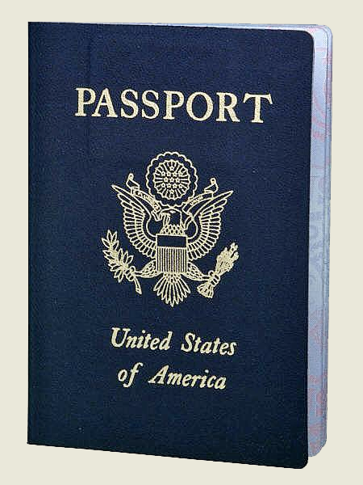
The Game Has Changed
Duty of Care
Who are they?
Where are they?
What are they doing?
Are they well informed?

Slide 7
The Game Has Changed
Travel Tracking
Risk Assessment Committee
International Risk Analysts
International Travel Policy
Restricted Regions List
Trip Leader Training/Manuals
International Incident Collection
Emergency Assistance Provider(s)
Emergency Response Procedures
Emergency Response Team

Slide 8
International Risk Management
Assess | Prepare
Respond | Recover

Slide 9
Assess
Regional Risk Assessment (“Scanning & Monitoring”)
Monitor World Events
U.S. Department of State Guidance
Non-U.S. government guidance
Private Security Analysts, Regional Risk Ratings
Programmatic Risk Assessment
Facilities/Housing
Emergency Response Capability
Policies & Protocols
Travel Restrictions
Required Trainings

Slide 10
Prepare
Pre-Departure Training & Consultation
Travel Warnings, Risk Ratings, Security/Medical Threats
Risk Mitigation Strategies
One-on-One Consultation, Group Presentations
University Resources (e.g. insurance information, visas, vaccinations, etc.)
Emergency Procedures
Trip Leader Training
Expectations of Role
Responding to Emergencies

Slide 11
Respond
Travel Tracking
Emergency Outreach
Emergency Procedures
Assistance Providers
Insurance Providers
Response Team (at home)
Response Team (on the ground)

Slide 12
Recover
Ongoing Care
Medical, Security, Legal Assistance
Emotional Support
Evacuation/Repatriation
Supporting Parents and the University Community
Academic Impact
Financial Assistance
International Incident Collection
Debrief (revise protocols/policies as needed)

Slide 13
In Summary…
The game has changed: more faces, more places
Travel risk is less about the destination, more about the traveler
Be strategic
Collaborate: leverage internal/external resources
Have a team
Have a plan (and practice it)

Slide 14
Tools You Can Use
Site Visit Checklist
Trip Leader Checklist
Emergency Plan (the “one-pager”)

Slide 15
Tools You Can Use
U.S. Government
U.S. Department of State
Embassies & Consulates
Overseas Security Advisory Council (OSAC)
Office of Foreign Asset Controls (OFAC)
Smart Traveler Enrollment Program (STEP)
StudentsAbroad.state.gov
Center for Disease Control (CDC)
FBI: Safety & Security for U.S. Students Traveling Abroad
Foreign Governments (U.K., Australia, Canada, etc.)
Security Agencies
Online News (Al Jazeera, All Africa, CNN, BBC, LAHT, NYTimes)
Weather & Natural Disaster Centers (GDACS, USGS, PTWC)

Slide 16
Global Incident Management Team
Core Members
Executive Director, Office of Risk Management & Insurance
Executive Director, Global Support Services
Deputy Chief, Penn Police
Director, Penn Abroad
Director, Student Intervention Services
Director of International Risk Management
Advisory Council
Office of General Counsel
Office of the Provost
Office of Student Affairs
Office of Global Initiatives
Student Health Services
Counseling Services
International Students & Scholars
Privacy & Compliance
Public Affairs, Penn Health System
University Chaplain
VPUL Communications
University Communications

Slide 17
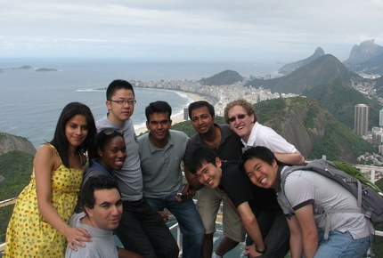
Thank you
Jaime Molyneux
The University of Pennsylvania
molyneux@upenn.edu
215-573-6122

