Slide 1

Healing Centered Engagement in Academia
LaVerne Xilegg Demientieff, LMSW, PhD
Deg Xit’an Athabascan
Professor
UAF Social Work Department

Slide 2
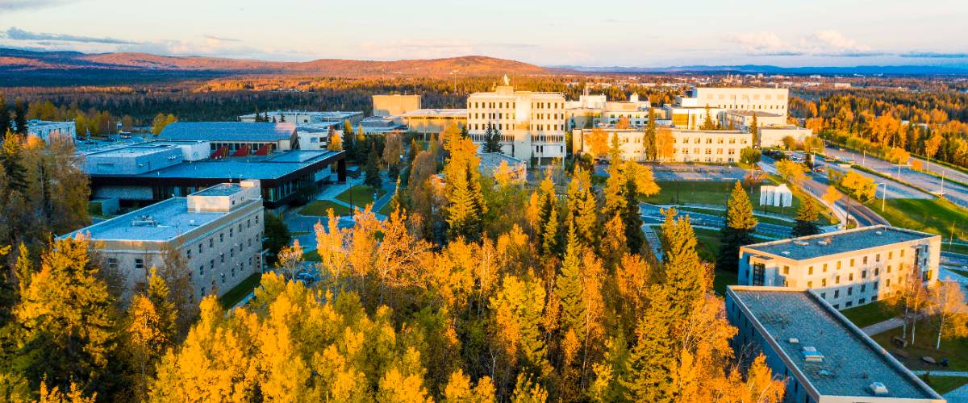
In Fairbanks, our Troth Yeddha' Campus is located on the traditional lands of the Dena people of the lower Tanana River. We acknowledge that these lands on which we live and work are the unceded, ancestral lands of the Dena people who stewarded these lands for thousands of years and continue to steward these lands today. We give thanks to all the Indigenous ancestors for sharing their love and resilience and wisdom so that we can use cultural and traditional knowledge and practices for our well-being now and into the future.
Notes:
Land acknowledgement and origins of name/ LaVerne

Slide 3
What Guides This Work
∙Indigenous cultural wisdom and practices must continue to exist for another 10,000+ years;
∙Cultural practices serve as a guide for wellness and healing in our communities and organizations and systems; these practices plant seeds of wellness in all ages.
∙Indigenous people and communities have the strength, resilience and ability to confront the challenges that face them;
∙Indigenous communities should be at the helm of all research, programming, and activities that involve them.

Slide 4
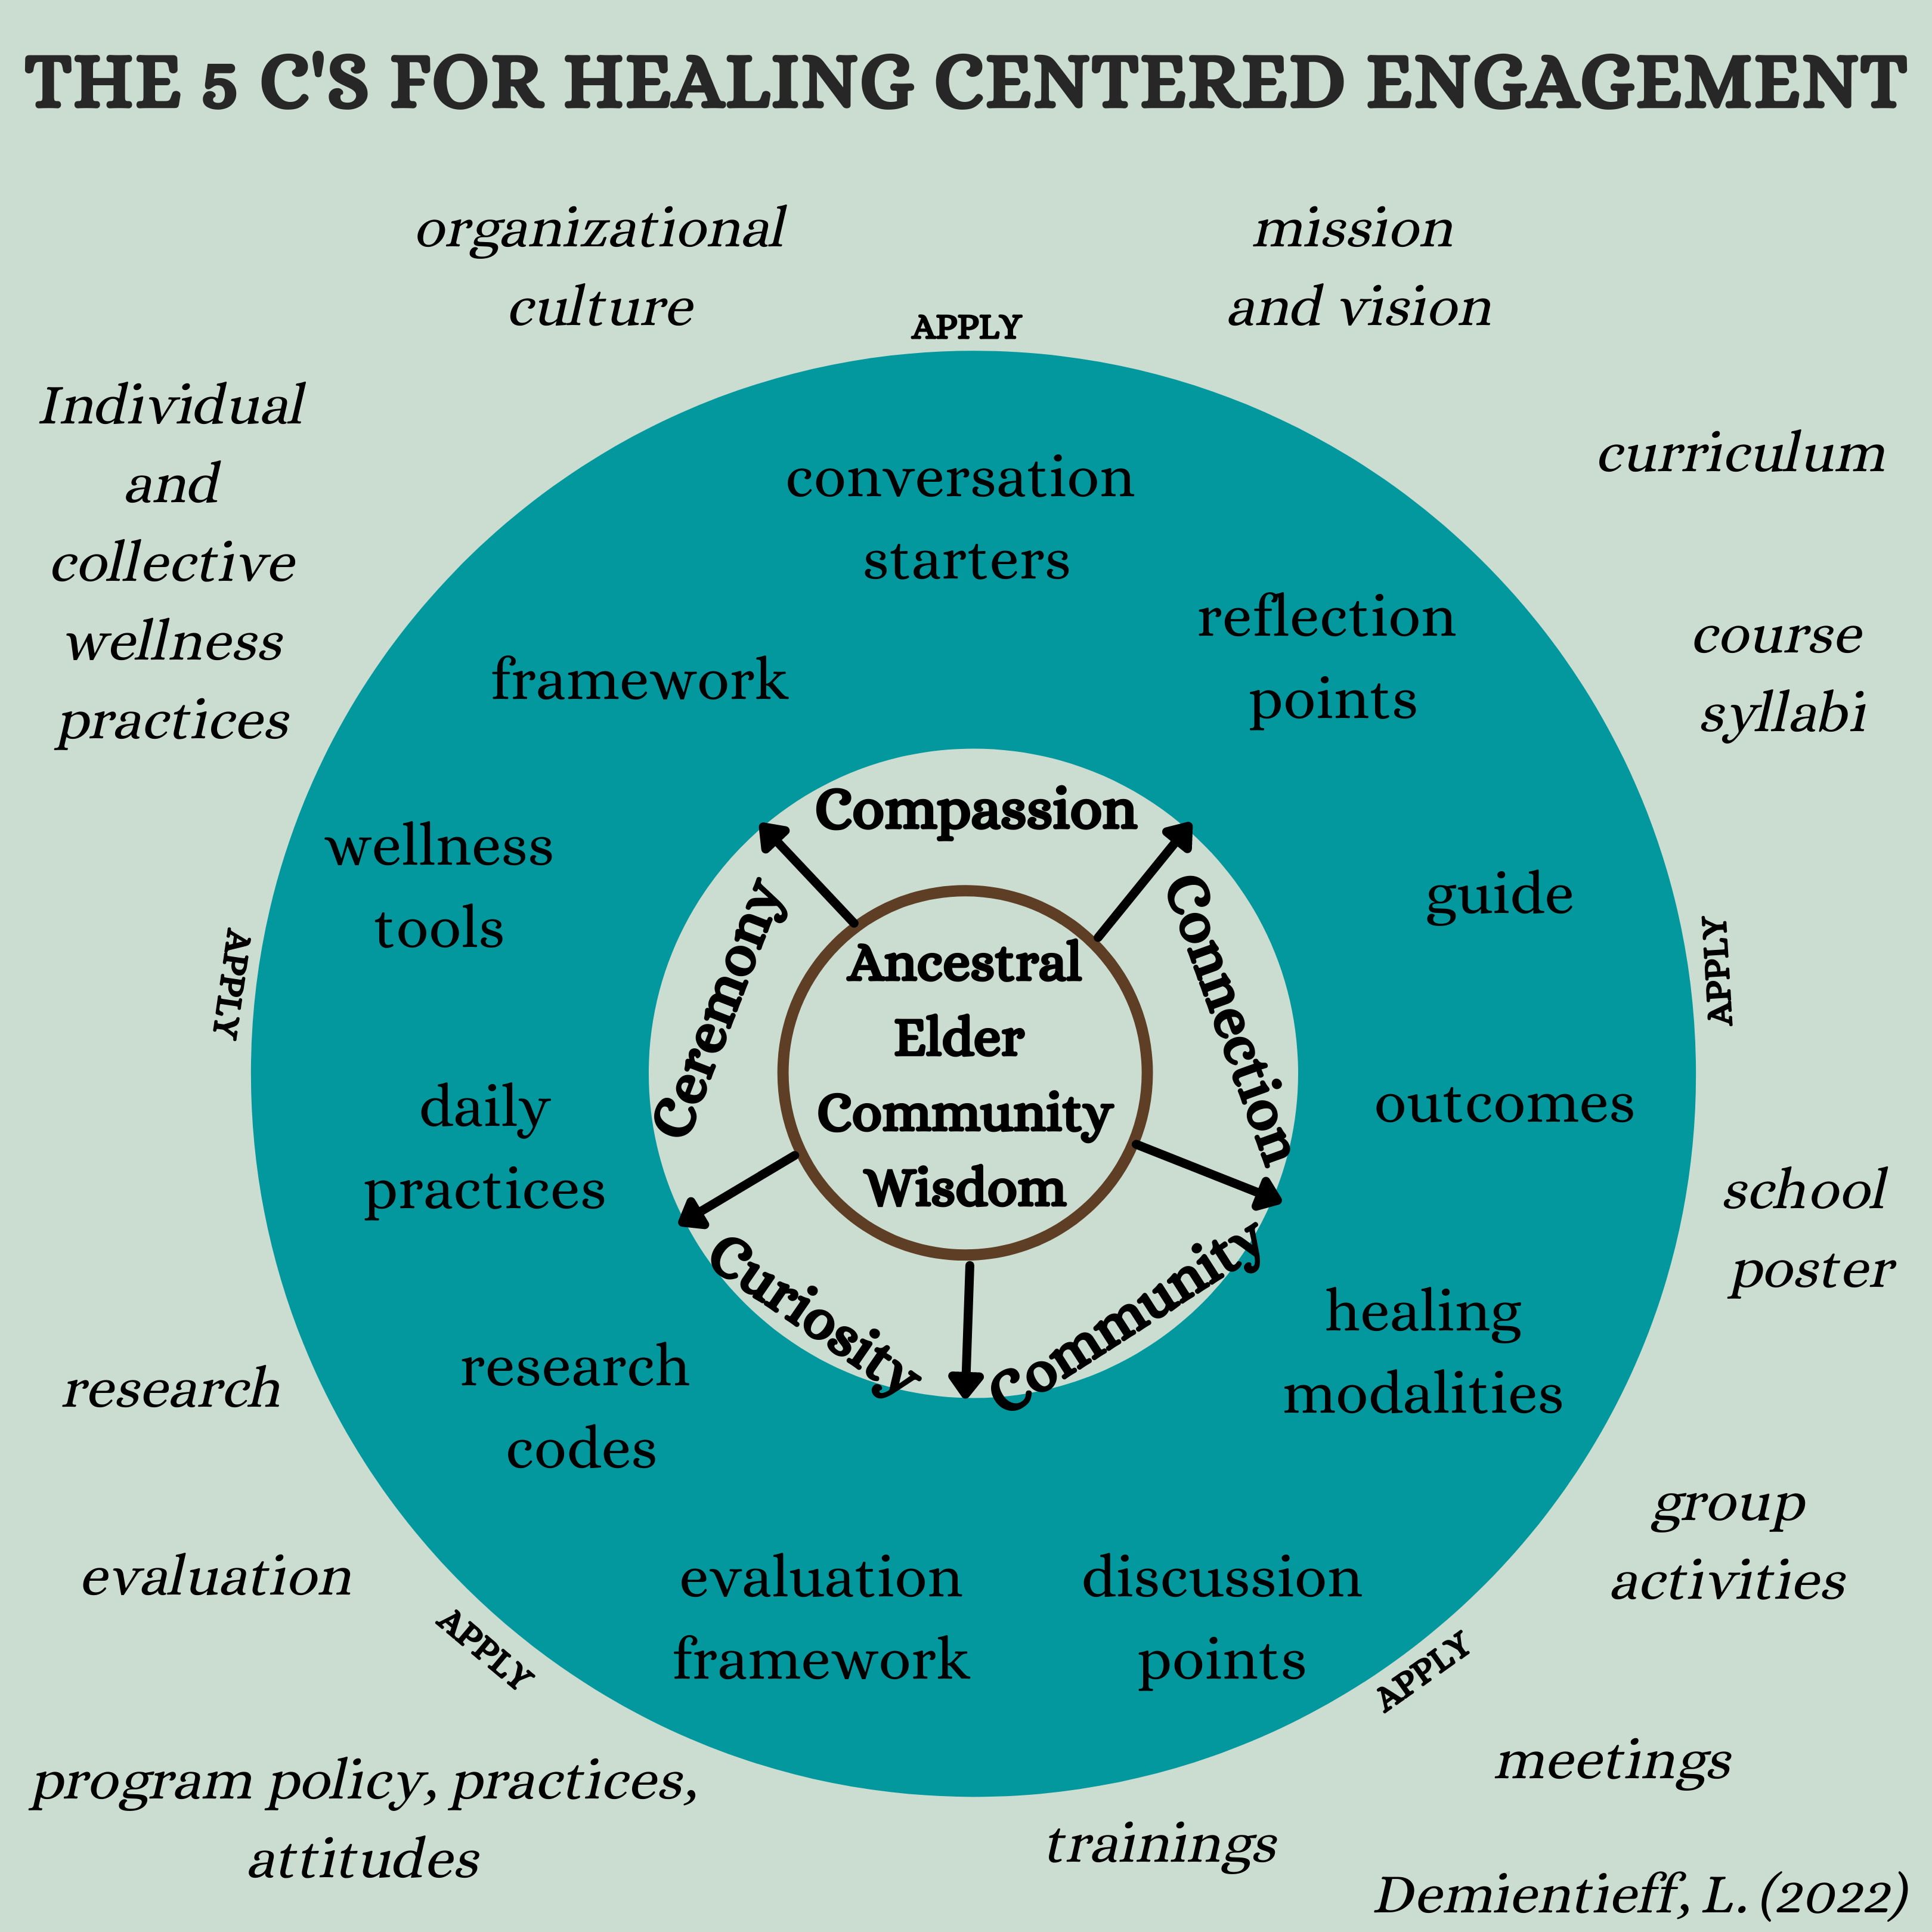
The 5 C’s for Healing
Centered Engagement
• Compassion
• Connection
• Community
• Curiosity
• Ceremony
Notes:
Recommended time to spend on this slide (6 minutes)
5C’s handout provided by LaVerne Xilegg Demientieff
You can modify the examples of the 5 C’s to fit your community.
The 5C’s are significant concepts learned from Elders in Alaska around healing and wellness. They include Compassion, Connection, Community, Curiosity, and Ceremony. The 5C’s can be applied in any setting. They can be self-reflected upon as you do good work with others and they can be shared with those that you are working with. They can also be a framework or foundation for projects, activities, programs, or just to use as discussion points. When we learn about how trauma impacts our mind and bodies we are more compassionate with ourselves and others. When we are curious about what causes pain and grief we can help to create connection and ceremony for healing. Healing happens when we are in our bodies and in relationship to others in our community.

Slide 5
Trauma and College Students
In recent decades many health professionals, researchers, policymakers, and scholars outside of health and human services disciplines have come to understand “trauma” as a set of phenomena extending well beyond clinical diagnoses of Post-traumatic Stress Disorder (PTSD). Psychological trauma, as defined by SAMHSA,
“Results from an event, series of events, or set of circumstances that is experienced by an individual as physically or emotionally harmful or life-threatening and that has lasting adverse effects on the individual’s functioning and mental, physical, social, emotional, or spiritual well-being."
Trauma responses occur when a person’s ordinary internal resources for coping and maintaining a sense of control, connection with others, and meaning are overwhelmed by external stressors, imparting an intense, lingering experience of helplessness and terror.[6] Some basic types of trauma include:
Acute trauma: single-episode, unexpected event, e.g., a car accident, tornado, one-time rape.
Complex or developmental trauma: sustained or repeated traumatic episodes, e.g., life-threatening illness, combat, ongoing abuse or neglect, poverty.
Continuous traumatic stress or historical/generational trauma: ongoing, systematic, and/or cumulative group trauma, e.g., identity-based discrimination, racism, slavery and its legacies.
Even before the pandemic, trauma and traumatic stress touched the lives of many postsecondary learners. 66%-94% of students report exposure to at least one traumatic event by the time they reach college, with many reporting exposure to multiple traumatic events. 9-12% of first-year college students meet the clinical criteria for PTSD, while many more report symptoms below the diagnostic threshold. Slightly over half of student respondents in a 2020 survey reported at least one Adverse Childhood Experience (ACE), early traumatic stressors closely tied to a range of negative, long-term psychological and life outcomes. Student groups demonstrated to be at greater risk of trauma exposure include women, students who are BIPOC (Black and Indigenous People of Color), LGBTQ+ students, students with disabilities, veterans, current and former foster youth, refugee students, and nontraditional adult learners.
Trauma-Informed Practices for Postsecondary Education: https://educationnorthwest.org/resources/trauma-informed-practices-postsecondary-education-guide

Slide 6
One Definition of Trauma
Informed Care
  Trauma informed care is defined as: an attempt to create a paradigm shift that encourages human service providers to approach their clients’ personal, mental,
  and relational distress with an informed understanding the impact trauma can have
  on the entire human experience.
  (Trauma Informed Care: How Neuroscience Influences Practice by Amanda Evans and Patricia Coccoma, 2014)

Slide 8

Moving From Trauma Informed Care to Healing Centered Care – Natalie Clark
ABC’s of Self Care - https://youtu.be/BXvxezGpXbc
Trauma Informed Practice with Indigenous People Across the Lifespan - https://youtu.be/Ul71hyrAW-A
“Accentuating the problems of clients creates a web of pessimistic expectations of, and predictions about, the client, the client’s environment, and the client’s capability to cope with that environment. Furthermore, these labels have the insidious potential, repeated over time, to alter how individuals see themselves and how others see them. In the long run, these changes seep into the individual’s identity” (Saleebey, 2002, pp. 4).
We often discuss trauma as an individual personal problem. But healing-centered engagement means contextualizing the widescale collective harm many communities experience and thinking through the actions groups can take together to chip away at societal root causes. It de-centers trauma and centers healing.

Slide 9
TIC and HCE Principles
Promote a sense of safety/trust. –shared attention,
mirroring, co-regulation,
Promote calming/emotional regulation and co-regulation.
Promote a sense of self-efficacy and collective
efficacy/empowerment.
Promote connectedness.
Instilling hope.
Promoting compassion, a sense of belonging, and love.
Promoting community well-being & collaboration (shared
decision making).
Using an equity lens; addresses inequalities

Slide 10
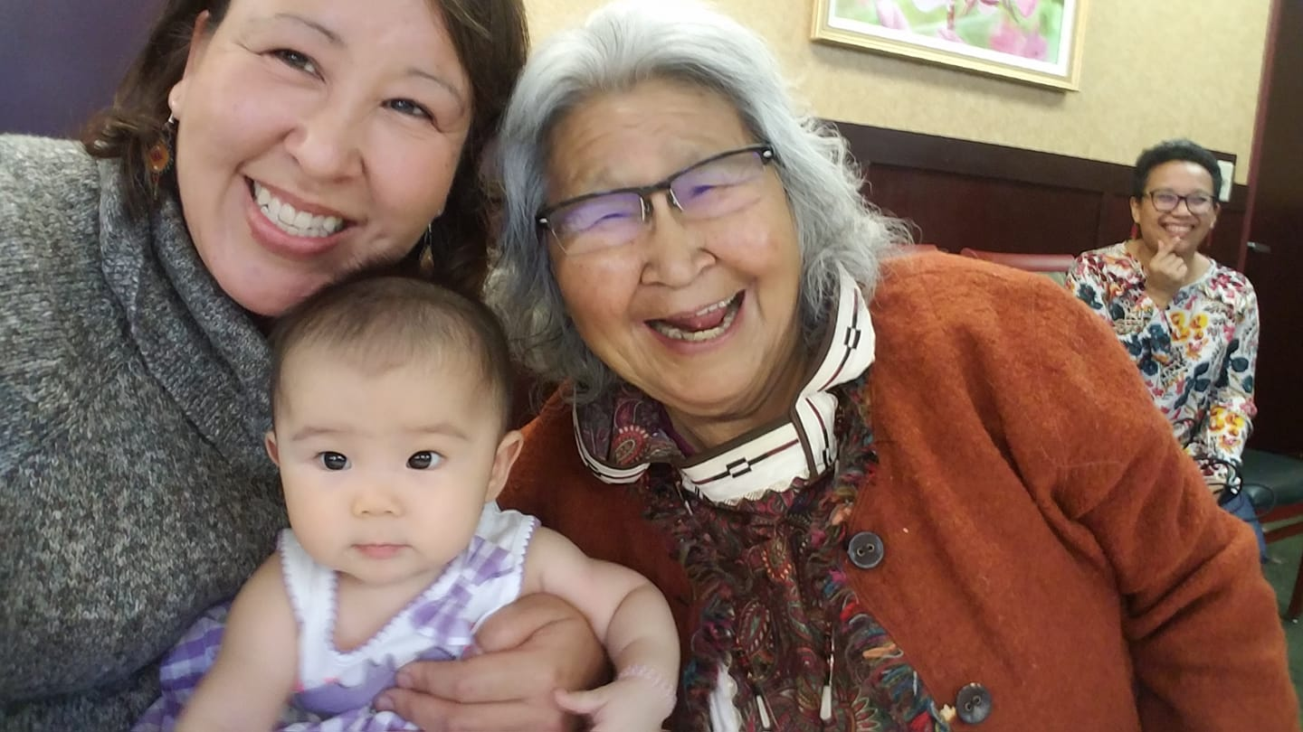

Slide 11
Healing Centered Engagement Practices
1. Practice moving from your head to your heart every day.
2. Create an affirmation to shift thoughts that are not serving you.
3. Cultivate gratitude daily.
4. Self-awareness - life long learning
5. Trauma Stewardship for Health Care Professionals by Laura van Dernoot Lipsky - https://youtu.be/zOJYz3Sojlk
4. Awareness: Multiple spheres involved in compassion fatigue and burnout:
  Work environment
  “People helped” environment
  Personal environment
  ProQol Info: Professional Quality of Life Scale: www.proqol.org - A screening for stress related issues
  Do learning activities in your classroom help rehumanize education by focusing on what it means to “Be” human?

Slide 12
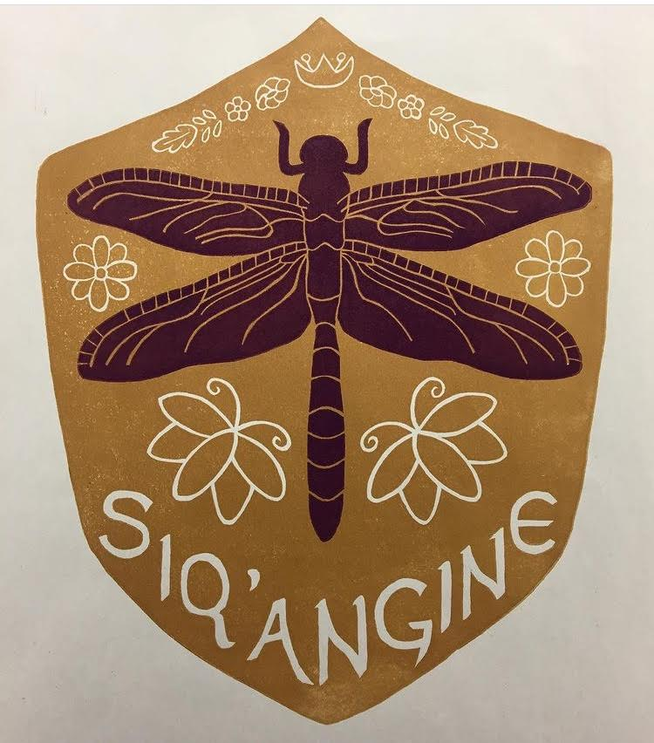
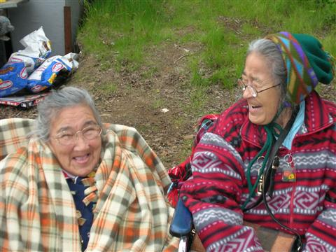
Being A Good Relative
Relationality
and
Relational
Accountability
Art by Rebekah Gadiniid Hartman
Siq’angine - Dragonfly
(literal translation is protect me.)

Slide 13
Relationality is about learning what relationship are important and then finding out how we can be accountable to those relationships in the way we live and work with people and the earth. We have a responsibility to our relationships and relatives. Relationality is focused on strengthening all relationships. Relationality is learnt from stories and from the land (context), it is a reciprocal process.
Research and work with clients and communities from a western perspective is often extractive, non-relational, and invasive, using strict time frames, restrictive policies and procedures, hierarchical notions of expertise, and colonial discourses of ‘discovery’, finding the gap, and collecting data.
Relationality is also about connecting to unwanted messages as well, like feeling the grief of the community. There are lessons about being a good relative in the grief and challenges faced.
As an ethic of responsibility, relationality is something that is practiced.
To conceive of something or someone as “other” is to sever an inherent relationship between things and reify certain peoples or ideas as more important.
We become as we emerge together.
Is your classroom helping students learn how to become better relatives (e.g., using sharing circles where students learn to listen and listen to learn)?
(Shawn Wilson, Research As Ceremony, 2008 and Jo-ann Archibald, Indigenous Storywork, 2008)

Slide 14
RELATIONALITY
Deg Xinag Language Examples:
Gits'an-ghingalnoł ts'i ngighal sits'i ditiłdheyh. ^{AJ} Turn over and throw me your pack. Asking raven to turn over in flight to drop his pack, giving you good luck.
Spider Ivisoghluq ^{JD+ED} lit. My dear grandfather
Raven Yixgitsiy ^{HM+KH} lit. Everyone's grandfather
Gegha ^{KH+AJ} Brown bear lit. Older brother
Yix xidina' tr'idilighith. ^{HM+ED} The house spirit gets startled. Say this when someone sneezes.
Dragonfly Siq'angine ^{KH+JD} lit. Protect me

Slide 15
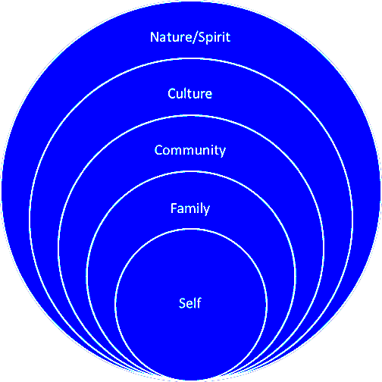
Trauma disconnects us…
So how do we cultivate connection?
What do we
connect to in each of
these circles?
How can we build
connections in each of these circles?

Slide 16
Stress Response &
Trauma Triggers
Trigger Warning/Content Warning
Hand Model of the Brain
Calming Your Stress Response
Notes:
Recommended time to spend on this slide (5 minutes)
Trigger Warning
Stress Response – Hand model of the brain
Calming your nervous system
Please note this material may feel uncomfortable due to the nature of the content. I would encourage you to sit with that discomfort and reflect on what it is that might make you feel uncomfortable. Some signs of feeling uncomfortable are anger, disbelief, avoidance, stopping reading/watching/listening to material because you don't feel like it relates to you. Please practice self-care as needed. Some examples to help move you from your emotional brain back into your thinking brain are taking some deep breaths, acknowledging your feelings, writing in a journal, and taking a break.

Slide 18
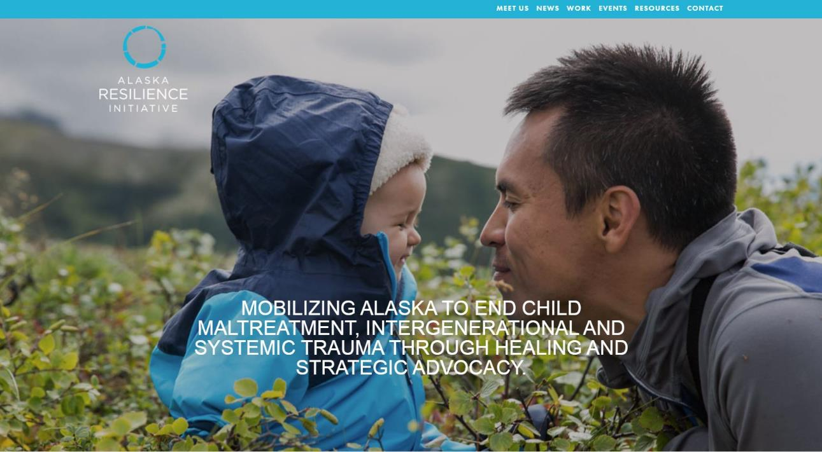
HISTORY AND HOPE WORKSHOP
www.alaskachildrenstrust.org
ACES/Resilience/TIC; Ecological Systems Perspective; Social Justice Lens; Emotional Regulation; Tools; Historical and Cultural Trauma and Wellness

Slide 19
Healing Centered Engagement Practices
1. Journal about ways you can nurture connection within your own life in the area of self, family, community, culture, nature/spirit.
2. Support cultivating connection for those you work with in your positions.
3. Recognize the value of relationality and relational accountability.
Do your rubrics reflect wholistic measures of success such as connection and self-actualization?

Slide 20
Healing Centered Engagement Practices
1. Creating a community of learners that support each other is important. Reflect on what communities are missing and what communities can be created to provide that sense of belonging, connection, and support system.
2. Watch the video titled, ABC’s of Self Care, by Indigenous Social Work Scholar Natalie Clark. Practice self-care and community care.
Is the classroom truly a community of learners where they feel safe and willing to take transformative risks?

Slide 21
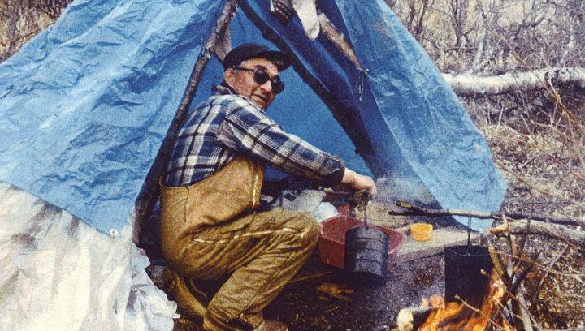
Honoring the Whole Person

Slide 22
Healing Centered Engagement Practices
1. Be curious…about how trauma impacts feelings and behavior in yourself and others. One of my favorite people to learn about trauma from right now is Gabor Mate.
2. Ask questions related to strengths and start with those.
3. Be open to signs from nature and the universe. To begin to do this you have to start with nurturing your relationship with the earth, nature, animals, land, and water. When we have a relationship with something we work to care for it. When something is cared for it gives back to that relationship. That is the law of reciprocity. The late Elder Howard Luke always talked about…taking care of your luck. This wisdom recognizes the practice of doing things in a good way and incorporates an understanding of the laws of reciprocity. What you give in the world is what you get back.
4. Add self/co-regulation/emotional regulation skills to your toolbelt.
5. How Childhood Trauma Affects Health Across A Lifetime –Nadine Burke Harris - https://youtu.be/95ovIJ3dsNk
6. What’s in your basket? Create a sensory wellness basket with items that will help to calm your nervous system.
Are you as the instructor being intellectually and culturally inclusive of different ways of knowing and being?

Slide 23
Healing Centered Engagement Practices
Ceremony is about connecting to spirit, community, yourself, it is about regaining balance, it is a personal and also a community practice. (Prayer, yoga, meditation, dance, music, nature, fishing, running, smudging, singing, potlatches, naming ceremonies, sweatlodge/steam, etc.)
Start and end class in a good way.
Do you take time to authentically welcome others in a humble, respectful way?

Slide 24

Grounding ourselves in hope. Here is something to keep in mind…For every trauma history (individual, family, group or community), there is also a survival or wellness history – a history of resilience.

Slide 25
Dogidinh (Thank you)!
When we start our own healing journey the movement and energy towards health and wellness ripples out into the present healing those around us, ripples into the past healing our ancestors, and ripples into the future healing the next generations. That is a powerful place to be in (Duran, 2006).
Contact Info:
lmdemientieff@alaska.edu

