Slide 1
University of Alaska Fairbanks
April 10, 2020
Using Data and
Analytics to Improve
Student Success
Timothy M. Renick, Ph.D.
Sr. Vice President for Student Success
twitter: @tim_renick

Slide 2
The Challenge in Front of Us
82.4%
Top Income Quartile
40.2%
36.1%
Third Income Quartile
14.9%
16.5%
Second Income Quartile
10.9%
Bottom Income Quartile
6.2%
8.3%
Source: New York Times, “The Reproduction of Privilege,” March 12, 2012

Slide 3
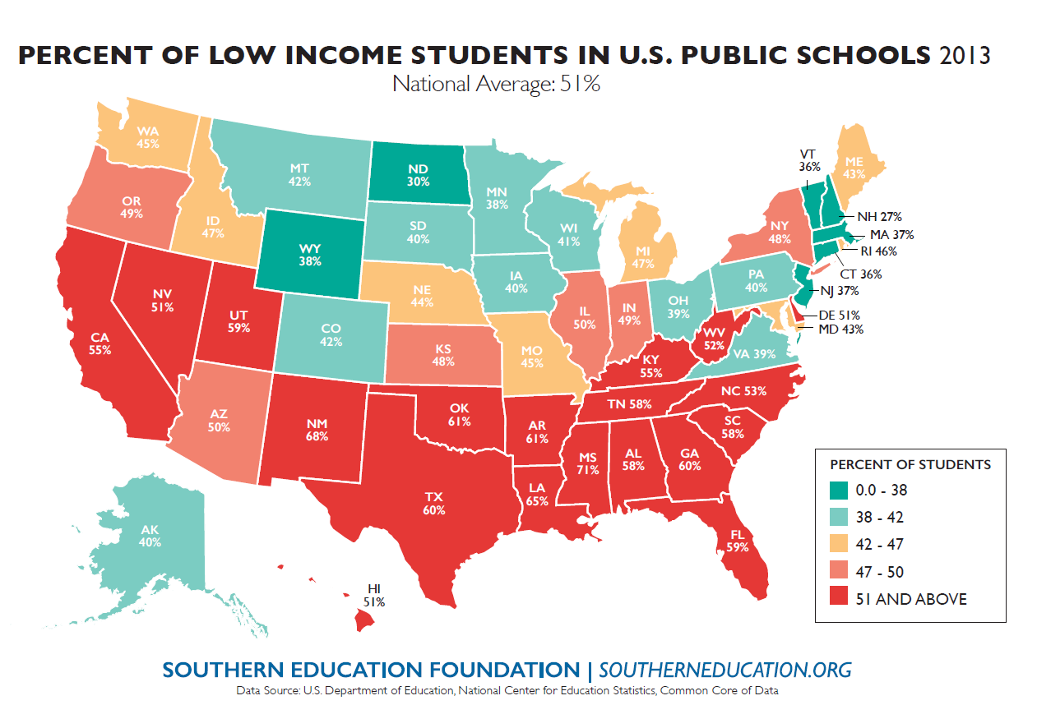
Changing Demographics
No FLC
FLC
No FLC
FLC

Slide 4
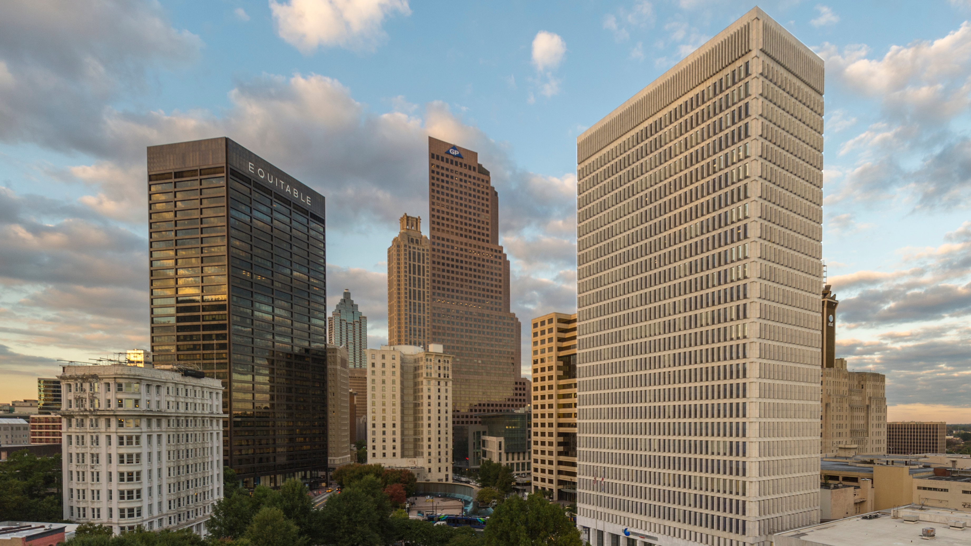
34,000 Students on the Atlanta campus
53,000+ Students as of 2016 with Perimeter College consolidation

Slide 5
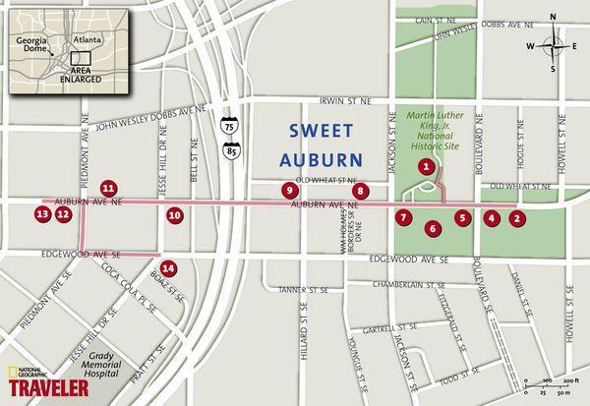
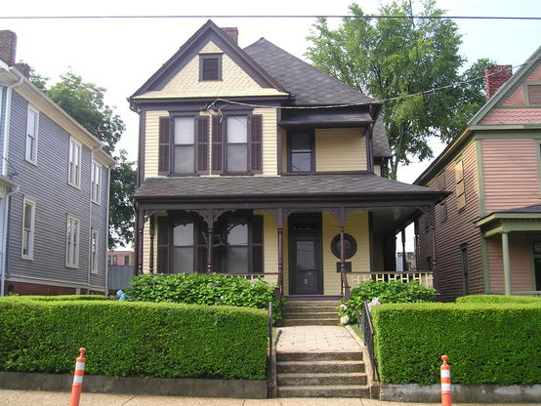
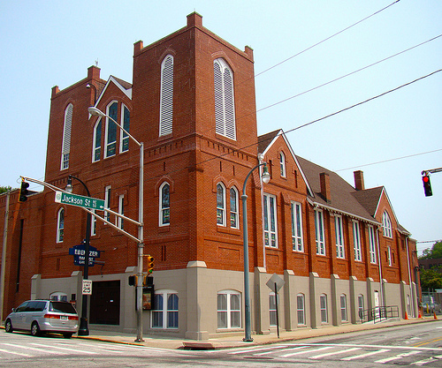

Slide 6
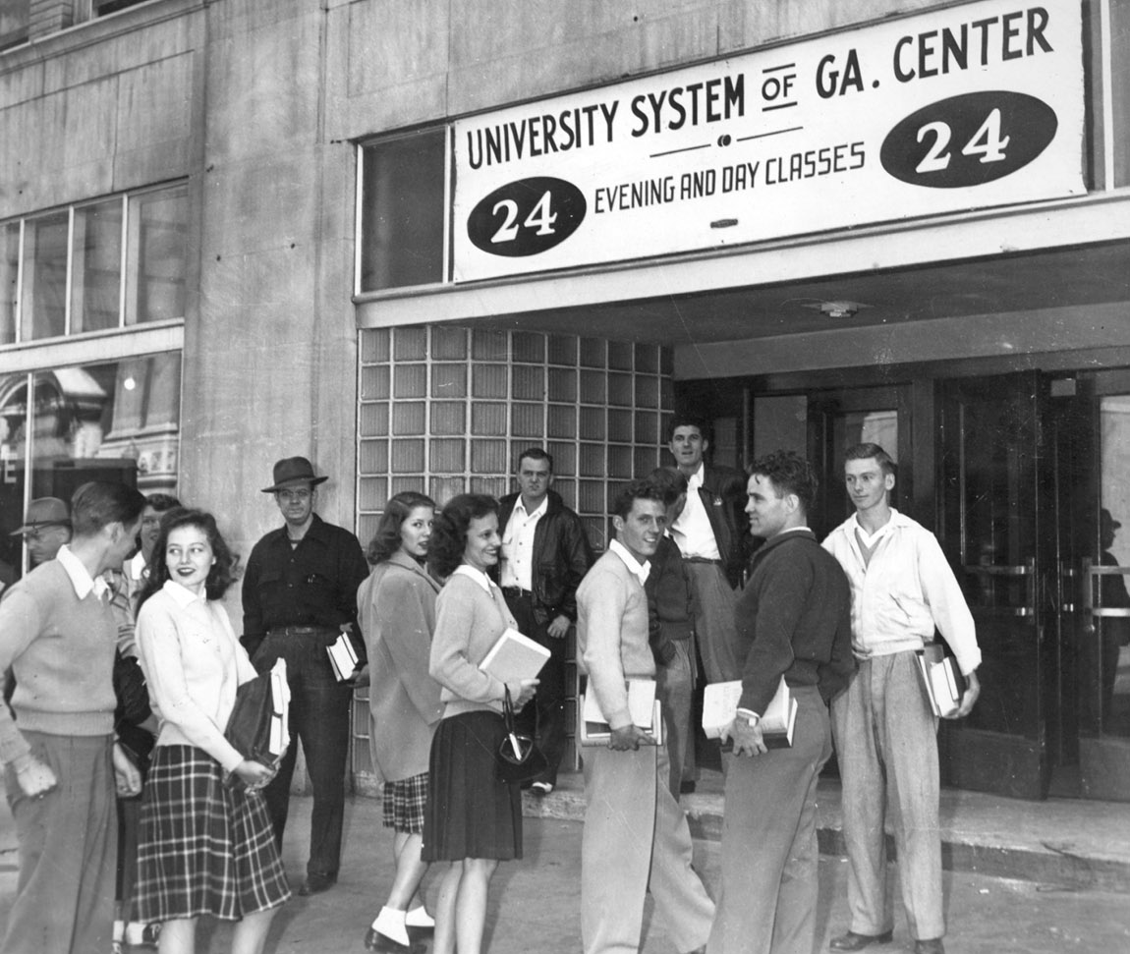
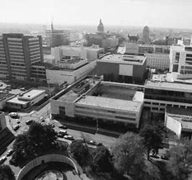

Slide 7
Graduation Rates by Race & Ethnicity
Where we were: 2003
WHITE
AFRICAN
AMERICAN
HISPANIC
No FLC
FLC
No FLC
FLC

Slide 8
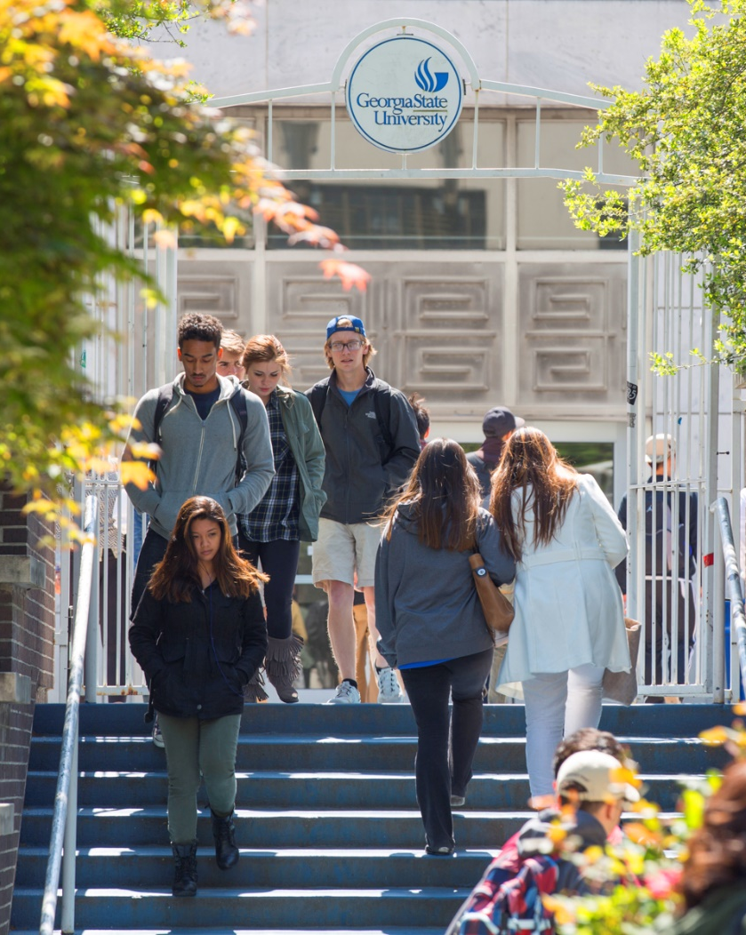
Changing Demographics: Race & Ethnicity

Slide 9
Low-Income Students

Slide 10
SAT SCORES
-33 points
Notes:
Need approval on image – istock purchase

Slide 11
Appropriations Cuts
-$40 million
Notes:
Need approval on image – istock purchase

Slide 12
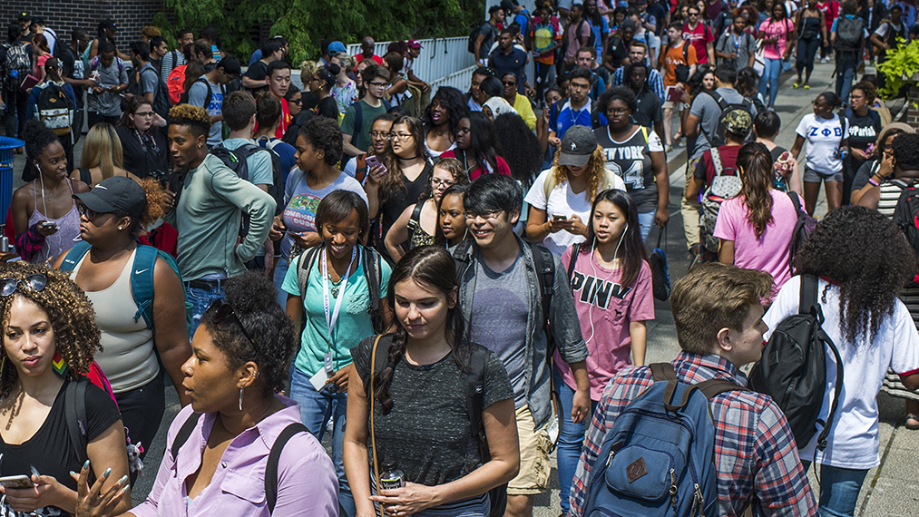
Are We the Problem?
Notes:
Need approval on image – istock purchase

Slide 13
19%
Percent of Confirmed Freshmen Who Did Not Enroll Summer 2015

Slide 14
Summer Melt
Fall 2015
Confirmed GSU Freshman Who
Never Attended Any College: 278
Non-white 76%
First Generation 45%
Low Income 71%
Avg. High School GPA 3.34

Slide 15
The Hidden Obstacles to Enrollment
Federal Financial
Aid Application
Verification Request
State of Georgia
Immunization Proof
Taking Placement
Exams
Registering for Classes

Slide 16
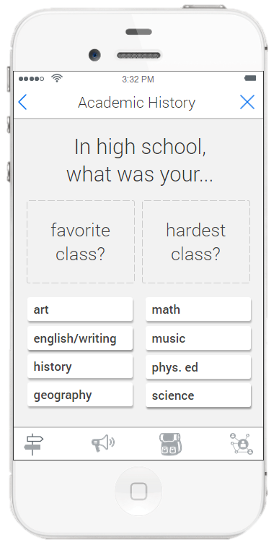
Personalized Interactions Before Enrollment Source: EAB

Slide 17
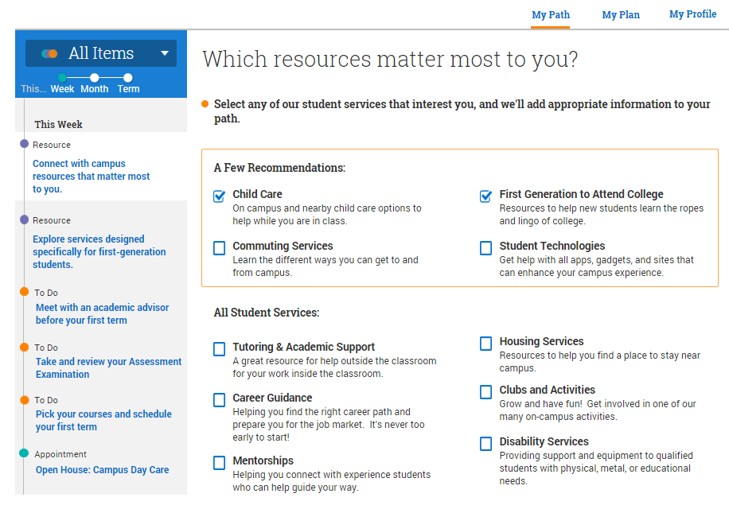
Portal to Guide Students Through Next Steps

Slide 18
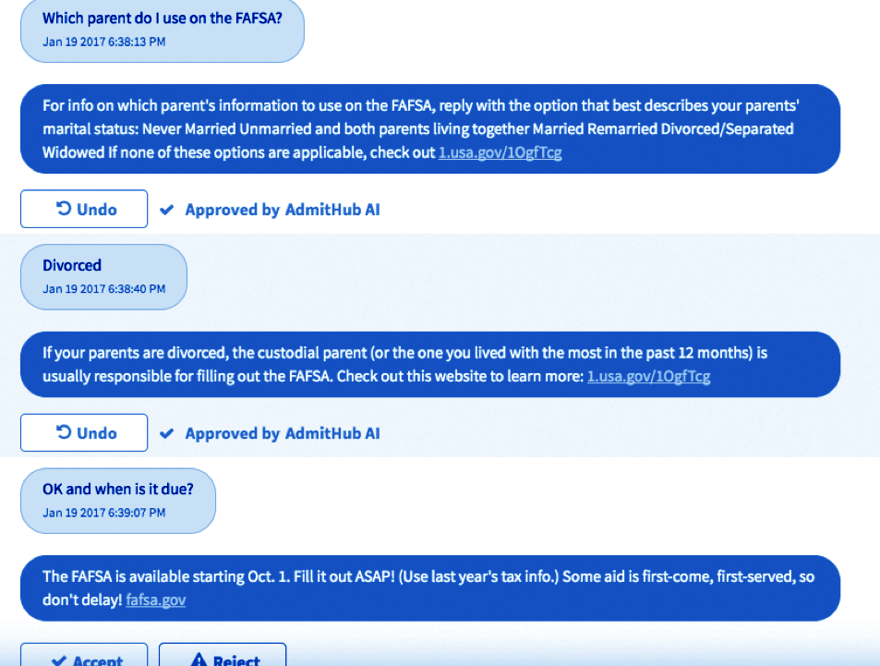
A.I.-enhanced Chatbot: 24/7 Help

Slide 19
Guided Conversations
Yes
Yes
Cool! Would you like me to help you get a parking permit?
Hey {First Name}, do you plan to park a car on campus? 🚗
No
Visit bit.ly/parking to see parking fees and rates, and to figure out what option will best fit your needs. To register your vehicle and get a permit, please create an account here: bit.ly/parkpermit.
OK. For future reference, visit bit.ly/parking for parking info. 🚗 For other modes of transportation (shuttles 🚌 , the metro 🚇 , bike shares , Zipcar, etc.) go to bit.ly/transit.
No

Slide 20
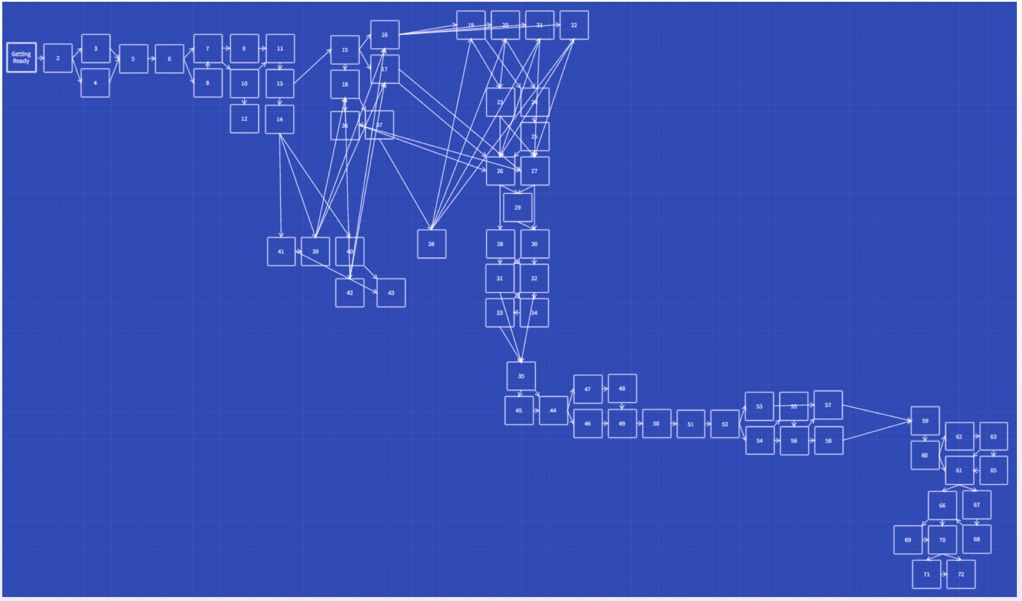
Guided Conversations
Why A.I.?
Our FAFSA Tutorial

Slide 21
185,000

Slide 22
Three-Year Drop in Summer Melt: 37%
+362
Students per year

Slide 23
Pilot: Continuing Students
Supported by the Dell and ECMC Foundations
Students who started the semester with a balance: -49%
Students with Account Balance
Who Opened a ticket with Financial Aid: +33%
Student meeting with Advisor within one week of being contacted: +28.5%

Slide 24
2.6
Average Number of Majors Cycled Through By Graduating Seniors in 2010

Slide 25
Overwhelming Choices

Slide 26
Freshman Learning Communities & Meta Majors

Slide 27
Choice Architecture: Meta Majors
Business
Education
Exploratory
STEM
Humanities & Arts Health Professions
Policy/Social Science
27

Slide 28
Academic Guides with Live Job Data

Slide 29
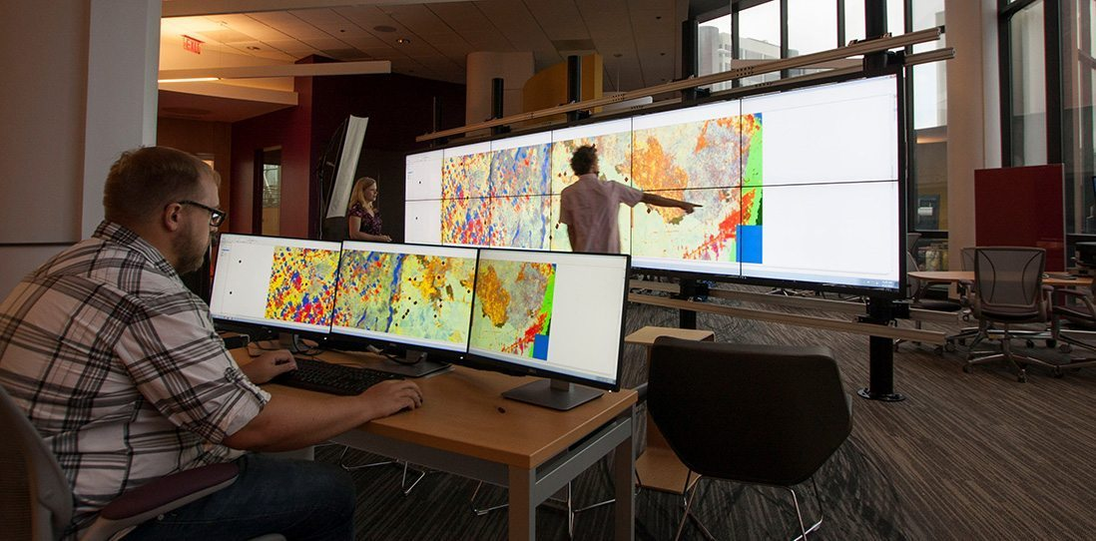
Faculty and Department Seed Grants
The Department of History
Skills-Based Approach to U.S. History Survey Courses
Use Tableau to interpret historical data
Data viz software as tool for presenting historical findings
Did NOT require any alteration to existing SLOs

Slide 30
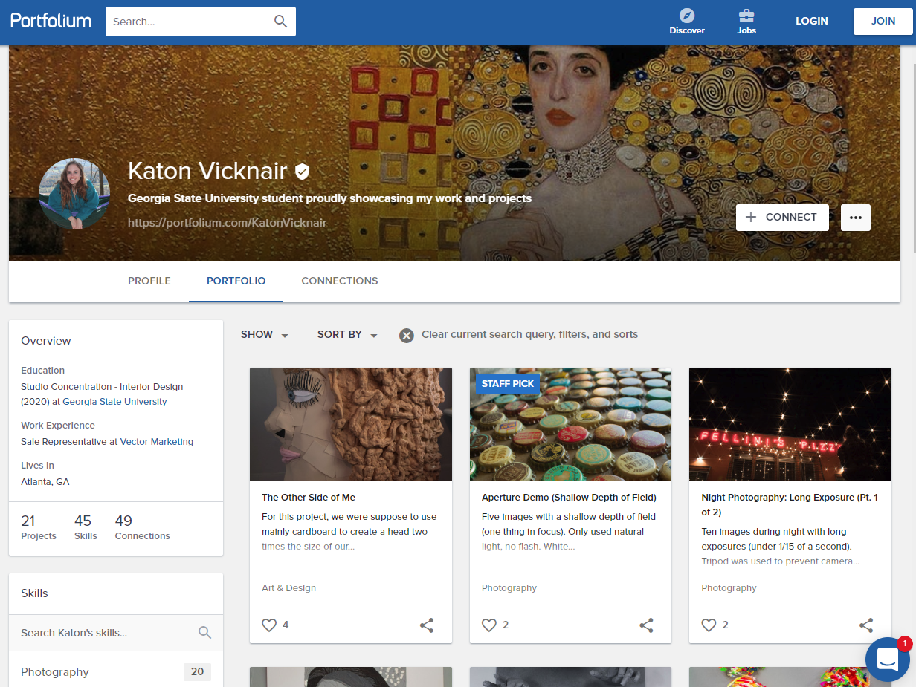
My GSU Experience

Slide 31
Meetings of Pre-Seniors with Career Counselors
685%
3-year increase
No FLC
FLC
No FLC
FLC

Slide 32
-32%
Drop in Major
Changes After the
Freshman Year

Slide 33
43%
Percent of Students Receiving Non-Passing Grades in Introductory Math Courses in 2008

Slide 34
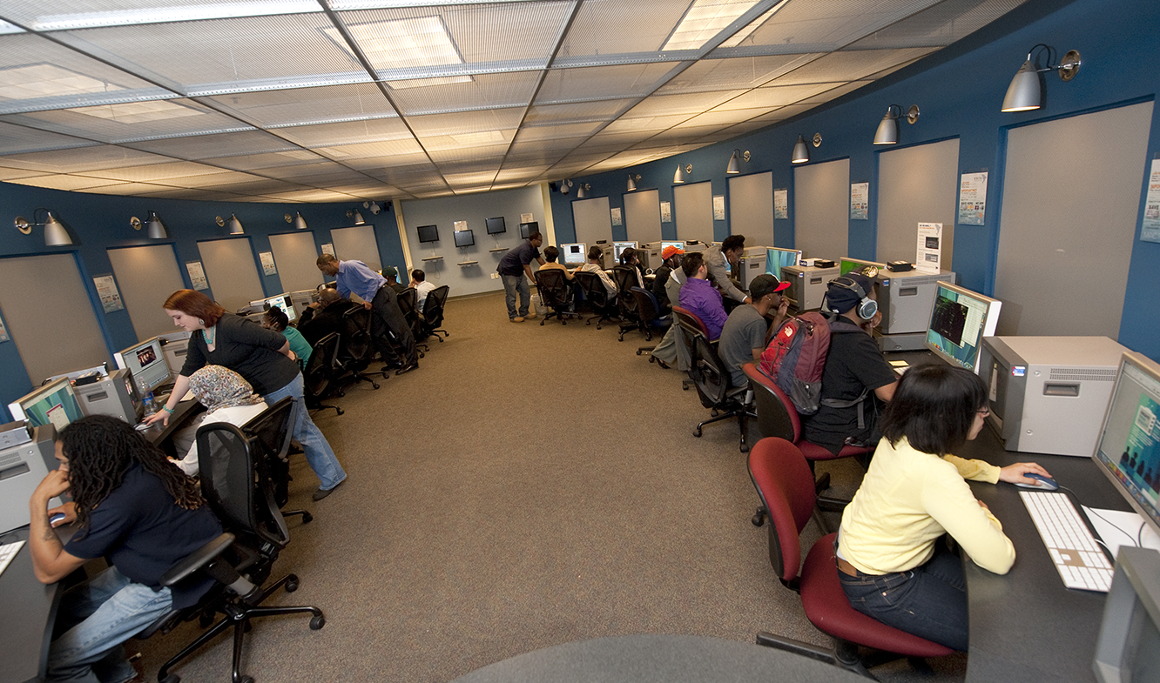
Strengthening Math Pathways
Pre-Calculus, College Algebra, Intro to Statistics
DFW Prior to Change: 43% DFW Today: 28% (35% drop)
Number of Students enrolled in courses taught through the MILE, 2017-18: 8,500
+1,275 Students Passing

Slide 35
Adaptive Learning at Scale
 |  | STUDENTS | SECTIONS | DFW
POLS 1101 | American Government | 4694 | 55 | 16.3%
MATH 1070 | Elementary Statistics | 2701 | 76 | 25.2%
ECON 2105 | Principle of Macroeconomics | 2340 | 38 | 19.2%
PSYC 1101 | Introduction to General Psychology | 2252 | 26 | 21.8%
POLS 2401 | Global Issues | 2250 | 35 | 18.9%
FILM 2700 | History of the Motion Picture | 2226 | 59 | 15.2%
ECON 2106 | Principles of Microeconomics | 2122 | 31 | 24.7%
MATH 1101 | Introduction to Mathematical Modeling | 2019 | 56 | 26.5%
MATH 1111 | College Algebra | 1540 | 45 | 20.2%
SOCI 1101 | Introductory Sociology | 1432 | 29 | 20.2%
MATH 1113 | Pre-calculus | 1289 | 34 | 27.5%
CHEM 1211 | Principles of Chemistry I | 1096 | 37 | 17.2%
BIOL 1103 | Introductory Biology I | 1051 | 48 | 24.8%

Slide 36
Adaptive Learning in the Social Sciences
Pass Rates in Adaptive Sections
Compared to Face to Face
American Government
Fall 2017 (launch) -4.8
Spring 2019 +5.5
Macroeconomics
Fall 2017 (launch) -19.6
Spring 2019 +1.9

Slide 37
Referrals: Supplemental Instructions and Tutoring
Supplemental Instruction (SI)
BIOL
POLS
PHIL
CHEM
ACCT
PHYS
CRJU
Course GPA
No SI: 2.41
SI: 2.91
One-Year Retention
No SI: 83.5%
SI: 91.2%
Students: 9,700
No SI
SI
No SI
SI
No SI
SI
No SI
SI
No SI
SI
No SI
SI
No SI
SI

Slide 38
1,000+
Number of Fully Registered Students Being Dropped Each Semester for Non-Payment in 2010-2011

Slide 39
Who were we dropping
Seniors
Academically on track
Balance below $1,500

Slide 40
Panther Retention Grants
Graduated: 86.5%
Grant Recipients
Graduated This Year: 1,321

Slide 41
r
Panther Retention Grants
17,000+
Grants awarded since 2011
41

Slide 42
5,760
Students Who Dropped Out of
Georgia State in 2010

Slide 43
Advisement: GPS Advising
Predictive Analytics Project with EAB

Slide 44
Registration Tracking and Academic Maps
B.S. in Chemistry
SEMESTER 1 | SEMESTER 2
Complete 1 of ENGL 1101, ENGL 1102 or ENGL 1103 (C or Better) Complete MATH 1113 or Higher (B- or Better) Complete CHEM 1211K (B- or Better) | Complete ENGL 1102 or 1103 (C or Better) Complete MATH 2211 or Higher (B- or Better) Complete CHEM 1212K (B- or Better) Maintain a cumulative GPA of 2.25 or Better
SEMESTER 3 | SEMESTER 4
Complete CHEM 2400 (B- or Better) Complete MATH 2212 (C or better) Complete PHY 2211k (C or better) | Complete CHEM 3410 (C or better) PHY 2212k ( B- or Better) (C or better) Maintain a cumulative GPA of 2.25 or Better
SEMESTER 5 | SEMESTER 6
Complete CHEM 4000 with a C or Better Complete CHEM 4110 with a C or Better | Complete CHEM 4010 with a C or Better Complete CHEM 4120 with a C or Better
SEMESTER 7 | SEMESTER 8
Complete CHEM 4160 with a B- or better | Complete CHEM 4190 with a C or Better

Slide 45
Performance in ‘Marker’ Courses
Graduation Rate in Major by Introductory Course Grade

Slide 46
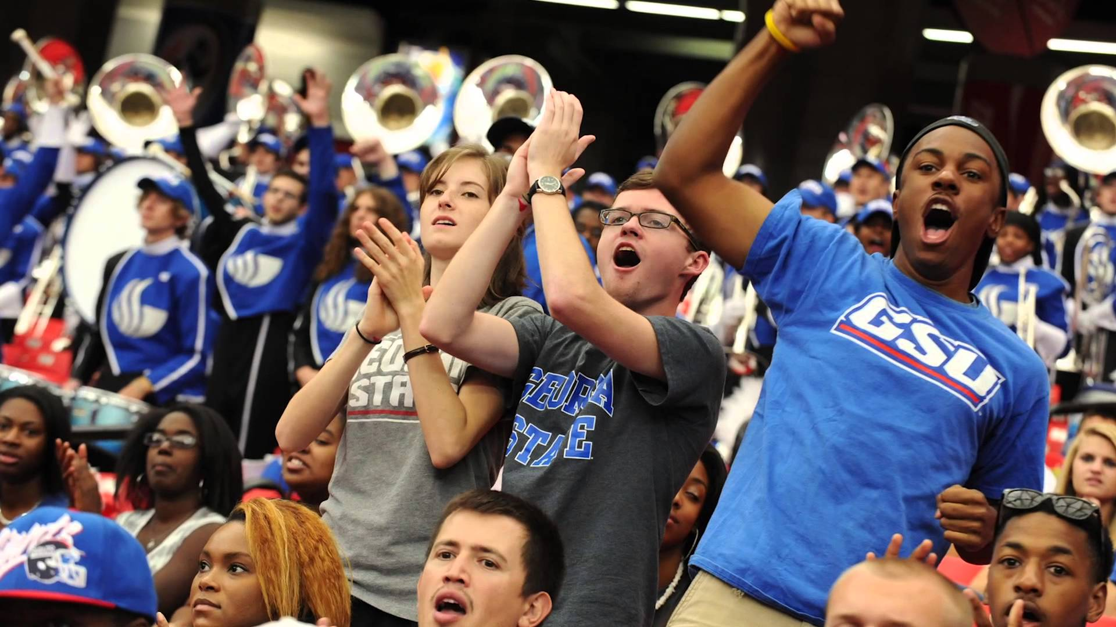
51,545
60,128
Notes:
Need approval on image – istock purchase

Slide 47
Results: Increased Retention
Increased Average First Term Retention
Fall to Spring Retention

Slide 48
Results: Decline in Time to Degree

Slide 49
r
ROI for Students
$18 million
Savings to the Class of 2019 in tuition
and fees when compared to the
Class of 2012
49

Slide 50
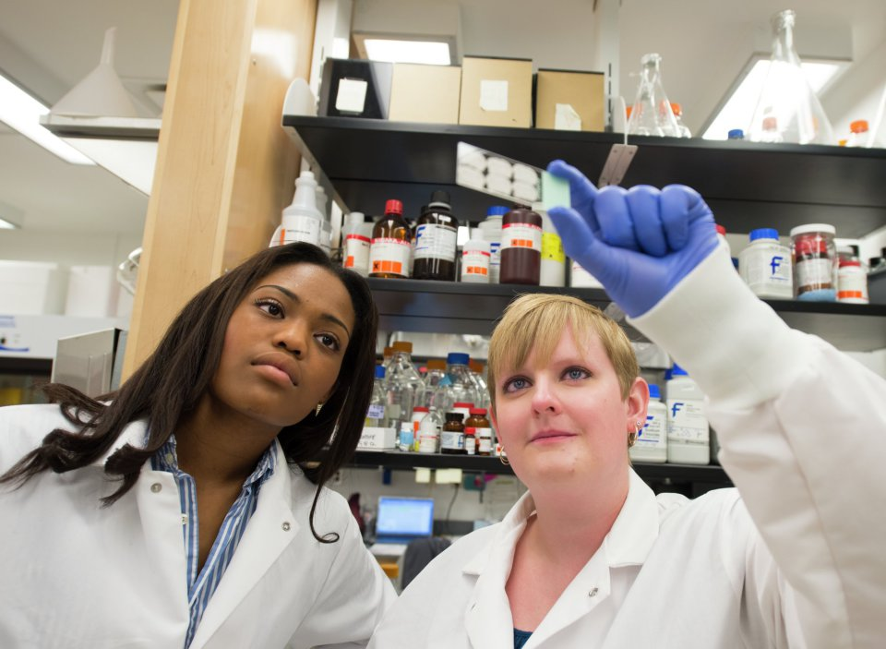
Confounding Expectations
STEM Degrees Conferred
Since 2011 (with enrollment change)
Black +167% (50%)
Black Male +221% (54%)
Hispanic +388% (118%)

Slide 51
Impacts

Slide 52
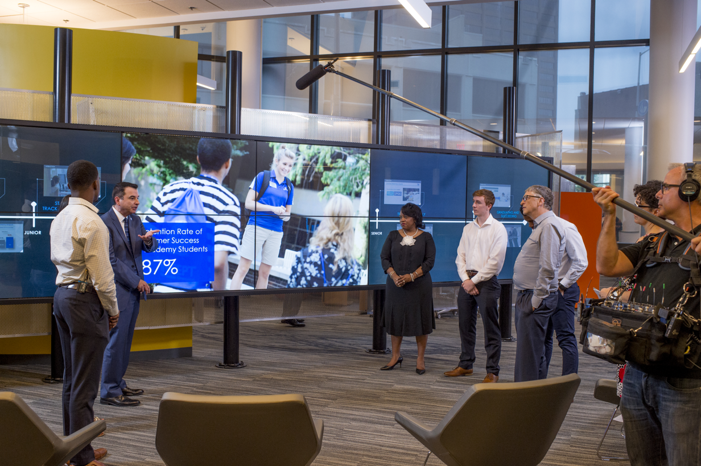
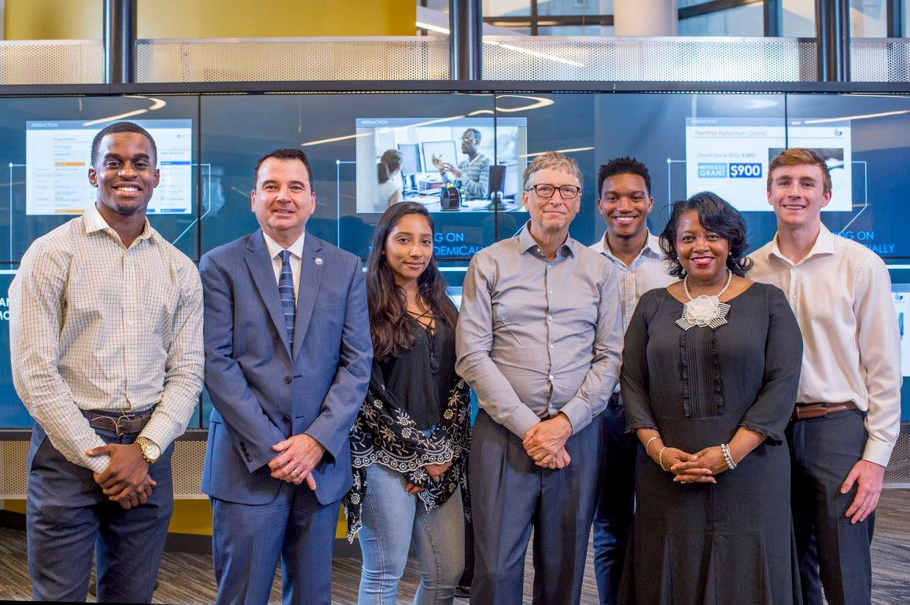
Overwhelming Choices

Slide 53
Overwhelming Choices

Slide 54
Growing Recognition

Slide 55
The Cost of Inaction
The Calculus of Student Success: ROI
1-point increase in retention = 325 students
Average student tuition & fees annually/student = $9,800
ROI for each 1-point increase = $3.18 million/year

Slide 56
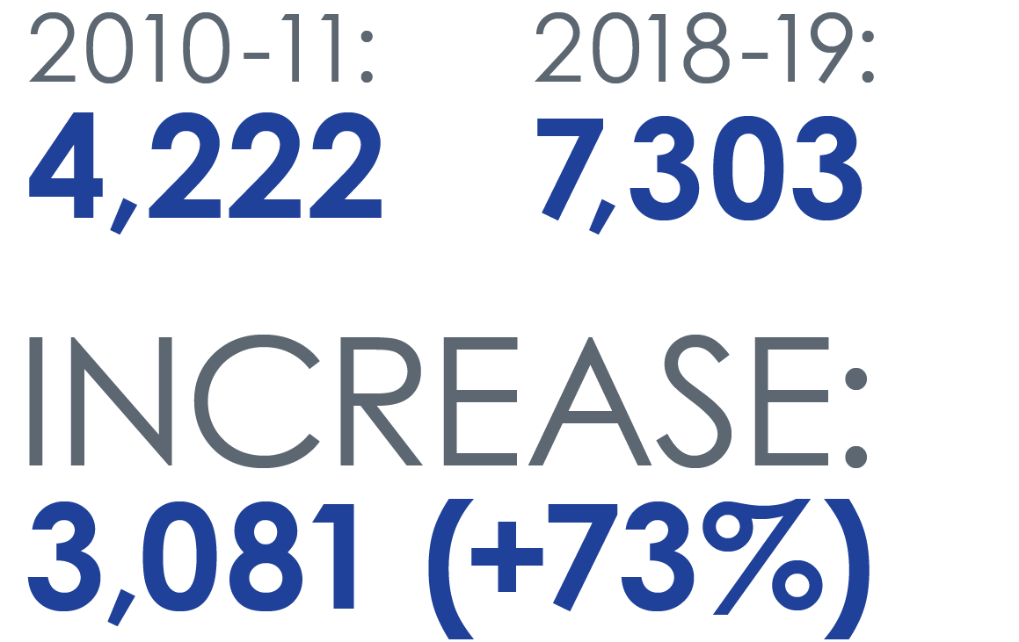
Georgia State Undergraduate Degrees Awarded

Slide 57
Bachelor’s Degrees Awarded by Group
 | 2009-10 | 2018 - 19 | Change | % Change
African American | 1,001 | 2,241 | +1,039 | +124%
Pell | 1,298 | 3,711 | +1,659 | +186%
Hispanic | 196 | 567 | +313 | +189%

Slide 58
Graduation Rates by Race & Ethnicity

Slide 59
#1 in Degrees Conferred to African Americans
Top 100 Degree Producers: Non-Profit Universities
2018 African-American Bachelor's - All Disciplines Combined
 |  |  |  | Total | %Grads | %Chg
 |  | Institutions | State
1 |  | Georgia State University | GA | 1,930 | 38% | 7%
2 |  | FAMU | FL | 1,477 | 95% | -7%
3 |  | University of Central Florida | FL | 1,401 | 24% | -1%
4 |  | University of Maryland-University College | MD | 1,443 | 11% | 8%
5 |  | Howard University | D.C. | 1,194 | 78% | 0%
6 |  | North Carolina A & T State University | NC | 1,227 | 91% | 6%
7 |  | Florida International University | FL | 1,087 | 19% | 7%
8 |  | Florida Atlantic University | FL | 1,054 | 11% | 9%
9 |  | University of Memphis | TN | 1,011 | 33% | 3%
10 |  | The University of Texas at Arlington | TX | 992 | 13% | -7%
Source: Diverse Issues in Higher Education, 2018

Slide 60
Two Questions

Slide 61
Social Mobility
Brookings Institution
#25 in the United States
2020 US News and World Report
#8 in the United States

Slide 62
Perimeter College 3-Year Graduation Rates
2019 Completed, Transferred, Still Enrolled: 83%*
*Chronicle of Higher Education, January 2020

Slide 63
http://success.gsu.edu
twitter: @tim_renick
Notes:
Need approval on image – istock purchase

