Slide 1


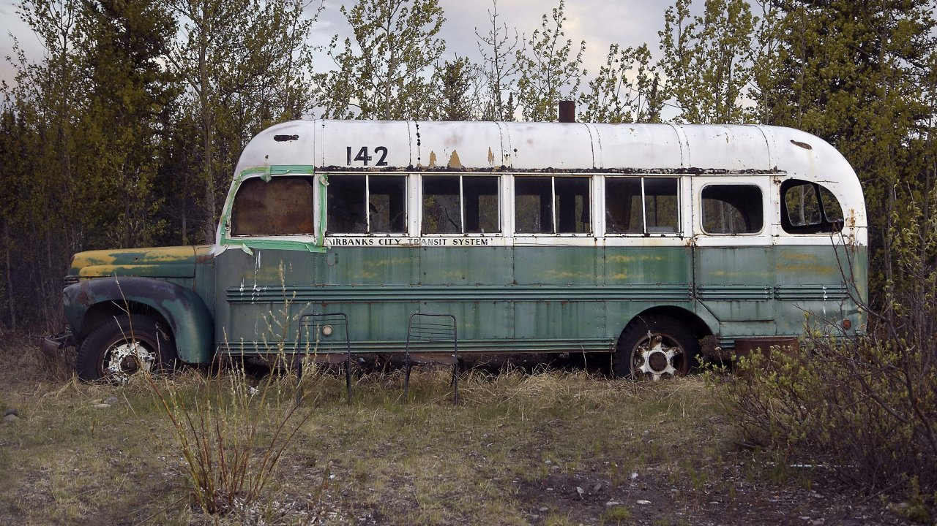
Bus 142
(a.k.a., Stampede Trail Bus, Magic Bus, Into the Wild Bus, The Bus)
A State-owned (DNR) historic object
International icon
Quick history
1940’s era International Harvester
1950’s Fairbanks public transit
1960’s Construction crew housing Stampede Trail
then abandoned
1970’s impromptu shelter for hunters/hikers
1992 Christopher McCandless stays for 114 days
1996 J. Krakauer book “Into the Wild”
2007 S. Penn movie “Into the Wild”
2020 AK DNR removes as safety risk
2020 UAMN chosen as repository

Slide 2
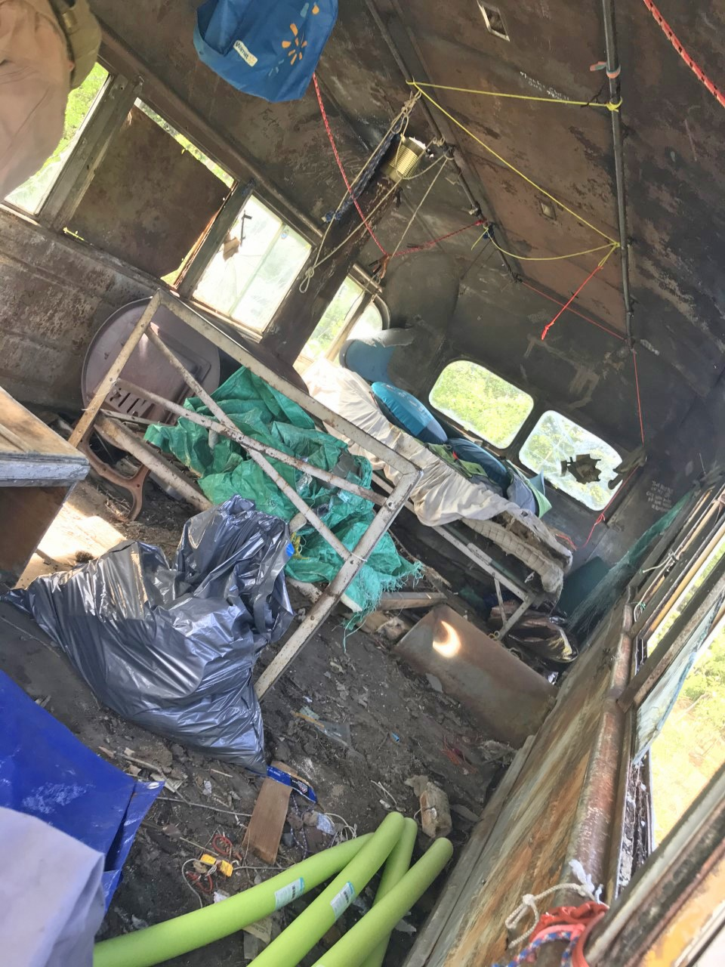
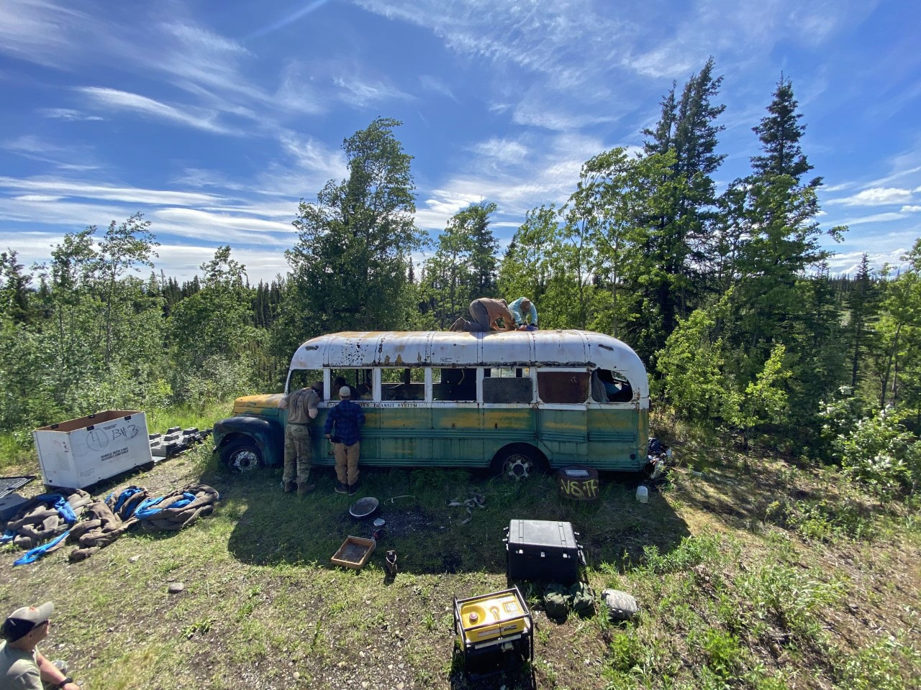
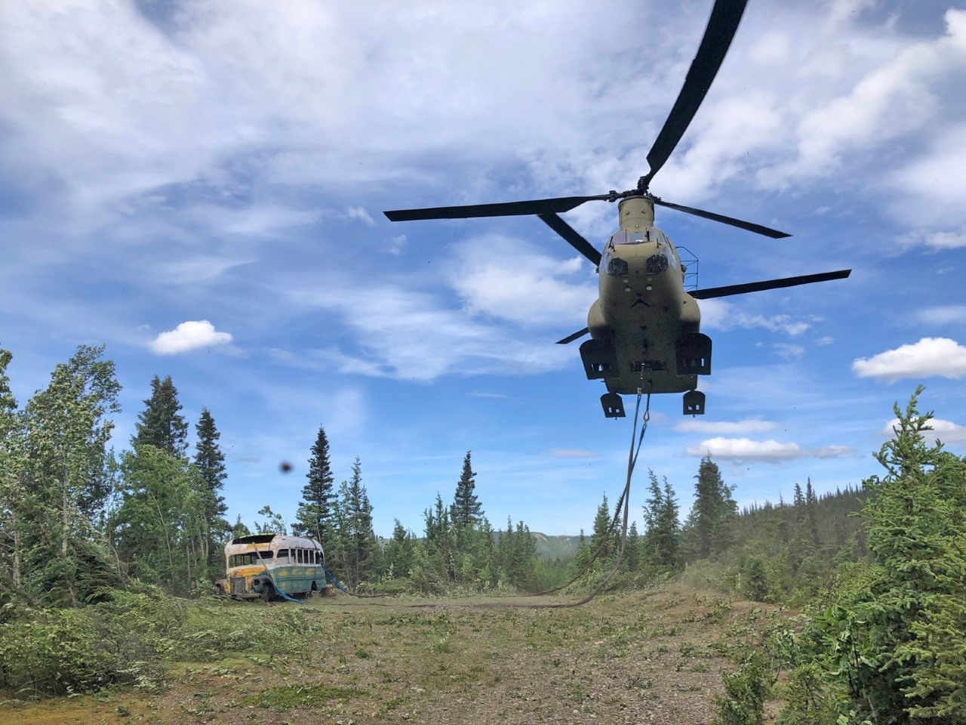
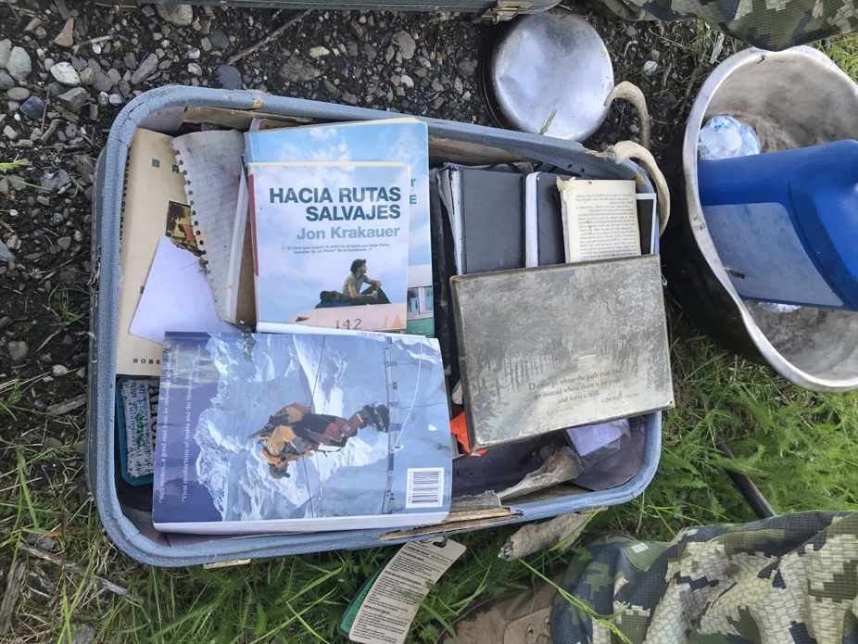
Collection and
Current Condition, 2020
Images: AK Air National Guard

Slide 3
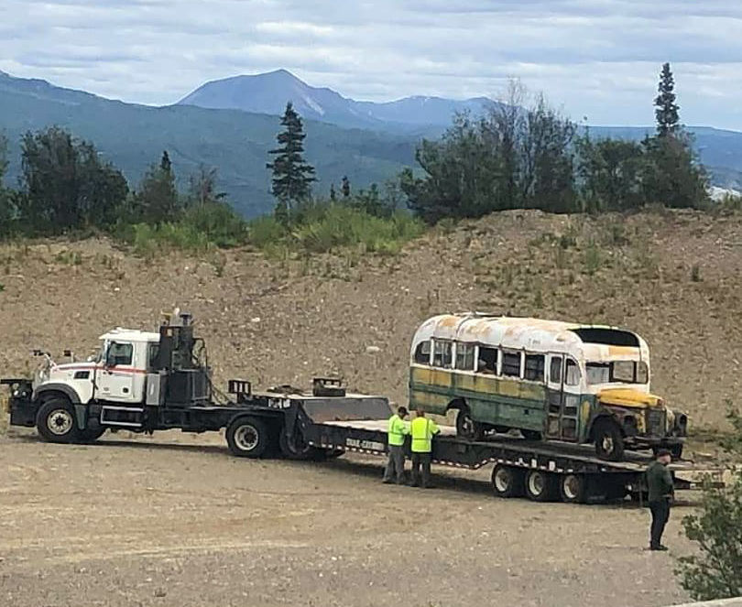
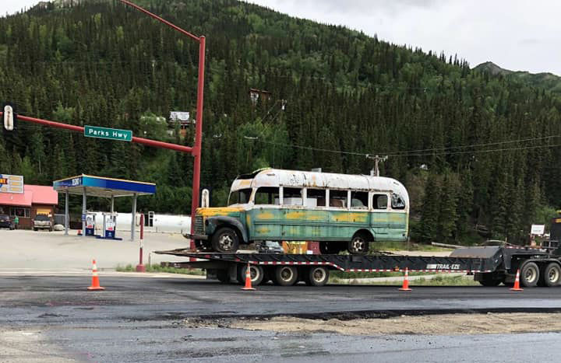
Transfer to Fairbanks*
Before end of September
Carlile Transportation?
*contingent on MOU - pending
Images: Fairbanks Daily News Miner

Slide 4
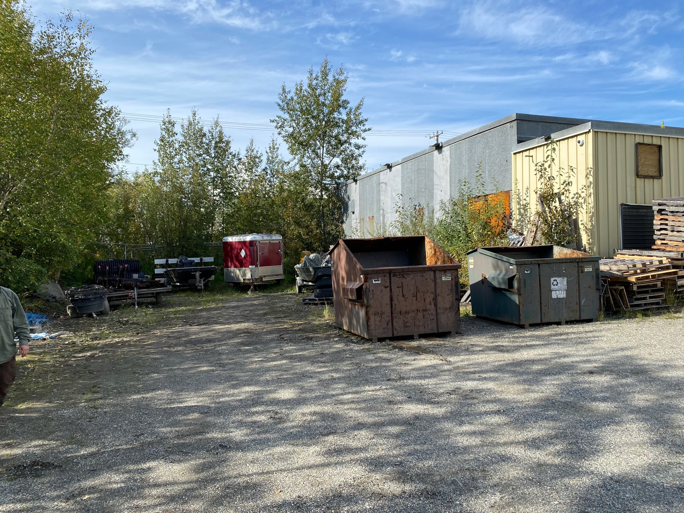
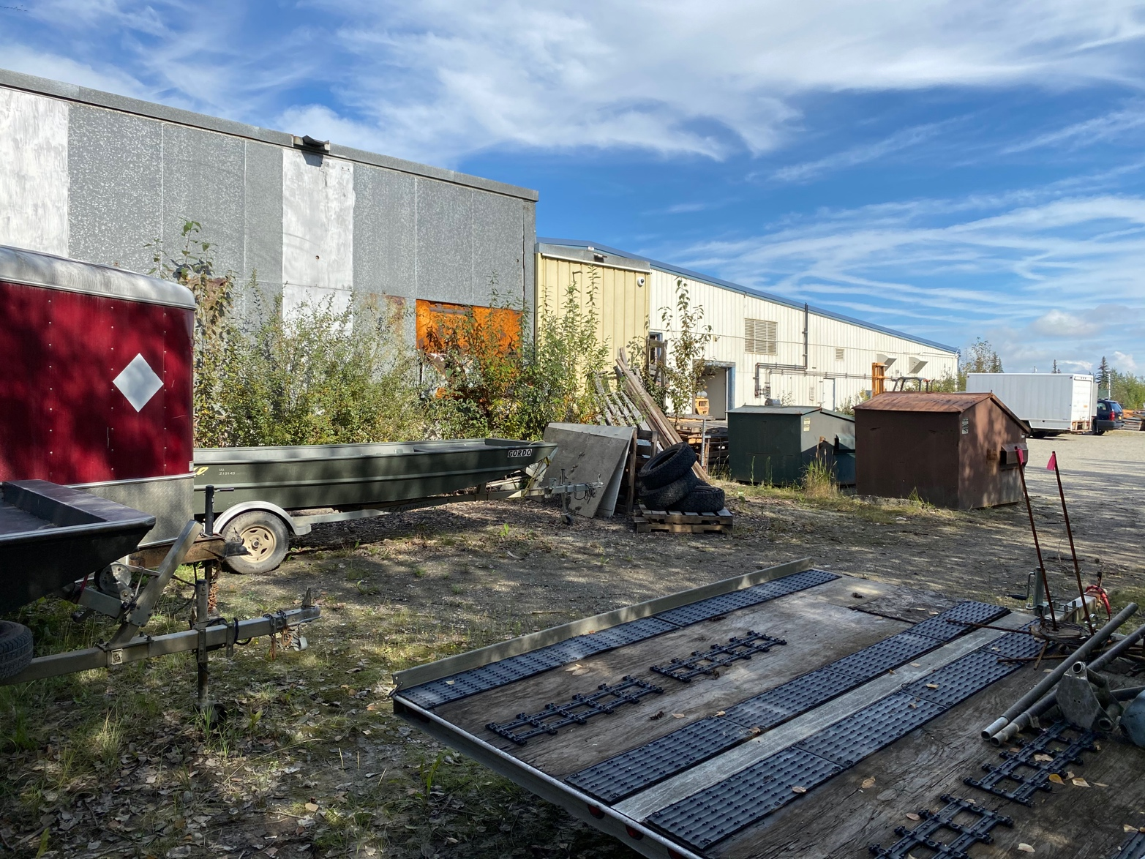
Temporary storage and refurbishment
Aurora Facility
Secure
Erect Weather Port covering
Assessment and conservation work
~2 years
Aurora Facility

Slide 5
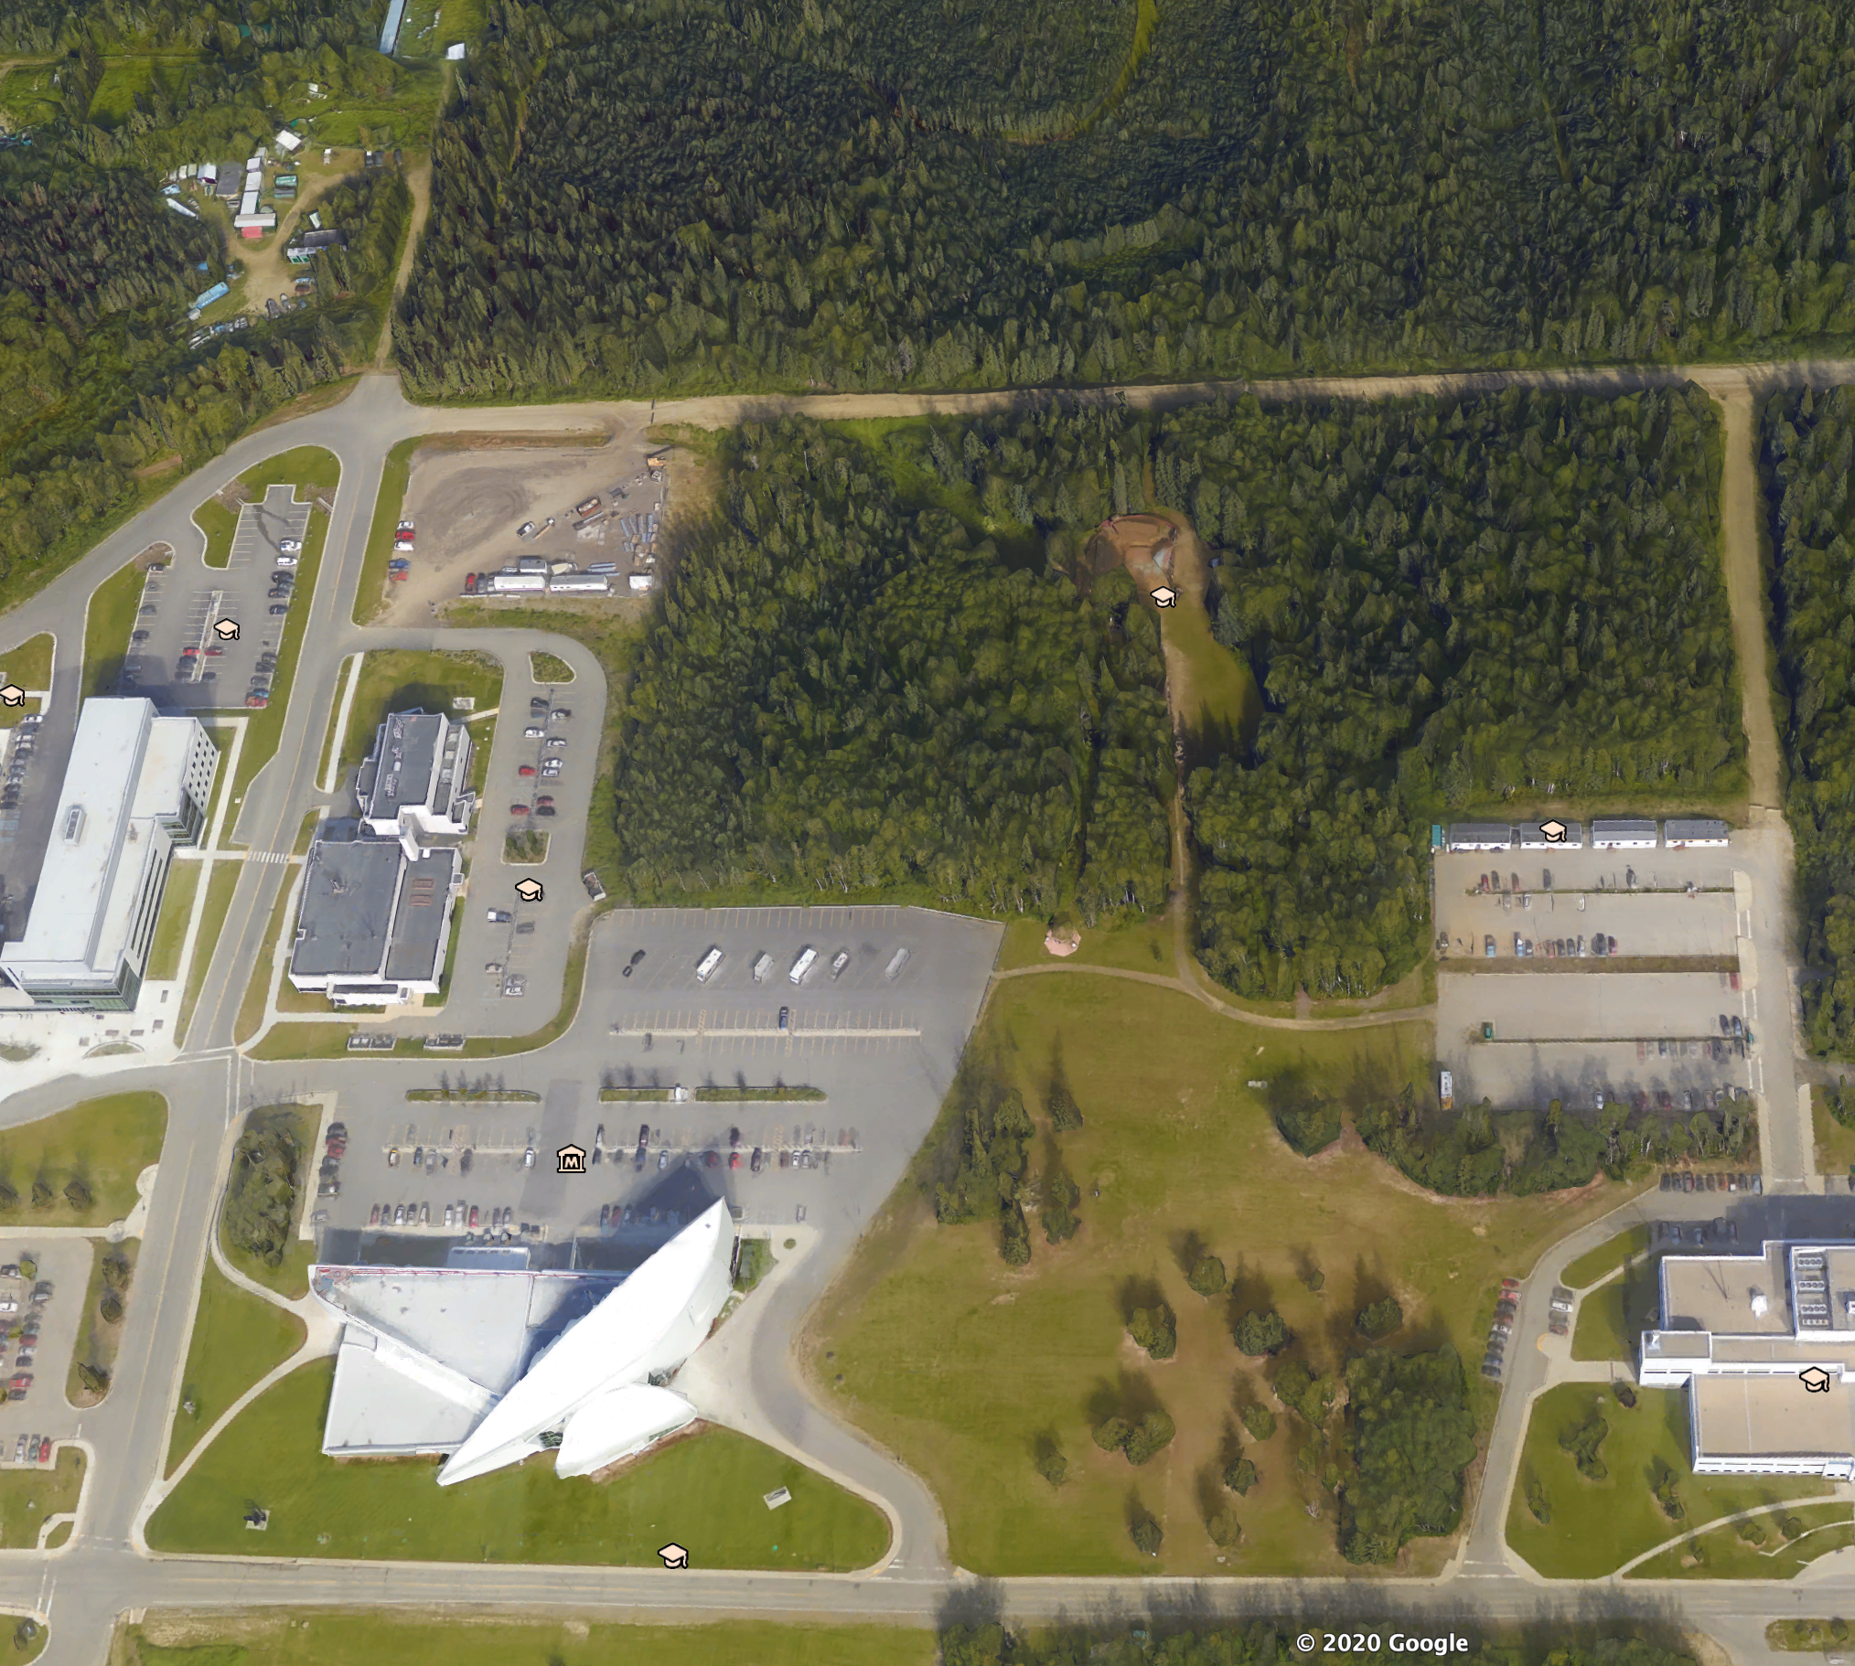
Deer Yard
Preferred Option
Outdoor Exhibition
Secure
Accessible
Free
Unobtrusive
Practical
North Tanana Dr.
Possible location
for bus
Murie
Bldg.
Current location of
the Blockhouse
Virology
Troth
Yeddha’
UA Museum
of the North
Reichardt
Bldg.
Sheenjeck Rd.
Yukon Dr.

Slide 6
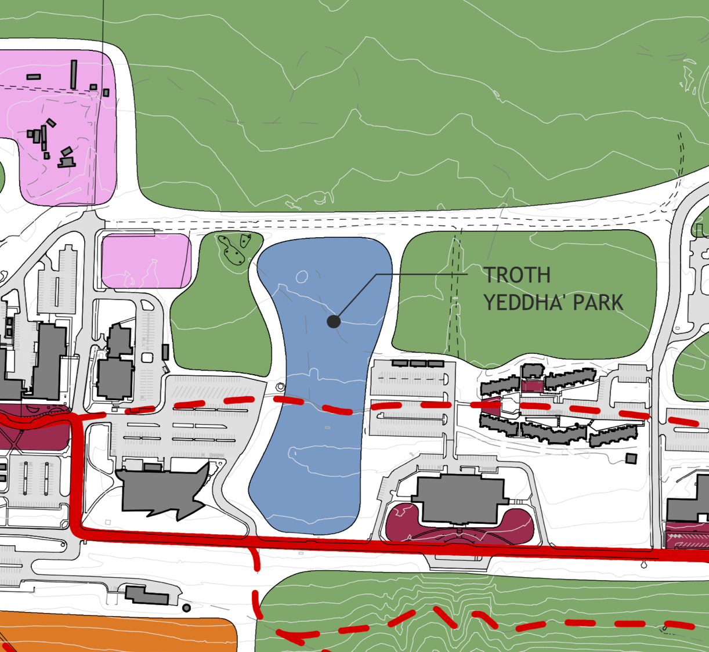
Challenges
Proximity to Troth Yeddha’
Permafrost
Accessibility
Security
Parking
And…?

Slide 7
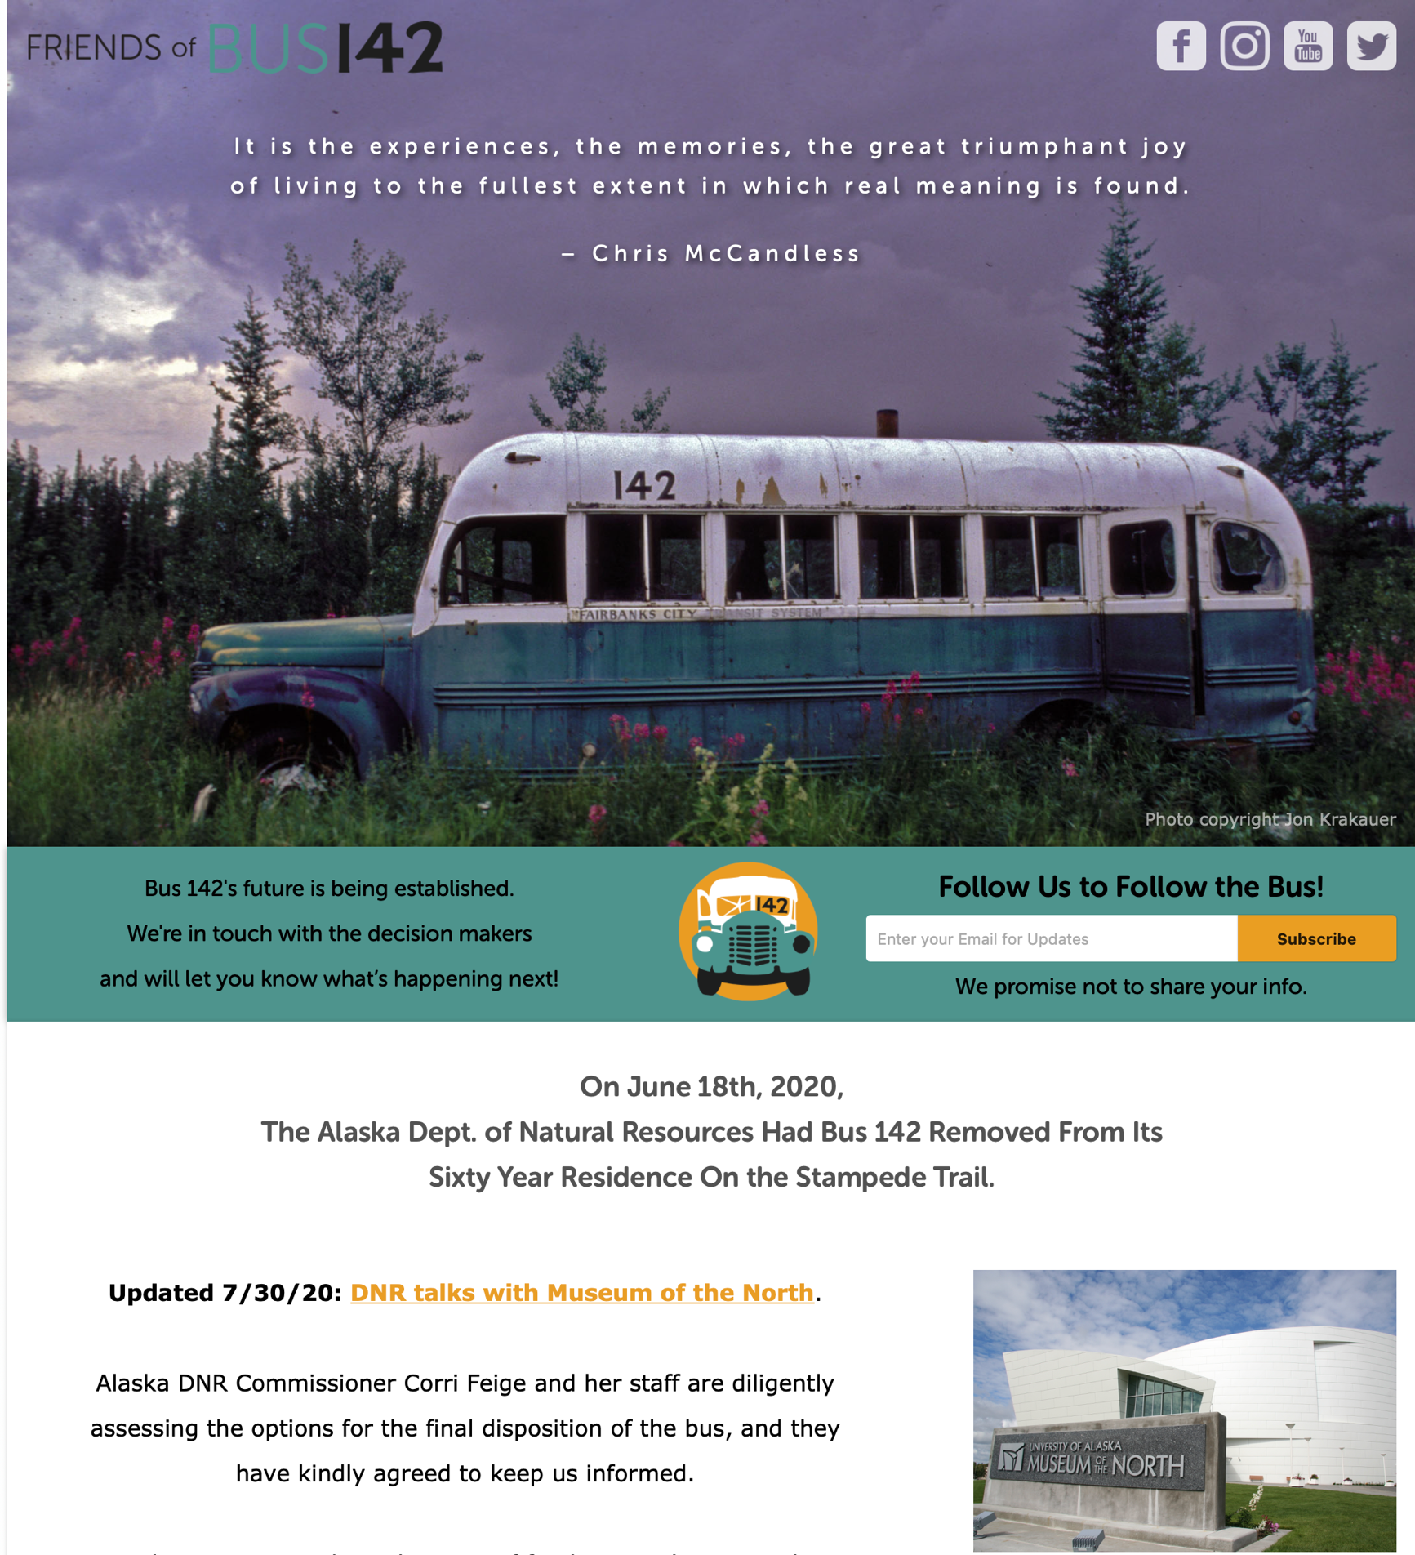
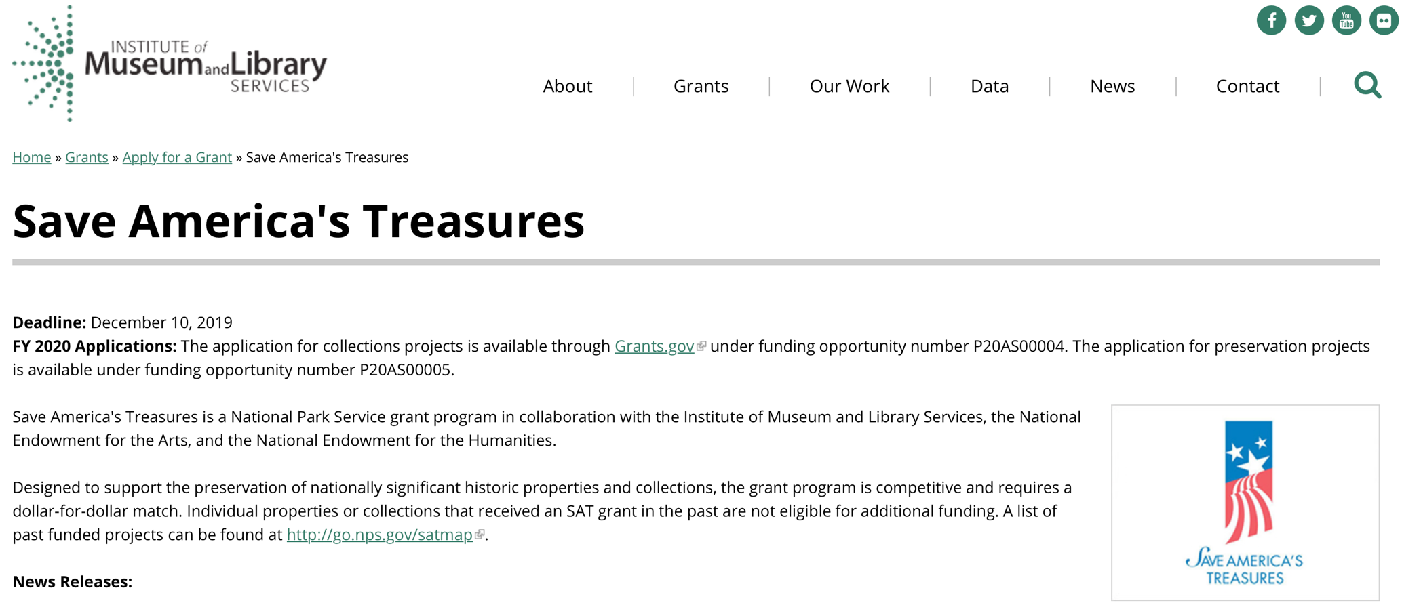
Fundraising
Federal (IMLS)
private (FOB142)
Total Cost = at least $0.5 M

Slide 8
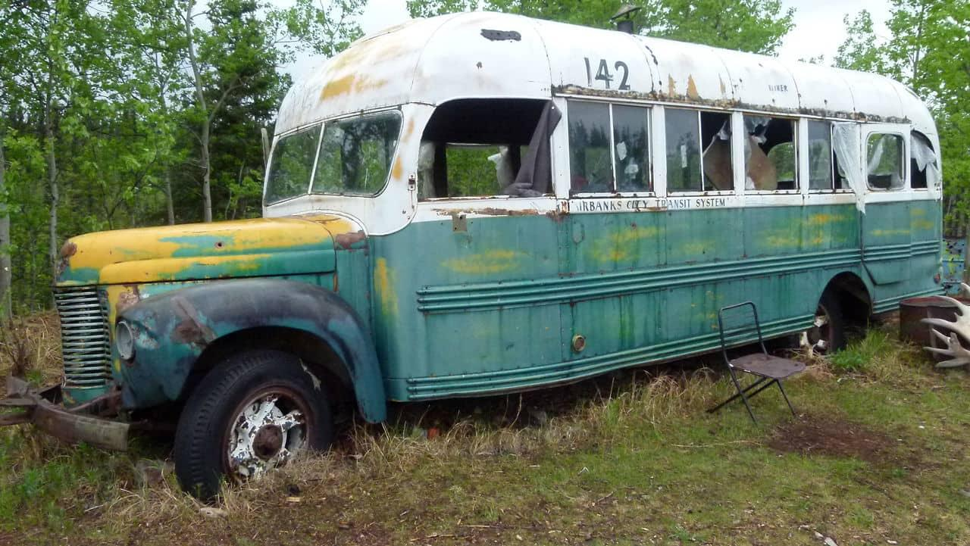
Timeline and Phases
Phases
Transfer, temporary housing
Assessment and cataloging
Conservation and stabilization
Exhibition design
Site preparation
Exhibit production
Installation
Grand opening
(End September, 2020)
(Fall, 2020)
(Winter, 2020-21)
(Begin Winter, 2020)
(Begin Summer, 2021)
(Fall, 2022 (or 2023))

