Slide 1

Draft Design Proposal
to the
Master Planning Committee
Presented by DJRM Engineering
March 26, 2015

Slide 2
Current Concerns
lack of a modern curb and gutter system,
abrupt sidewalk terminations at intersections,
differential settlement and frost heaving,
jarring shifts in the path between Reichardt Building and MBS,
plow damage to concrete,
ice buildup associated with sidewalk overflow, and
lack of controlled pedestrian crosswalks.

Slide 3
Basic Design Considerations
safety and ease of pedestrian access,
anticipation of phasing,
ease of maintenance, and
ADA compliance.

Slide 4
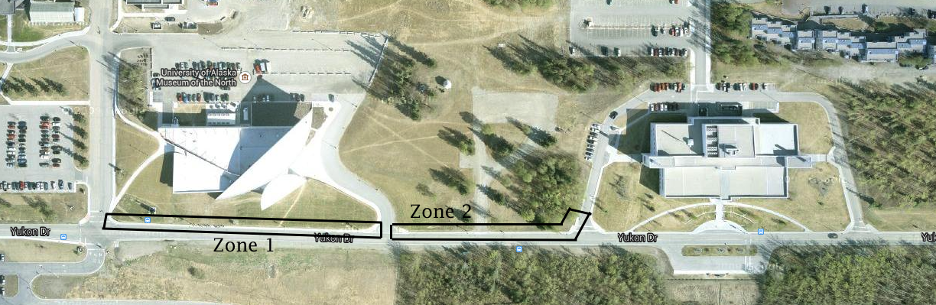
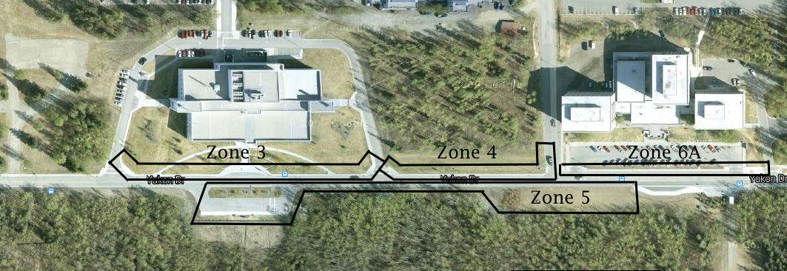
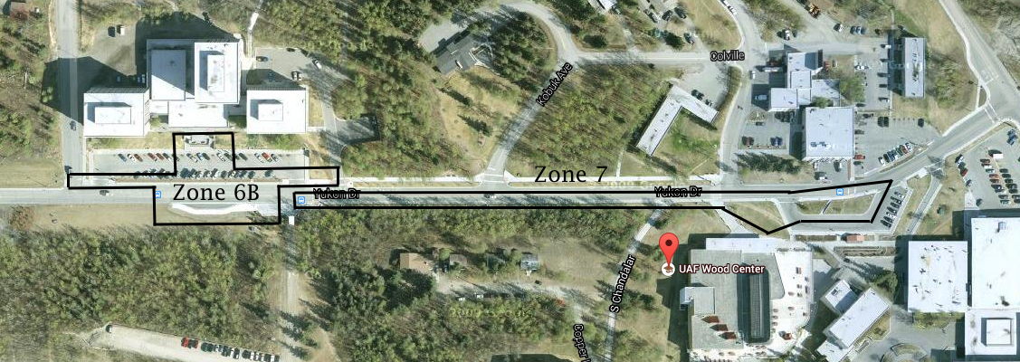

Slide 5
Basic Design Components
new curb and gutter
minimum sidewalk width of 6 feet
landscape buffer with a minimum width of 4 feet
at-grade access ramps compliant with ADA design standards

Slide 7
Zone Specific Design Components
Zone 5: Collaborate with UAF Residence Life to appropriately utilize green space across from dormitories.
Zone 7: Widen the sidewalk on the south side of the roadway from the Wood Center bus pullout to the MBS dormitories.

Slide 8
Zone Specific Design Components
Zone 4: Install drainage swale and storm drain catch basin North of the sidewalk stretching between the dormitories and the Reichhardt building.
Zone 4: Install retaining wall between dormitories and Reichhardt building to assist in the routing of water.

Slide 10
Zone Specific Design Components
Zone 6: Reduce posted speed limit in front of MBS dormitories, and install crosswalk the full length of the sidewalk in front of the dormitories.

Slide 13


