Slide 1
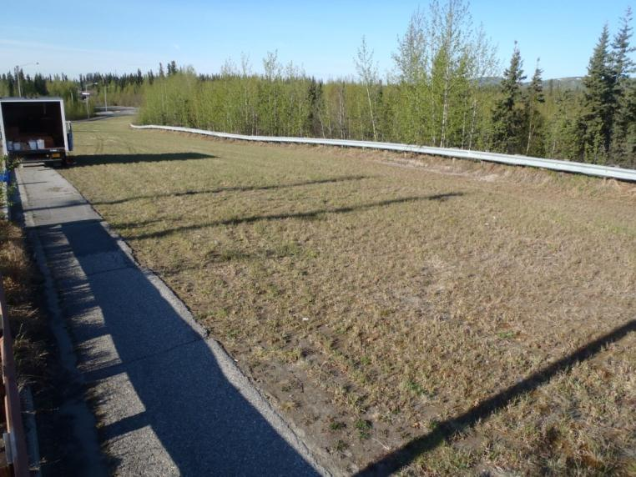


UAF CAMPUS COMMUNITY GARDEN
Chas Jones
PhD student, Campus Community Garden Committee Chairperson
chas.jones@iarc.uaf.edu
Summer 2012

Slide 2
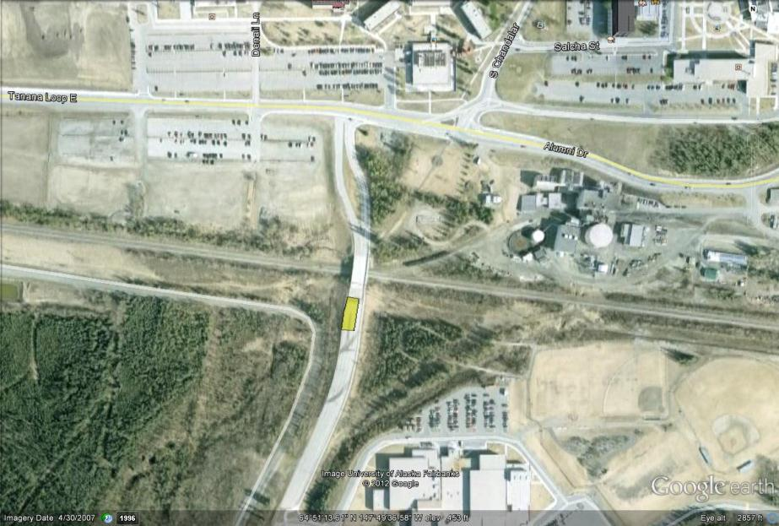
LOCATION & PURPOSE
Formerly
Fairbanks Ave.
Roadway converted
Into campus
Community garden
Place to grow organic foods
Enhance campus community across disciplines and between students, staff, and faculty
Outreach: workshops, classes, & campus tours
Mental & physical well-being
Site beautification

Slide 3
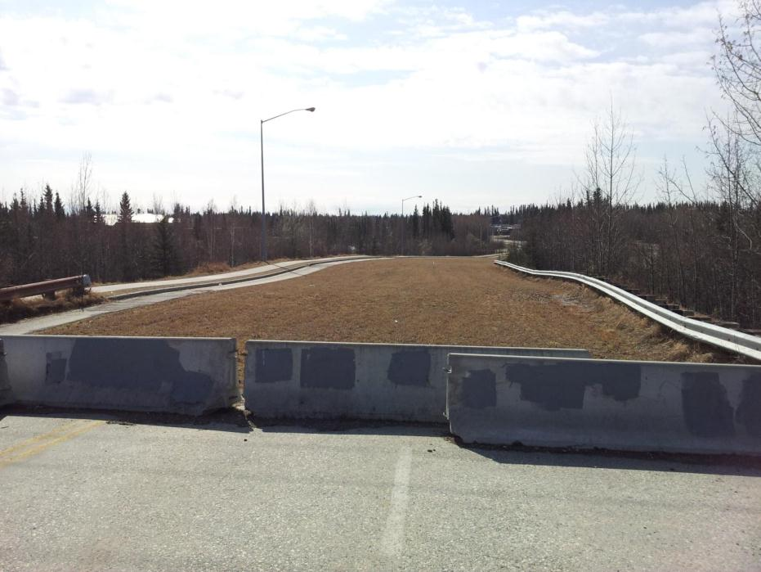
PROCESS
Preliminary interest survey
Office of Sustainability offered support
Weekly meetings in initial stages
  12 active in planning committee
  8 weeks from planning to construction
  Infrastructure completed in 2 work days
Funding
  UAF People’s Endowment; $5,000
  RISE Board; $4,673

Slide 4
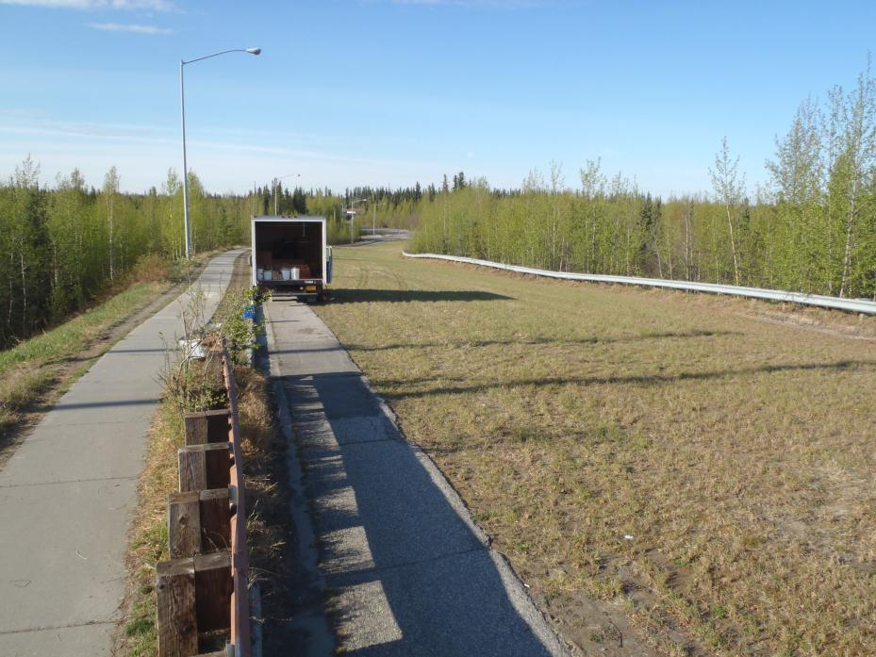
PROCESS (cont.)
Consulted with
UAF Lands office
Facility Services
CCHRC & Sustainable Village
Master Planning Committee
Parking Services
Environmental Health, Safety and Risk Management
UAF Police Dept.

Slide 5
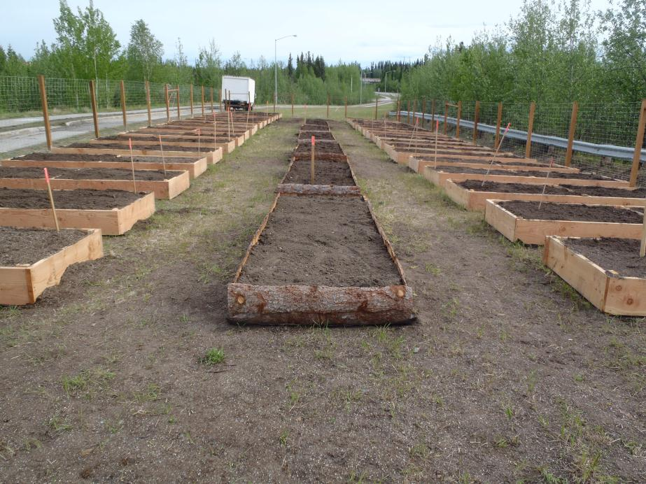
GARDEN DETAILS
Finished size:
~ 50 ft x 90 ft
~ 0.1 Acre
Infrastructure
42 raised plots (4’ x 12’)
36 Kiln dried lumber
6 raw slab spruce
6 ft tall wire fence
Water tank
Tool shed

Slide 6
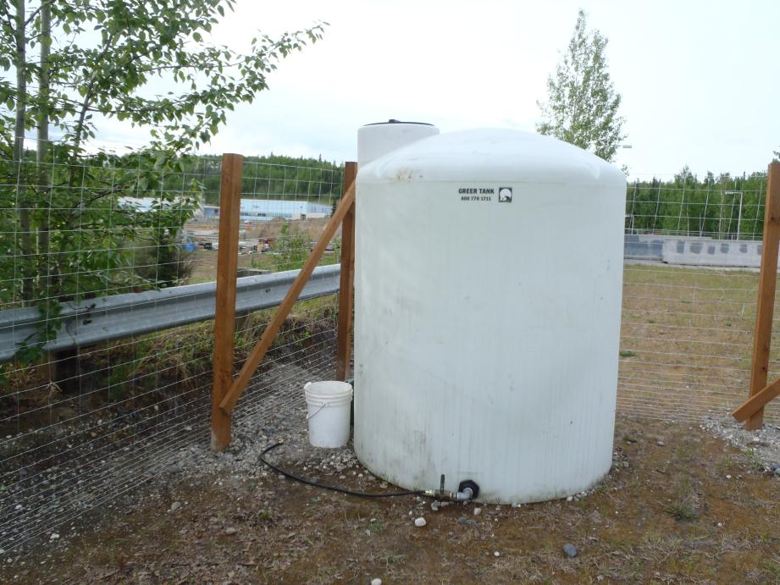
GARDEN DETAILS
Finished size:
~ 50 ft x 90 ft
~ 0.1 Acre
Infrastructure
42 raised plots (4’ x 12’)
36 Kiln dried lumber
6 raw slab spruce
6 ft tall wire fence
Water tank
Tool shed

Slide 7
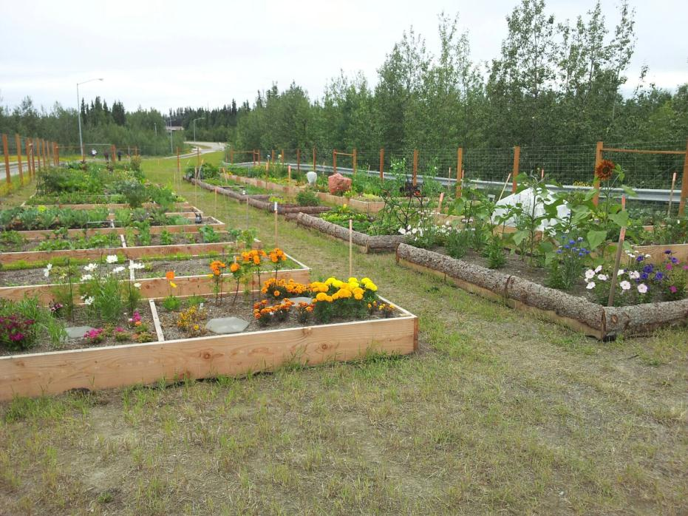
ADDITIONAL PROGRESS
Garden committee formed
Planning ahead for next year’s garden season
Gardener’s UAF affiliation
Type | Percent
Students | 52%
Staff | 38%
Faculty | 8%
Alumni | 2%

Slide 8
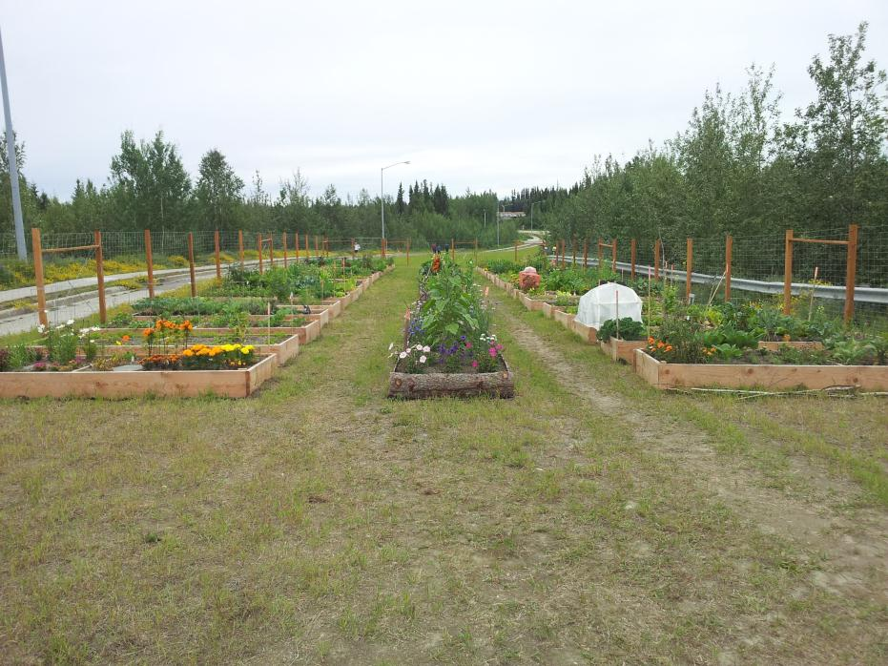
FUTURE STEPS
Signage
Work / picnic table
Community tools
Gardening workshops
Marketing prior to next spring
End of season clean-up
Seek gardeners for next summer

Slide 9
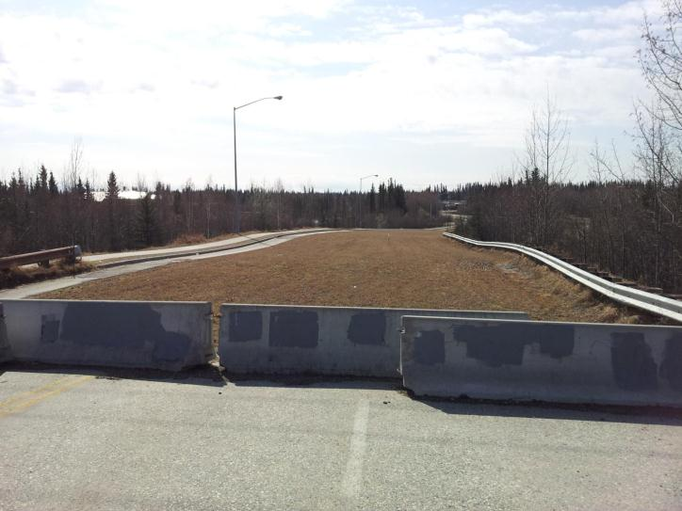

Thank you
UAF CAMPUS COMMUNITY GARDEN

