Slide 1
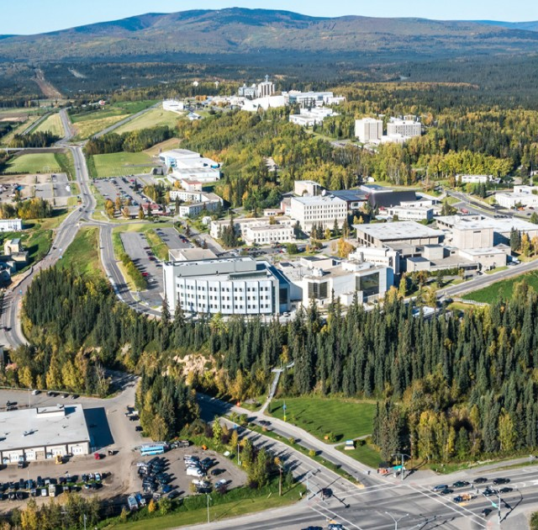

FACILITIES SERVICES ROADSHOW
Presented by:
2025
Facilities Services (907) 474-7000

Slide 2
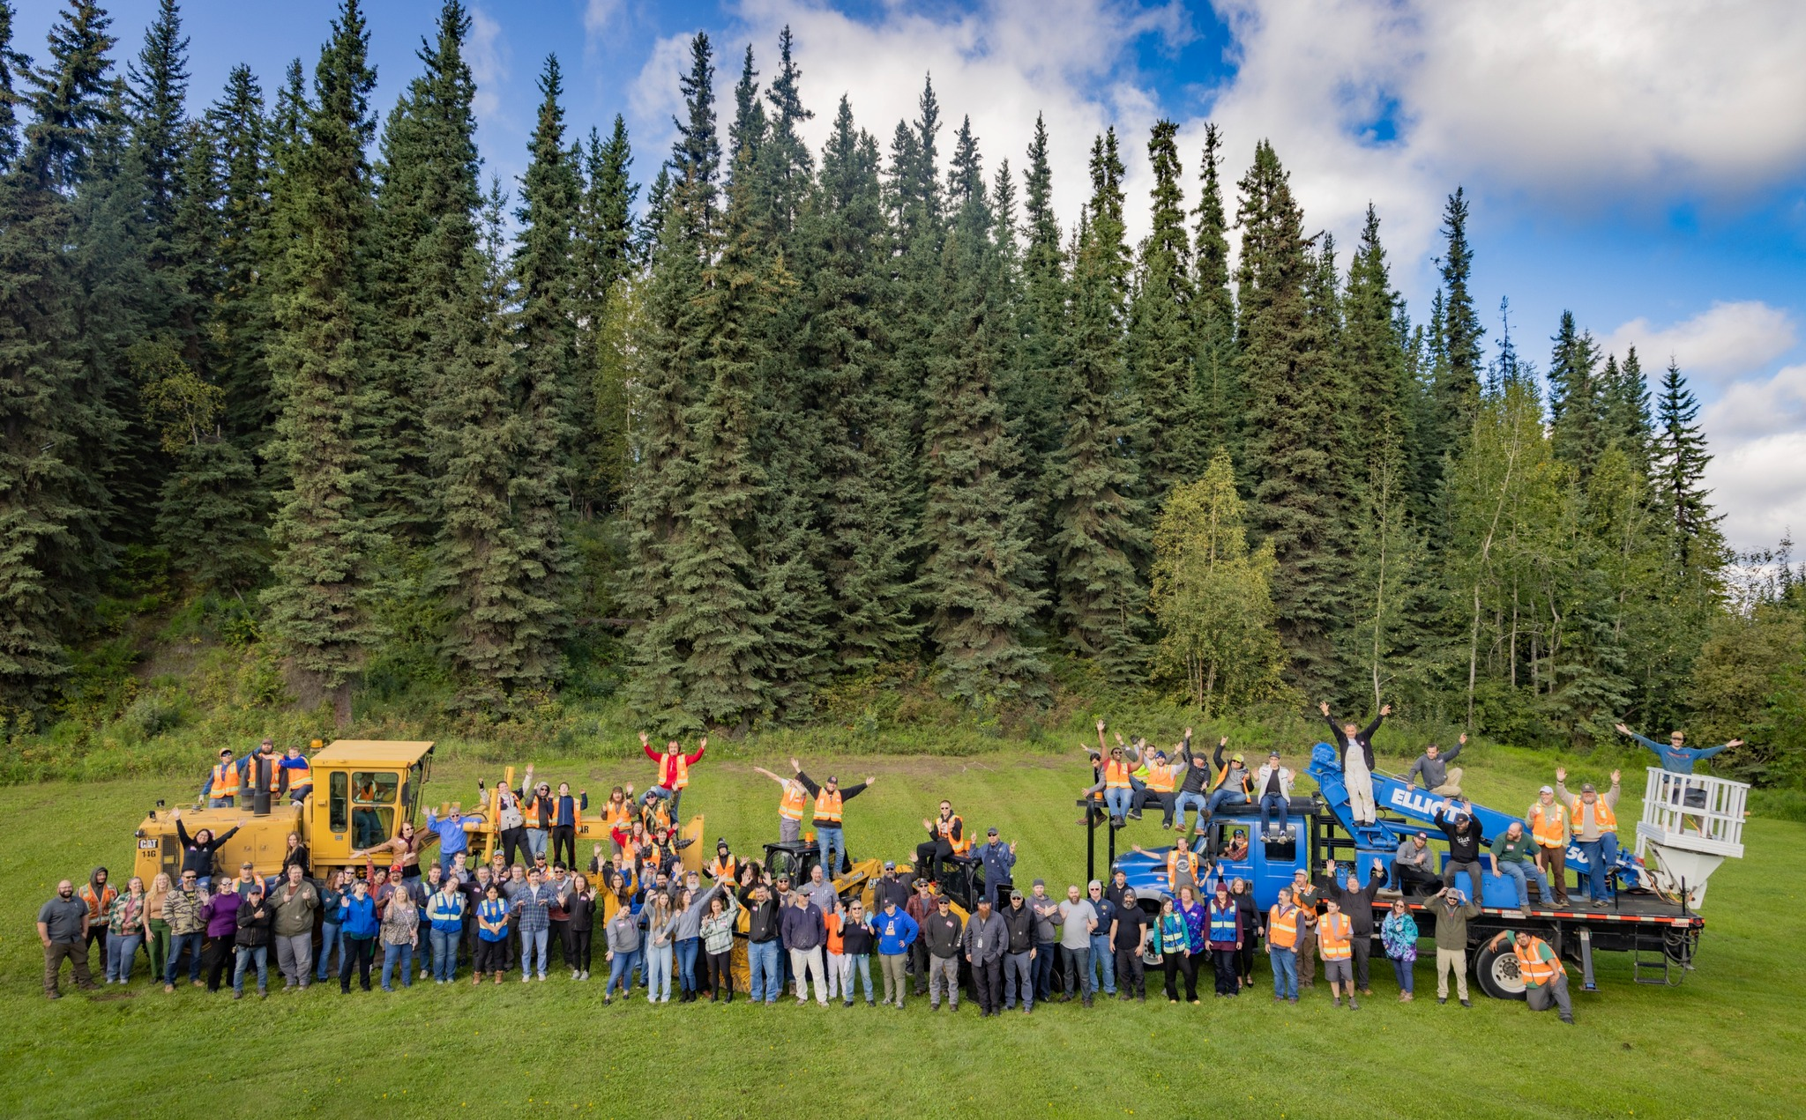
FACILITIES SERVICES
MISSION STATEMENT
“To promote academic excellence in education and research as we build, maintain, and enhance UAF’s Infrastructure.”
Facilities Services (907) 474-7000

Slide 3



ORGANIZATION
FACILITIES SERVICES
LEADERSHIP
Chancellor
Mike Sfraga
Vice Chancellor
Administrative Services
Julie Queen
Associate Vice Chancellor
Facilities Services
Kellie Fritze
Maintenance
Nathan Platt
Utilities
Kurt Knitter
Space Planning and Leasing
Brittany Van Eck
Design and Construction
Cameron Wohlford
Operations
Darrin “Bear” Edson
Business Operations
Karen Mallette
250+
Facilities Services Staff
Facilities Services (907) 474-7000

Slide 4
SERVICES AND SHOPS
Campus Mail Center
Capital Planning
Property & Central Receiving
Custodial Services
Design and Construction
Equipment & Vehicle Maintenance
Space Planning and Leasing
Maintenance
Keys, Locks, & Access
Labor
Roads & Grounds
Warehouse
Remote Site Maintenance
Shuttle Bus
Storage Space
Utilities
Vehicle Rentals
Facilities Services (907) 474-7000

Slide 5
FUN FACTS
How Many Lights on Campus?
80,000+ Light Fixtures
6 Electricians
830+ Toilets
4 Plumbers
How Many Toilets on Campus?
3,600,000 sq. ft of Buildings
120 Maintenance and Operations Staff
How Many Square Feet of Buildings?
Facilities Services (907) 474-7000
Notes:
34 acres of roof
24 acres of parking lots
8.5 miles of road
Illustrate how much work FS staff get done each year

Slide 6

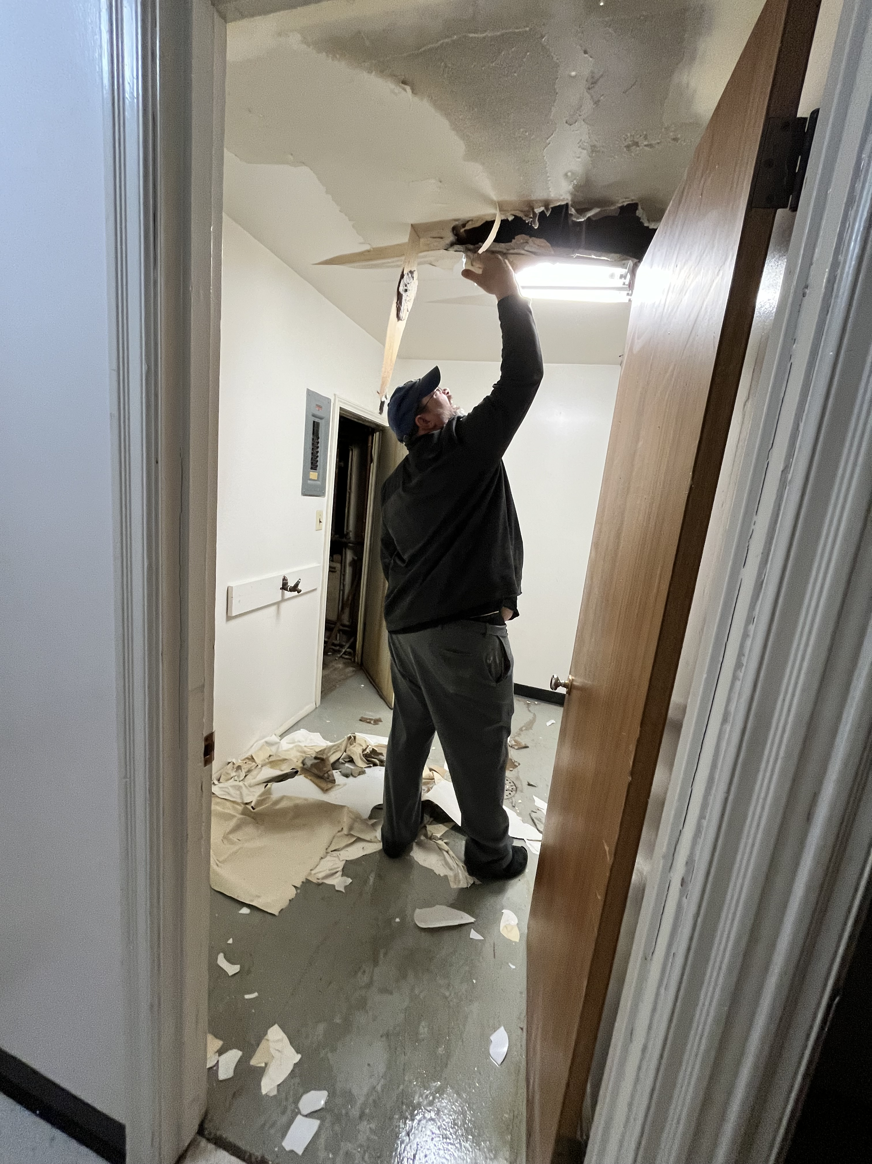
DEPARTMENTS
Housing and Dining
MAINTENANCE
Repairs in campus housing and dining facilities. Services include addressing plumbing, heating, electrical, and appliance issues.
Plumbing
Plumbing systems within University buildings.
HVAC
Equipment associated with heating, ventilation, and air conditioning systems
Key Shop
Makes, issues, installs, and authorizes keys, locks, and other physical access controls and devices to all campus personnel and property (residences & buildings)
Martin Pahkamaa - Maintenance
Facilities Services (907) 474-7000

Slide 7
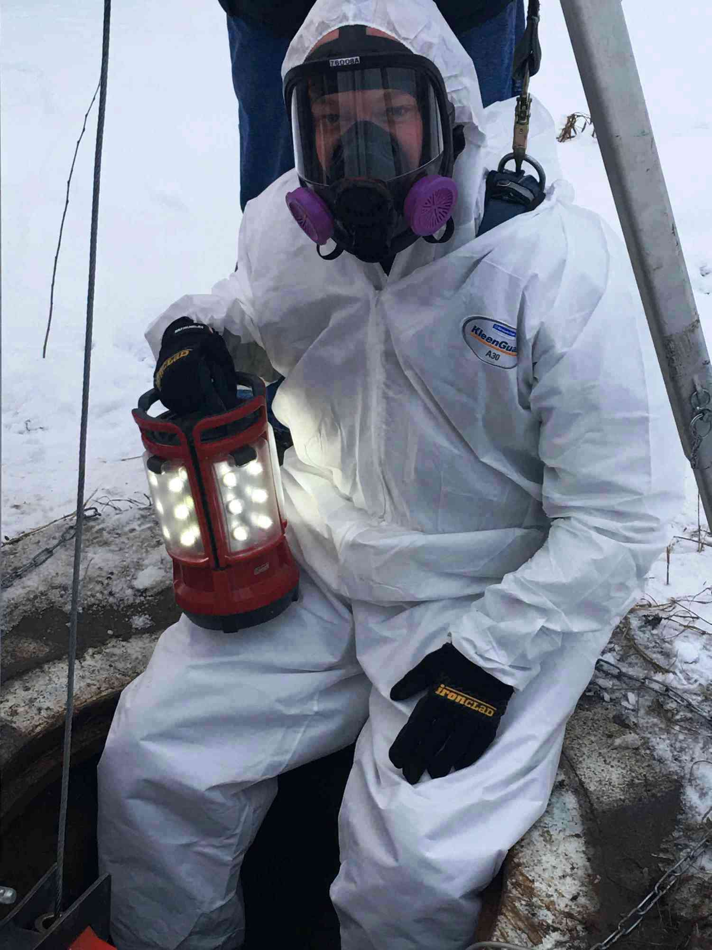
DEPARTMENTS
MAINTENANCE
Alarm Shop
Manages and maintains safety and security systems, including fire alarms and smoke detectors.
Asbestos Shop
Identification, management, abatement, and disposal of asbestos and other hazardous materials
Sprinkler Shop
Tests and maintains sprinklers in buildings throughout campus
Facilities Services (907) 474-7000

Slide 8
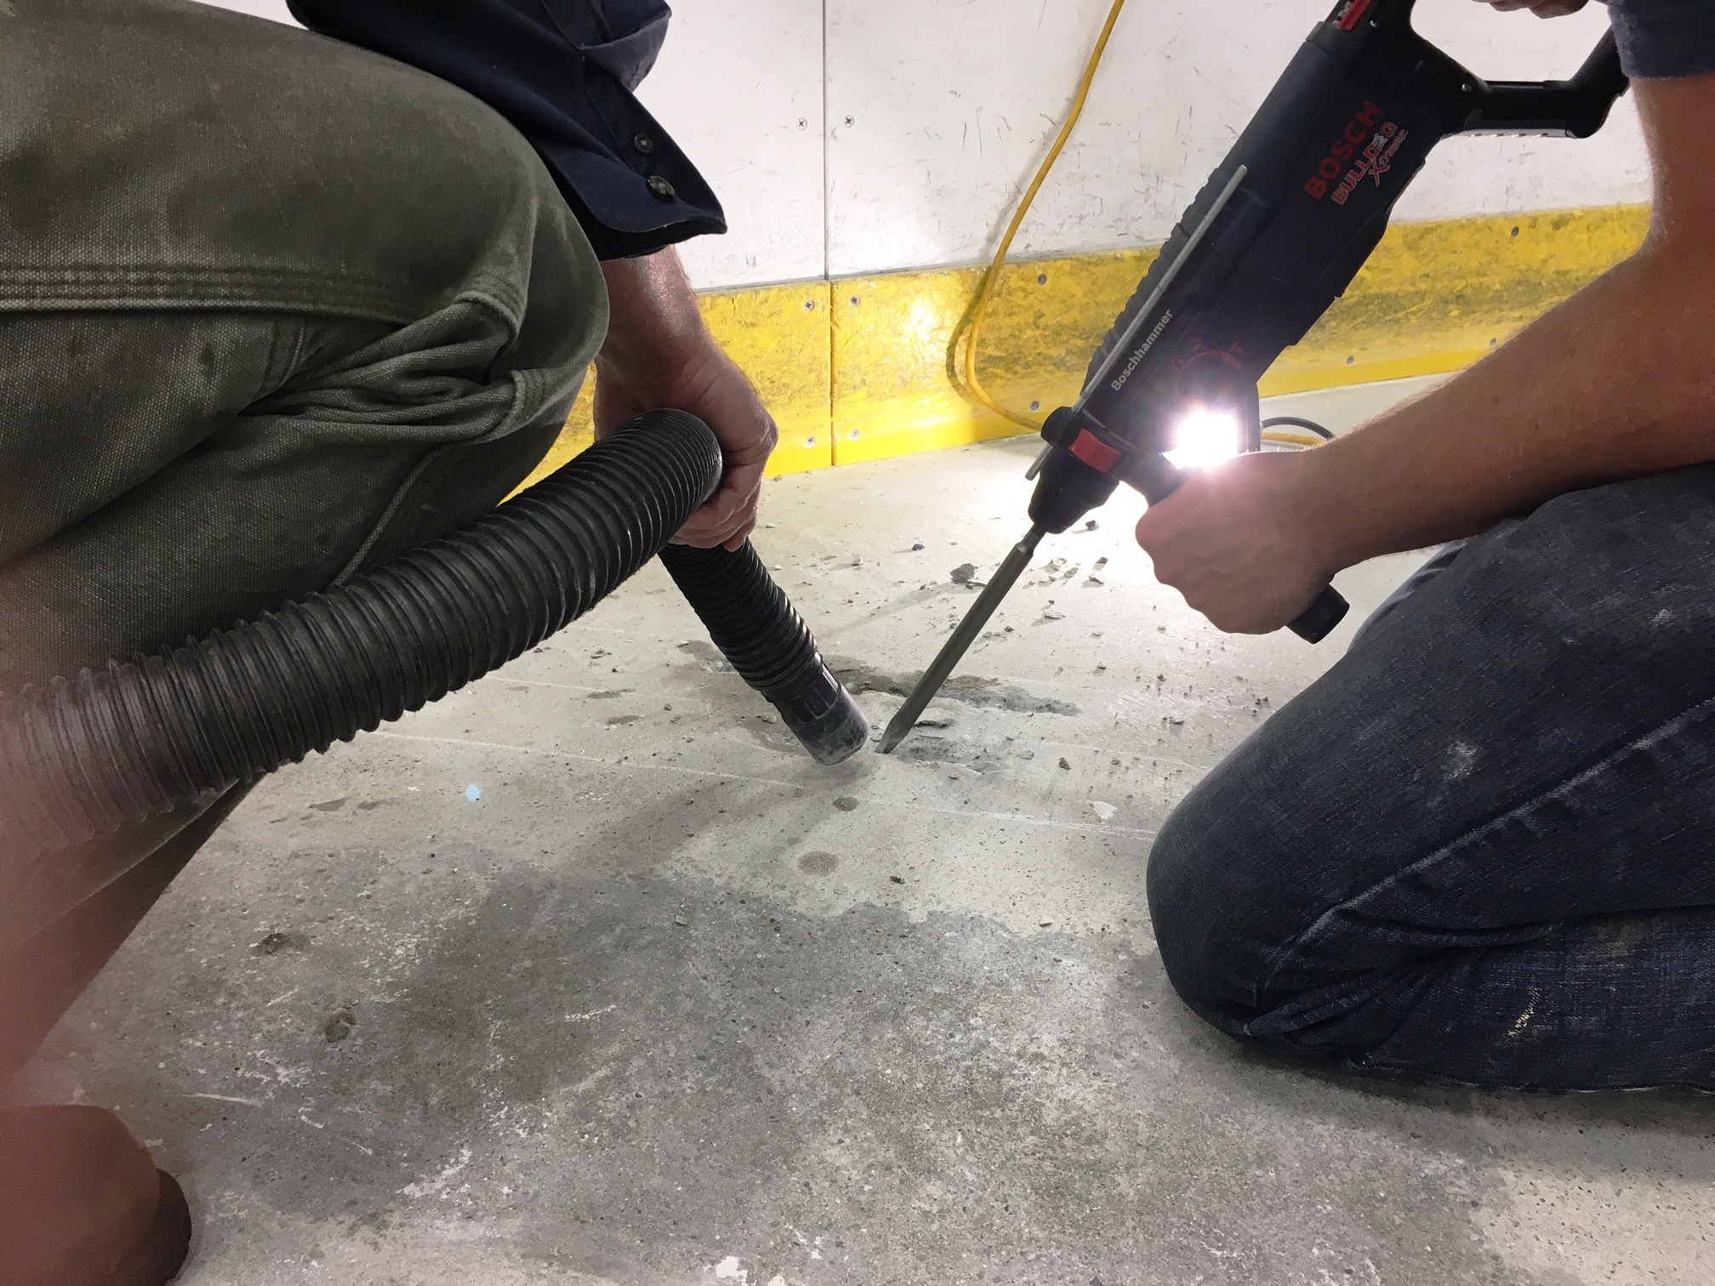
DEPARTMENTS
MAINTENANCE
Carpentry Shop
Full range of services including flooring, glass repair, and all aspects of carpentry
Electrical Shop
Interior and exterior lighting, and building-wide electrical systems
Paint Shop
Touch-ups, minor and major paint projects
Sign Shop
Graphics, vinyl signs, plastic signs, Name placards, room number signs, directories
Facilities Services (907) 474-7000

Slide 9

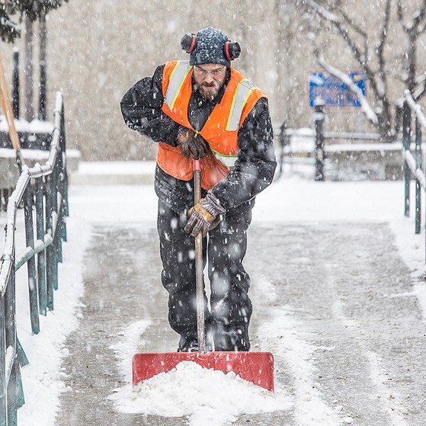
DEPARTMENTS
OPERATIONS
Grounds
Snow removal , road maintenance, lawn mowing and maintenance, planter beds, indoor plant program
Transportation
Campus shuttle service, vehicle rental and maintenance, shuttle and driver hire
Labor
Special event setup, classroom furniture, litter collection, furniture and equipment moving
UAF photo by Todd Paris
Facilities Services (907) 474-7000
Notes:
Snow Removal schedule on the website, talk about priorities (EMS, Reslife, high traffic areas, etc)
Grounds plants 50,000+ flowers planted each year

Slide 10
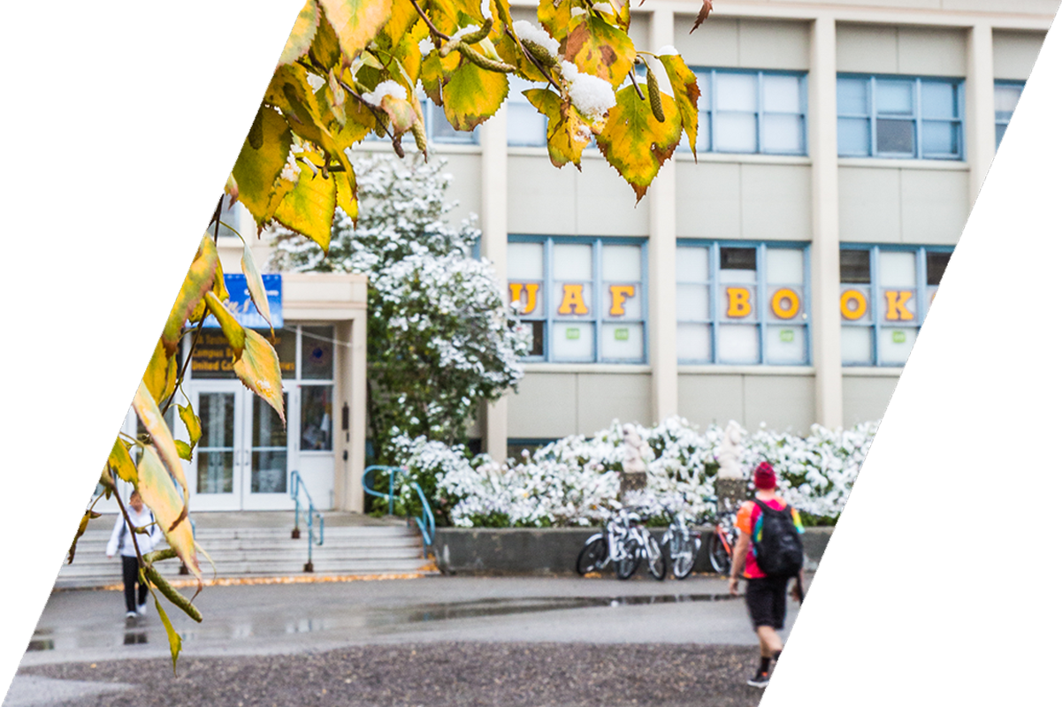
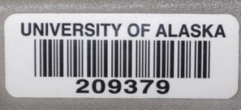
DEPARTMENTS
WAREHOUSE
CAMPUS MAIL CENTER
Procurement of Supplies and Services
Material Handling and Distribution
Shared Services
Property Inventory ($5,000 or more)
Surplus and Storage
Auctions (govdeals.com)
Receives and Delivers Mail on Campus Departmental Mail
Student and Staff PO Boxes
Passport Office at FS - Appointment Only
CENTRAL RECIEVING
Facilities Services (907) 474-7000

Slide 11
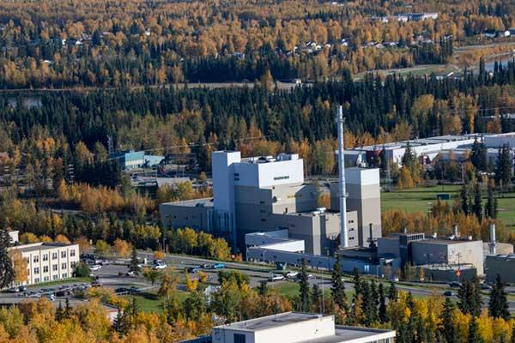
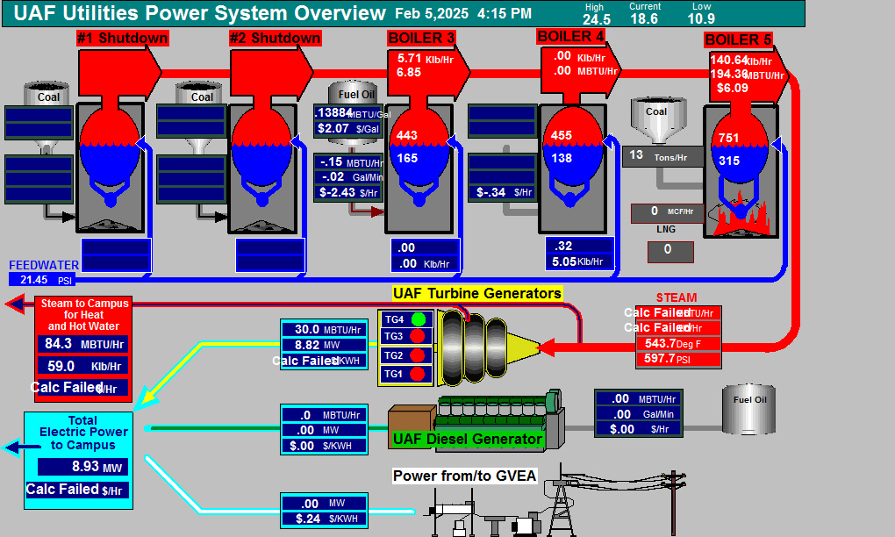
DEPARTMENTS
UTILITIES
Electric Power
Steam Heat
Domestic Water
District-Chilled water
RO Water for Laboratories
Compressed Air
Parking Lot Head Bolt Heater Schedule (They cycle on/off in warmer weather and are always on below -20F)
Utility Reports
Weekly Utilities Reports
Weekly Power Use
Facilities Services (907) 474-7000
Notes:
Value Added:
HBO Schedule, between 20 and -20 on one hour off one hour. Below -25, always on

Slide 12

DEPARTMENTS
SPACE PLANNING AND LEASING
NORTH CAMPUS TRAILS
Space Planning
Functional Use of Space and Space Changes
Additional Space Needs
Space Movements or Shifts
Backfill Planning
Leasing
UAF Request for non-UAF space
Non-UAF Request for UAF space
Agreements w/in UA
Supports Research, Education, & Outreach
Trail System for Recreation
Disc Golf Course
UAF photo by Todd Paris
Facilities Services (907) 474-7000
Notes:
National Weather Services leases space in Akasofu
GCI leases space for cell towers on Moore Hall

Slide 13
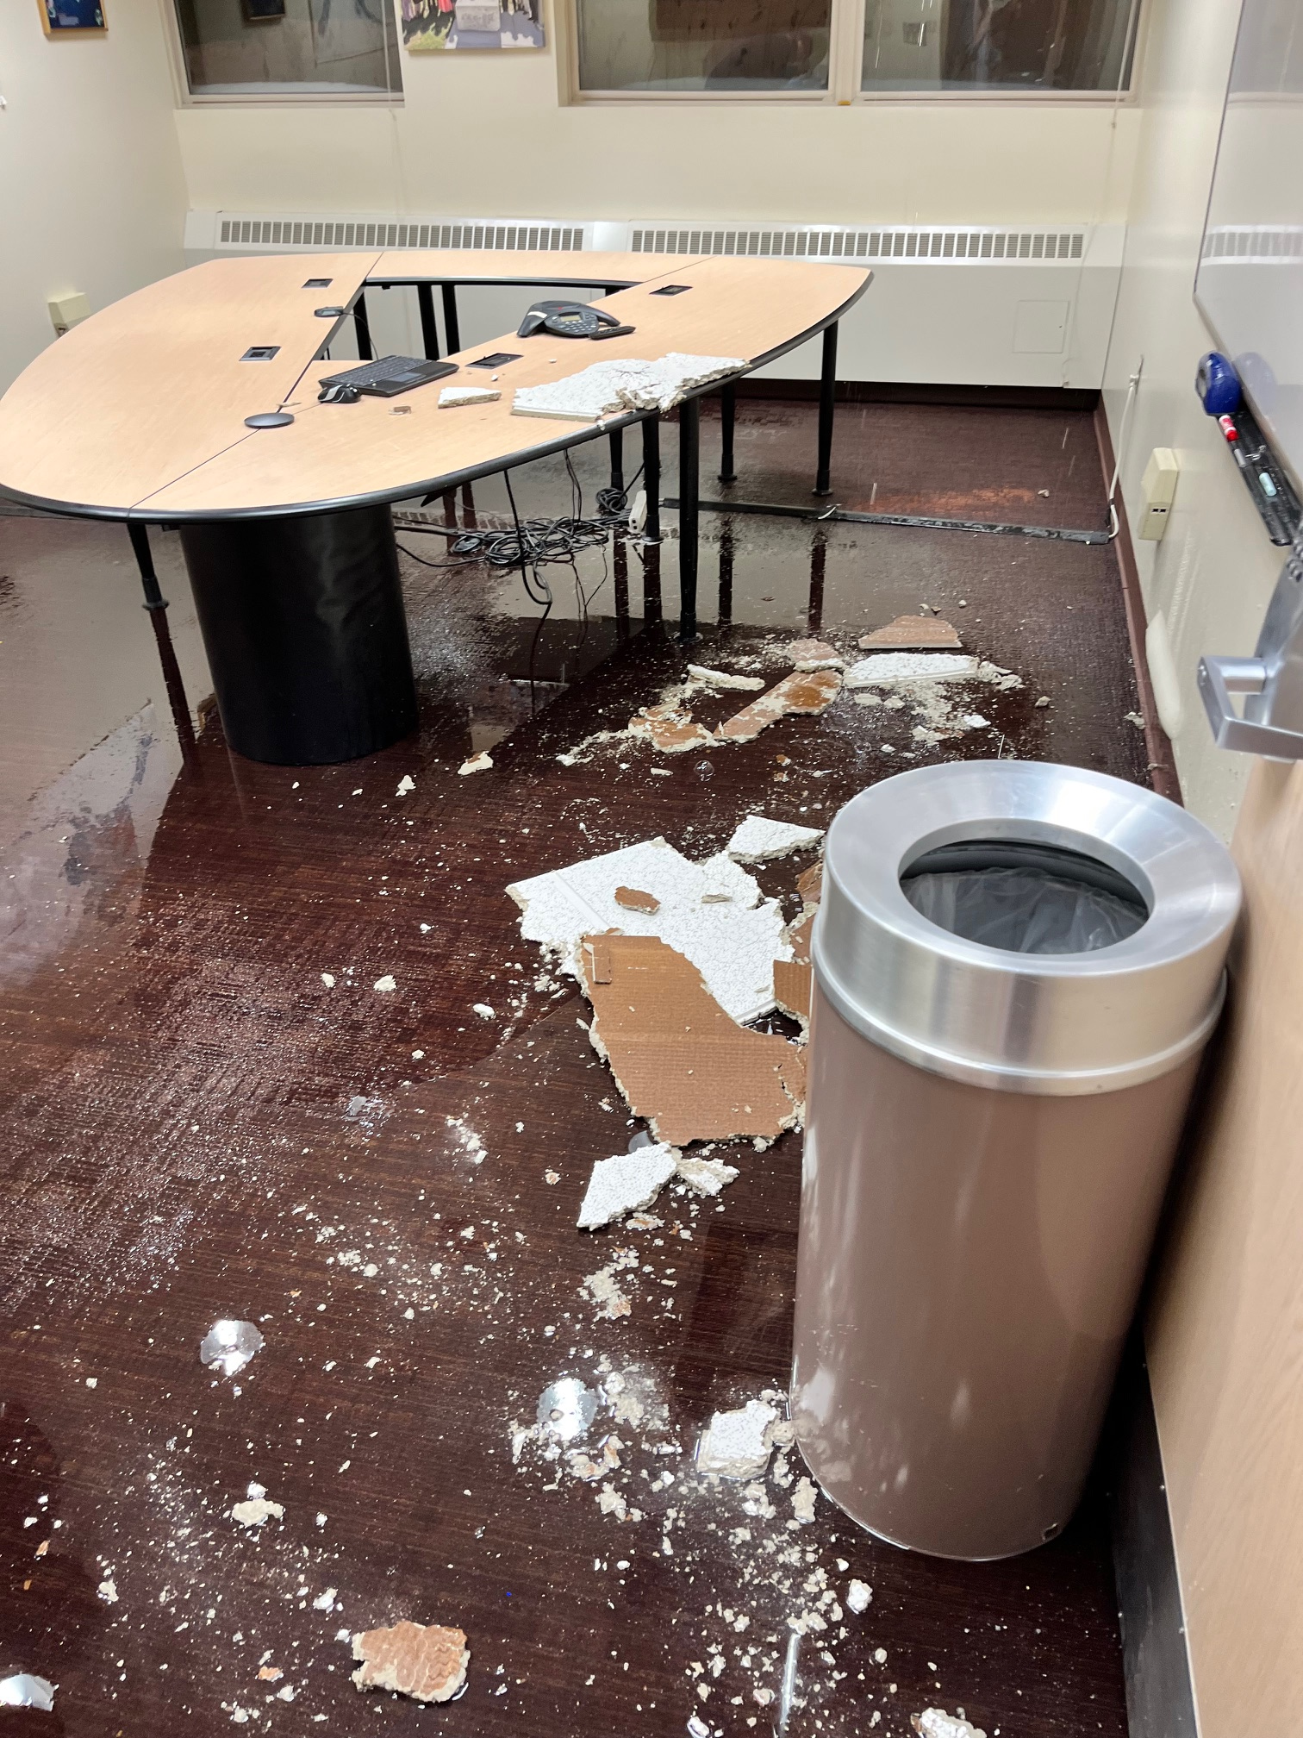
DEPARTMENTS
CUSTODIAL
Custodial Contracts Managed by FS
Facilities Inspectors Work for FS
See An Area That Needs Attention? Call 907-474-7000
Special Projects Are Available
Custodial Schedule is Available Online
QR Codes In All Bathrooms for Immediate Needs
Facilities Services (907) 474-7000

Slide 14
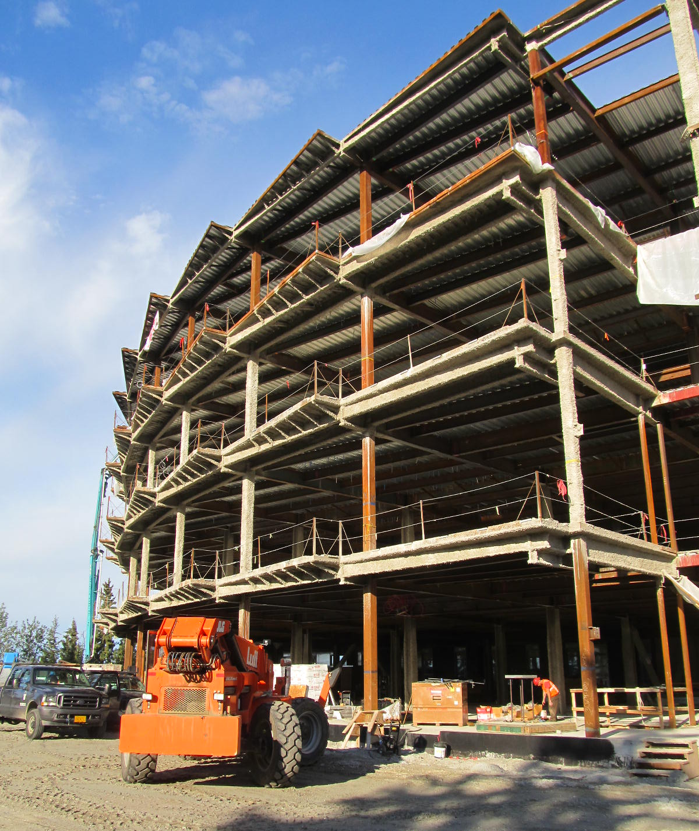
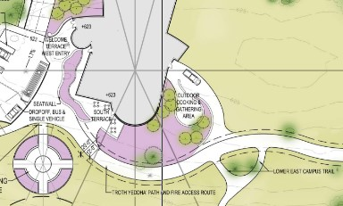
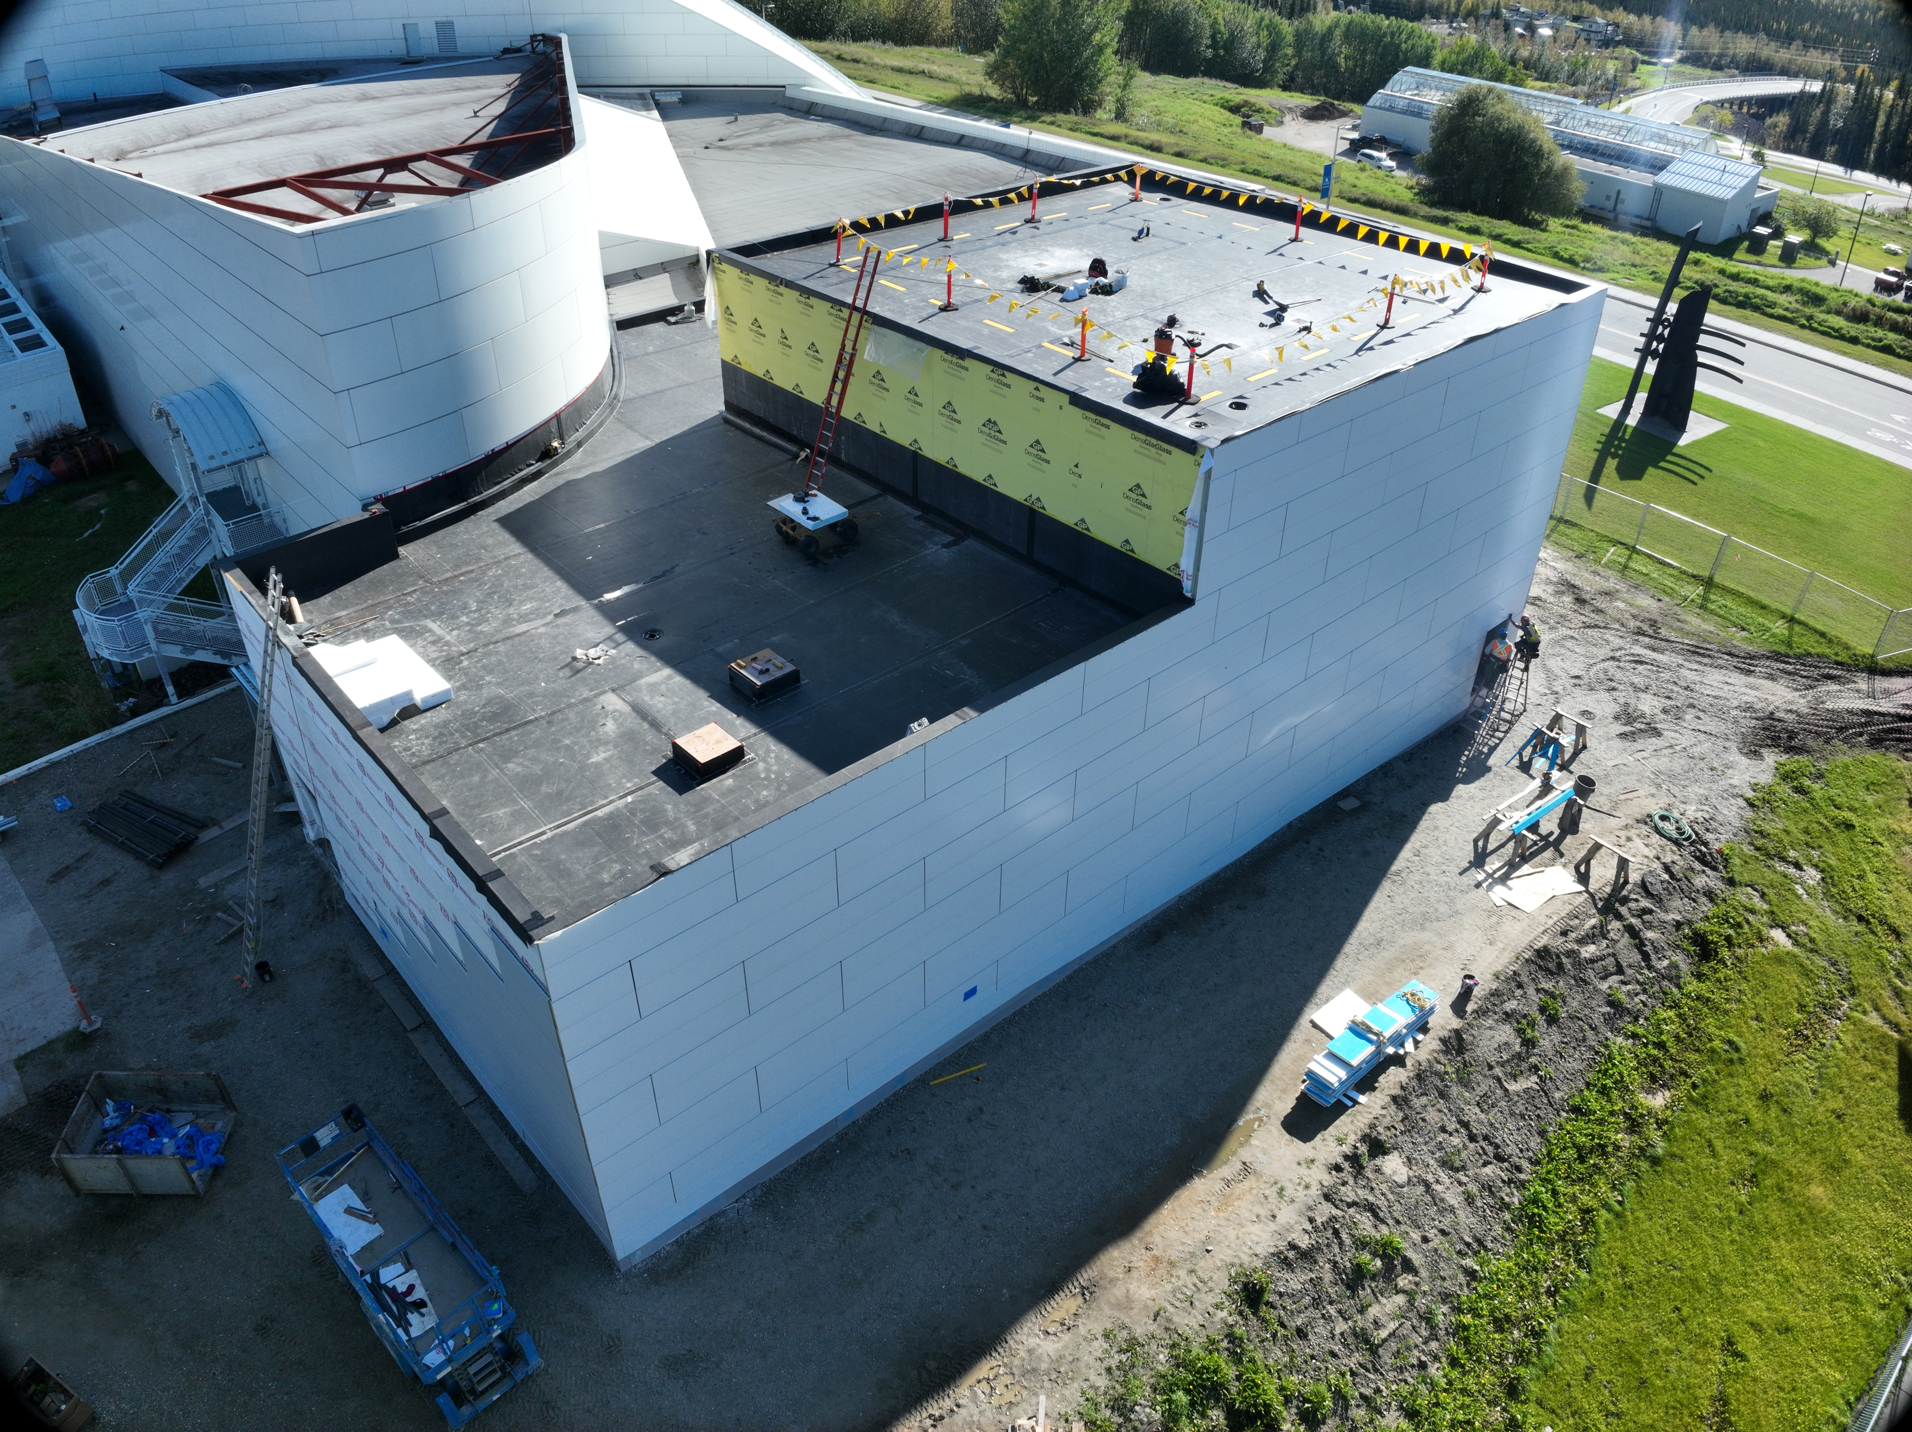
DEPARTMENTS
DESIGN & CONSTRUCTION
Construction Project Management
Campus Engineering
Deferred Maintenance Planning
UAF Design Standards
Facility Modifications
Yearly Construction Map
Campus Master Planning
Capital Planning
Facilities Services (907) 474-7000

Slide 15
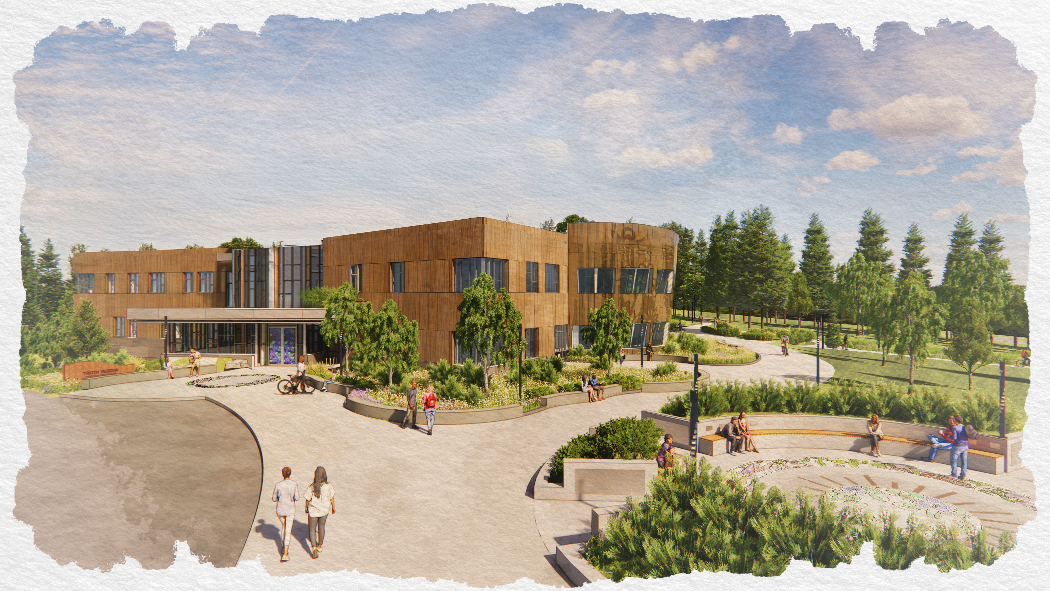
CAMPUS MASTER PLAN
Outlines The Vision for Future Campus Improvements
Guides Decision-Making For Short and Long-Term Projects
2020-2030 Campus Master Plan for Buildings
Indigenous Studies Center- Coming 2028!
Facilities Services (907) 474-7000

Slide 16
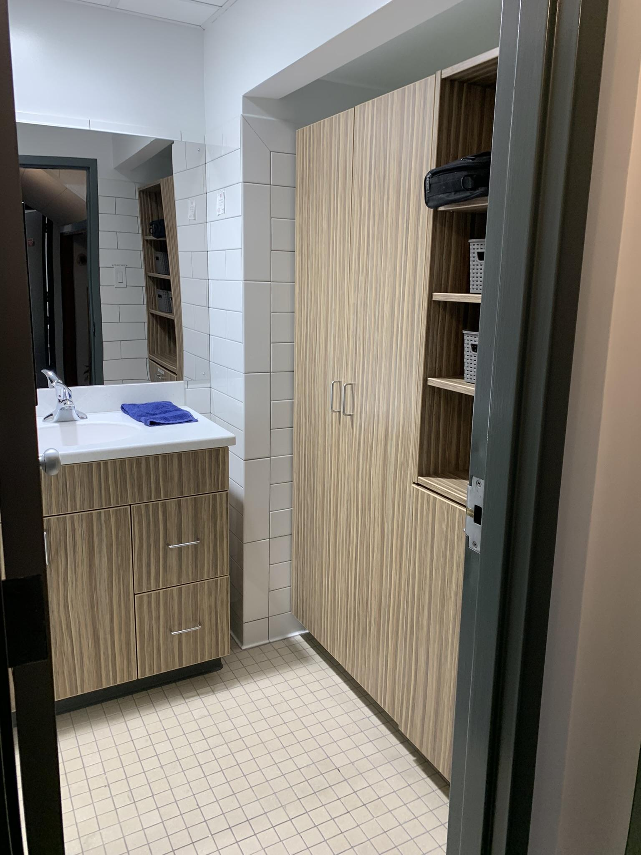
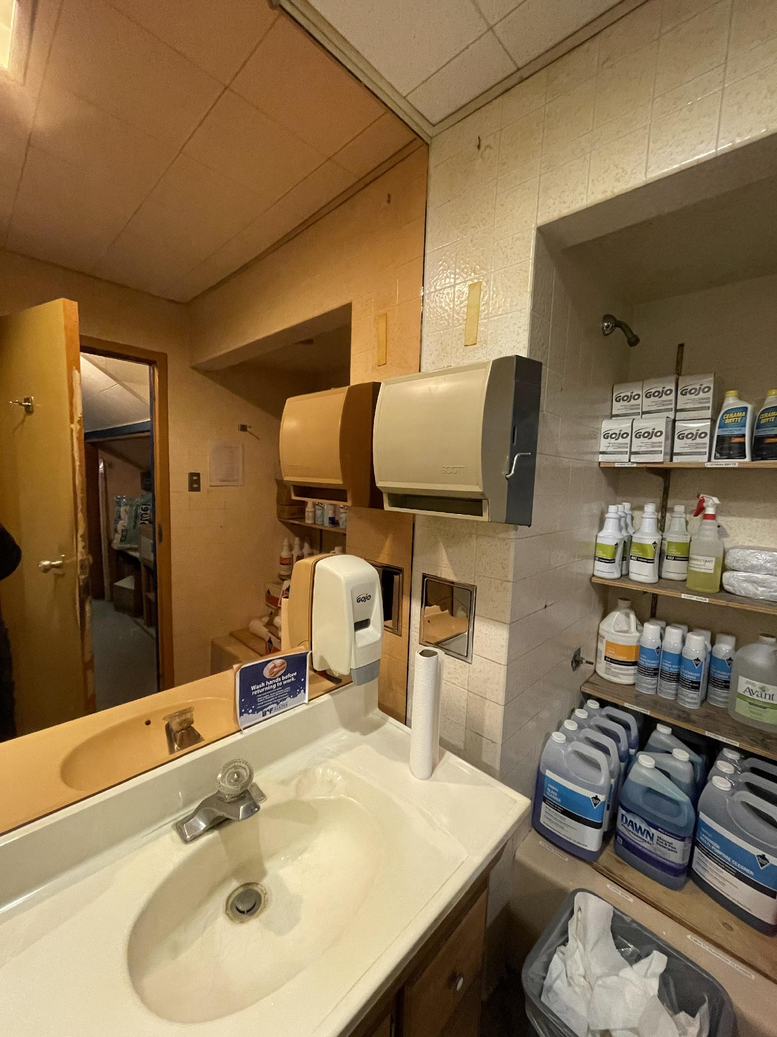
FACILITY MODIFICATIONS
BEFORE
AFTER
Managed by Design and Construction
Completed by a Contractor
FACMODS Are Often Tenant Improvements or Larger Maintenance Projects
2024 Whitaker Bathroom Remodel
Facilities Services (907) 474-7000
Notes:
When a work order becomes a Facmod
Change in Size or Access to the room
Change in department assignment
Change in use of the room
New Equipment being installed

Slide 17
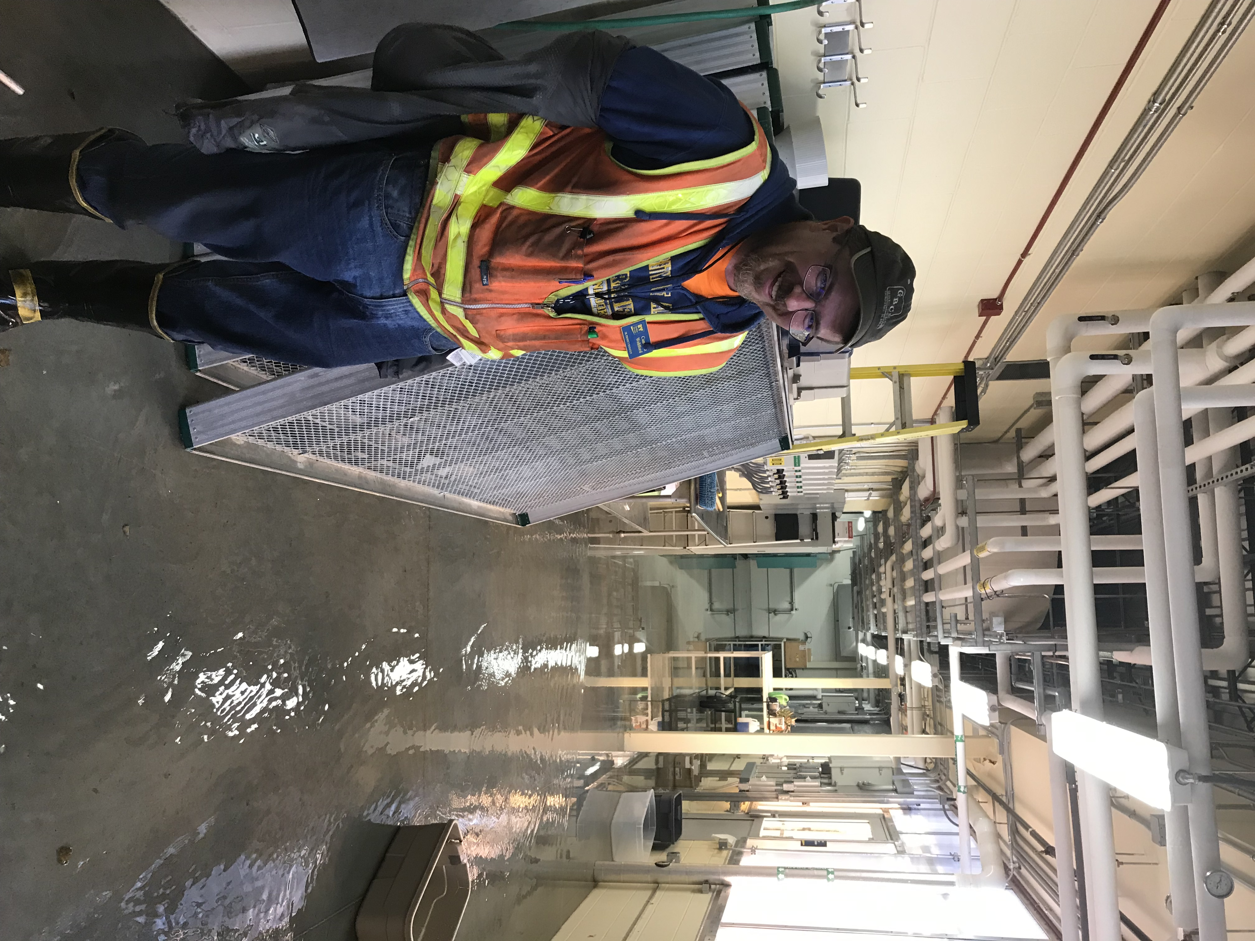
WORK ORDERS
See Something Broken?
Need Work Done?
If It’s Urgent, Call 907-474-7000. After Hours Calls Go To University Police Department Dispatch
Not Urgent- Enter An Electronic Work Order Request Form (EWORF) On The Website
Online Work Order Look Up Tool
Building Coordinators Work With FS
CALL 911 FOR EMERGENCIES
Cameron Wohlford - Design and Construction
Facilities Services (907) 474-7000

Slide 18
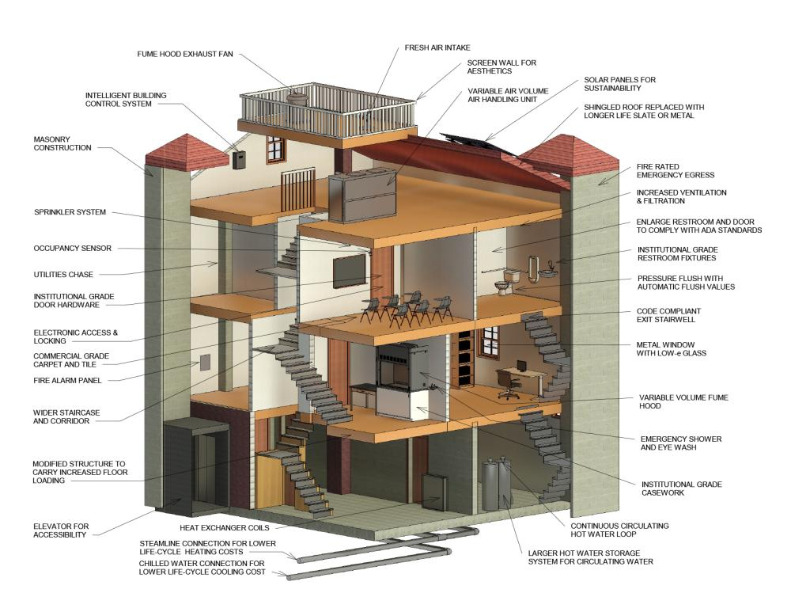
Why Does Work On Campus Cost So Much!?
Cost Drivers Include…
Building Code Requirements
Design Costs
Skilled Labor
University Design Standards
State and Federal Procurement Laws
Management Costs
Facilities Services (907) 474-7000

Slide 19
SHOP MAINTENANCE RATES
UAF Facilities Services FY26 Labor Rates | Internal Rate
Maintenance (Electrical, Trades, Housing, Dining, Plumbing, Alarms, Insulation, & HVAC) | $125
General Labor | $88
Grounds Maintenance | $52
Mechanic – Heavy Duty | $130
Mechanic – Light Duty | $100
Equipment Operator | $104
Shuttle Driver and Vehicle | $172
Facilities Services (907) 474-7000

Slide 20

FS CUSTOMER SERVICE
Call 907-474-7000
Facilities Services (907) 474-7000

