Slide 1
HOW TO order textbooks
From the
UAF bookstore website
https://www.bkstr.com/alaskafairbanksstore/home

Slide 2
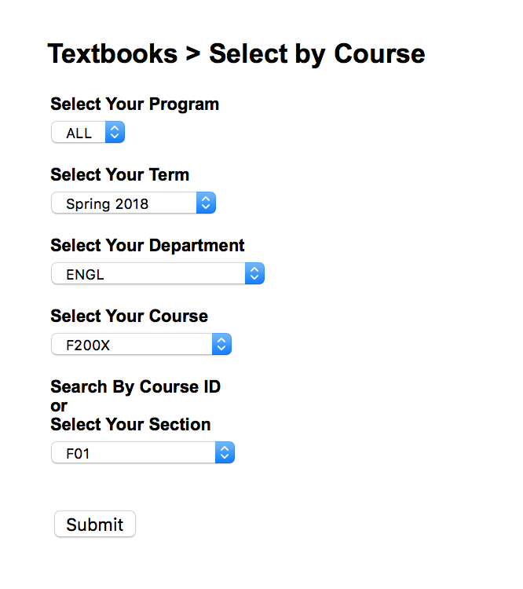
Select Course
Via the UAF Follett website
Student selects “Books” from top menu, taking them to a screen to select applicable course(s)
Via UAOnline
Student using UAOnline will have courses pre-populated after using the “Get Books” button during registration & will start at the next step

Slide 3
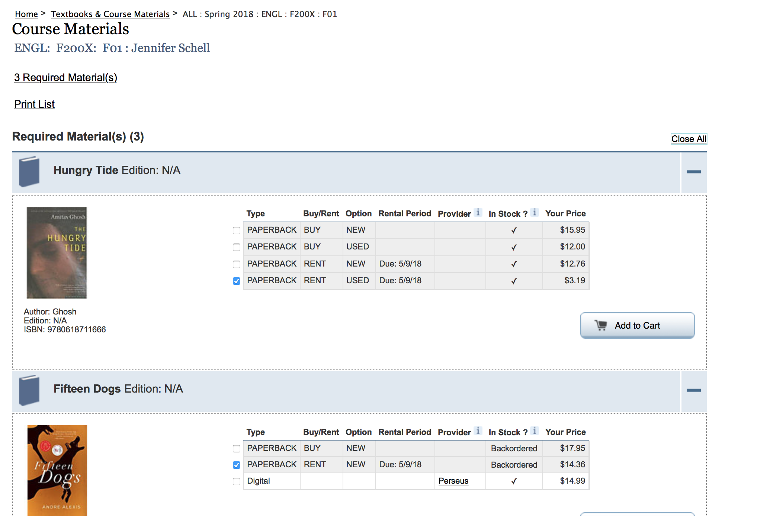
Verify books/course materials
Required & recommended books are shown for rent & purchase
Student selects books & clicks “Add to Cart”
For more books, the student clicks “Select another course” to continue searching for books

Slide 4
Note on rent vs. buy
For book Rentals, it is Follett policy that a credit card be provided in the event the rental is not returned by the deadline date; there is no alternative to this requirement
Students receive multiple emails reminding them of the deadline PRIOR to charge of the credit card
The card will not be charged unless rented materials are not returned

Slide 5
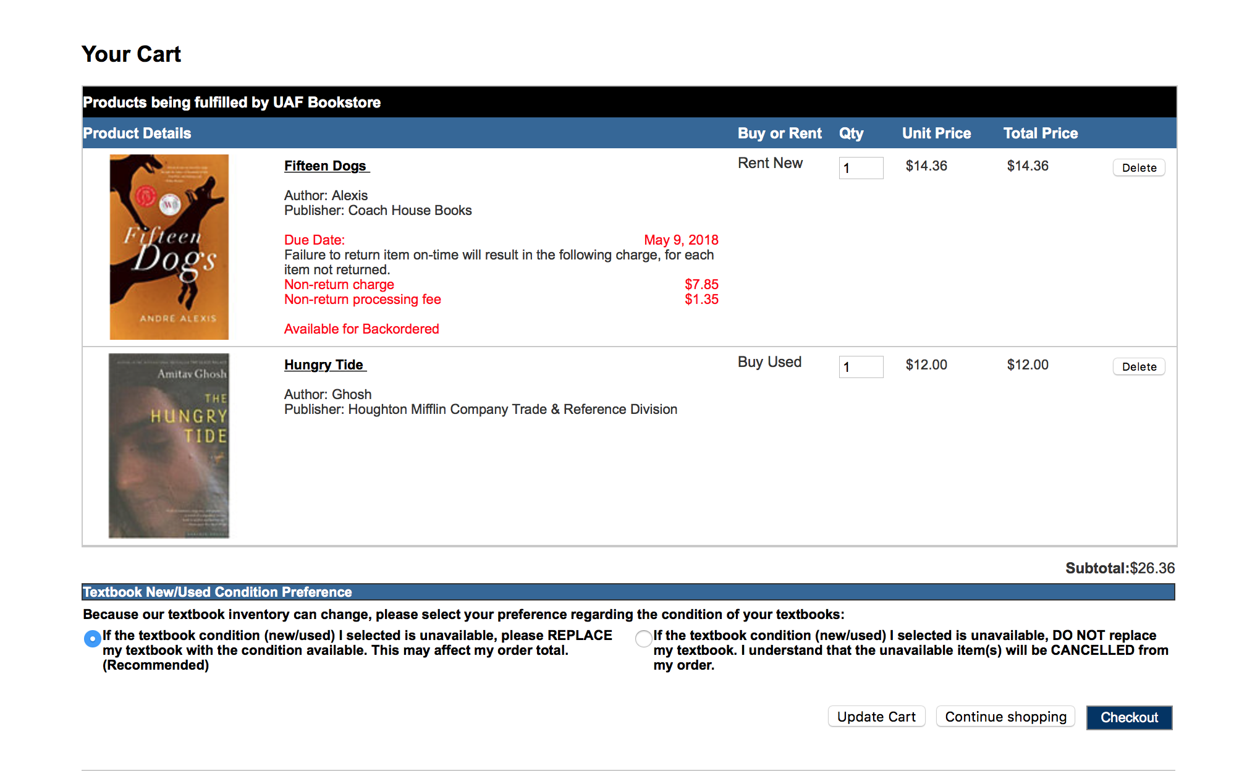
Verify Cart
Go to “Cart” to view books selected for rent or purchase
Students have the option to replace textbook condition if the one requested is not available or cancel the order
Click “Checkout” to start the checkout process

Slide 6
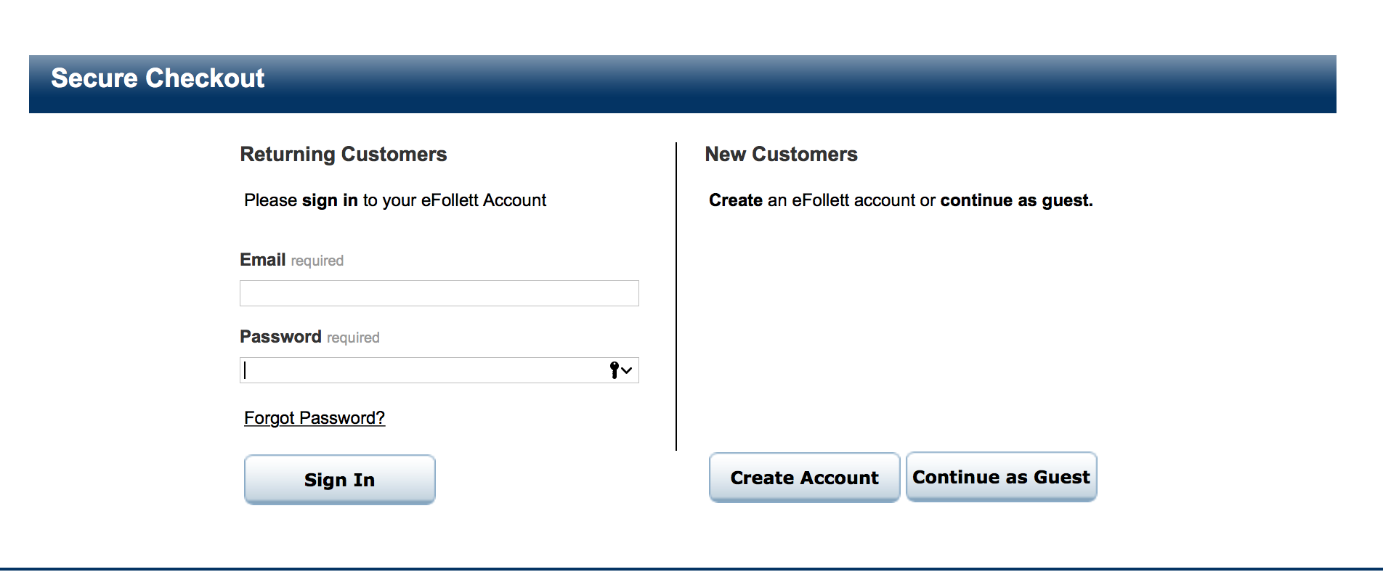
Checkout Process
For Checkout, the student logs into an existing account, creates a new account, or continues as a guest
Books can be purchased without creating an account
If a student elects to rent a book, an account must be created

Slide 7
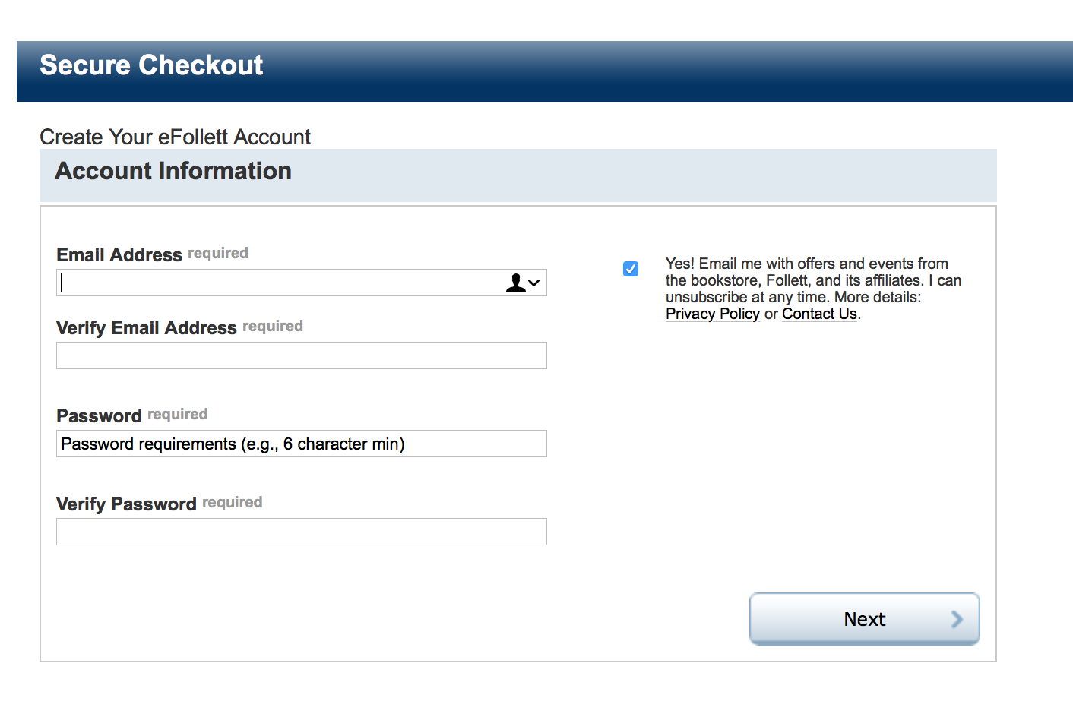
New Account Creation
If a student creates an account, basic information is collected

Slide 8
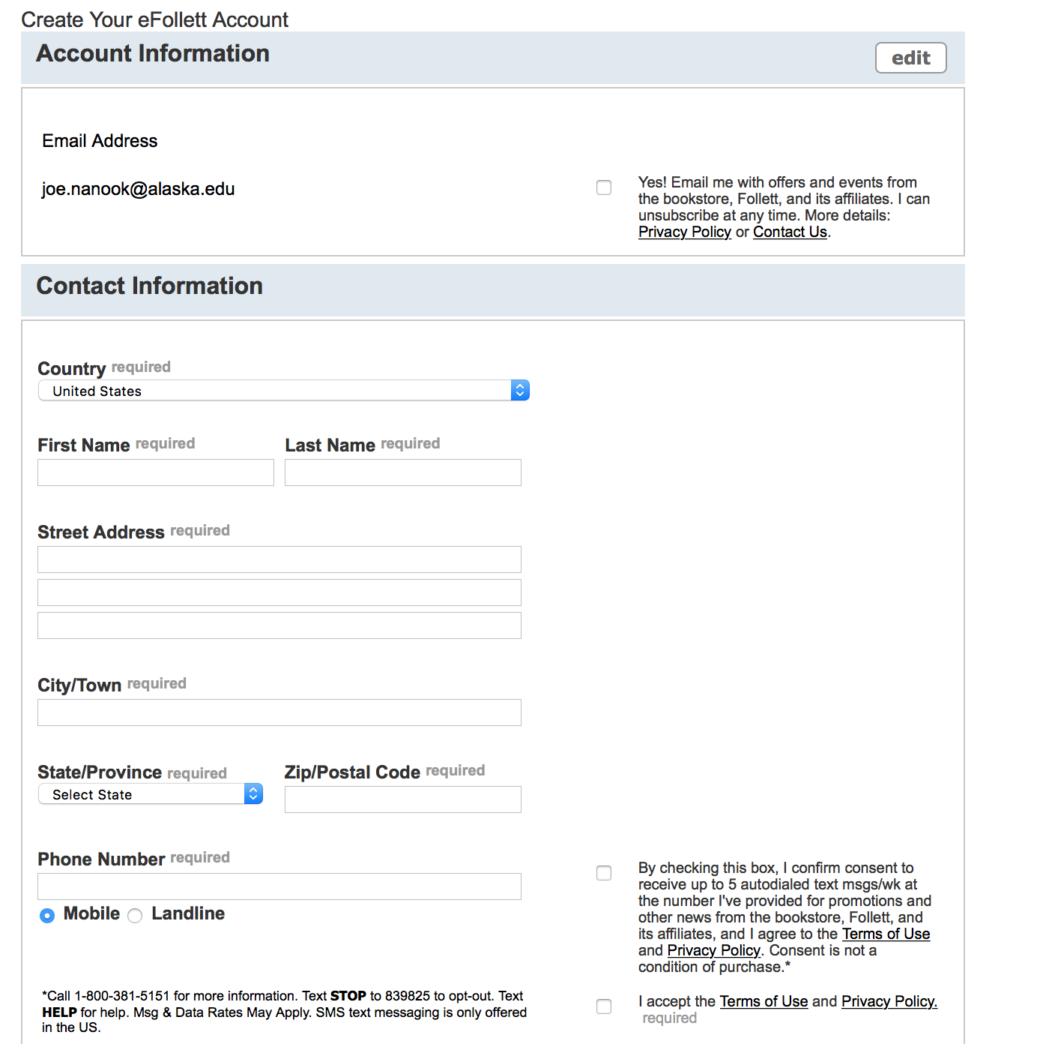
New Account Creation – Cont.

Slide 9
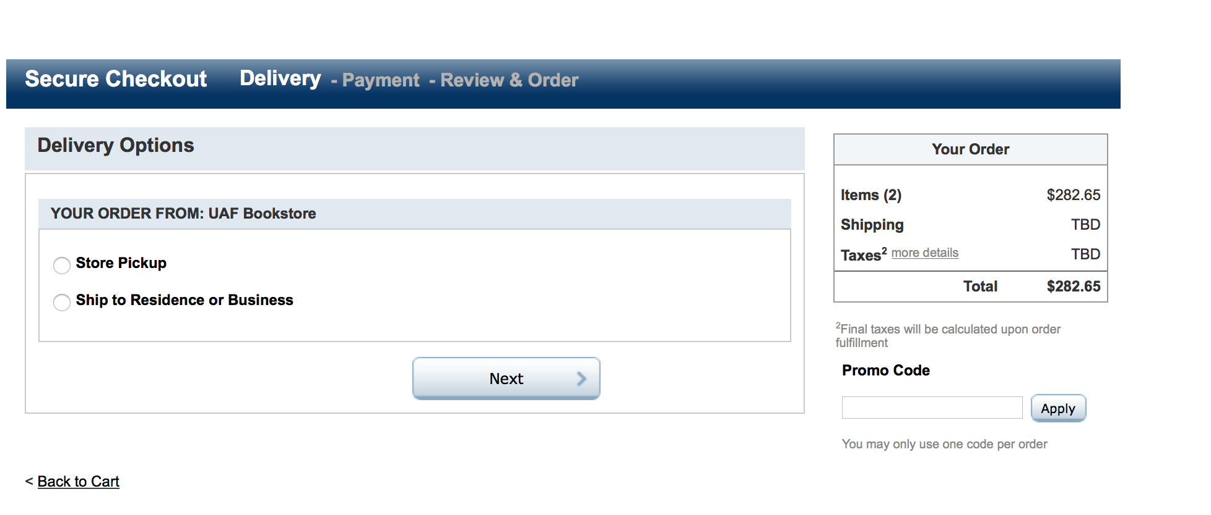
Checkout Process
After account creation, students return to the Cart to complete the process
Students must choose “Pickup in Store” or “Ship to Home/Business”

Slide 10
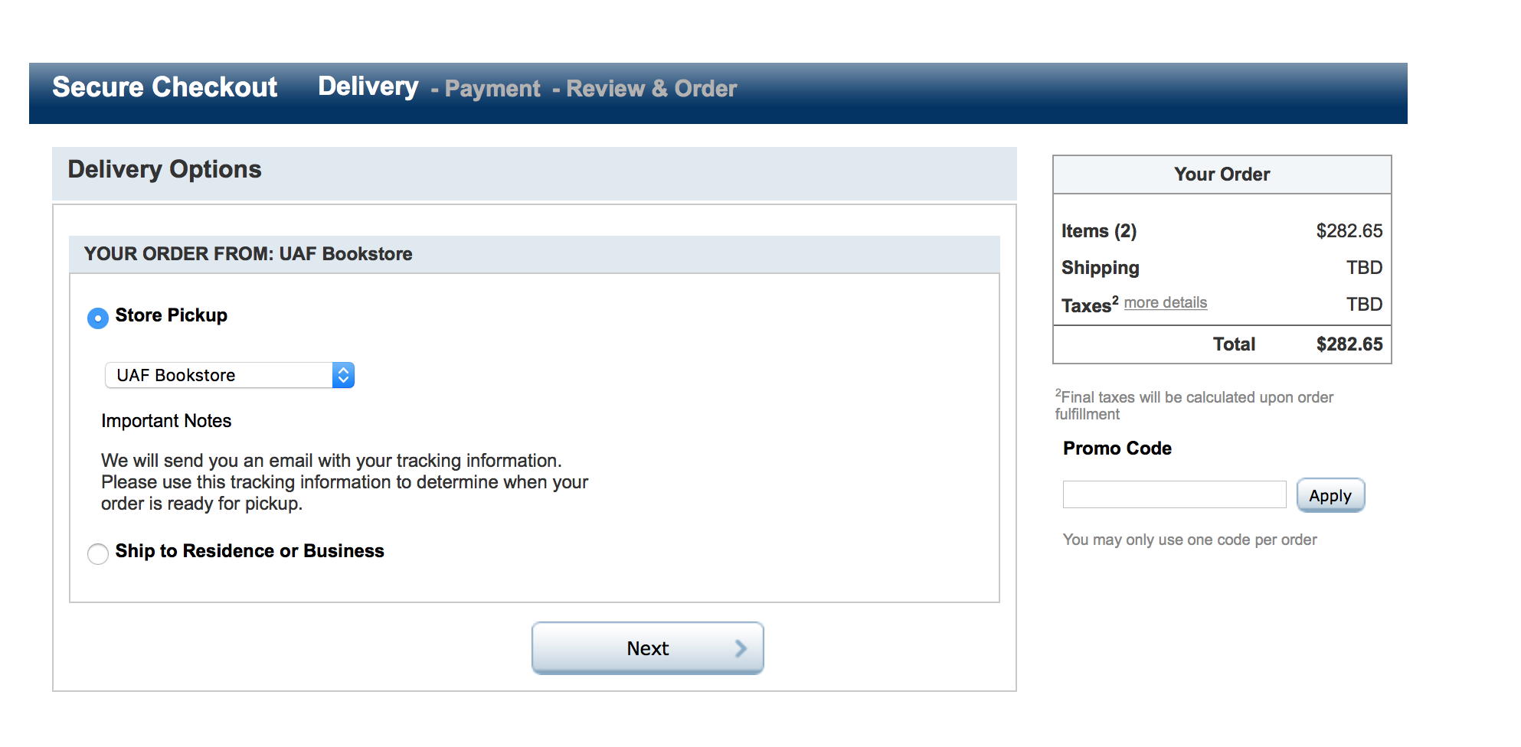
Delivery method: store pickup
The only option for in-store pickup is the UAF Bookstore on the Fairbanks Campus

Slide 11
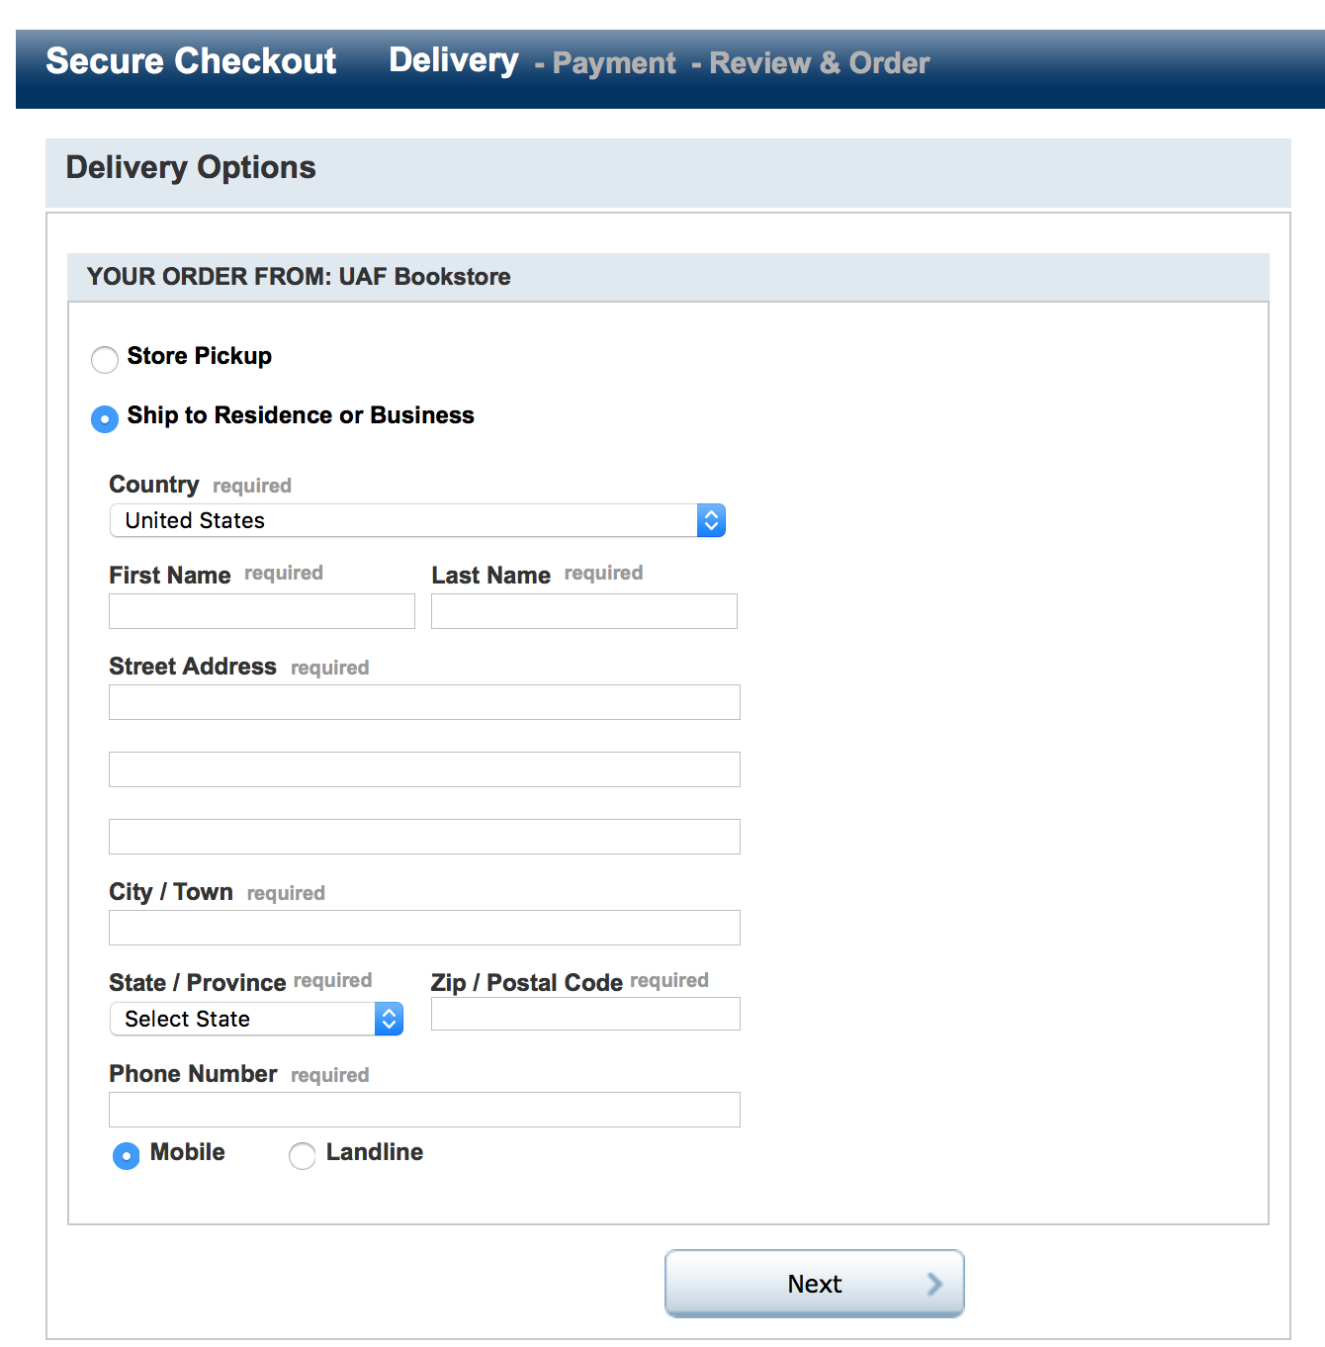
Delivery method: ship (step 1)
Student completes required fields
If the student has a Follett account, this information will pre-populate

Slide 12
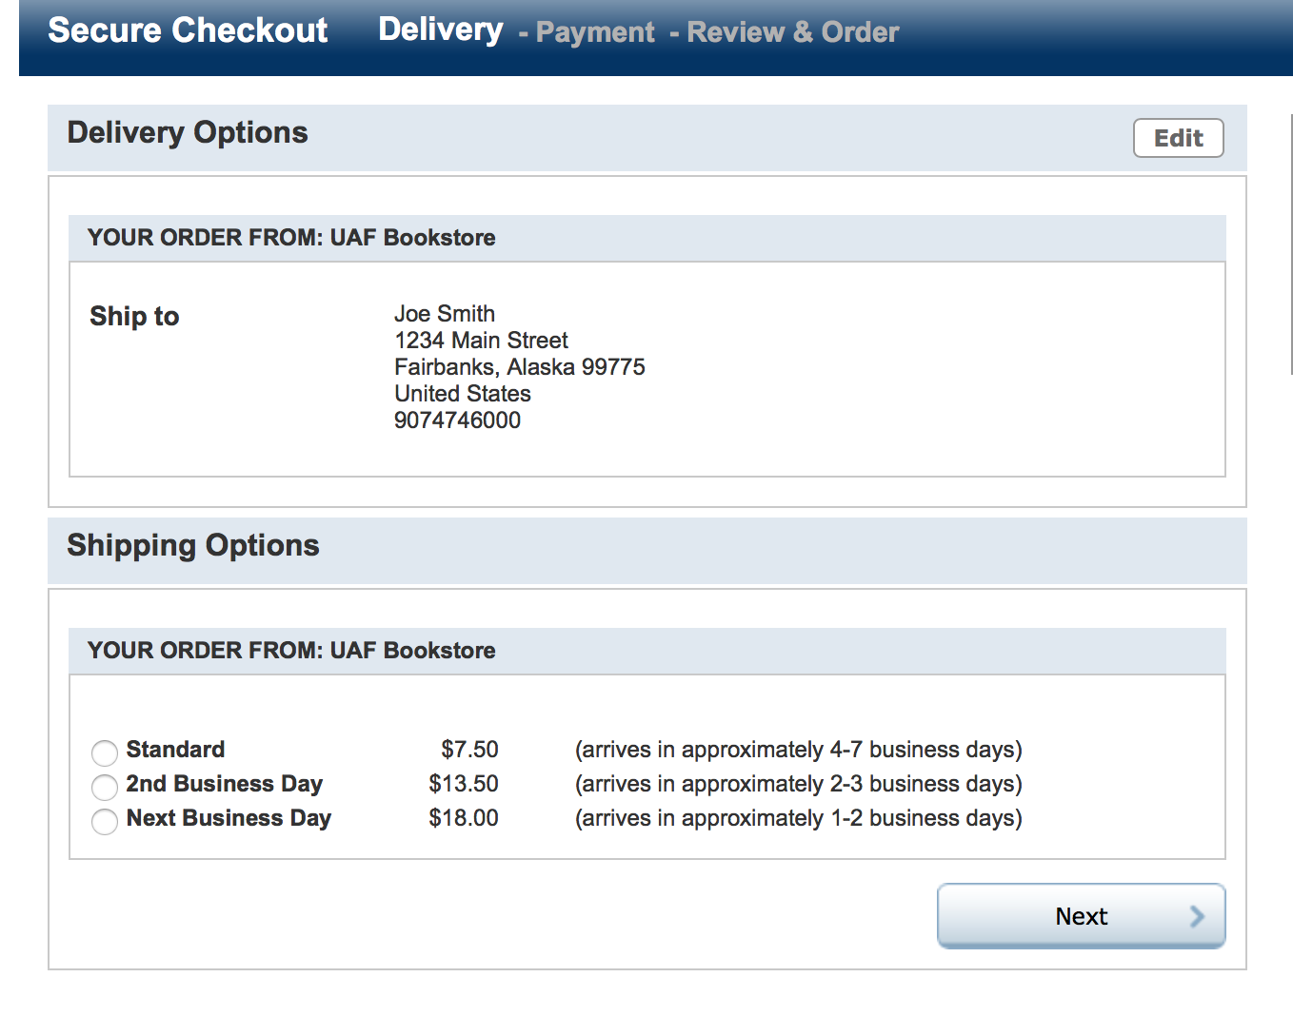
Delivery method: ship (step 2)
Students select how quickly they need books shipped
Follett ships via USPS & can ship to a “General Delivery” address

Slide 13
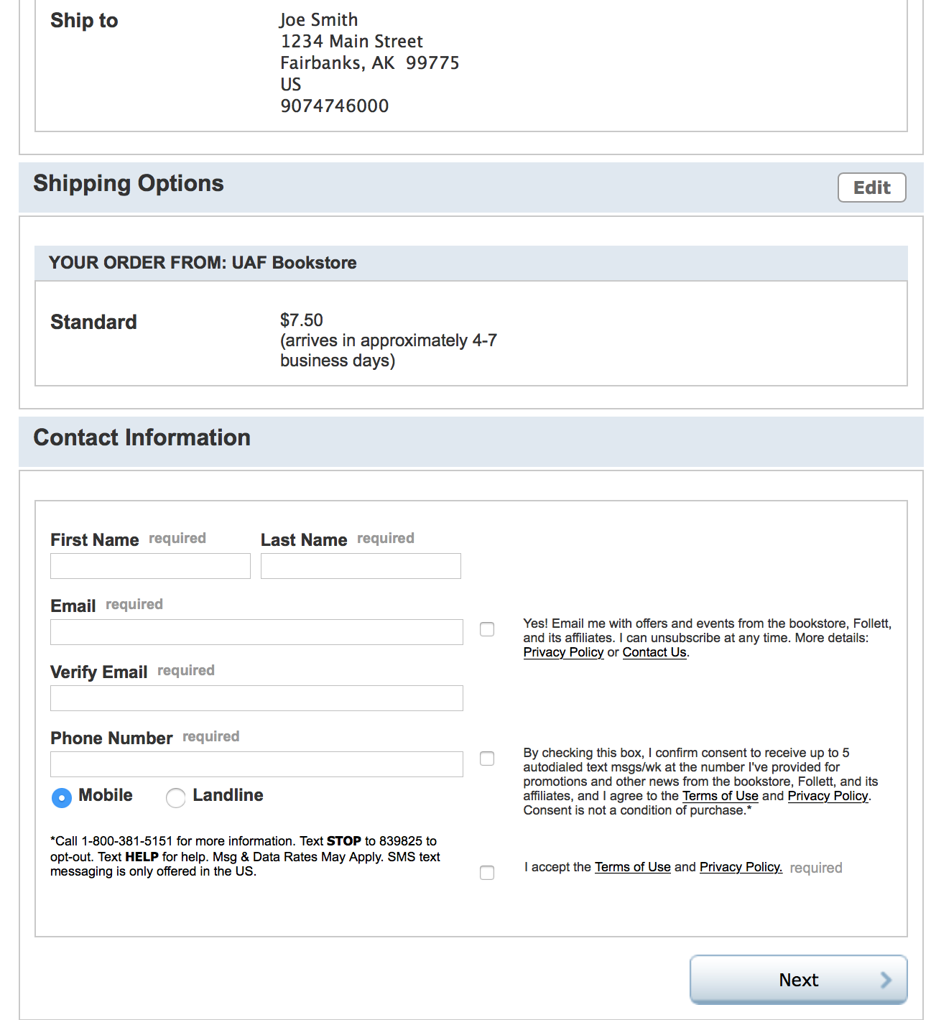
Delivery method: ship (step 3)
“Contact Information” section must be completed

Slide 14
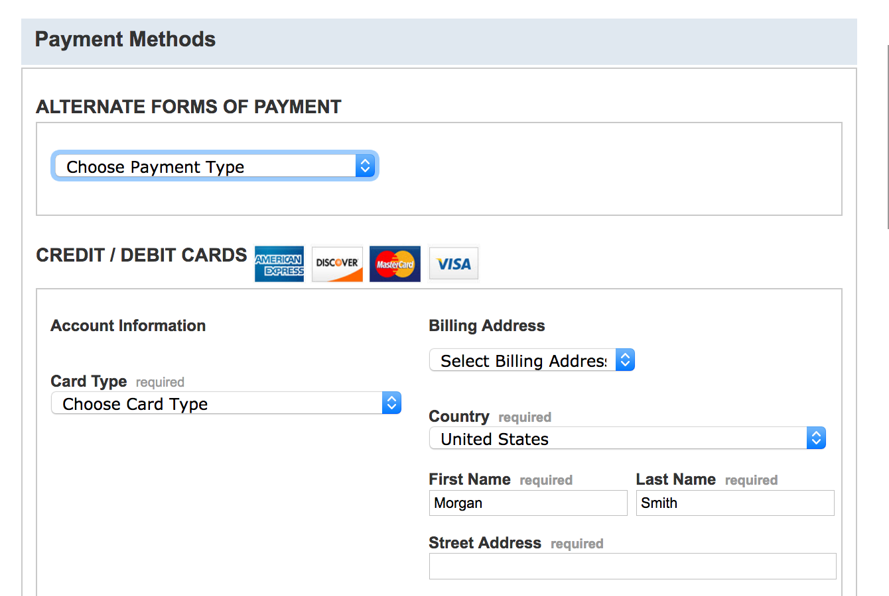
Select payment option
Student selects form of payment:
Alternative forms of payment
(or)
Credit card
American Express
Discover
Mastercard
Visa

Slide 15
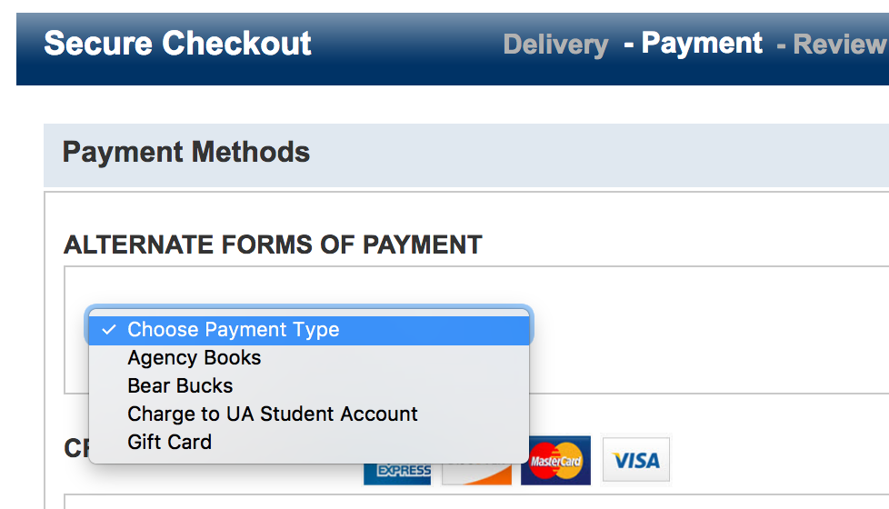
Select payment
charge to ua student account
Via dropdown menu, student selects “Charge to UA Student Account”
Agency Books, Bear Bucks, or Gift Card are other options
Multiple forms of payment are acceptable

Slide 16
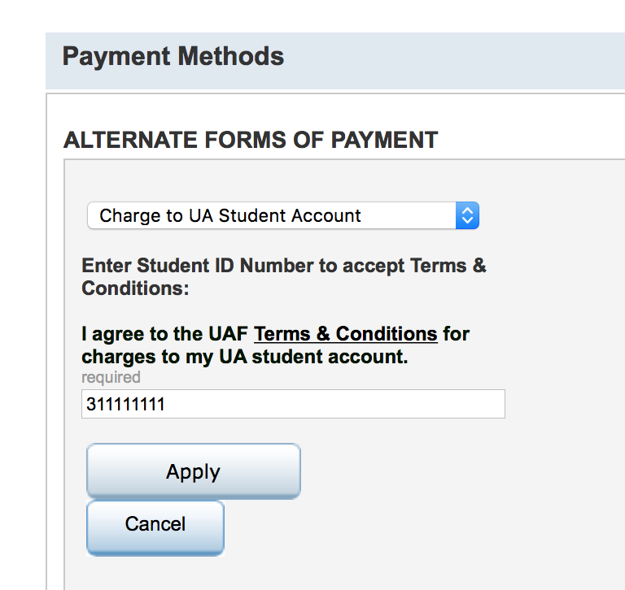
Select payment
charge to ua student account
Enter UA ID number to accept UAF’s Terms & Conditions for charges to account
Students are responsible for all account charges

Slide 17
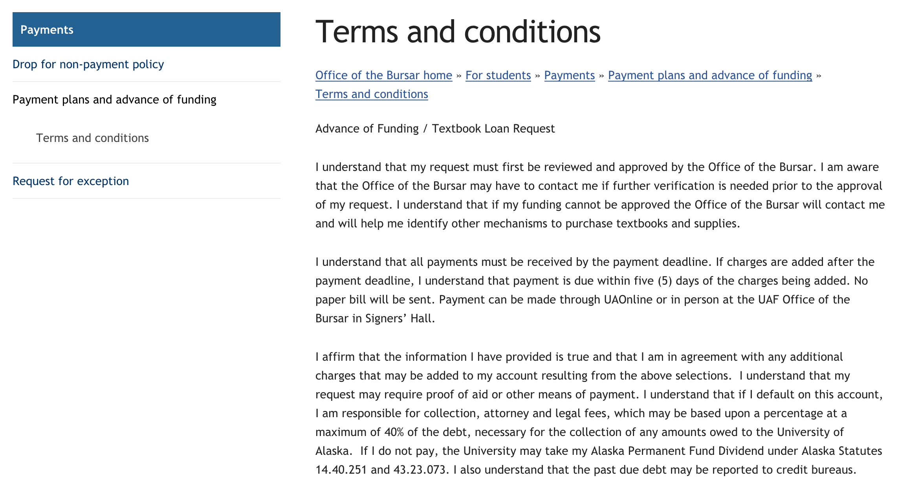
Student responsibility
UAF Terms & Conditions
Terms & Conditions open in new window for acceptance
Students must pay account charges
http://www.uaf.edu/bursar/for-students/payments

Slide 18
Charge to UA Student Account
Charging to a student account via the Bookstore website is new, allowing for a small loan at the point of textbook/materials purchase
If a student has a request for advance funding (outside of where books are purchased), an Advance of Funding form can be completed at any time & used for any educational purpose
Advance of Funding requests prior to a textbook purchase will preload funds in the student account & show as available Bear Bucks funds in the Bookstore website Cart, upon Checkout

Slide 19
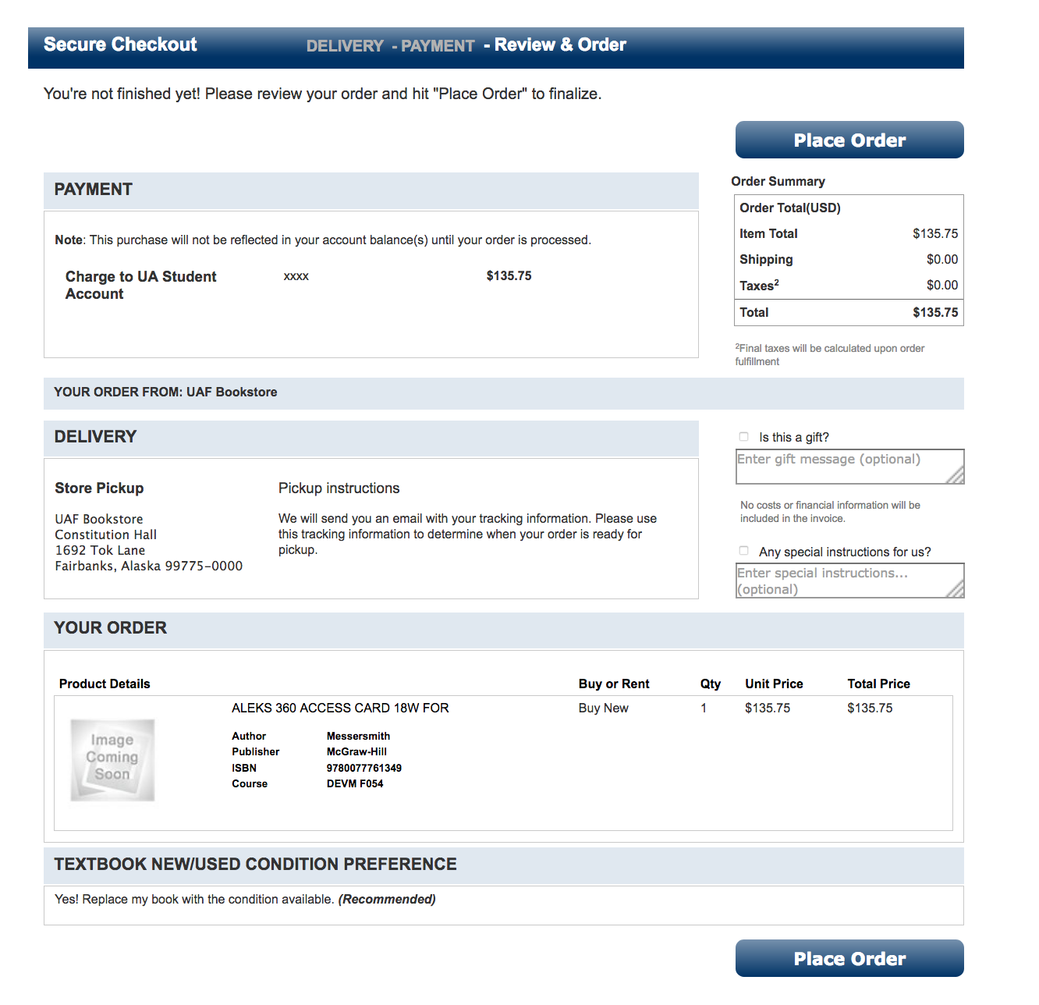
Charge to UA Student account:
Review & order - purchase
Review for accuracy
Click “Place Order” to purchase books

Slide 20
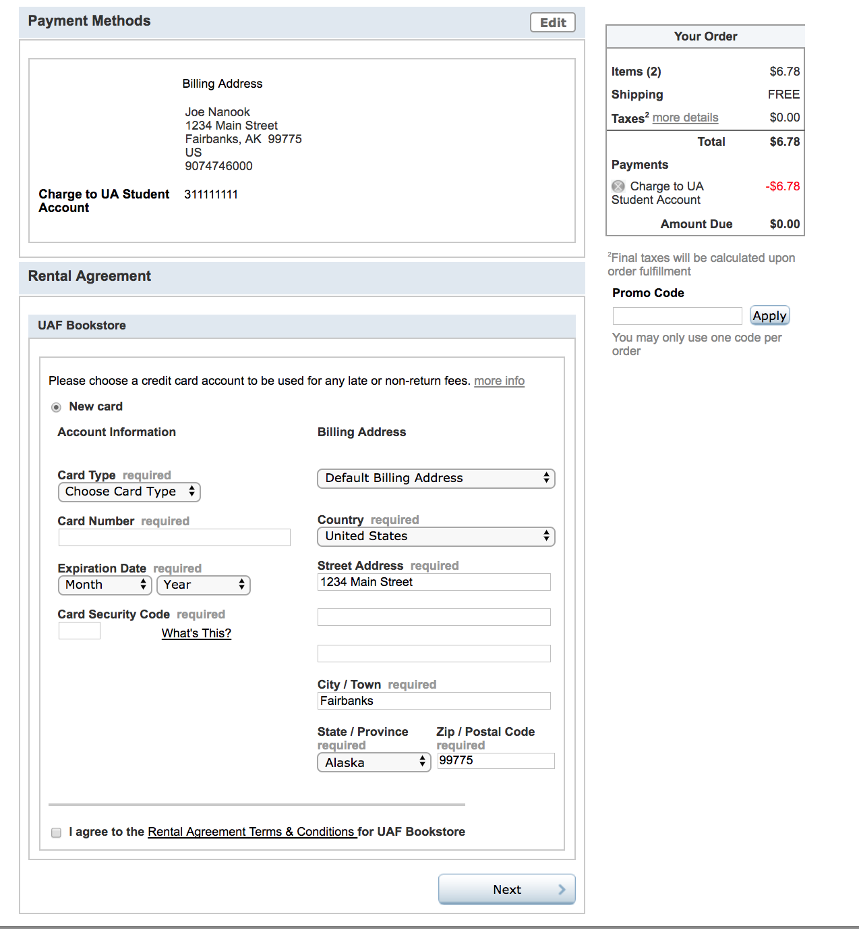
Charge to UA Student account:
Review & order - rentals
If order includes a Rental, student must provide a credit card number; card will not be charged unless books are not returned
Rental amount is charged to UA account

Slide 21
Order confirmation
Students receive a confirmation number (on screen), followed by email confirmation
For charges to student accounts, the Bookstore holds the order in suspense until the Bursar’s Office applies charges (via Bear Bucks)
Charges over $300 require validation of aid or CRCD assumption of liability (CRCD students only)
Once charges are applied, the Bursar notifies the Bookstore to complete the order/ship textbooks

Slide 22
Questions?
Charges to UA Account:
UAF Bursar’s Office
907.474.7384 (voice), uaf-bursar@alaska.edu (email)
CRCD student eligibility/validation of aid:
Carrie Aronson, Bookstore Rural Student Coordinator
907.474.7711 (voice), cmaronson@alaska.edu (email)
Website functionality:
Jesse Biggs, Bookstore Manager
907.474.7348 (voice), 1191mgr@follett.com (email)

