Slide 1
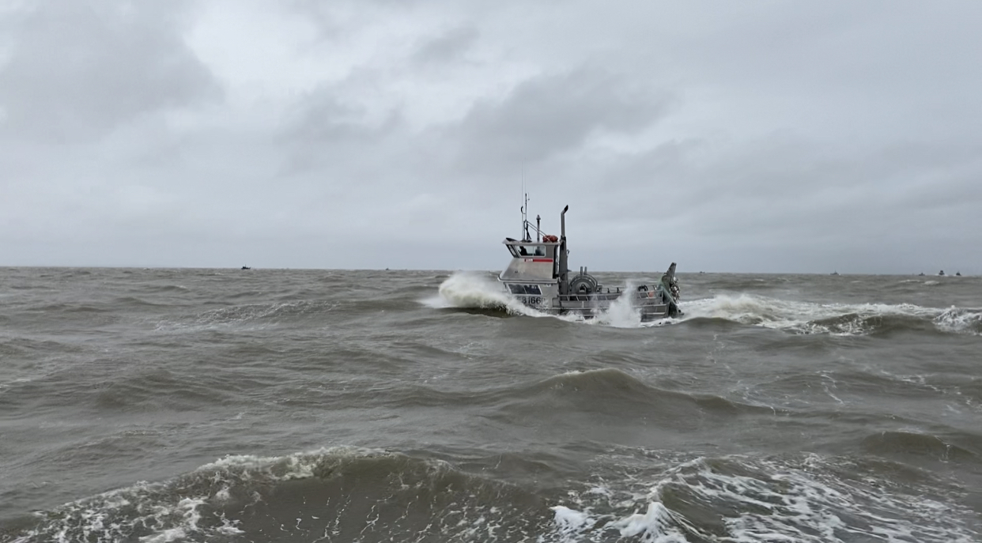
HOLDING STEADY IN THE STORM
Stress & Commercial Fishing
AJ Knittel, Counseling with AJ ● Bernina Venua, BBAHC ● Tav Ammu, Marine Advisory Agent
Photo Credit: Nora Keele

Slide 2
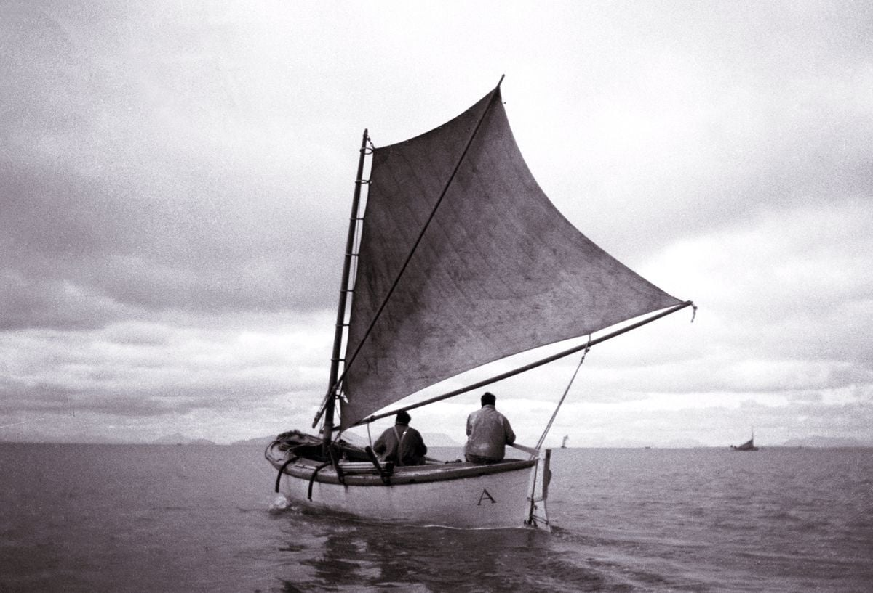
I am a fisherman.
It is not merely something that I do,
It is who I am.
Fishing is not simply my escape,
It is where I am supposed to be.
It is not a place that I go,
But a lifelong journey I am taking
It is a passage that was shown to me
And that I will continue to show to others.
When you understand all of this
You will then know me.
And we will fish together.
- author unknown
Photo Credit:
Dave Carlson, Dave and Mary Carlson Collection Samuel K Fox Museum, Dillingham
Sailing for Salmon
Notes:
There’s a lot of mythos related to fishing.
Forced Resiliency, you have to be tough

Slide 3
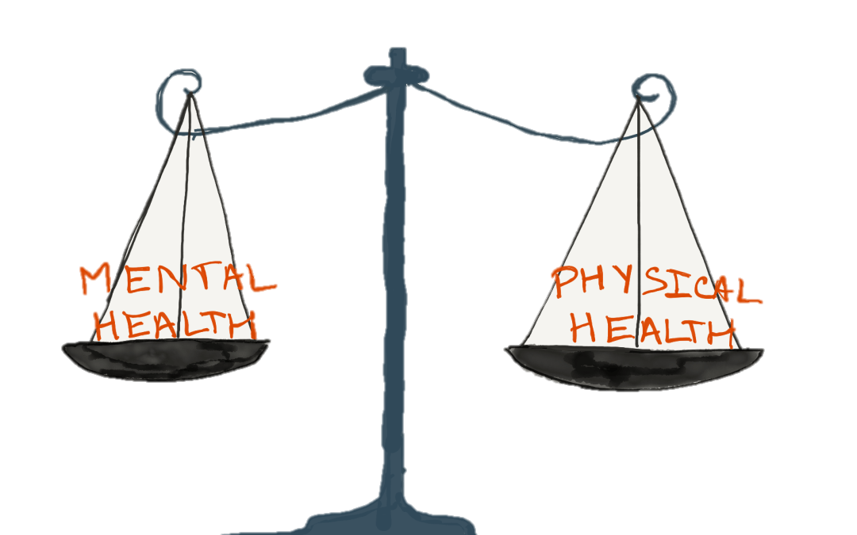
Mental Health & Fishing
Managing expectations
Preparation
  Communication styles
  Safety planning
Mental health and physical health
Notes:
Compare/contrast mental health and physical health
Making sure that everyone has their appropriate medication
Having a plan and a baseline is helpful.
If you fail to plan, you are planning to fail
Having NARCAN
Issues with MH will impact physical health and the opposite is true. They work hand in hand to determine our health.

Slide 4

Mental health includes our emotional, psychological, and social well-being. It affects how we think, feel, and act. It also helps determine how we handle stress, relate to others, and make choices. Mental health is important at every stage of life, from childhood and adolescence through adulthood.

Slide 5
Mental Health Continuum
Optimal Mental Health
A diagnosis of a serious mental illness but copes well and has optimal mental health.
No diagnosis of mental illness and positive mental health.
Severe
Mental Illness
No Mental
Illness
A diagnosis of a serious mental illness and has poor mental health.
No diagnosis of mental illness and has poor mental health.
Poor Mental Health
Notes:
Mental Health isn’t something that doesn’t stay the same.
A diagnosis is not something that should be judged. It only exists to help treat it, just like having diagnosis with High Blood Pressure or Diabetes.
1 in 5 adults in the US are diagnosed with a mental disorder in a single year.
It’s constantly moving, depending on what’s happening to and around us.

Slide 6
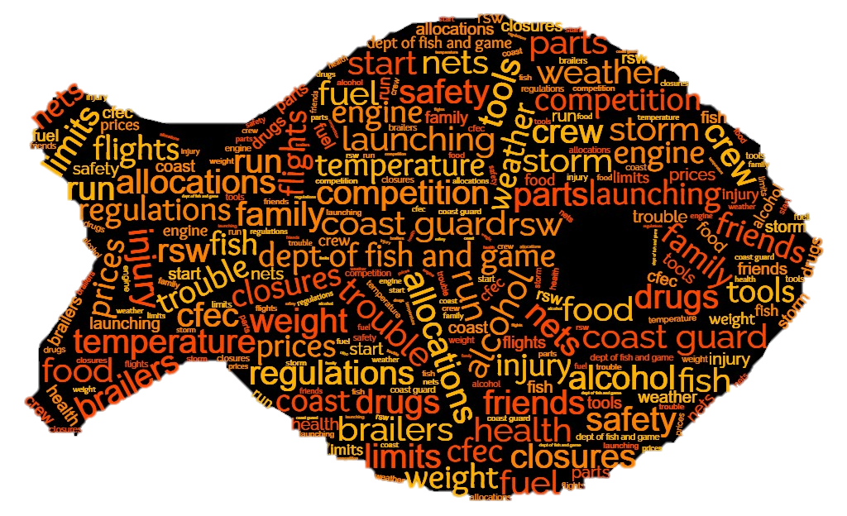

Stressors
Notes:
Being in the industry can be grounding, but it can also be stressful. There are so many things that can impact the season and all those things weigh on us.
Irregular patterns of sleep and all the unknown variables doesn’t really help.

Slide 7

Rough Time or Mental Health Crisis?
Is there a major change in a person’s thinking, feeling, or acting?
Does a change interfere with the person’s ability to live their life?
Does the interference go away quickly or does it last longer than expected emotions or reactions?

Slide 8
SIGNS and SYMPTOMS
Things we can see or observe
Indicators of what a person can feel
Social Withdrawal
  Avoiding social occasions
  Declining performance
Irregular Expression of Feelings
  Indifference to situations
  Laughter ant inappropriate times or for no apparent reason
Mood Disturbance
  Deep sadness/depression
  Hopelessness
Changes in Behavior
  Hyperactivity, inactivity, or both
  Drug and alcohol abuse
Thought Disturbances
  Inability to concentrate
  Irrational statements

Slide 9

Untreated mental health conditions can result in unnecessary disability, unemployment, substance abuse, homelessness, inappropriate incarceration, and suicide, and poor quality of life.

Slide 10

Early Intervention
Improves outcomes for people with mental health challenges.
When we notice changes in appearance, wellbeing, and behaviors.
Check-in privately
  Gauge reactions
Never pressure the person to share their thoughts and feelings. Reassure them you’ll be there when THEY are ready.
Use “I” Statements. “I have noticed…”
Make sure you have the time.
Notes:
Early intervention is good, but so is being prepared. Making sure that

Slide 11
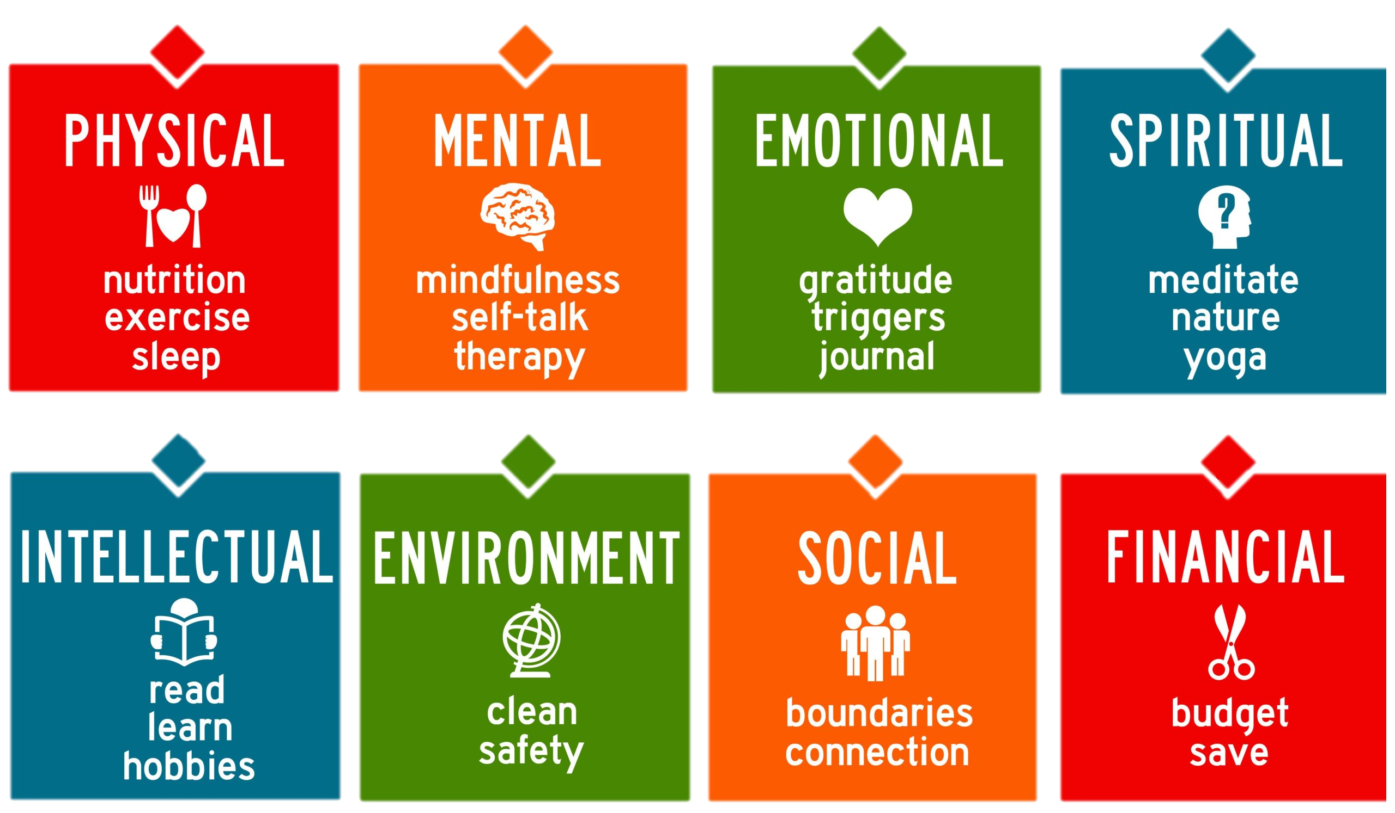
What to do (for self):
Self-care
Learn coping skills
  Deep breathing
  Meditation
  Sleeping
  Music
  Journaling
Take breaks
One eye in, one eye out
Seek help
Notes:
Self-care can help prevent things. Knowing yourself and your own pattern is important.
Throughout the season, we check in on various things: the condition of the nets, weather, maybe the engine is making a funny noise. We feel the physical hurts and take advil or put a salve on it. We should also be checking our mental health status and helping prevent further hurts.

Slide 12

How to help others:
Look for signs
Ask direct/open ended questions
Actively listen
Validate and give information
Remove dangers
Support them in finding help
Notes:
As we check in on ourselves, we should also check in on others around us. They have a direct impact on the success of the season.

Slide 13

Suicidal
Ideation/Behaviors
Direct
  “I wish I were dead.”
Indirect
  “Nothing matters anymore.”
Behavioral clues
  Giving away prized possessions
Preparations Suggestions:
Medication lockboxes
Firearm locks
Having a plan

Slide 14

What to do in a crisis
Keep your voice calm
Avoid overreacting
Express support and concern
Ask how you can help
Offer options instead of taking control
Avoid touching the person unless you ask permission
Be patient
Give them space
Notes:
Response vs Reaction
Station watch bill

Slide 15
Validating and Giving Information
Does not sound like:
Sounds like:
You’ll be fine. Just don’t think about it.
The way you’re reacting isn’t good.
You just need to…
That sounds like a difficult situation. I’m here when you are ready to talk.
You are not alone.
Breakups are hard. It’s natural you’re sad.

Slide 16
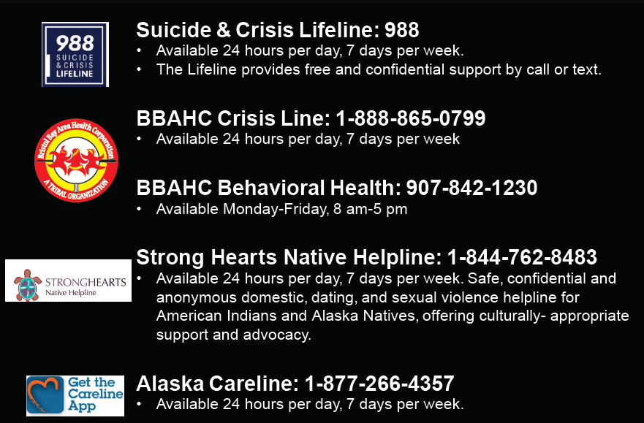
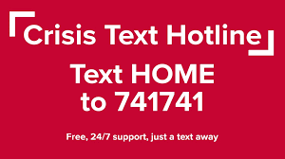
Resources
Communication services available:
    Starlink
    GCI

Slide 17
Contact Information
AJ Knittel, Counseling with AJ
  aj@counselingwithaj.com
Bernina Venua, BBAHC
  bvenua@bbahc.org
Tav Ammu, Marine Advisory Agent
  tammu@alaska.edu

