Slide 1
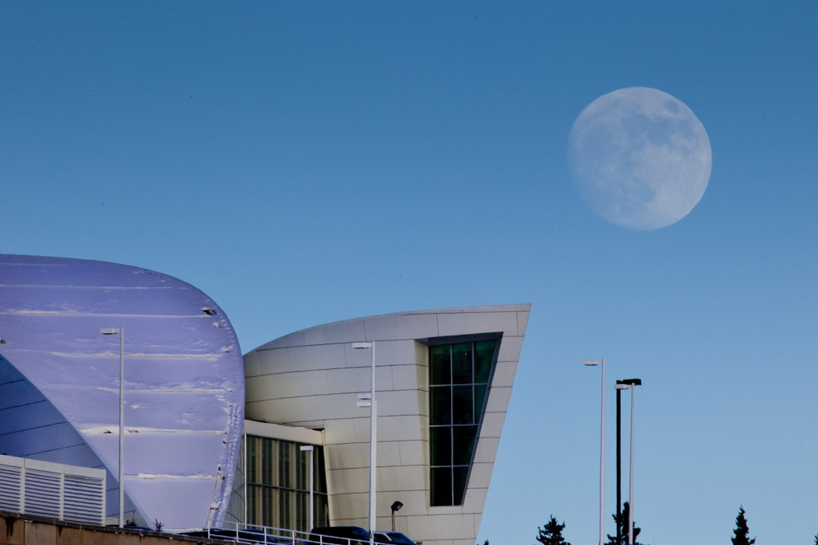
University of Alaska Fairbanks
Executive Leadership Workshop
ALASKA’S FIRST UNIVERSITY  AMERICA’S ARCTIC RESEARCH UNIVERSITY
ALASKA’ S FIRST UNIVERSITY  AMERICA’ S ARCTIC RESEARCH UNIVERSITY

Slide 2
UAF Earned Revenue
FY06-FY10 Annualized Compared to % Change from FY10-FY11 Projected
ALASKA’ S FIRST UNIVERSITY  AMERICA’ S ARCTIC RESEARCH UNIVERSITY
2

Slide 3
Annual Revenue Growth Rate
FY06-FY10 Annualized Change in Revenues with FY11 Projected
ALASKA’ S FIRST UNIVERSITY  AMERICA’ S ARCTIC RESEARCH UNIVERSITY
3

Slide 4
Percent of Revenue by Source
UAF & UAF Peers
ALASKA’S FIRST UNIVERSITY  AMERICA’S ARCTIC RESEARCH UNIVERSITY
ALASKA’ S FIRST UNIVERSITY  AMERICA’ S ARCTIC RESEARCH UNIVERSITY
4

Slide 5
Relative Size
FY10 General Fund and Non-General Fund Revenue
($ in millions)
 | General | Non-General |  | Percent
Unit | Fund | Fund | Total | of Total
Provost | $64.8 | $71.9 | $136.7 | 32.6%
VCR | $13.9 | $78.2 | $92.2 | 22.0%
CRCD | $19.9 | $26.4 | $46.2 | 11.0%
Physical Plant & Utilities | $13.9 | $23.8 | $37.7 | 9.0%
VCS | $4.4 | $25.3 | $29.7 | 7.1%
VCAS Operating | $9.9 | $19.4 | $29.3 | 7.0%
VCAS Institutional | $15.8 | $10.3 | $26.1 | 6.2%
VCUA | $7.4 | $6.1 | $13.4 | 3.2%
OIT | $3.6 | $2.1 | $5.6 | 1.3%
Chancellor | $1.7 | $0.1 | $1.8 | 0.4%
Total | $155.2 | $263.6 | $418.8 | 100.0%
*Non-General fund includes research funded with capital dollars (FA, FR, 91)
ALASKA’ S FIRST UNIVERSITY  AMERICA’ S ARCTIC RESEARCH UNIVERSITY
5

Slide 6
General Fund Over Time
ALASKA’ S FIRST UNIVERSITY  AMERICA’ S ARCTIC RESEARCH UNIVERSITY
6

Slide 7
FY06-FY10 Unrestricted Expenditures by NCHEMS
% increase FY06-FY10
ALASKA’ S FIRST UNIVERSITY  AMERICA’ S ARCTIC RESEARCH UNIVERSITY
7

Slide 8
Percent of Expenditures by Type
UAF & UAF Peers
ALASKA’S FIRST UNIVERSITY  AMERICA’S ARCTIC RESEARCH UNIVERSITY
ALASKA’ S FIRST UNIVERSITY  AMERICA’ S ARCTIC RESEARCH UNIVERSITY
8

Slide 9
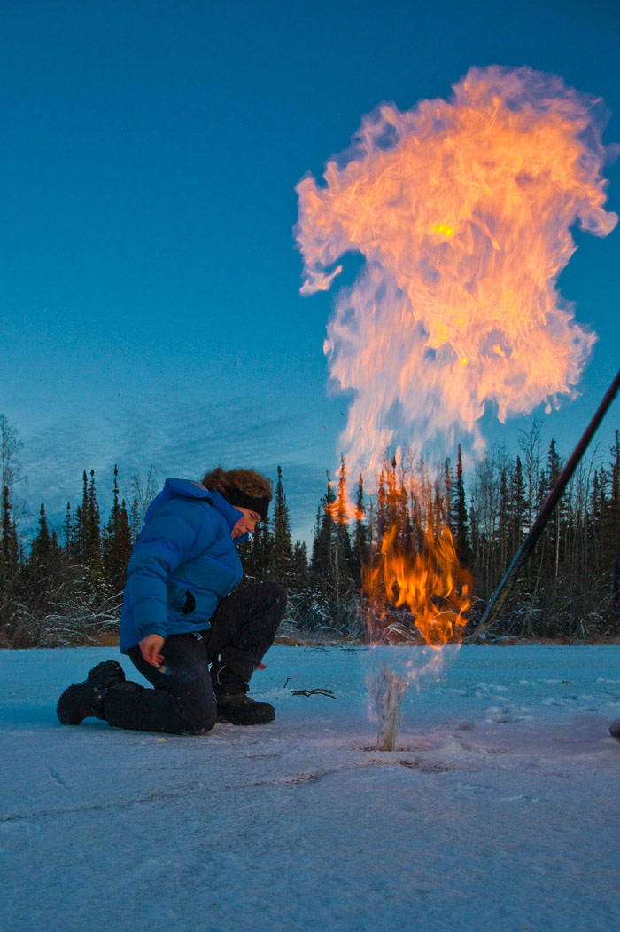
FY11 Status – Projected Results
ALASKA’ S FIRST UNIVERSITY  AMERICA’ S ARCTIC RESEARCH UNIVERSITY
9

Slide 10
Projected F1 UFB by Executive Unit
December 2010 ($ in thousands)
Cabinet | Projected UFB
Chancellor | $ 178.7
VC for Rural, Community & Native Education | $ 1,147.7
Provost | $ 2,435.0
VC for Students | $ 197.4
VC for University Advancement | $ 211.8
VC for Administrative Services | $ 740.0
Central obligations (Scholarships, Debt Service, Utilities etc.) * | $ 1,388.7
VC for Research | $ 1,526.7
Total | $ 7,826.1
December 2009 projection | $ 3,080.4
* After central commitments
ALASKA’S FIRST UNIVERSITY  AMERICA’S ARCTIC UNIVERSITY
ALASKA’ S FIRST UNIVERSITY  AMERICA’ S ARCTIC RESEARCH UNIVERSITY
10

Slide 11
UFB Expectations
Based upon UFB Guidelines
  Minimum of 1% - $2.3M
  Maximum of 4% - $9.2M
Projected UFB based upon YTD Status
  Between $6M and $9M
Established UFB guidelines are in effect
ALASKA’S FIRST UNIVERSITY  AMERICA’S ARCTIC UNIVERSITY
ALASKA’ S FIRST UNIVERSITY  AMERICA’ S ARCTIC RESEARCH UNIVERSITY
11

Slide 12
FY11 Status – Institutional Accounts
FY11 Central Institutional Balance | amt
Institutional Reserve | $2,000.0
Insurance Rebate | $2,200.0
Tuition/ICR/UAR/PBB Revenue | $800.0
Less Required | $(1,000.0)
Available Balance | $4,000.0
FY11 Identified Needs (not incl) | max amt
High Performance Computing | $350.0
VoIP Transition* | $1,000.0
Classroom Technology Refresh | $1,000.0
Dysfunction Junction/Planning | $800.0
Dillingham Facility/CRCD | $450.0
Utilities cost shift (ARSC/AUX) | $1,300.0
Identified Needs | $4,900.0
ALASKA’ S FIRST UNIVERSITY  AMERICA’ S ARCTIC RESEARCH UNIVERSITY
12

Slide 13
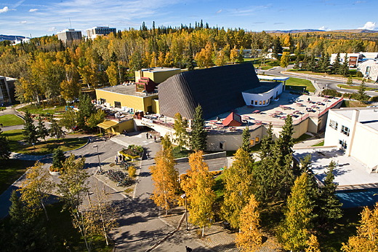
FY12 Conditions and Distributions
ALASKA’ S FIRST UNIVERSITY  AMERICA’ S ARCTIC RESEARCH UNIVERSITY

Slide 14
FY 12 Budget
Governor’s Proposed Operating
Compensation Increase $3.12M General Fund $2.28M Non-General Fund | Maintenance & Repair $0K General Fund $690.3K Non-General Fund
Other Fixed Costs $0M General Fund $3.52M Non-General Fund | Programs $225.0K General Fund* $85.0K Non-General Fund
*Includes CES, ACEP, MAP and 150K of one-time STEM funding.
ALASKA’ S FIRST UNIVERSITY  AMERICA’ S ARCTIC RESEARCH UNIVERSITY
14

Slide 15
FY 12 Budget
Governor’s Proposed Capital Budget $37M for UA DM (UAF $24M)
BOR request $37M plus $100M UA Revenue Bonds, Research Projects
UAF Deferred Maintenance & R&R
Power Plant
Electrical Distribution (incl VoIP)
Main Waste Lines
Roofs
CTC
Energy Conservation Projects
Elvey Planning and AHRB Phase III
Salisbury Theater
Fine Arts*
Moore Hall*
Kuskokwim Campus
NW Campus
ALASKA’ S FIRST UNIVERSITY  AMERICA’ S ARCTIC RESEARCH UNIVERSITY
15

Slide 16
Program Considers FY12-FY15
(not inclusive and not in priority order)
Program | FY12 | FY13 | FY14 | FY15 | ~ amt
High Performance Computing | X | X | X |  | $1,500.0
Econ. Dev. and Tech Trans. |  | X |  |  | $200.0
INBRE/EPSCOR/CANHR | X | X | X | X | $1,000.0
Special Education | X |  |  |  | $90.0
Honors/Undergrad Research | X | X |  |  | $350.0
R/V Sikuliaq |  | X |  |  | $500.0
IARC/ North 2 North | X | X | X | X | $300.0
VoIP Transition* | X | X | X | X | $1,200.0
R/V Sikuliaq |  | X | X |  | $500.0
Life Sciences Debt/Oper |  | X | X |  | $2,200.0
Veterinary Program | X |  |  |  | $100.0
Classroom Technology Refresh | X | X | X | X | $800.0
Development / Cornerstone Campaign | X | X | X |  | $700.0
*additional $'s required via capital and fees
 | If funded avg. annual new/reallocation revenue above normal cost increases |  |  |  | $2,360.0
ALASKA’ S FIRST UNIVERSITY  AMERICA’ S ARCTIC RESEARCH UNIVERSITY
16

Slide 17
Operating Budget
3 to 5 Year Assumptions
Annual 2% salary increase
Annual 5% benefit increase
Annual 9% tuition increase
Enrollment increase 3.5% if significant State financial aid package
ICR rate impact over 3 years – 3%/yr
GF per year – 2% - 4%
ALASKA’S FIRST UNIVERSITY  AMERICA’S ARCTIC RESEARCH UNIVERSITY
ALASKA’ S FIRST UNIVERSITY  AMERICA’ S ARCTIC RESEARCH UNIVERSITY
17

Slide 18
UAF Near-term
Capital Project Considerations
Capital Projects
Energy Technology Facility
Engineering Bldg Annex
Fire Station Replacement
Housing – Northern Sustainable Village*
Housing – Public Private Partnership*
*Primarily Externally Funded
ALASKA’ S FIRST UNIVERSITY  AMERICA’ S ARCTIC RESEARCH UNIVERSITY
18

Slide 19
FY12 Unit Planning Expectations
Tuition
Enrollment
ICR Distribution (Taskforce)
PBB
Salary and Benefit Increases
VOIP
ALASKA’S FIRST UNIVERSITY  AMERICA’S ARCTIC RESEARCH UNIVERSITY
ALASKA’ S FIRST UNIVERSITY  AMERICA’ S ARCTIC RESEARCH UNIVERSITY
19

Slide 20
ARSC Indirect Cost Support
FY10 ARSC-Generated to:
Facilities | $305,349
Statewide | 285,290
VCAS | 276,375
Library | 104,755
WRRB | 44,577
Research Integrity | 22,288
Total | $1,038,634
Total w/o Statewide | $753,344
ARSC-generated indirect cost support represented 7.9% of total indirect cost support for UAF in FY10.
ALASKA’S FIRST UNIVERSITY  AMERICA’S ARCTIC RESEARCH UNIVERSITY
ALASKA’ S FIRST UNIVERSITY  AMERICA’ S ARCTIC RESEARCH UNIVERSITY
20

Slide 21
UAF Earned Revenue
FY06-FY10 Annualized Compared to % Change from FY10-FY11 Projected
ALASKA’ S FIRST UNIVERSITY  AMERICA’ S ARCTIC RESEARCH UNIVERSITY
21

Slide 22
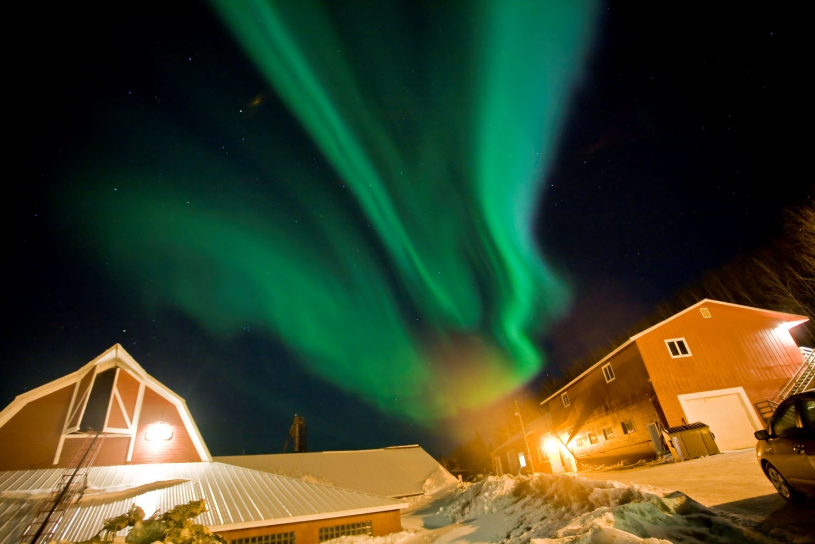
Discussion
ALASKA’ S FIRST UNIVERSITY  AMERICA’ S ARCTIC RESEARCH UNIVERSITY
22

Slide 23

ALASKA’ S FIRST UNIVERSITY  AMERICA’ S ARCTIC RESEARCH UNIVERSITY

Slide 24
ALASKA’ S FIRST UNIVERSITY  AMERICA’ S ARCTIC RESEARCH UNIVERSITY
24

Slide 25
ALASKA’ S FIRST UNIVERSITY  AMERICA’ S ARCTIC RESEARCH UNIVERSITY
25

