Slide 1
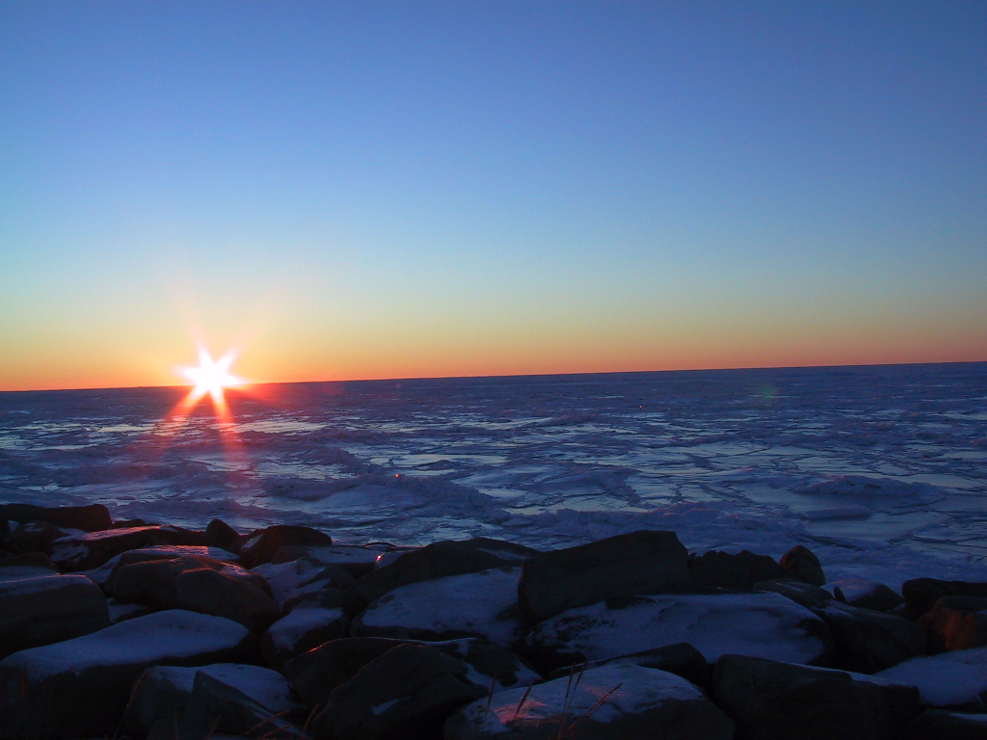

Service at the Point of Need
College of Rural & Community Development
Bernice Joseph
Executive Dean &Vice Chancellor Rural, Community & Native Education

Slide 2
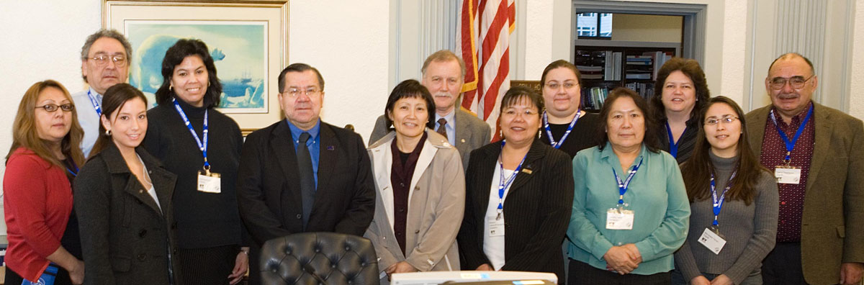
Many Campuses – one university
UAF reaches beyond Fairbanks to over 40 locations across the state.
UAF vision statement includes “Demonstrate ways in which gender, racial and cultural diversity strengthen the university and society.” and
“Provide excellent educational services at the point of need for Alaska Native and rural populations.”
UAF Academic Plan states, “Be an educational center for Alaska Natives.”
Rural Development students meet with Senator Lyman Hoffman in Juneau

Slide 3
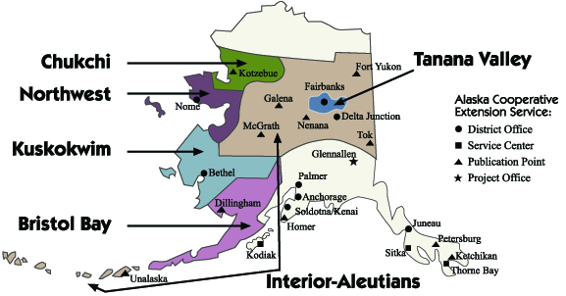
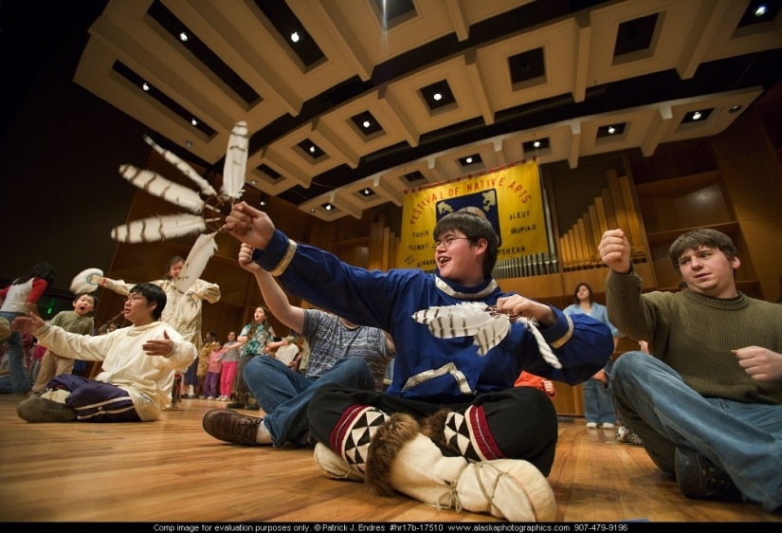
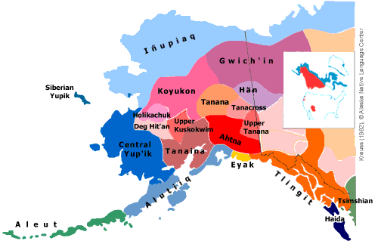
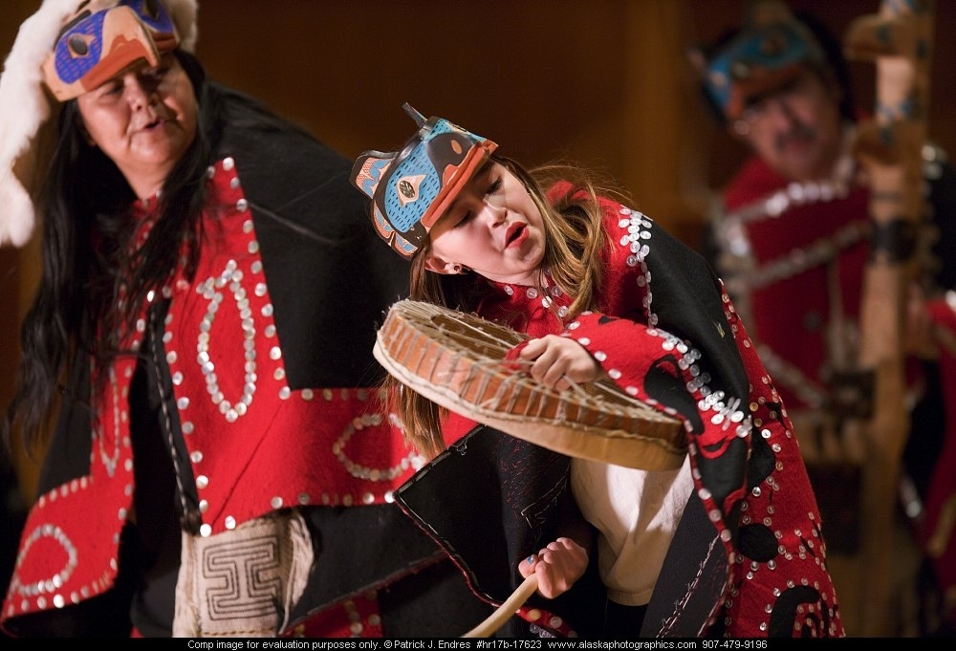
CRCD Service Area & Alaska Native Languages Map
Photos by P.Jendres, Courtesy of FNA
Community &
Technical College

Slide 4

CRCD Mission and Vision
Core Purpose:
Education for Sustainable, Healthy, Culturally-Enriched Communities
Core Values:
Student Centered
Culturally Responsible
Living our Indigenous Cultures & Languages
Career Pathways
Partnerships

Slide 5

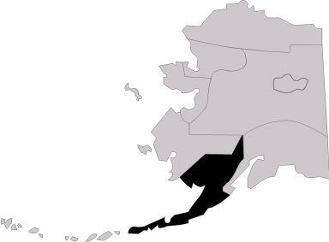
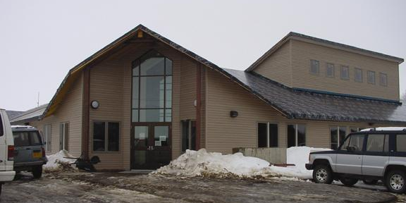
Bristol Bay Campus
Aleknagek
Chignik
Chignik Lake
Chignik Lagoon
Dillingham
Egegik
Ekuk
Ekwok
Igugig
Illiamna
Ivanoff Bay
Kanatak
King Salmon
Kokhanok
Kolinganek
Knugank
Levelock
Manokotak
New Halen
New Stuyahok
Naknek
Nondalton
South Naknek
Togiak
Twin Hills
Pedro Bay
Perryville
Pilot Point
Portage Creek
Port Alsworth
Port Heiden
Ugashik
Dillingham
Notes:
Serves 32 villages Two Learning Centers – King Salmon and Togiak
594 students enrolled Fall 2002
During Fall Semester 2004, BBC had 444 students and 418 in 2005/
Census Areas
Bristol Bay Borough
1100 jobs – 26% adults not in workforce
1200 population; 43%Native
8% below poverty level
Lake & Penn
950 jobs – 50% adults not in workforce
1800 population; 80%Native
33% below poverty level
Dillingham
6500 jobs – 45% adults not in workforce
16,000 population; 87%Native
27% below poverty level

Slide 6
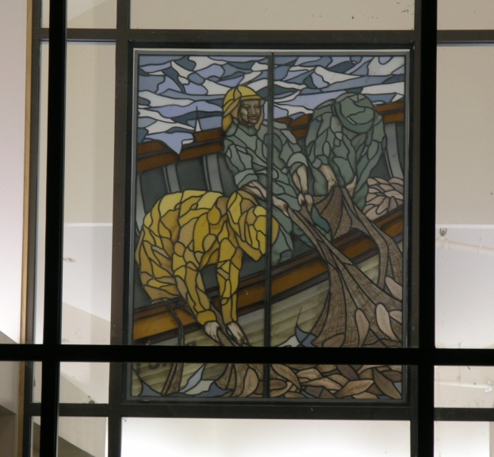
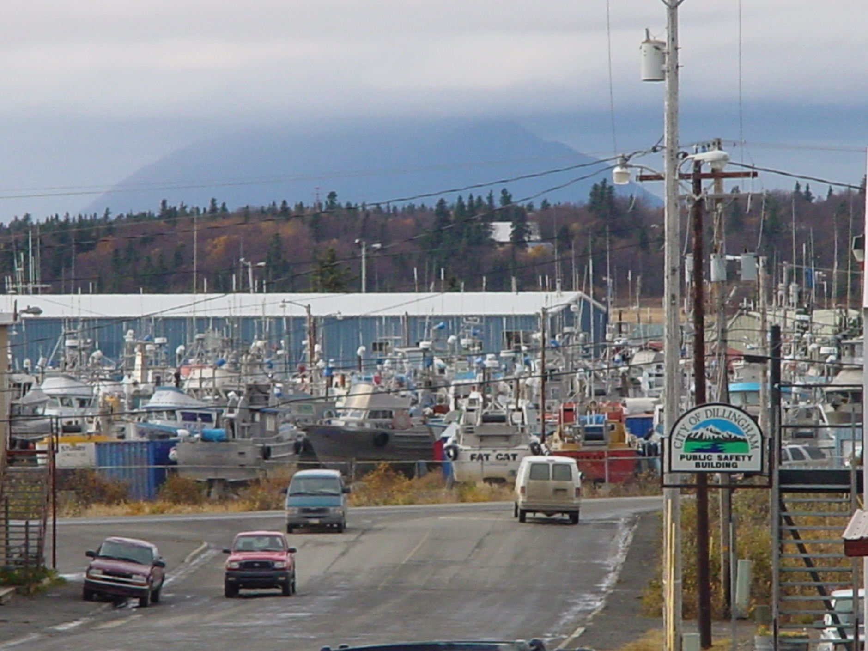
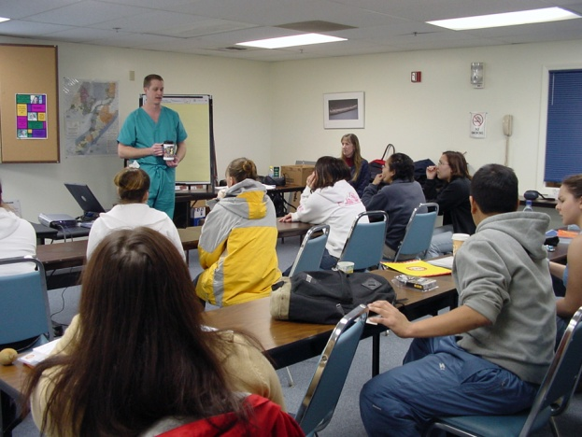
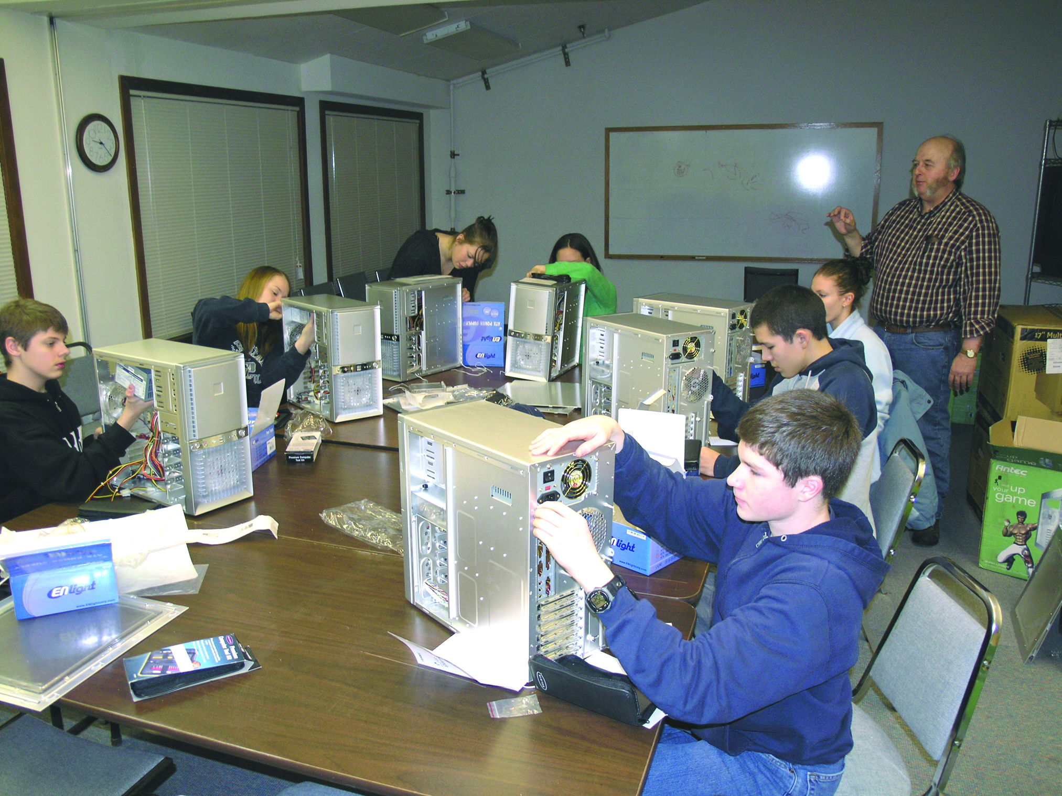
Bristol Bay Campus
Notes:
Rural Wood Center – name after Director Peggy Wood
The building was made possible by a state GO bond, US EDA
And Title III.

Slide 7
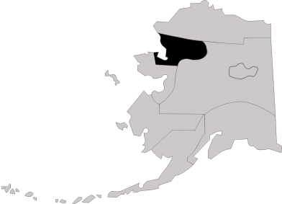
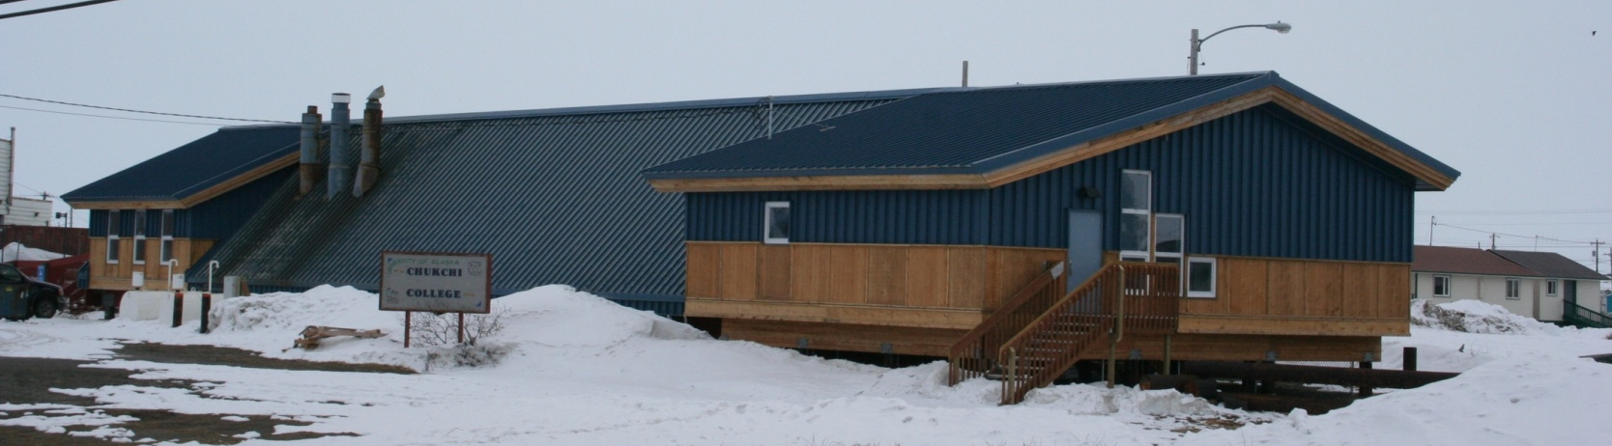
Chukchi Campus
Kotzebue
Ambler
Buckland
Deering
Kiana
Kivalina
Kobuk
Kotzebue
Noatak
Noorvik
Selawik
Shungnak
Notes:
Serves 10 villages
Northwest Arctic Census area:
Population 7000– 86% Native
21% below poverty level
Kotzebue is the service and transportation center for all villages in the northwest region. It has a healthy cash economy, a growing private sector, and a stable public sector. Due to its location at the confluence of three river drainages, Kotzebue is the transfer point between ocean and inland shipping.
The majority of income is directly or indirectly related to government employment, such as the School District, Maniilaq Association, the City and Borough. The Cominco Alaska Red Dog Mine is a significant regional employer. Commercial fishing for chum salmon provides some seasonal employment. 128 residents hold commercial fishing permits. Most residents rely on subsistence to supplement income.
During Fall Semester 2005, CC had 179 students enrolled and 764 credit hours.

Slide 8
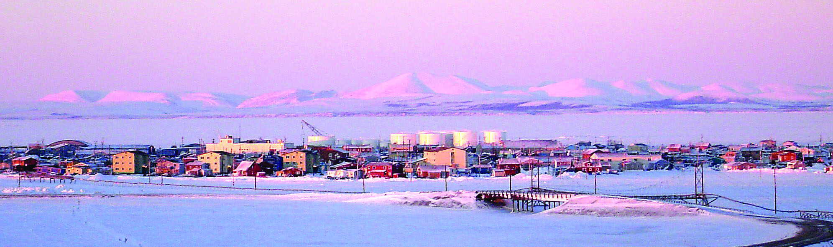
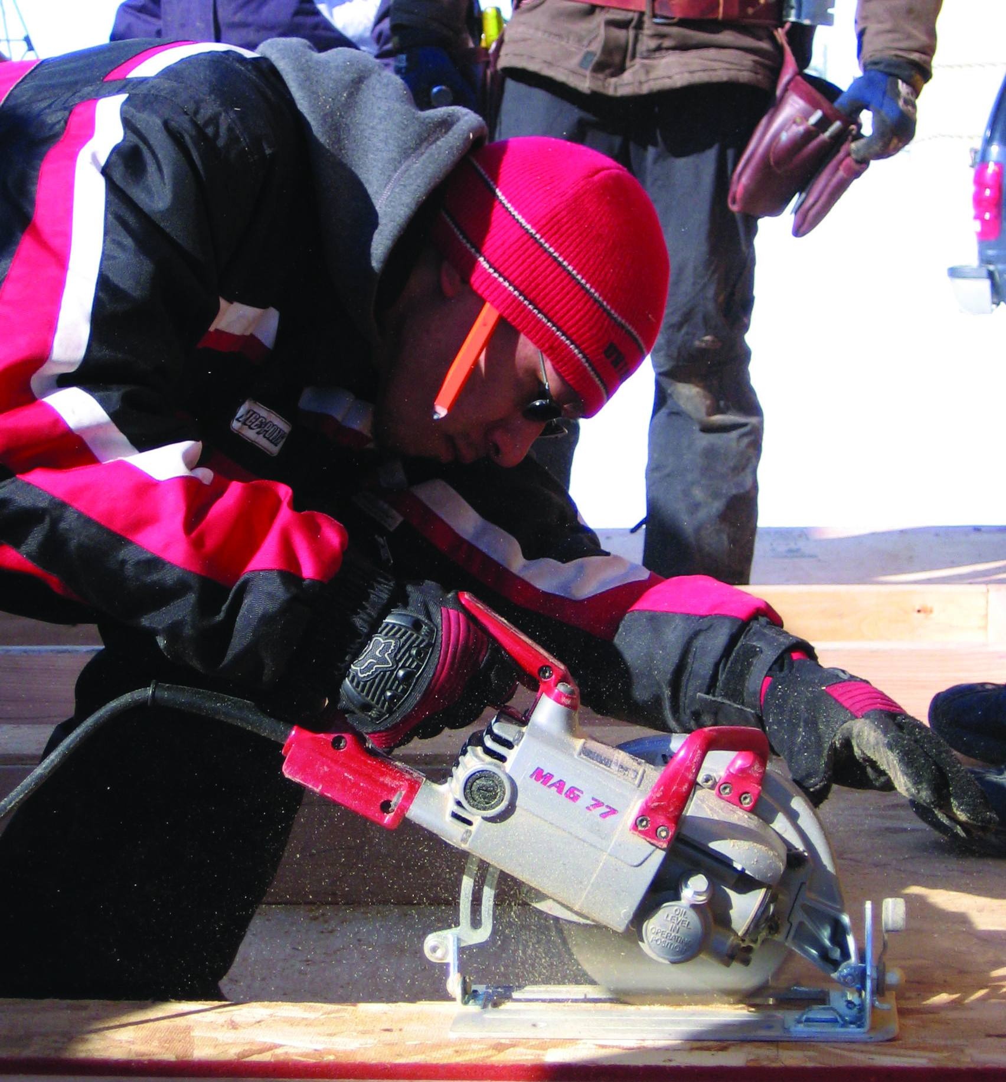
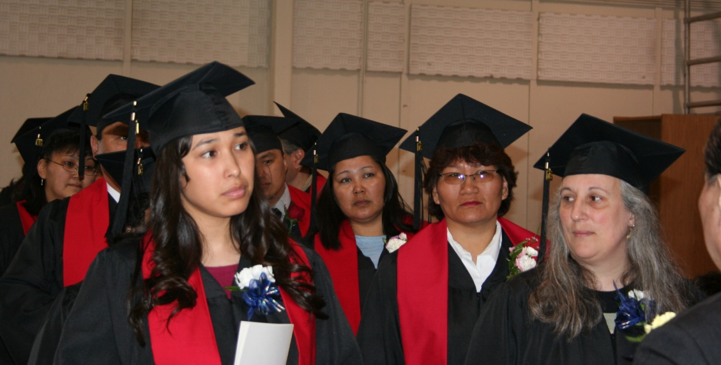
Kotzebue
Notes:
Manilaaq is the largest employer in the region and an important partner to the campus.
The northwest region is also served by the Alaska Technical

Slide 9

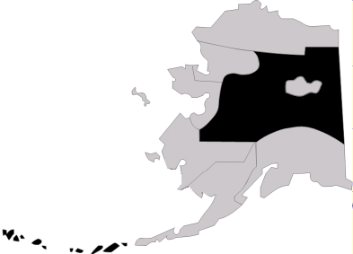
Interior-Aleutians Campus
Allakaket
Alatna
Anvik
Arctic Village
Beaver
Bettles
Birch Creek
Chalkyitsik
Circle
Copper Center
Dot Lake
Eagle
Evansville
Ft. Yukon
Galena
Grayling
Healy Lake
Holy Cross
Huslia
Kaltag
Koyukuk
Manley
McGrath
Minto
Nenana
Nickolai
Northway
Nulato
Ophir
Rampart
Red Devil
Ruby
Shageluk
Stevens Village
Takotna
Tanana
Tanacross
Telida
Tetlin
Tok
Venetie
Adak
Akutan
Atka
Cold Bay
False Pass
King Cove
Nikolski
St. George
St. Paul
Sand Point
Unalaska/Dutch Harbor
Decentralized - Fairbanks
Notes:
Interior-Aleutians Campus decentrialized Admin offices in FBX
I-AC had 698 students enrolled for a 20% increase in student headcount - a 54% increase in credit hours over Fall 2002.
Serves 57 villages including the Aleutian Islands and communities on two Bering Sea Islands from 6 Community Learning Centers in: Tok Galena Neneana McGrath Ft. Yukon Aleutian/Pribilofs
Census Areas
Yukon Koyukuk
2000 jobs – 40% adults not in workforce
6300population; 63%Native
24% below poverty level
Aleutians East
2000 jobs – 10% adults not in workforce
5200 population; 30%Native
6% below poverty level
Aleutians West
3800 jobs – 26% adults not in workforce
1200 population; 43%Native
8% below poverty level

Slide 10
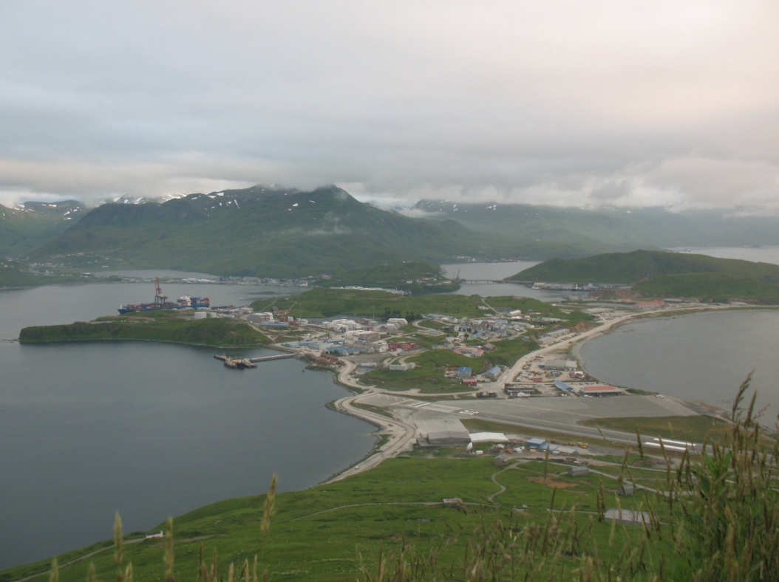
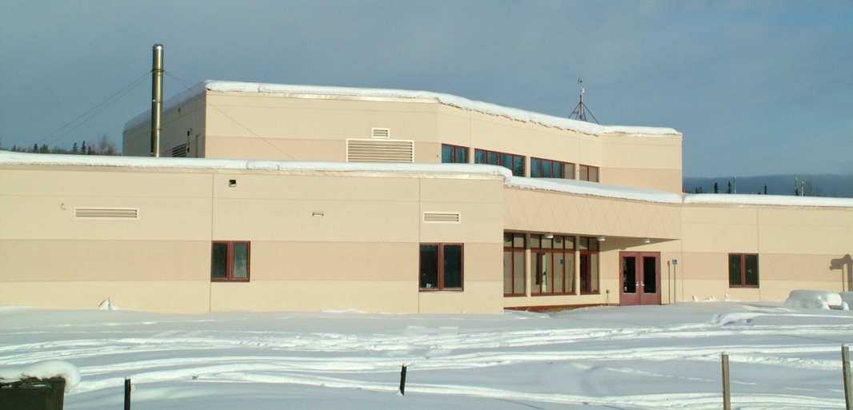
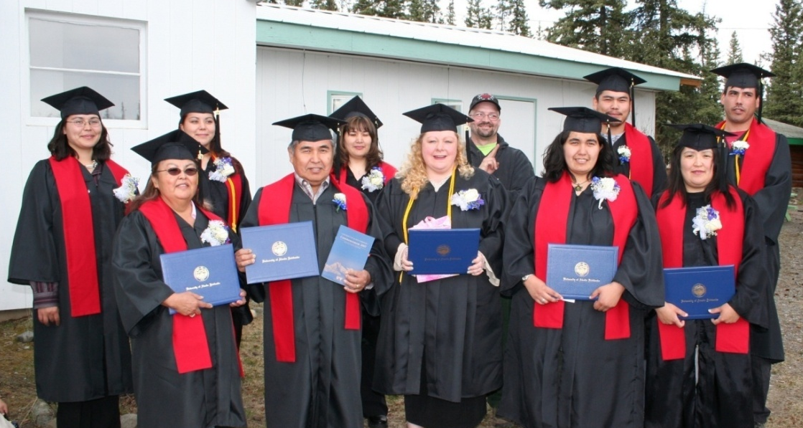
Interior-Aleutians Campus
Unalaska
Decentralized - Fairbanks
Notes:
Yukon-Koyukuk Census area
2005 Population estimate 6,000
Per capita income $14,700
Median income $29, 937
17.5% of population under the poverty guidelines
2005 Fall headcount 473
SCH 1,586

Slide 11

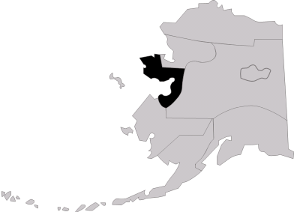
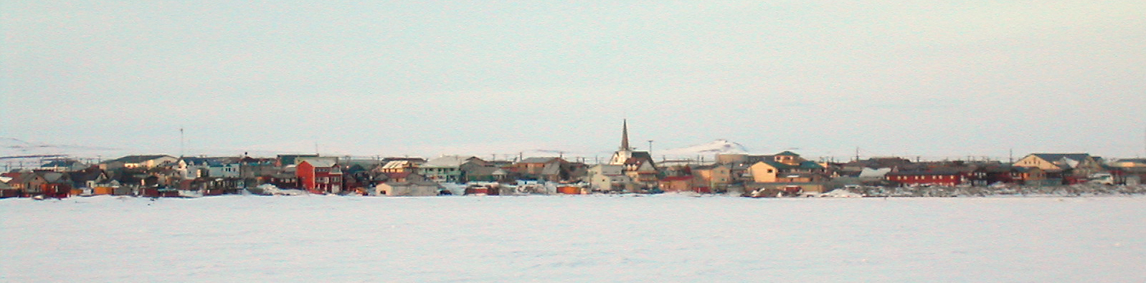
Northwest Campus
Brevig Mission
Gambell
Golovin
Elim
Koyuk
Little Diomede
Nome
Savoonga
Shishmaref
Stebbins
Shaktoolik
St. Michaels
Teller
Unalakleet
Wales
White Mountain
Nome
Notes:
Northwest Campus in Nome
Serves 16 villages including two
Bering Sea islands communities
Nome Census Area
3695 employed in 1999 – 39% not in workforce
Population 9,0000 – 80% Native
24 % below poverty level
456 students Fall 2004
261 students Fall 2005
Credit hour production in Fall 2005 was 688.
The first building was constructed in 1974 – library. Two buildings were added in 1976. In 1978 NWC acquired the KD building which is used by Kawerak, ABE and warm storage. The main building was built in 1980 and dedicated in 1981.
In 2004 UAF/CRCD purchased the Seppala Bldg.

Slide 12
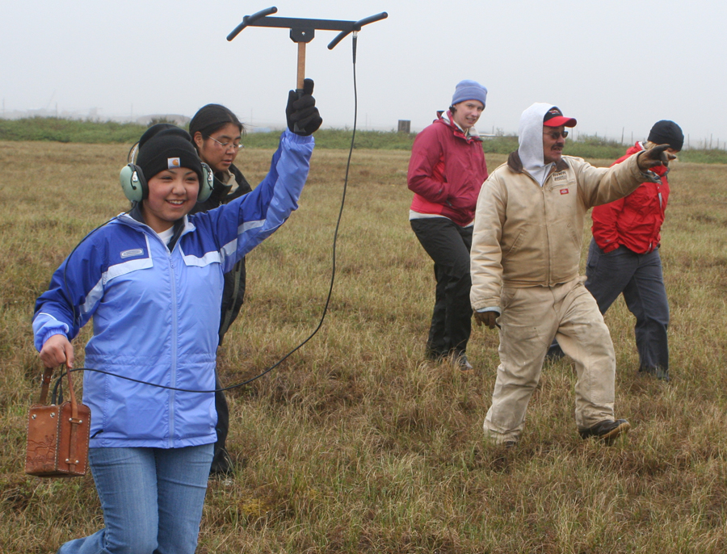
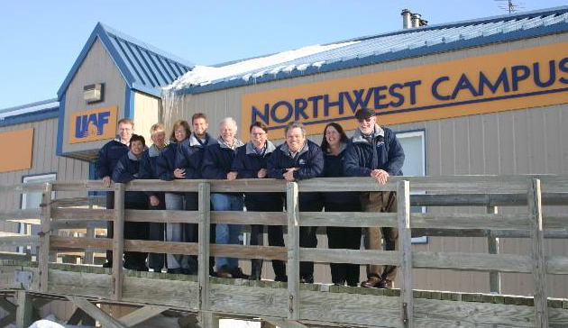
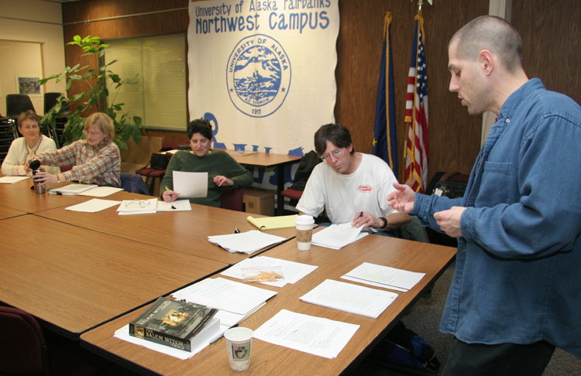
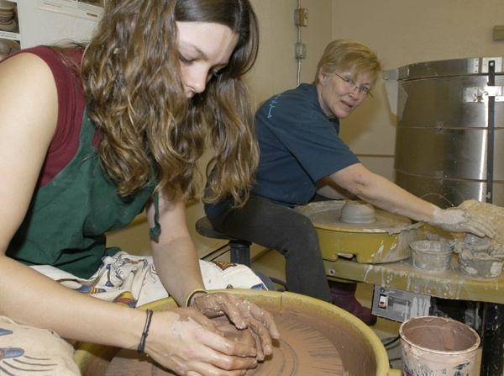
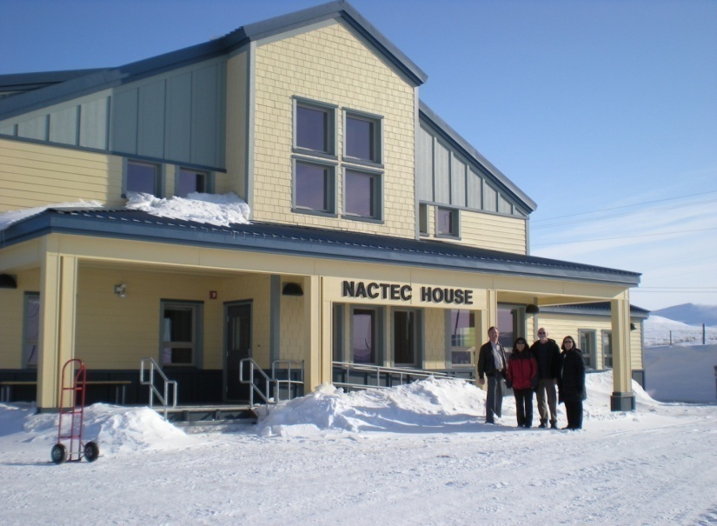
Northwest Campus
Notes:
The population of Nome is a mixture of Inupiat Eskimos and non-Natives. Although many employment opportunities are available, subsistence activities are prevalent in the community. Former villagers from King Island also live in Nome. Economy: Nome is the supply, service and transportation center of the Bering Strait region. Government services provide the majority of employment.
Retail services, transportation, mining, medical and other businesses provide year-round income.
Several small gold mines continue to provide some employment. NovaGold Resource Inc.'s new mine at Rock Creek, 8 miles north of Nome, should be producing by 2006. The Rock Creek mine will require $40 million in capital investment, and is expected to create 100 jobs. Subsistence activities contribute to the local diet.

Slide 13
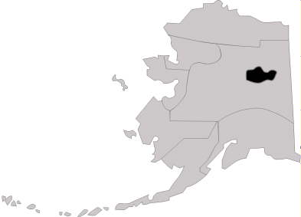
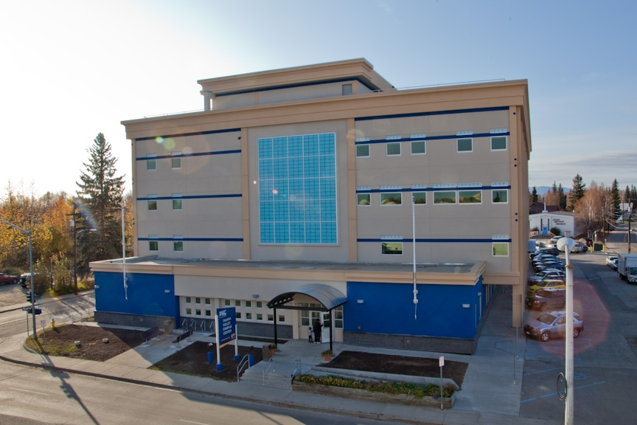
Community & Technical College
Fairbanks
Delta Junction
North Pole
Military Programs
-Ft. Wainwright
-Eielson AFB
-Ft. Greely
-Clear AFB
11 locations in the Interior
Fairbanks
Notes:
Fairbanks North Star Borough Census Area
4100 jobs – 23% adults not in workforce
84000 population; 8%Native
9% below poverty level
2933 students enrolled Fall 2002
TVC had record enrollment for the 2002/2003 academic year, producing more than 34,000 student credit hours and offering more than 1,200 courses. During Fall Semester 2005, TVC had 3,087 students enrolled.

Slide 14
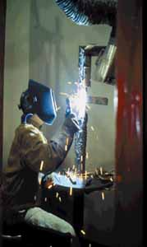
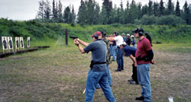
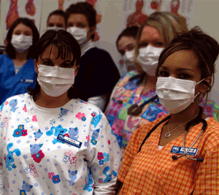
Community & Technical College
Core Purpose
Community Driven Education
Core Values
Student Centered, Excellence, Empowerment, Innovation, Flexibility, Collaboration, Integrity
Mission
CTC is Alaska’s first choice for quality workforce development, academic preparation and life-long learning

Slide 15
Community & Technical College
34% of UAF’s student body headcount as fall 2010
20% of the credit hour production as fall 2010
3,500 students served every semester
Offers 40+ certificate and degree programs and specialized training programs
One of the top 10 employers in Fairbanks
300+ adjunct faculty and 60+ full-time faculty/staff each semester
$12 million annual operating budget
Extensive partnerships with industry, labor, schools and community organizations
Offers college credit to high school students through Tech Prep and other outreach activities
Export high demand courses/training around Alaska

Slide 16

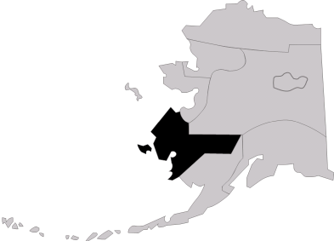
Kuskokwim Campus
Goodnews Bay
Platinum
Quinhagek
Kwigillingnak
Konginganak
Kipnuk
Eek
Chefornak
Tuntatuliak
Mekoryak
Unkumiut
Nightmute
Tooksook Bay
Hooper Bay
Tununak
Newtok
Nunapitchak
Kasigluk
Atmautlak
Napaskiak
Napakiak
Oscarville
Kwethluk
Chuloonawick
Kotlik
Bill Moore’s Slough
Hamilton
Akiachak
Akiak
Tulusak
Lower Kalskag
Kalskag
Aniak
Chuathbaluk
Napaimute
Red Devil
Crooked Creek
Georgetown
Stony River
Sleetmute
Lime Village
Chevak
Paimiute
Scammon Bay
Chogamiute
Russian Mission
Marshall
Pilot Station
St. Mary’s
Andreafsky
Pitka’s Point
Mountain Village
Nunam Iqua
Alakanuk
Emmonak
Bethel
Notes:
Wade Hampton and Bethel Census Areas
Bethel:
6500 jobs – 45% adults not in workforce
16,000 population; 87%Native
33% below poverty level
Wade Hampton
2500 jobs – 44% adults not in workforce
7,000 population; 94%Native
40% below poverty level
308 students Fall 2002
During Fall Semester 2005 KuC had a headcount of 368 students
1661 credit hous

Slide 17
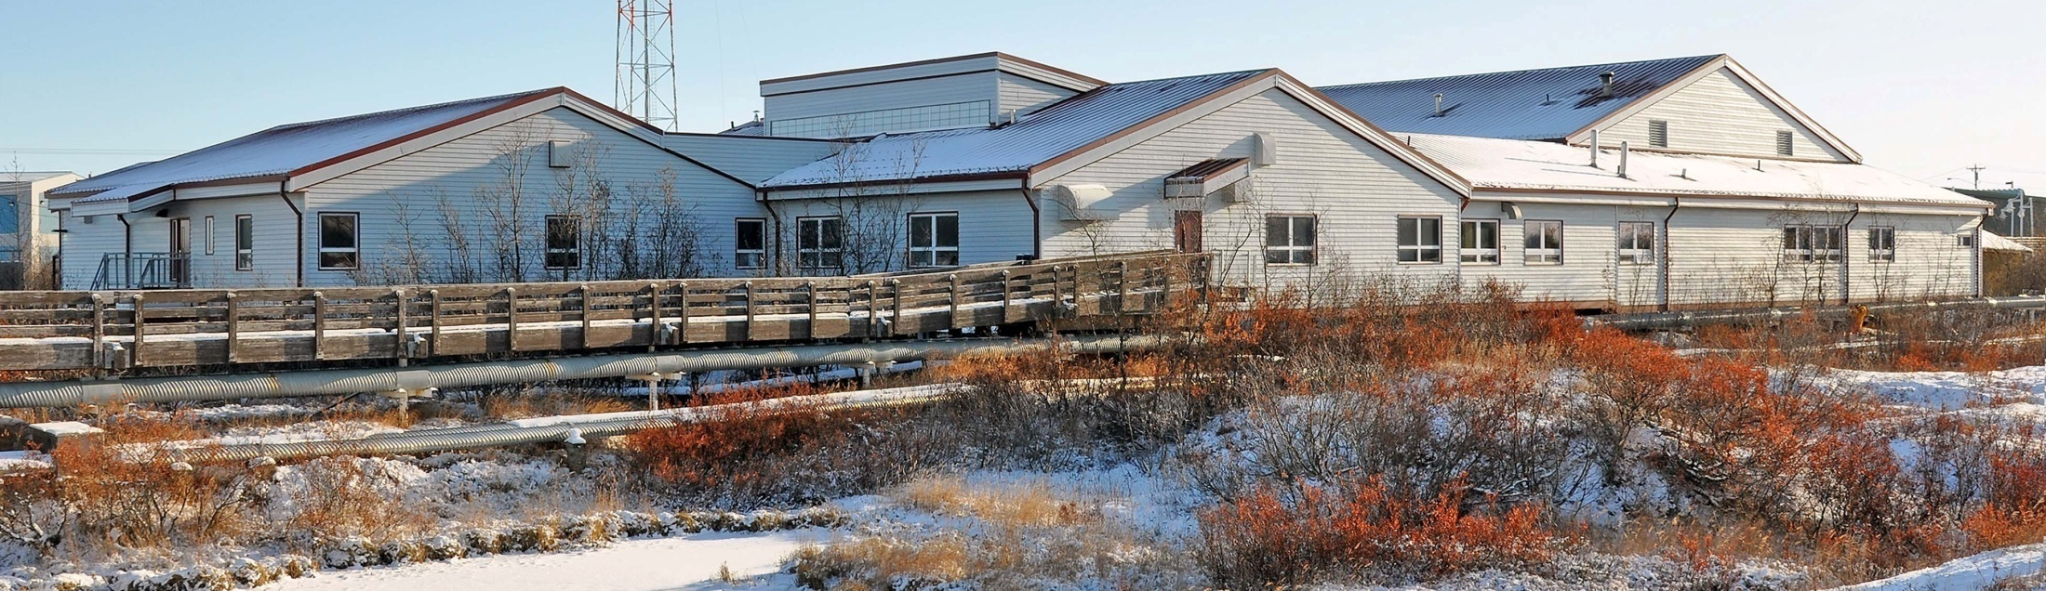
Kuskokwim Campus
Bethel
Notes:
Only residential campus in CRCD. Sackett hall on right

Slide 18
B.A. Program: Yupiit Nakmiin Qaneryaraat
Available exclusively at KuC, the BA program is designed to accommodate students from three different backgrounds:
traditional on-campus students,
non-traditional students who have completed the 30-credit certificate or 60-credit A.A.S. in Yup’ik Language Proficiency, and
non-traditional students who have completed the 30-credit certificate or 60-credit A.A.S. in Native Language Education: Yup’ik Option.

Slide 19
Program Features
Includes traditional on campus classes as well as summer intensive and distance delivery options.
Students have options to enroll directly in the B.A. program or the “feeder” programs: Certificate/AAS in Yup’ik Language Proficiency or Certificate/AAS in Native Language Education.
Significant numbers of non-traditional students are already pursuing the two “feeder” programs.
Offered in collaboration with UAF’s ANLC faculty and courses.

Slide 20
Student Backgrounds
Most students pursuing the Certificate/AAS in either Yup’ik Language Proficiency or Native Language Education: Yup’ik Option are currently employed as teacher’s aides within the six school districts within the Kuskokwim Campus service area.
Most students are non-traditional – they are older, with family and job responsibilities.

Slide 21
Program Goals
To increase both the quality and quantity of Yup’ik language programming available through the schools and villages from which the students are drawn by providing them with advanced knowledge of Yup’ik language, literature, linguistics, and cultural traditions.
To use acquired knowledge to enhance the teaching and learning within their own classrooms.

Slide 22
Current Enrollment and Expected Graduates
We are in our 3rd year of the BA program.
6 Full time students on and off campus in Bethel
8 part-time students in villages
Expected graduates this spring (2011)
1 AAS
2 BA

Slide 23
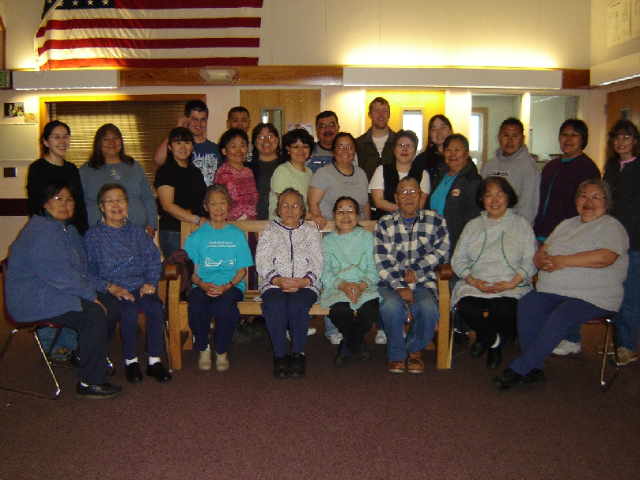
Kuskokwim Campus – YNQ students, faculty and elders

Slide 24
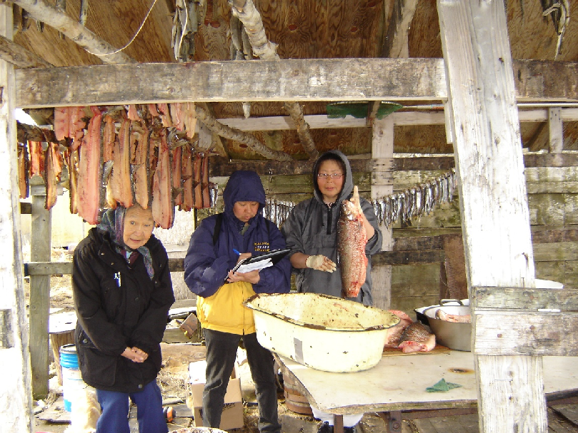
Kuskokwim Campus – Summer Intensive class

Slide 25

Kuskokwim Campus - Vocabulary Development

Slide 26

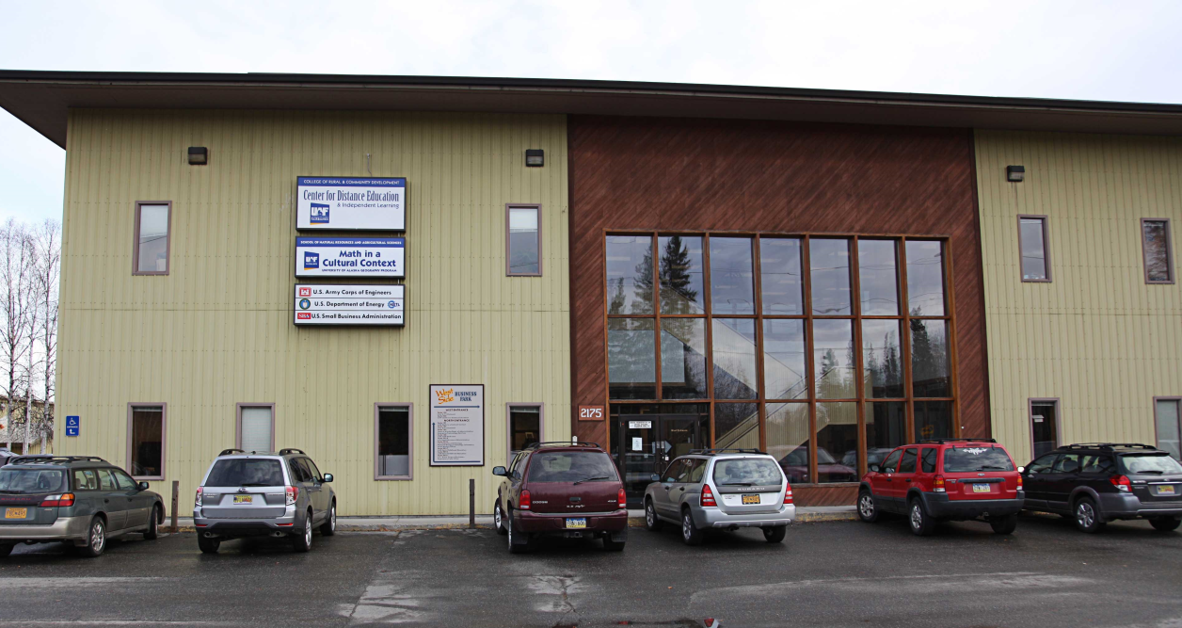
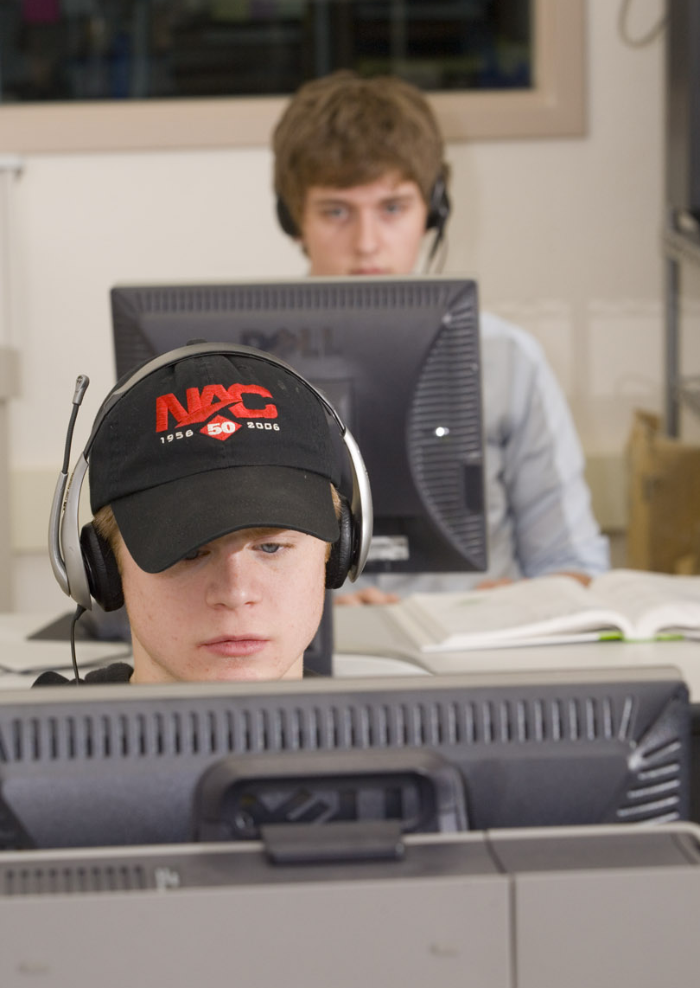
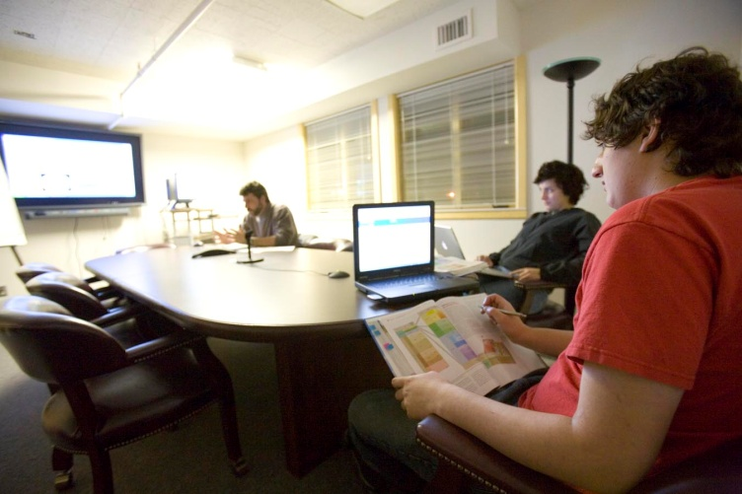
Center for Distance Education
More than 170 courses available
Online course/program development
Web-based, interactive and Independent
Faculty Professional Development
Student support services
Coordination with UAF schools/colleges.

Slide 27
CDE Facts
Total 25 staff at CDE
Enrollment in courses delivered through CDE is approximately 7300 annually, generating more than 22,000 student credit hours (SCH).
CDE’s enrollment has increased by an average of 10% each of the last 3 years.
CDE serves over 4300 individual students annually, 65% of them UAF main campus students or students residing in the Fairbanks area, 26% outside Fairbanks, and 9% outside Alaska.
CDE’s student age distribution: 53% are 19-25, 19% are 26-30, and 28% are 30+ years old.

Slide 28
CDE Facts

Slide 29
CDE Facts

Slide 30
CDE Facts

Slide 31
The Course Design Framework
“Reverse Engineering” from outcomes to activities by way of evidence-based assessment of understanding, turning the process away from disconnected activities that are not coherently tied to learning objectives
Development emphasis on:
Learning community within the classroom
Facilitating the three vectors of interaction between student, instructor and curriculum
Integrating place-based knowledge, information and activities
Creating activities that bring the “real world” and media into the classroom
Providing access to—and practices for working within—socially networked environments, inside the classroom and out

Slide 32
CDE Service and Support
CDE Student Services: Who do we serve
Faculty Development for UAF
Two days weekend workshop on how technology can facilitate teaching.
iTeach and iDesign
CDE tuition revenue sharing with School and College
Partnership with departments to meet students’ need and demand
Increase online instruction capacity within each department

Slide 33
Thank you
Bernice M. Joseph
Vice Chancellor Rural, Community, & Native Education
www.uaf.edu/rural

