Slide 1
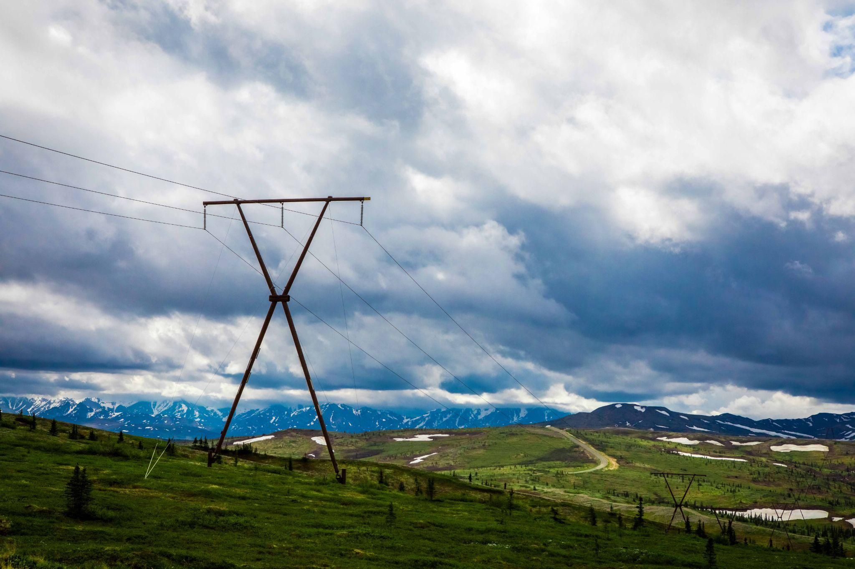


ACEP Railbelt Decarbonization Project Results
Phylicia Cicilio,
Jeremy VanderMeer, Steve Colt
Alaska Center for Energy and Power
University of Alaska Fairbanks
Derek Stenclik,
Matt Richwine
Telos Energy
January 18th, 2024

Slide 2
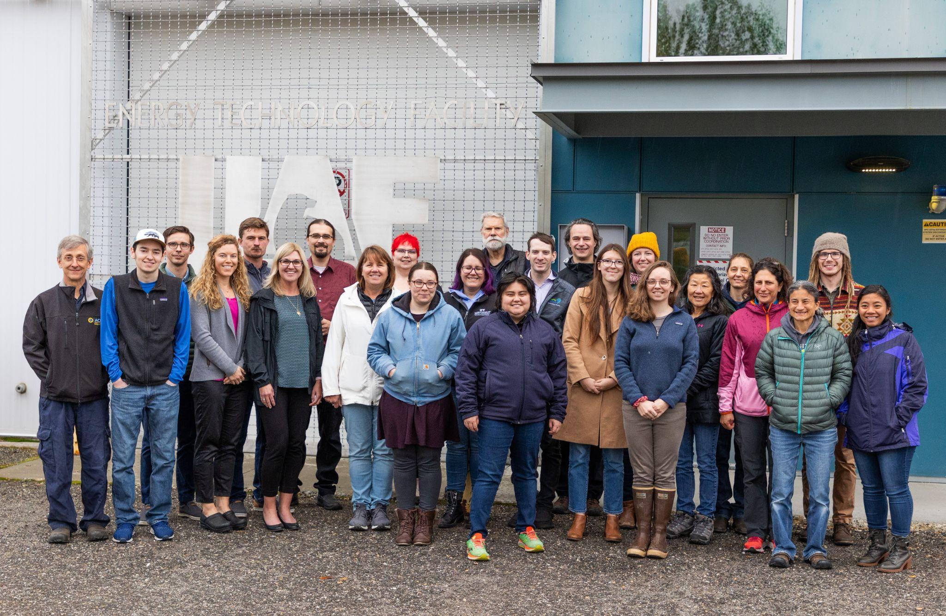

Our Mission
Develop and disseminate practical, cost-effective and innovative energy solutions for Alaska and beyond.
Our Research
As an applied energy research group, we provide leadership in sustainable energy systems for islanded, non-integrated electric grids, and heat and transportation systems.
Notes:
This project is being lead by the Alaska Center for Energy and Power, which is a research institute part of the University of Alaska Fairbanks. ACEP’s mission is to develop and disseminate practice, cost-effective and innovative energy solutions for Alaska and beyond.
ACEP focuses on applied energy research. We aim to provide leadership in sustainable energy systems for islanded, non-integrated electrical grids such as those found in Alaska and also in heat and transportation system.

Slide 3
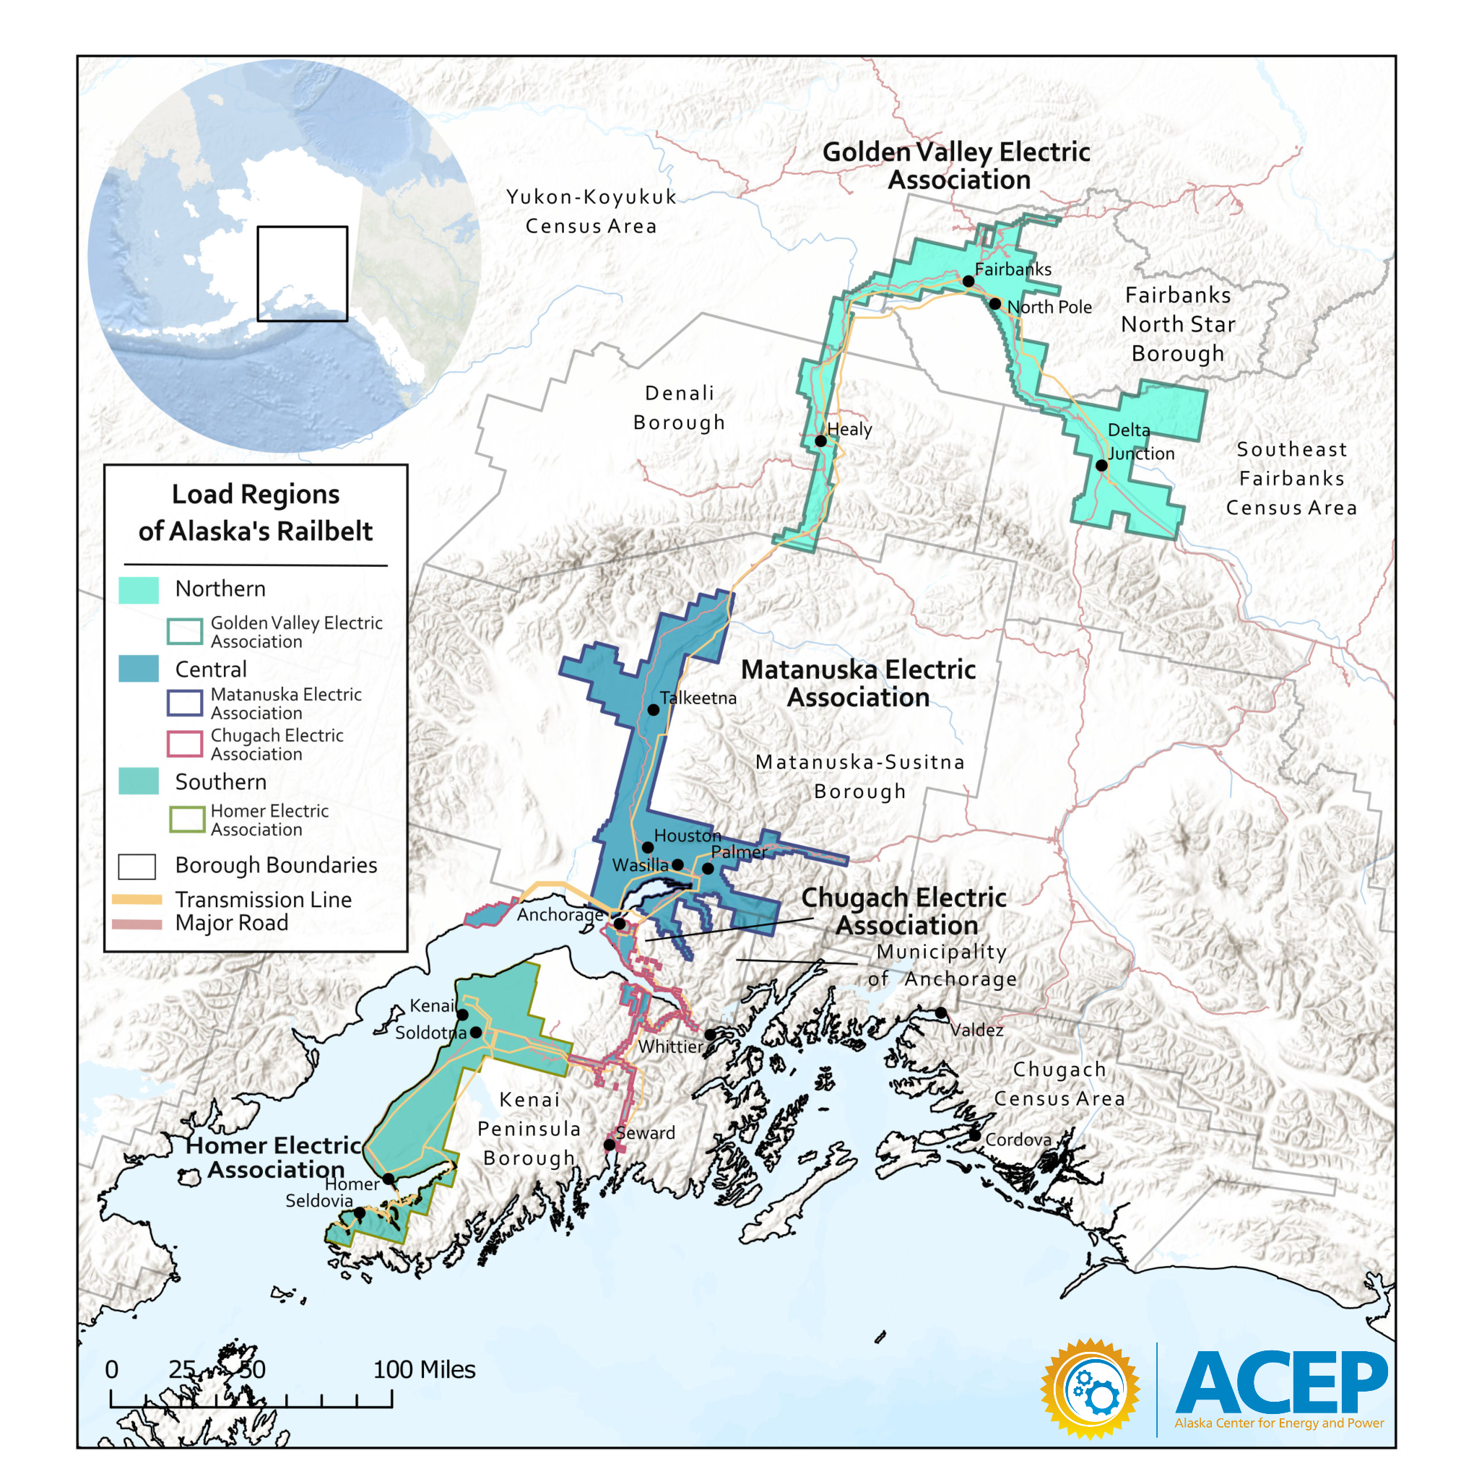
Goal
Exploring and quantifying scenarios that aim for 100% Railbelt Electric Grid Decarbonization in 2050.
Outcomes
Quantify the economic and reliability implications of decarbonization scenarios
Create information for Railbelt planning discussions and studies
Build capacity
Notes:
In 2022 ACEP started the Railbelt Decarbonization Pathways project.
The goal of this project is to evaluate pathways toward 100% Railbelt electric grid decarbonization in 2050.
The Railbelt is Alaska’s largest electrical grid, which spans from down in Homer, through Anchorage, and up to Fairbanks and Delta Junction. It is run by five electric cooperatives including Golden Valley Electric Association, Matanuska Electric Association, Chugach Electric Association, City of Seward, and Homer Electric Association.
This study is just looking at 100% decarbonization of this electric grid, and not the other energy systems for this region such as heating and transportation. We do account for the increase in electric load due to the electrification of those other sectors, however we are not studying 100% decarbonization of those sectors.
I’ll note that these decarbonization scenarios are not predictions of the future, but illustrations of what certain pathways to decarbonization could look like.
Through this project we are aiming to provide valuable information to the Alaskan public and decision makers on the economic and reliability implications of several decarbonization pathways. This includes general information such as resource availability and load forecasts, and information specific to our decarbonization scenarios such as stability and reliability of the system, and the impact to rates.
I’ll also mention here that there is a complementary study ongoing at the National Renewable Energy Laboratory which is studying an 80% renewable portfolio standard for the Railbelt. The study has published an informative report which shows potential 80% renewable energy pathways, and provides good information that is complementary to this study. Our teams have shared resources when able.
Key differences include that ACEP’s study is looking at 100% decarbonization, which includes using Nuclear energy, hydrogen and ammonia fuels, and carbon capture. Additionally we go into detail on different components of study, such as stability and reliability, and will determine the impact to electric rates.
We will get into the details of the components of our study in a few slides.

Slide 4




Phylicia Cicilio, Steve Colt, Jeremy VanderMeer, Alexis Francisco, Emilia Hernandez, Cameron Morelli, Chris Pike, Michelle Wilber, Leif Bredeson (former intern), Mariko Shirazi, Dominique Pride, Noelle Helder, Gus Lewis, Dallas Fisher, and advice and review from many others
The Team
Brian Rogers, Peter Asmus
Derek Stenclik,
Matthew Richwine,
Isabela Anselmo,
Christopher Cox
Frana Burtness-Adams, Lisa Baraff, Kerry Nelson,
& Jamie Hansen
Notes:
I’d like to highlight the team that is making this project possible…

Slide 5
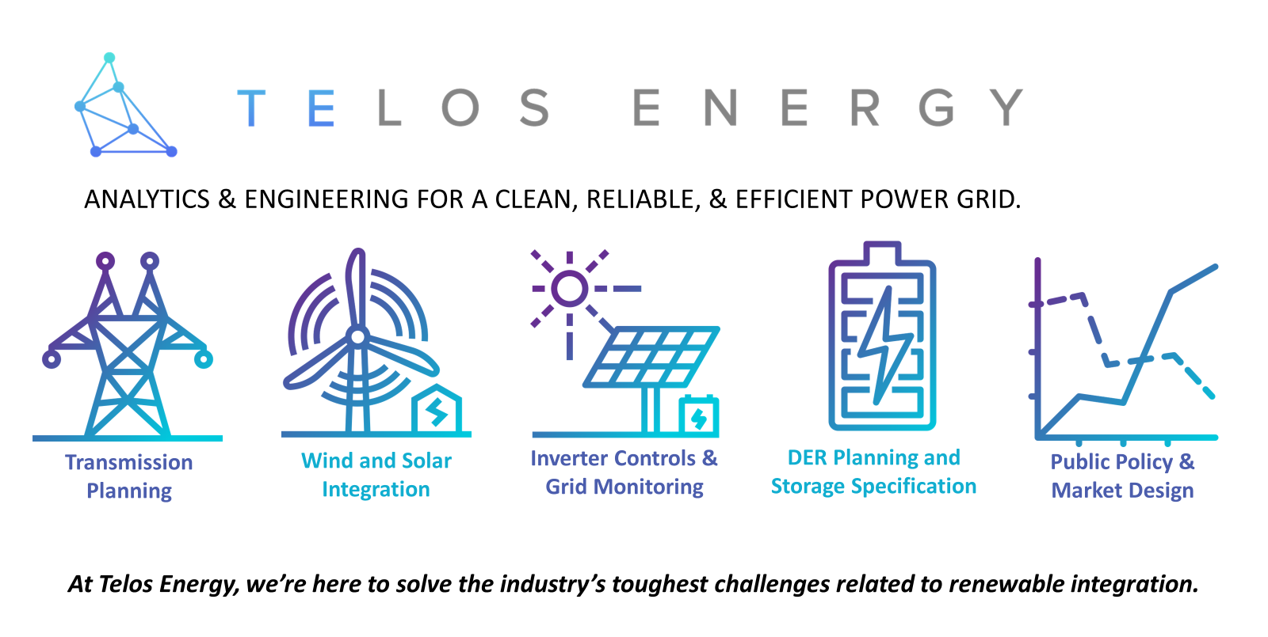

Slide 6

Technical Advisory Group
Funding and Support
Golden Valley Electric Association
Chugach Electric Association
Matanuska Electric Association
Homer Electric Association
Alaska Energy Authority
Railbelt Regional Coordination
Office of Naval Research
State of Alaska FY23 Economic Development Capital Funding
Notes:
We are very fortunate to have the participation of the Technical Advisory group. THis group provides invaluable information about system operations, provides critical data for performing modeling and analysis, and reviews our work so that we can be as accurate as possible given our study period and assumptions.
This project has been supported by both the Office of Naval Research, and the State of Alaska through their Economic Development Capital Funding.

Slide 7





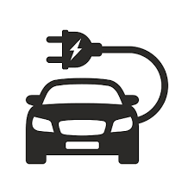



Scenario Development
Load Forecast
Determining what components to consider for 2050.
i.e. resources, electrification and grid integration strategies.
Resource Selection
and Sizing
Quantifying how much will the load grow by 2050 and electrification impacts.
Generation Analysis
Identifying where resources are available and hourly generation profiles.
Transmission Analysis
Economic Analysis
Quantifying generation mix, emissions, costs, curtailment, etc.
Required investment and changes in cost of service, considering the new equipment in each scenario.
Evaluating power flow across network, losses, frequency and voltage stability
Hourly Load
Hourly Resource Generation
Hourly Dispatch
Notes:
Jeremy
Overview of why we need all these different parts and why it is so complex.
Such as we need to load to get to the amount of generation needed
Now we will dig into the different components of our study. These study components are commonly found in other studies that evaluate electrical grid transitions.
Go into the details of the components…
Using this report as template: https://cambiopr.org/wp-content/uploads/2021/03/Puerto-Rico-Distributed-Energy-Resource-Integration-Study-Telos-Energy.pdf
Scenario Development:
In 2023, looking out to 2050, there are many different pathways that to achieve clean and affordable energy goals.
Choose several pathways to study. Actually pretty hard to do, hard to choose, decide level of optimization vs manual
Selected different scenarios based on assumptions about whether certain large infrastructure projects go ahead, and what load growth will do, and optimize the rest of the system
Resource assessment:
Wind, solar, tidal and hydropower. Mix of modeled and measured data
Load Forecast:
Perhaps the biggest variable! Load growth used to be fairly predictable. With electrification, very hard to predict, especially in AK where we are still fairly early in the electrification journey and we have a very unique climate and energy landscape compared to other locations. How much electrification? How fast? We looked at EV, heat pumps, BHM solar and population. Representative. The load could easily double by 2050, huge implications for the grid and our planning. Its a challenge for the grid, but also an opportunity - decarbonize transport and heating load, and possibly controllable loads provide value back to grid
Generation analysis
Build what, where? How to run the system? Minimize costs while making sure load is always served.
Transmission analysis:
Generation Analysis makes sure there is enough energy in each hour to meet the load. Transmission analysis makes sure the system can actually function based on laws of physics. If not, correction measures need to be taken: either adjust the generation analysis, or upgrade the grid eg cap banks, transmission etc
Rate analysis:
What will the impact be on rates?
We’ll go over load forecast results after the break. P and I will briefly discuss our scenarios, Generation and Transmission analysis.

Slide 8

Scenario Development
Load Forecast
Resource Selection and Sizing
Generation Analysis
Transmission Analysis
Economic Analysis

Slide 9
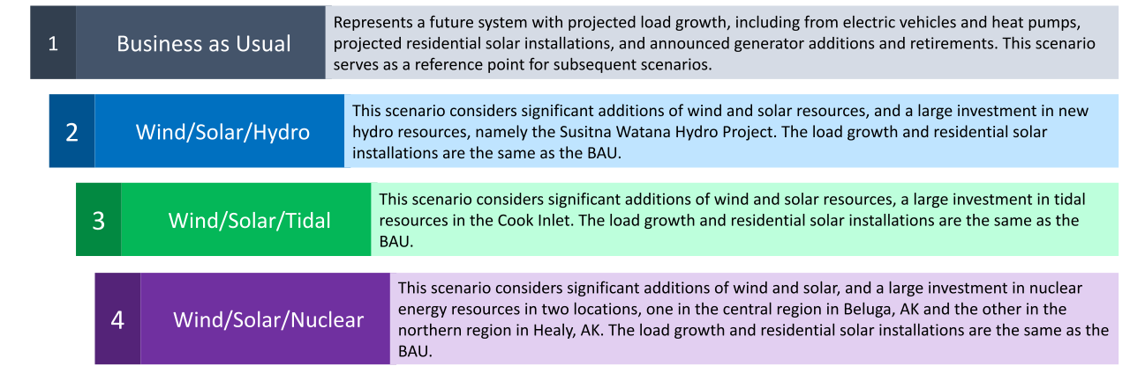
Scenarios

Slide 10
Scenario Development
Load Forecast
Resource Selection and Sizing
Generation Analysis
Transmission Analysis
Economic Analysis

Slide 11
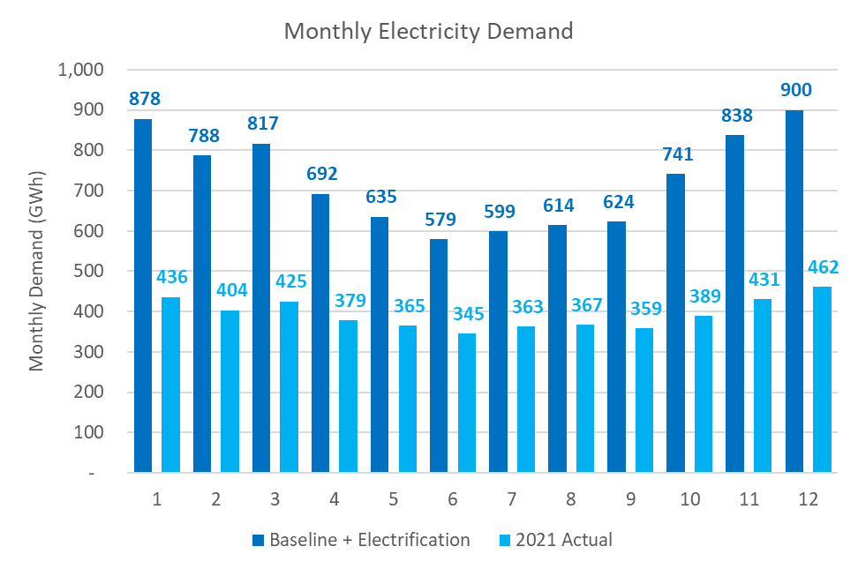
Notes:
New EV, heat pumps, and residential solar PV
Annual energy demand increases by 84%, from 4,725 to 8,705 GWh.
Peak load increases by 112%, from 765 to 1,626 MW
Minimum load increases from 381 to 580 MW
This will require upgrades to the transmission and distribution systems. We only looked at transmission upgrades.
Our goal was to come up with a plausible load growth
We did not take credit for any decarbonization or cost savings from the electrification of heating and transportation loads.

Slide 12
Scenario Development
Load Forecast
Resource Selection and Sizing
Generation Analysis
Transmission Analysis
Economic Analysis

Slide 13
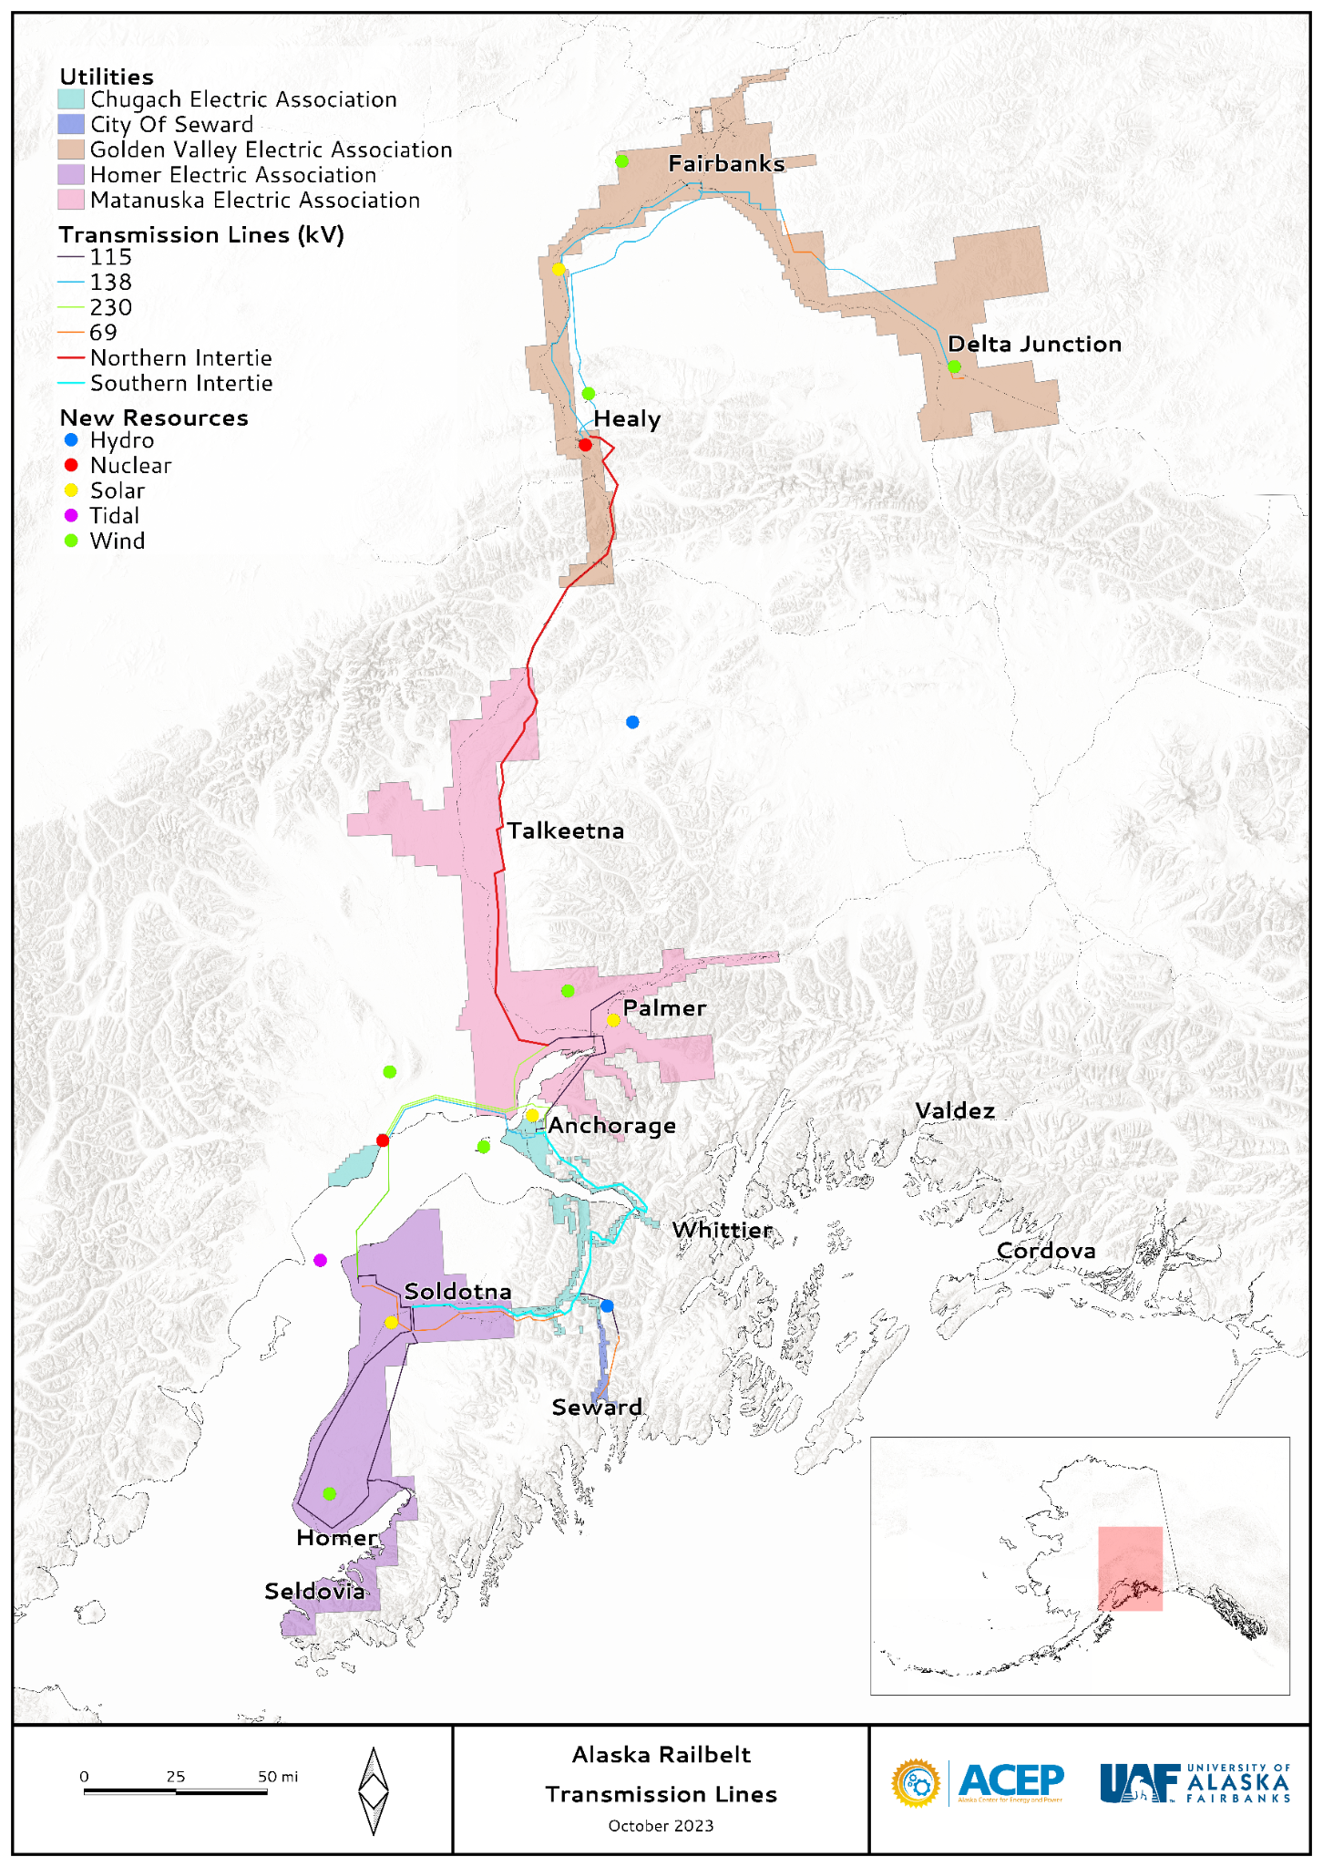
Resource selection
Resource Type | Project
Hydro | Susitna-Watana, Grant Lake, Bradley Lake, Eklutna Lake, Cooper Lake
Wind | Delta Wind, Eva Creek, Fire Island, Homer, Houston, Little Mount Susitna, Shovel Creek
Solar | Fairbanks, Houston, Nenana, Point Mackenzie, Sterling, Willow
Residential Solar | Northern, Central, Southern
Tidal | Cook Inlet
Nuclear | Healy, Beluga
Notes:
Which resources and projects will be available to choose from in the scenarios?
Available resources were chosen to be included in each scenario
Wind, solar and tidal are variable resources, where the amount of generation available from each site varies over time.
Tidal is very predictable while wind and solar are less predictable.
Sites can be curtailed to generate at a lower power, however this results in lost generation that has already been paid for
Hydro is firm source of generation
Variable water flows are buffered by the reservoir. This allows hydro plants to choose when and how much to generate, within the limits of available water and the size of the reservoir
Nuclear and fossil fuel are firm sources of generation
Unlike hydro, there are normally few limits how much they can generate in a year
Projects were identified for each resource
This included projects that already exist, that are currently being developed, that have been proposed and tjhat are purely hypothetical
Only existing and proposed hydro projects were included
Wind and solar resource maps were used to identify new sites in addition to existing and current proposed sites
Cook inlet resource data was used to identify the location for tidal power project’
Ideal locations on the transmission network were identified for nuclear generation
The resource and available generation from each site was characterized
For wind, solar and tidal sites:
Modeled resource data was primarily used and calibrated with available measured data
Resource data was converted into available hourly generation profiles for each site using expected generator and site characteristics including a power curve and losses
Hydro sites
Available water and reservoir size determined available generation throughout the year. Often this was modeled as a monthly energy budget. For Bradley, the actual reservoir and water inflows were modeled.

Slide 14
Resource sizing method
System portfolio
What size to build each project?
Predetermined project sizes for each scenario
  Hydro, tidal, and transmission
Size remaining projects based on cost
  Wind, solar, battery, nuclear, and fossil fuel
  Iterate until converge on lowest cost portfolio
Only partial optimizations
  Not all projects were sized based on cost
  Stability costs were calculated at a later stage
1 year simulation
Calculate annual cost of generation
Costs Converge?
No
Optimization algorithm generates a new portfolio

Slide 15
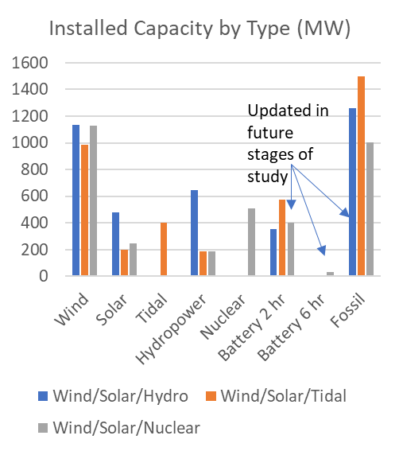
Resource sizing results
Generation from wind and solar was cheapest
  Curtailment costs limited their installed capacity
  Additional stability costs were identified in the Transmission Analysis
Firm sources of power were needed
  Hydro, nuclear, fossil fuel, and batteries
Nuclear was not competitive with LNG
  W/S/Nuclear scenario assumed no LNG imports
  Hydro and tidal competitiveness was not investigated
Cost projections are uncertain
  Especially for nuclear and tidal
  Sensitivity analyses were run
Notes:
Wind and solar were the cheapest sources of energy. But the cost of curtailment and energy storage limited their installed capacity
Among the firm sources of power, only fossil fuel, nuclear and batteries were sized based on cost. Nuclear did not compete with LNG and batteries. Thus, the W/S/Nuclear scenario assumed no LNG imports. This allowed nuclear to be built based on cost.
Since tidal and hydro projects were not sized based on cost, no information on their cost competitiveness is given by these results
Note that the plot shown here is installed capacity, in MW. A plot of annual generation contribution from each source of generation will look different! That will come in the Generation Analysis section.

Slide 16
Scenario Development
Load Forecast
Resource Selection and Sizing
Generation Analysis
Transmission Analysis
Economic Analysis

Slide 17
Generation Analysis
Simulate grid operations across the Railbelt across all hours of the year, considering changing load, wind and solar availability, reliability needs, and operating constraints.
How are resources scheduled (dispatched) to meet load in a least cost manner?
How can grid operators manage variability and uncertainty of wind and solar generation?
How should batteries be scheduled to charge, discharge, and provide reliability reserves?
How do transmission flows change across different weather conditions and load levels?
Which generators are displaced by new renewables and what are are the fuel cost savings?

Slide 18









Power system operations methods
Inputs
Modeling & Simulation
Outputs & Results
Detailed plant and system details
Load profiles
Wind and solar profiles
Hydro water budgets
Gas, coal, and oil plant characteristics (efficiency, cycling constraints, etc.)
Operating reserve requirements
Transmission constraints
Production cost simulation
Least cost, security-constrained, unit commitment, dispatch, and resource scheduling across all 8760 hours of the year
Utilizes third-party, industry recognized optimization software
Operations and Economics
Plant operations and starts
→ Stability analysis
Fuel consumption and cost
→ Economic analysis step
Emissions

Slide 19
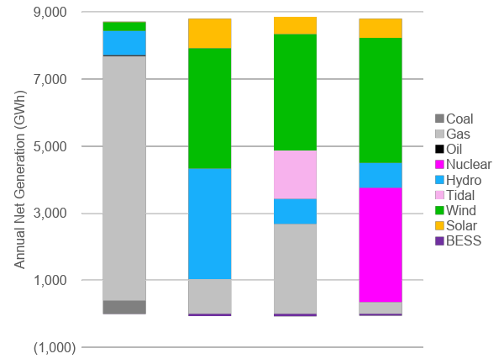
Resource Portfolios and Annual Generation
Emissions Free
11%
88%
70%
96%
Installed Capacity by Portfolio (MW)
 | BAU | Wind Solar Hydro | Wind Solar Tidal | Wind Solar Nuclear
Fossil | 2,090 | 1,330 | 1,740 | 1,330
Nuclear |  |  |  | 540
Solar | 180 | 710 | 430 | 470
Tidal |  |  | 400
Wind | 80 | 1,100 | 1,000 | 1,130
Battery | 220 | 650 | 580 | 540
Total | 2,570 | 3,790 | 4,150 | 4,010
Business as Usual
Wind
Solar
Hydro
Wind
Solar
Tidal
Wind
Solar
Nuclear
*rounded to the nearest 10 MW
Curtailment stays below 10% across all portfolios
Notes:
Between 70 and 96% zero carbon
Huge displacement of fossil fuel generation compared to BAU
Represents a big change in system operations
Batteries are negative since they have inefficiencies during charging and discharging

Slide 20
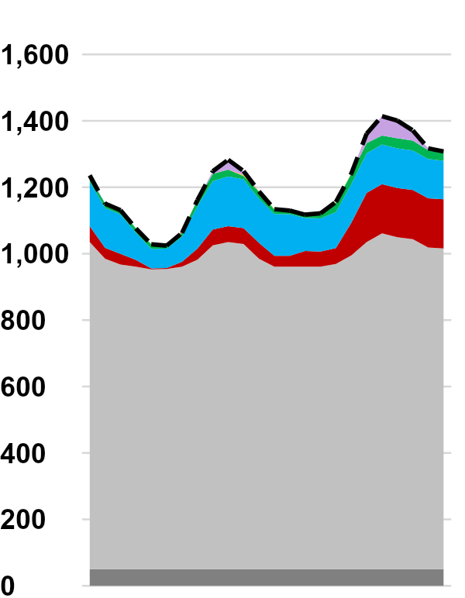
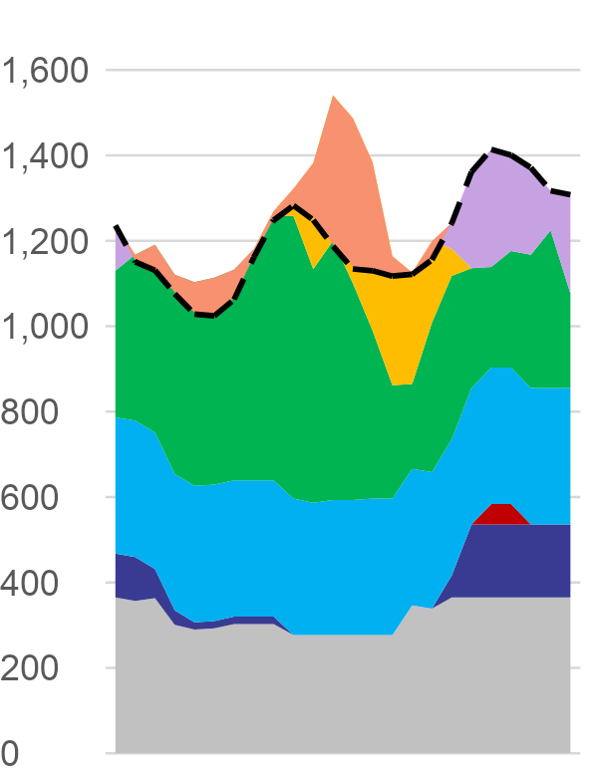
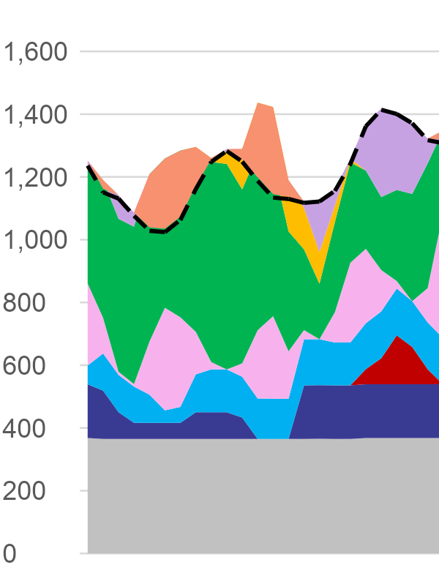
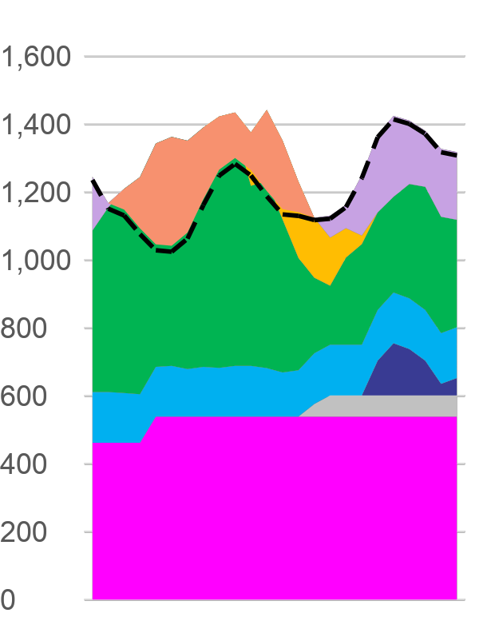
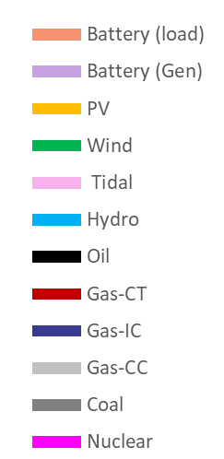
Representative Daily Generation & Operations
“Typical”
Winter Day
System operations will change considerably in high wind, solar, decarbonized portfolios
… but variability can be managed and reliability can be maintained
Business as Usual
Wind/Solar/Hydro
Wind/Solar/Tidal
Wind/Solar/Nuclear
MW

Slide 21
Challenging Conditions are evaluated further for stability
We screened through thousands of hours of operations across the year to evaluate transmission reliability and stability in more detail (more on that soon)
Business as Usual
Wind/Solar/Hydro
Wind/Solar/Tidal
Wind/Solar/Nuclear
MW
These “dispatch conditions” evaluated further in transmission analysis

Slide 22
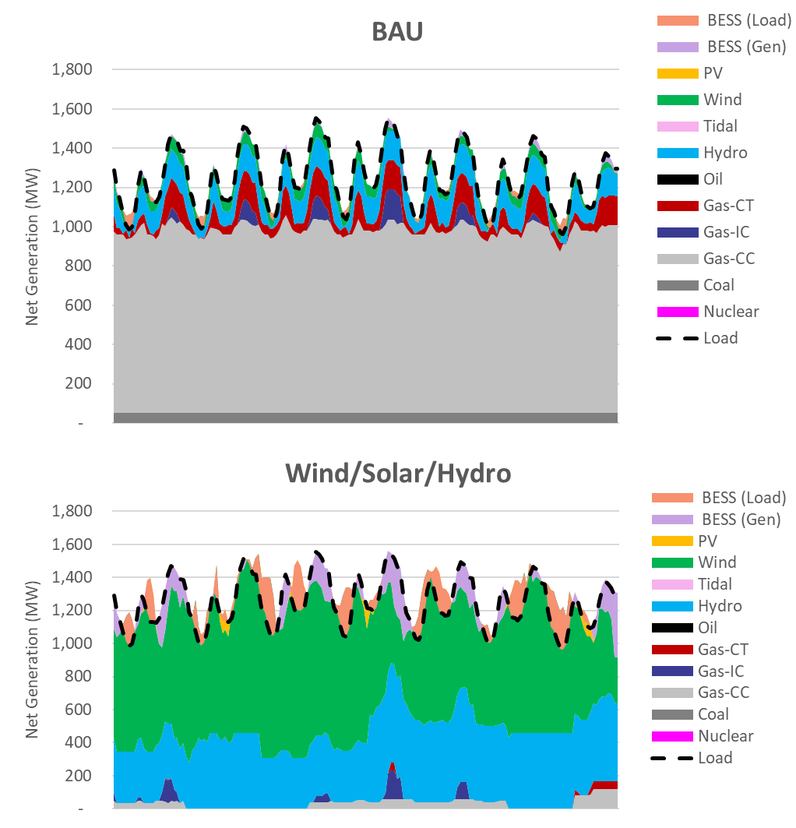
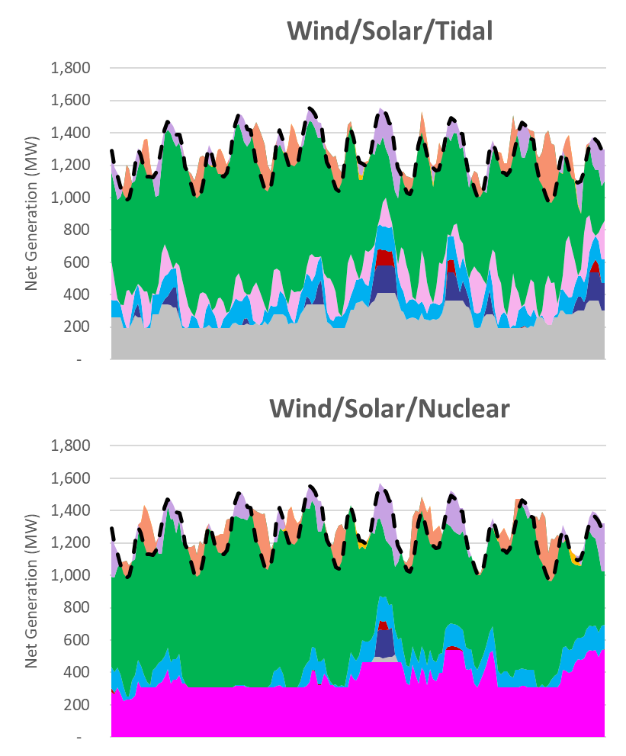
This process was repeated across the entire year
Highest
Renewable Week, December
Business as Usual
Wind/Solar/Tidal
Wind/Solar/Hydro
Wind/Solar/Nuclear
Notes:
Displacement of fossil generation from BAU represents a big change in system operation
Wind is the main source of variable generation
Fossil generation is also more variable and unpredictable. This will require additional flexibility in the natural gas supply than exists today on the Railbelt.
Batteries can be seen charging during low load periods and discharging during high load periods
Hydro and nuclear generation both help to displace higher amount of fossil fuel generation

Slide 23
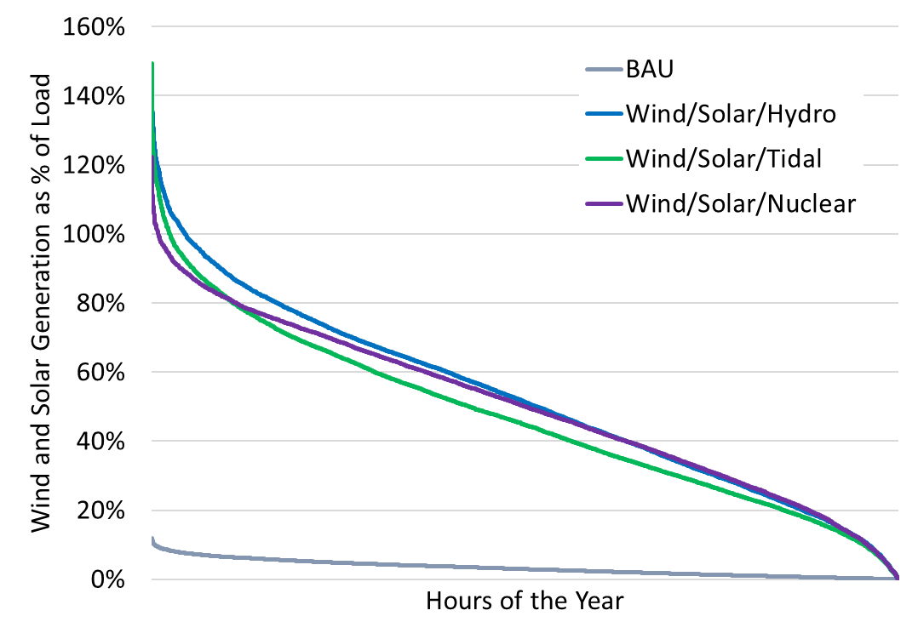
Timing of wind and solar generation will vary significantly across the year
A portfolio with 50% wind and solar will see periods exceeding 100% of total load (due to battery charging)
Inverter-based resources (IBRs) like wind, solar, and batteries have different controls and interactions with the grid
Periods of high penetration (see chart) must be evaluated in further detail for transmission reliability.
Additional analysis required

Slide 24
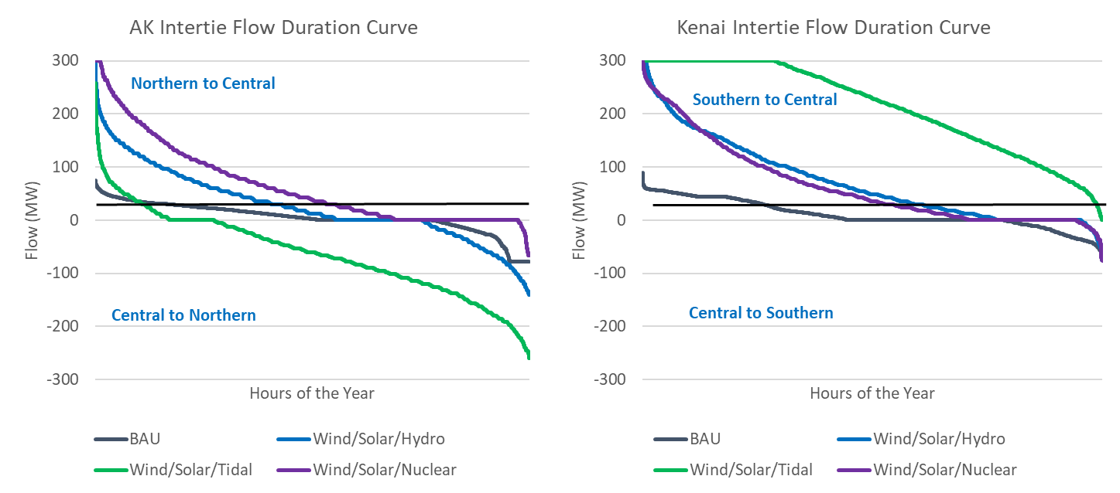
The location of generation will also change and transmission network utilization increases across all scenarios
Notes:
Upgrade to 230 kV on the transmission lines was assumed to increase their max capacity from around 75 MW to 300 MW on each intertie
Higher transmission capacity allows low cost resources to be shared between regions in the low carbon scenarios
Variable generation in different areas on the Railbelt can balance each other out
The W/S/Tidal scenario operates the most near the transmission max capacity, due to a large tidal project installed on the Kenai
This study does not determine which, if any, transmission upgrades are most cost effective

Slide 25
The location of generation will also change and transmission network utilization increases across all scenarios
Notes:
Upgrade to 230 kV on the transmission lines was assumed to increase their max capacity from around 75 MW to 300 MW on each intertie
Higher transmission capacity allows low cost resources to be shared between regions in the low carbon scenarios
Variable generation in different areas on the Railbelt can balance each other out
The W/S/Tidal scenario operates the most near the transmission max capacity, due to a large tidal project installed on the Kenai
This study does not determine which, if any, transmission upgrades are most cost effective

Slide 26
Scenario Development
Load Forecast
Resource Selection and Sizing
Generation Analysis
Transmission Analysis
Economic Analysis
Notes:
Today’s Topics and Goals
Today we will be providing an overview of the project. This project started over a year ago and we will provide a broad overview of what this project is, what the project goals are, and what we’re doing.
Additionally we will share some of the findings from our Railbelt Load forecast which includes adoption forecasts for electric vehicles, heat pumps, and behind-the-meter solar (such as residential rooftop solar).
Throughout the presentation we will also send out polling questions to get your feedback on what more you are interested in learning about and what you’re interested in this team looking into in the future on the topic of energy decarbonization.
There will be opportunities for questions after the project overview and at the end.

Slide 27
Transmission Analysis
Matt’s Notes on Slide Applicability
Chugach Meeting (~20 mins + Q&A):
I’d skip (or go super quick) until case selection
Skip the slide on PSSE
Include the last slides on models, weak grids, risk metrics
Public Library Meeting (15 mins + Q&A):
Bulk of the deck (exclude the extra for Chugach)
State Legislature Meeting (5-10 mins)
Bulk of the deck
  skip/go fast for: case selection (5), Steady-State Analysis (6), Dynamics Initial Results (7);
  exclude the extra for Chugach
Alaska Railbelt Presentations, Jan 18 & 19, 2024

Slide 28
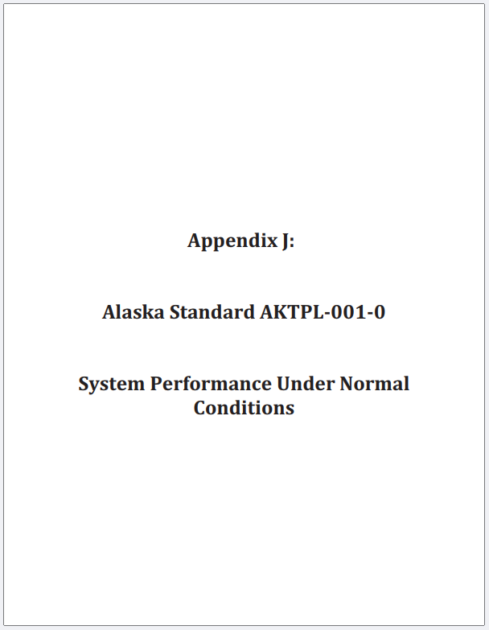
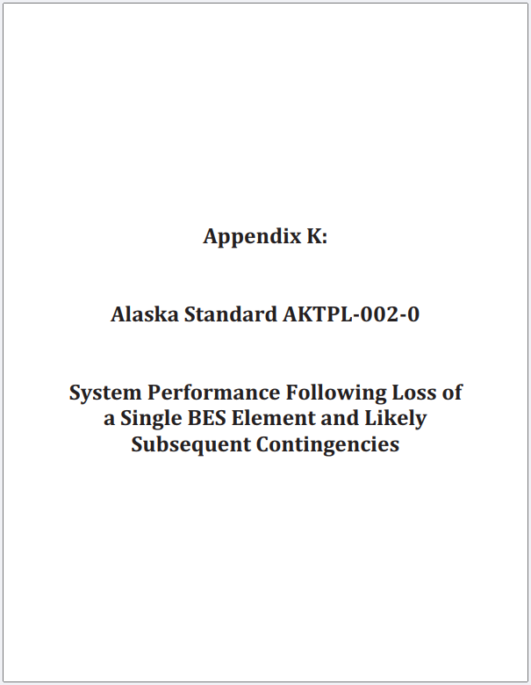
What is Analyzed?
Steady State Analysis
Can the grid sustain operations in all credible grid conditions?
Thermal 🡪 look for overloading of lines
Voltage 🡪 ensure enough voltage support
Dynamic Analysis
Can the grid recover from the “shock” of a sudden disturbance?
Frequency Stability
Voltage Stability
Analyses consider a defined set of grid disturbances and acceptance criteria, per Grid Planning Documents AKTPL-001, AKTPL-002
Transmission analysis is performed on “snapshots” in time – Stability must be satisfied at every moment

Slide 29
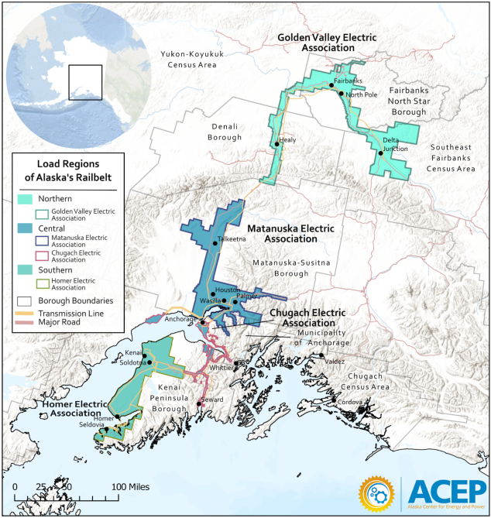
What are the Challenges?
Steady-State
New resources + retirements = different flow patterns
Different flow patterns 🡪 different needs/locations for voltage support
Dynamics
Sudden loss of a power plant 🡪 loss of power and voltage support must be quickly recovered
Sudden loss of a tie line 🡪 power and voltage support must be quickly reallocated
Successful recovery is a matter of sufficiency & timeliness of response from the remaining resource
This is true for all grids, but the Railbelt is especially challenged because of the
small size, isolated nature, and grid separation that occurs

Slide 30
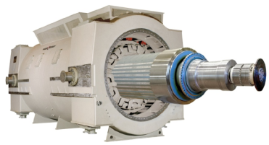
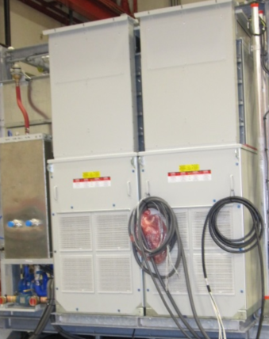
Resource Technologies
Synchronous Machines (SM) (i.e., Fossil, Nuclear, Hydro)
Frequency Response: Inertia (fast/immediate) + Governor Droop (slower, seconds)
Voltage Support: Grid strength (fast/immediate) + Voltage Regulation (slower, seconds)
🡪 Behavior dominated by physical geometries
Inverter-Based Resources (IBR) (i.e., Wind, Solar, Battery, Tidal)
Frequency Response: Droop (slower, seconds)
Voltage Support: Voltage Regulation (slower, half a second – seconds)
🡪 Behavior dominated by firmware code

Slide 31
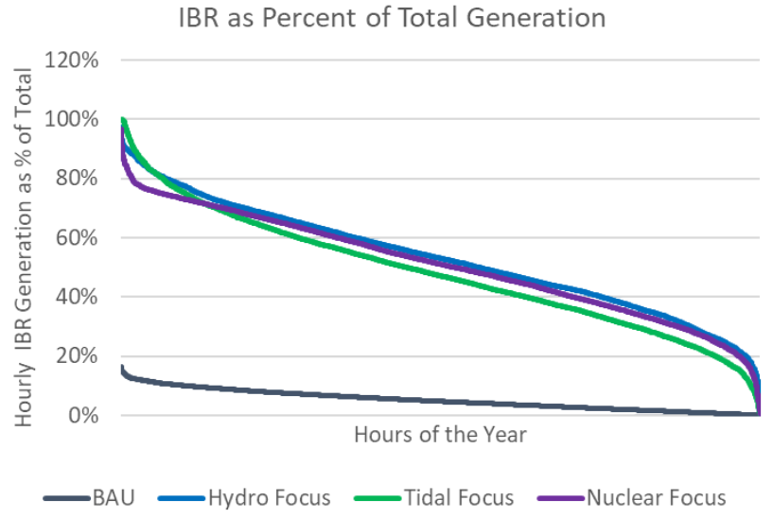
Case Selection
The study analyzed periods where both:
1. Generation is dominated by IBR
2. Highest Tie-Line Loading Event
Selection of grid operations for dynamic analysis
AK Intertie
Kenai Intertie
Fewest synchronous machines online (historical providers of stability services)
High tie-line loading makes the sudden loss of the line a more severe disturbance

Slide 32
Steady-State Analysis
Violations Identified
Mitigations Applied
Thermal
Power transfer limits of existing infrastructure exceeded
Why? Increased power flow due to electrification and new resource interconnections
Increased rating by upgrading lines (voltages or replacing conductors) and adding new lines (AC and DC)
Voltage
Low voltage violations (<95% nominal voltage) found at many buses (substations) across the system
Why? Increased power flows results in more demand for voltage support
Several, made in sequence:
Updated voltage schedule of resources
Adjusted the new HVDC line power flow
Added shunt capacitors
Added BESS projects for voltage support and line loading relief

Slide 33
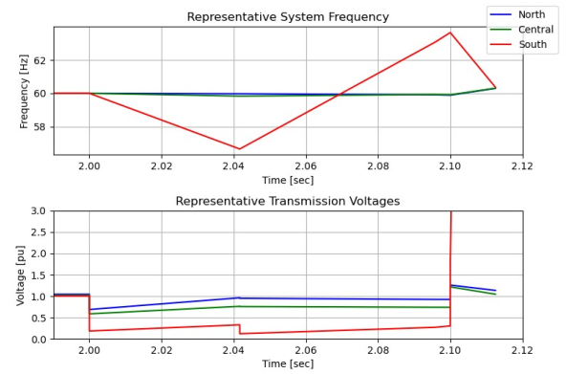
Dynamics: Initial Results
Simulation Setup
Hydro scenario, loss of the Kenai Intertie
Typical IBR plant configuration was used (typical of IBR installations today)
Initial Results
Grid frequency and voltage become out of control at the onset of the disturbance
There are insufficient reliability services being provided collectively from the remaining resources on the grid
Critical reliability services: frequency response and voltage support
Mitigations are needed…

Slide 34
Potential Mitigation Approaches
Operational Mitigations
Force more SM to remain online; not recommended for long-term action; not pursued here
Capital Investment Mitigations
Synchronous Condensers - a connected synchronous machine that does not produce power or consume fuel
Inverter Tuning for Performance – adjusting the configuration of IBR for more aggressive responses
Grid-Forming Inverters (GFM) – an emerging, commercially available inverter technology that can stabilize the grid much as synchronous machines do
These mitigations were applied in this study

Slide 35
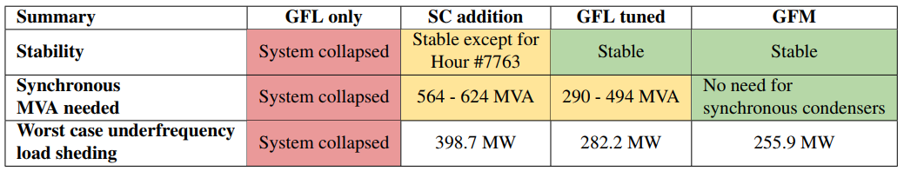
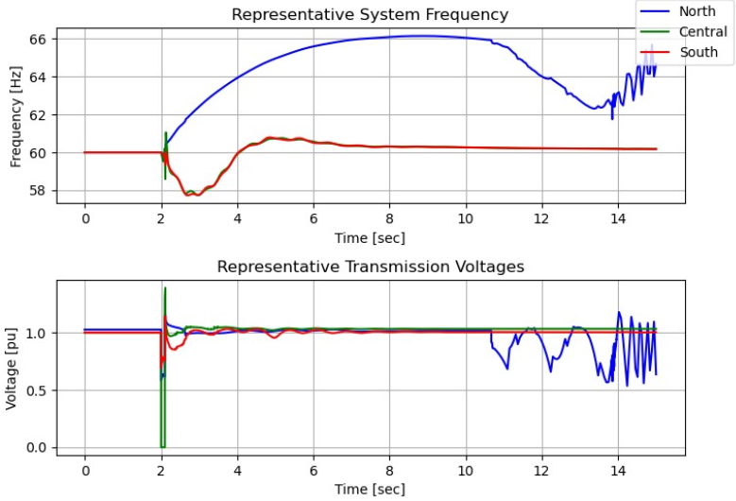
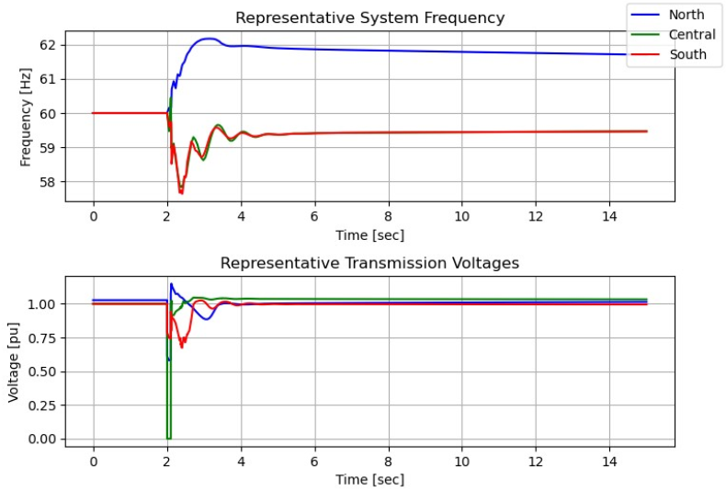
Impact of Mitigations
Loss of the AK Intertie for Hour 7763, GFL with SC Addition
Loss of the AK Intertie for Hour 7763, GFM Included
Stable, Sustained Recovery!
Failure in North!
GFM inverter technology is effective in replacing the reliability services from retiring synchronous plants

Slide 36
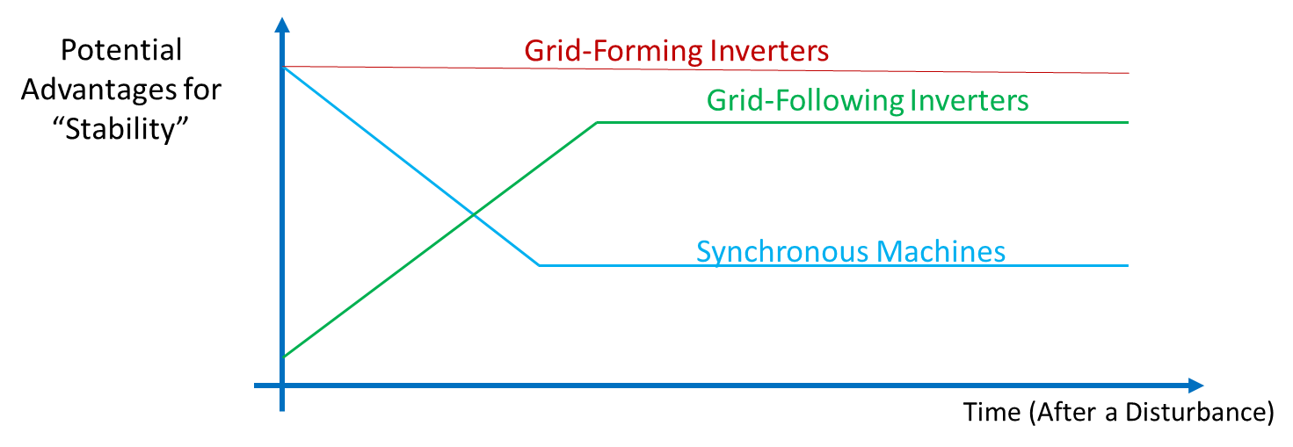
Emerging Technology: Grid-Forming Inverters
What is it?
Grid-forming (GFM) technology is largely a controls technology
BESS: no changes to hardware are needed
Wind: likely to be controls-only
What does it do?
Attempts to capture the “best of both worlds” from SM and IBR
Immediate responses of SM (inertia, grid strength) + resilience of synchronization from IBR

Slide 37
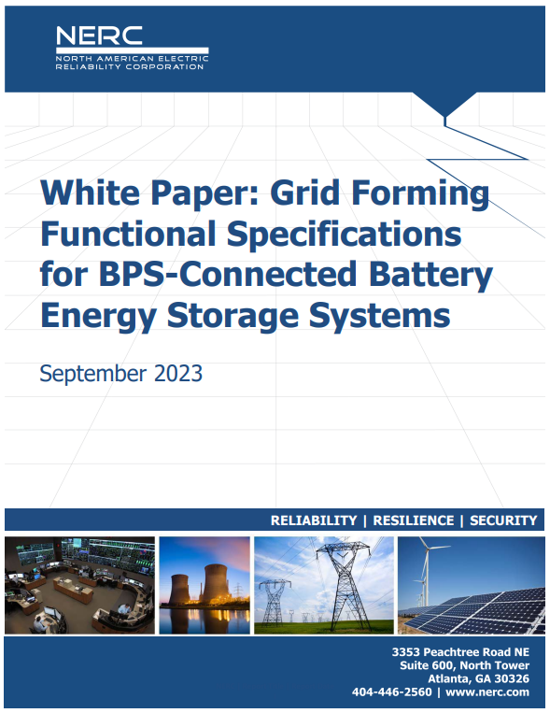
GFM – Industry Experience
Recent Industry GFM Installations (Utility-Scale)
2017 St. Eustatius BESS (SMA)
2018 Dalrymple BESS, Australia (ABB/Hitachi)
2018 Kauai BESS projects (Telsa)
2019 Dersalloch Wind, Scottland – (Siemens)
2019-2020 IID BESS for Blackstart, California (GE)
2022 Wallgrove BESS, Australia (Telsa)
2022 Hornsdale BESS, Australia (Tesla)
Others I’ve likely missed…
More on the Horizon: HECO Stage 2&3, Australia 8 BESS GFM Projects, NationalGridESO, etc.
North American Electric Reliability Corporation (NERC) Released a White Paper in 2023 recommending GFM for all BESS projects going forward

Slide 38

A Note on Analysis Methods & Tools
Commercially available software (Siemens PSSE)
Same tools used by Railbelt utilities and numerous others throughout the world
Many thousands of inputs to the model
  Grid – Lines, transformers, shunts
  Resources – generators, DER, loads
Engineering judgment and special care is needed with inputs, runs, and interpretation of outputs
It is critical to know and understand the limits of the tools, and at what point different tools are needed

Slide 39
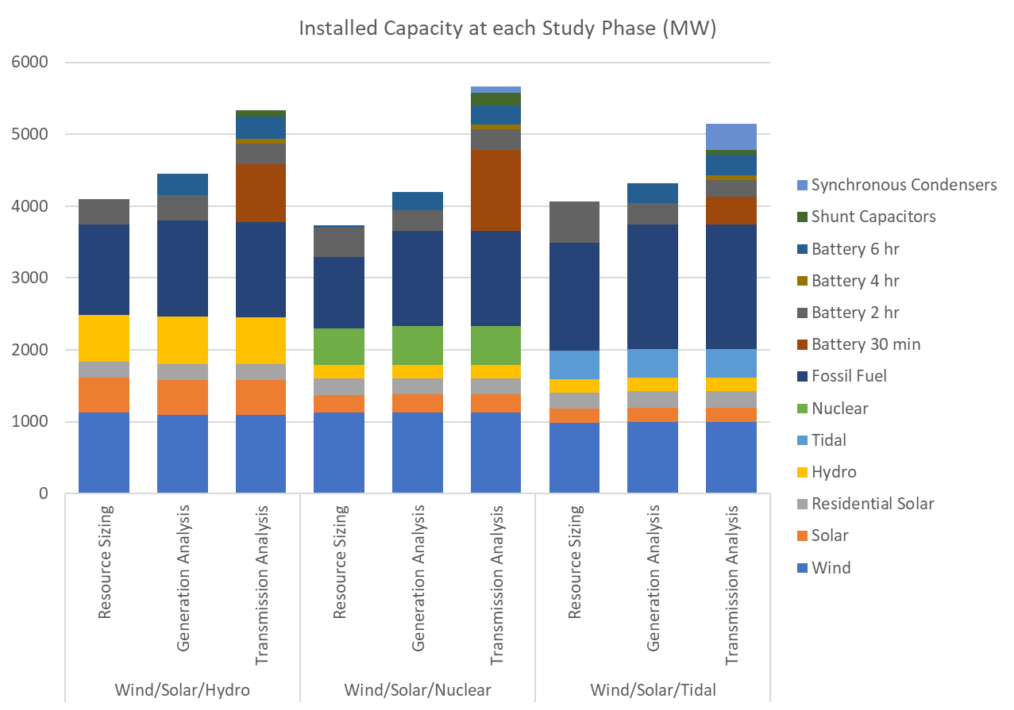
Compare installed capacity at each study phase
Resource Sizing
  Initial estimates
Generation Analysis
  Fossil fuel and battery capacity increased for capacity reserve margin
Transmission Analysis
  Battery, shunt capacitor, and synchronous condensers added for stability
Significant increase above initial estimates
Notes:
Steve

Slide 40
Scenario Development
Load Forecast
Resource Selection and Sizing
Generation Analysis
Transmission Analysis
Economic Analysis
Notes:
Today’s Topics and Goals
Today we will be providing an overview of the project. This project started over a year ago and we will provide a broad overview of what this project is, what the project goals are, and what we’re doing.
Additionally we will share some of the findings from our Railbelt Load forecast which includes adoption forecasts for electric vehicles, heat pumps, and behind-the-meter solar (such as residential rooftop solar).
Throughout the presentation we will also send out polling questions to get your feedback on what more you are interested in learning about and what you’re interested in this team looking into in the future on the topic of energy decarbonization.
There will be opportunities for questions after the project overview and at the end.

Slide 41
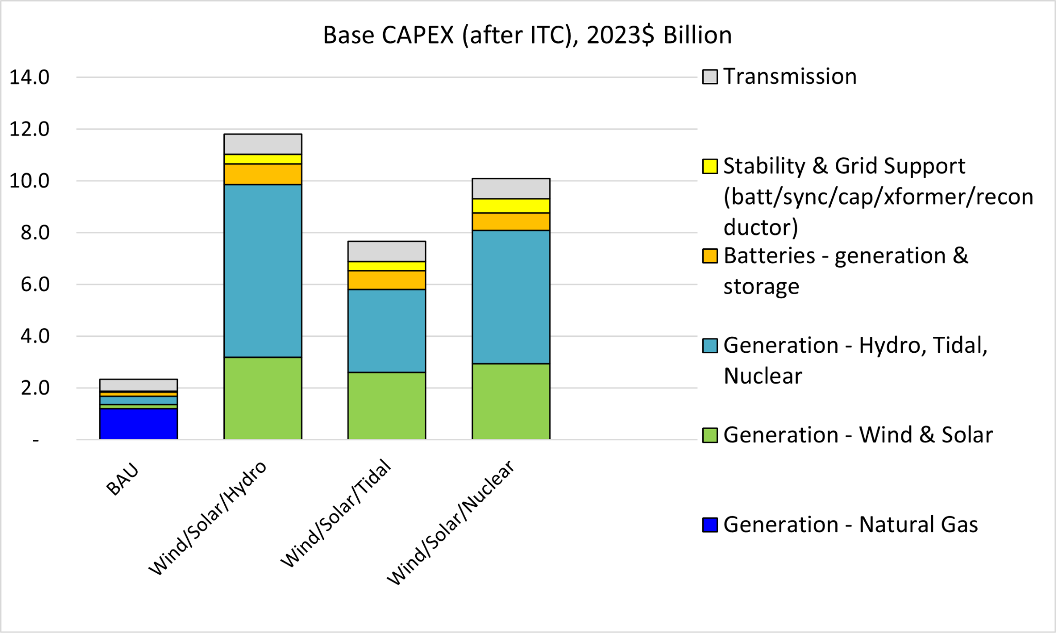
Required Capital Investment
Notes:
Annualized capital cost of the most capital-intensive scenario (Wind/Solar/Hydro) in Base case = $650 million per yr. That’s a lot. But compare it to fuel cost in BAU Bases case = $745 million per year. (If we also include the fuel cost still present in Wind/Solar/Hydro, then the comparison becomes: Base case fuel cost = $745 million vs. Wind/Solar/Hydro capital+fuel = $740 million.)
So, the trade-off of fuel only for fuel+capital is about one for one.

Slide 42
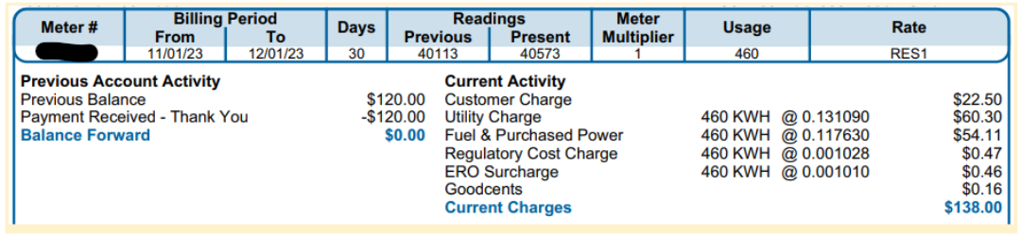
Generation & Transmission Cost of Service:
G&T Cost of Service equals:
Fuel
+ Variable O&M
+ Fixed O&M
+ Annualized Capital Cost of new generation & transmission
+ Margin (a financial cushion)
On your bill, = ”Fuel & Purchased Power” + SOME of “Utility Charge”
If G&T cost of service goes up by $10/MWh, rates go up by 1 cent per kWh.
Notes:
The Generation & Transmission Cost of Service, or “G&T Cost of Service”, was calculated for each scenario. The G&T Cost of service equals the cost of producing electricity and getting it to the distribution system. It can be thought of as the production cost of electricity.
Capital costs were determined based on fixed annual debt service, fixed in nominal dollars, similar to a home mortgage. The G&T cost also included revenue collected as “margin”, which serves as a financial cushion against uncertain revenues and costs.
(A detail: margins are determined based on capital costs. If the power system becomes much more capital-intensive and less fuel-intensive, margins will go up, perhaps significantly, under current formulas that base margins on debt interest payments.)

Slide 43
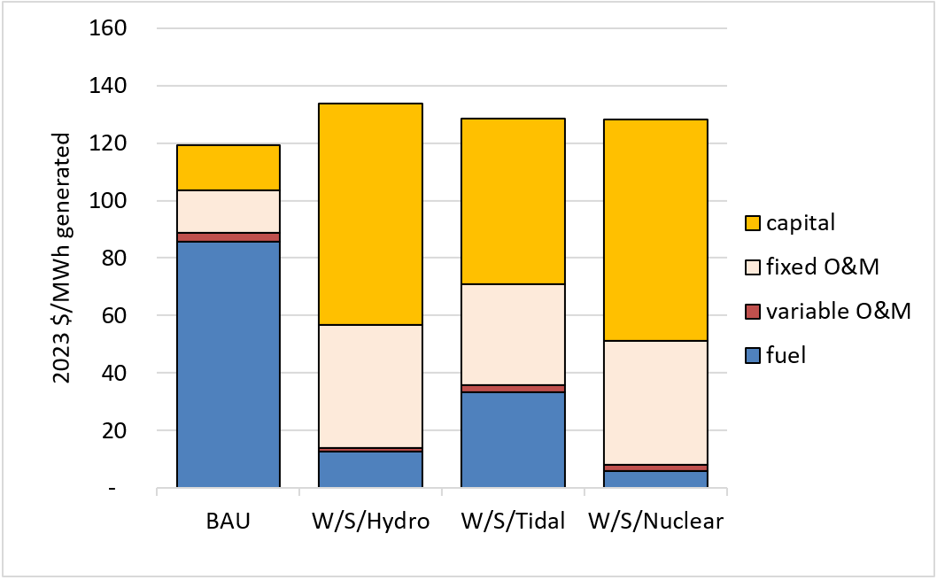
Base Case Generation & Transmission Cost of Service
Notes:
Given the highly uncertain capital and fuel costs going into these scenarios, the calculated cost of service numbers are essentially equal.
The cost of service shifts from fuel to capital and O&M.

Slide 44
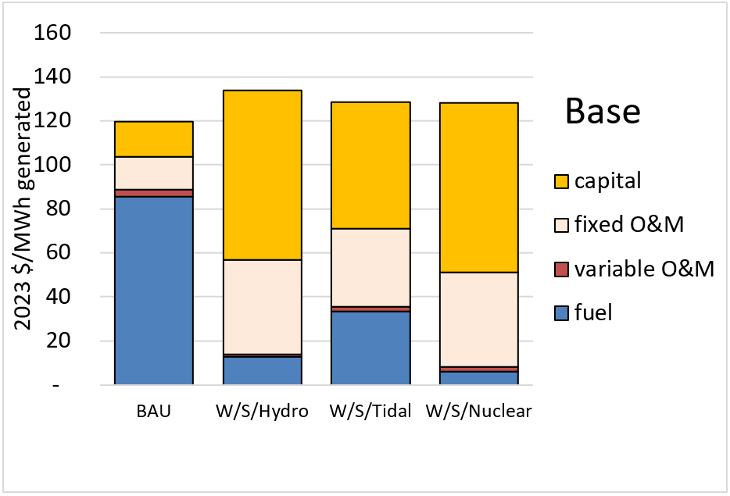
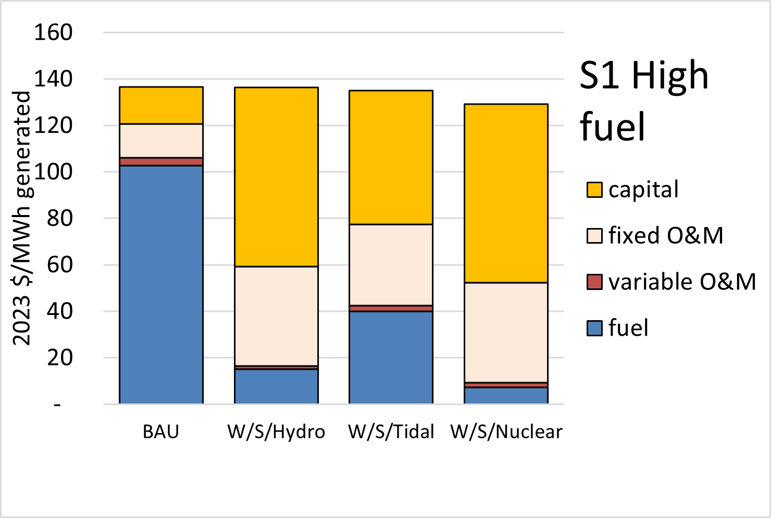
Base vs. S1: High fuel costs
S1: Fuel costs are 20% higher than Base.
Natural gas is increased from $14 to $16.80 per million btu; Oil from $20 to $24; Coal from $4 to $4.80
Notes:
Five sensitivity cases are presented here, named S1 through S5.
In each case, the dispatch of resources was NOT re-simulated in Plexos. This is not a problem since the resource mix is predetermined and the relative fuel costs are not being changed. Only relative fuel costs matter for determining what units get dispatched.

Slide 45
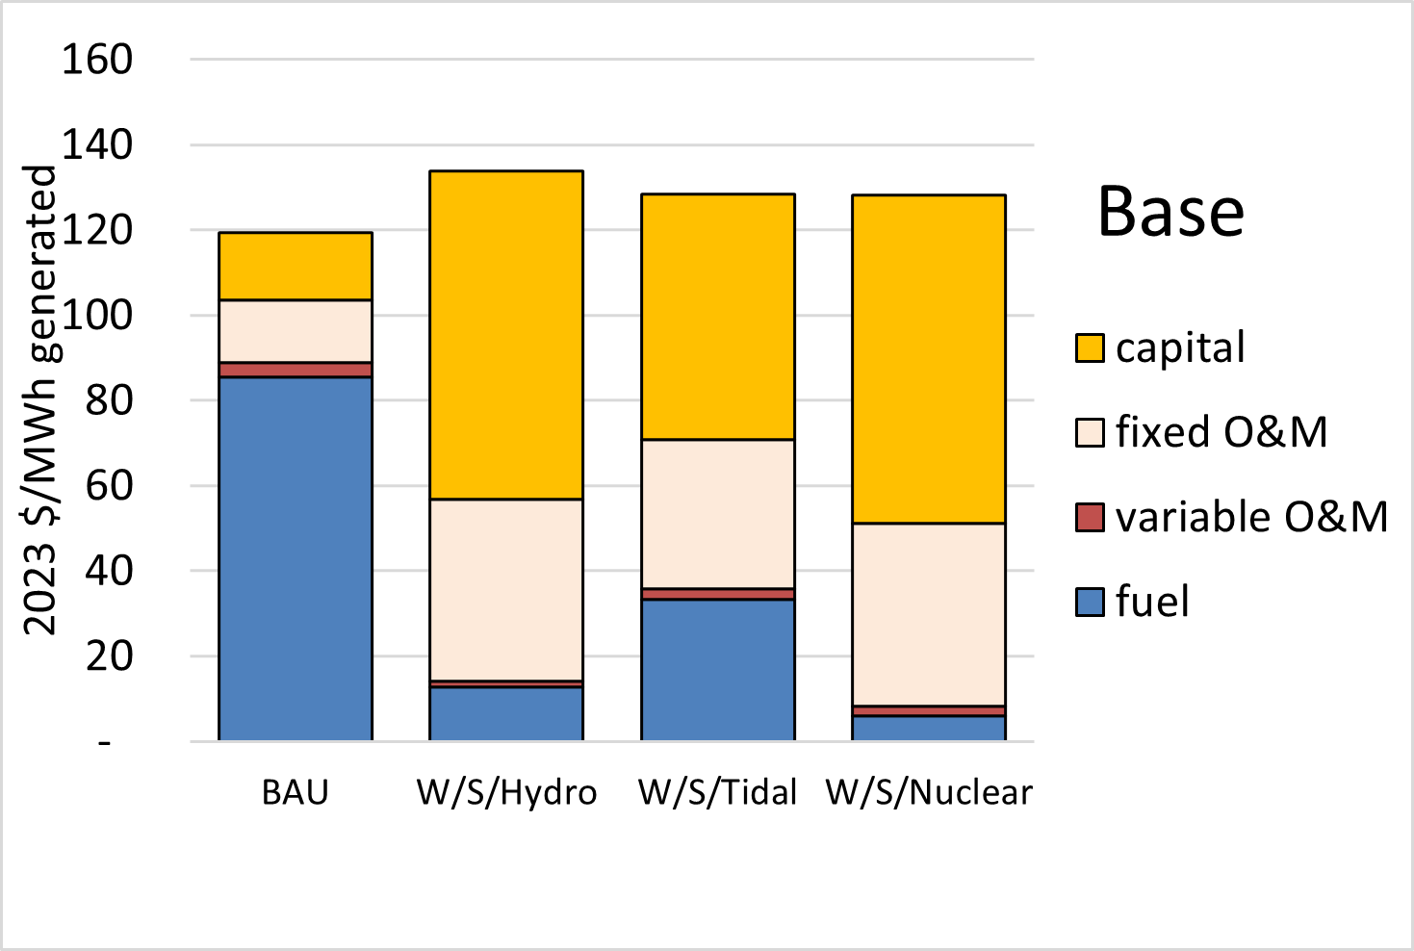
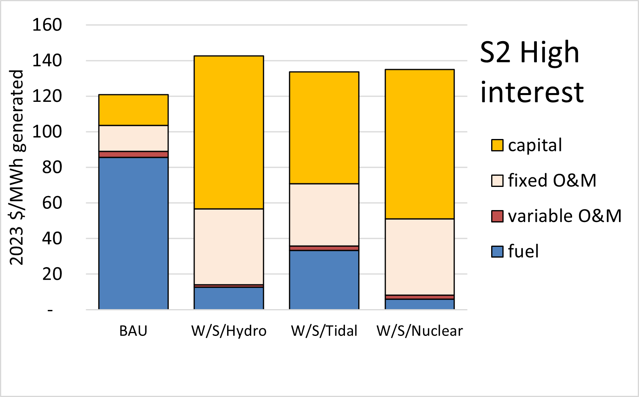
Base vs. S2: High Interest
S2: Interest rate is 20% higher than Base; increased from 5% to 6%.

Slide 46
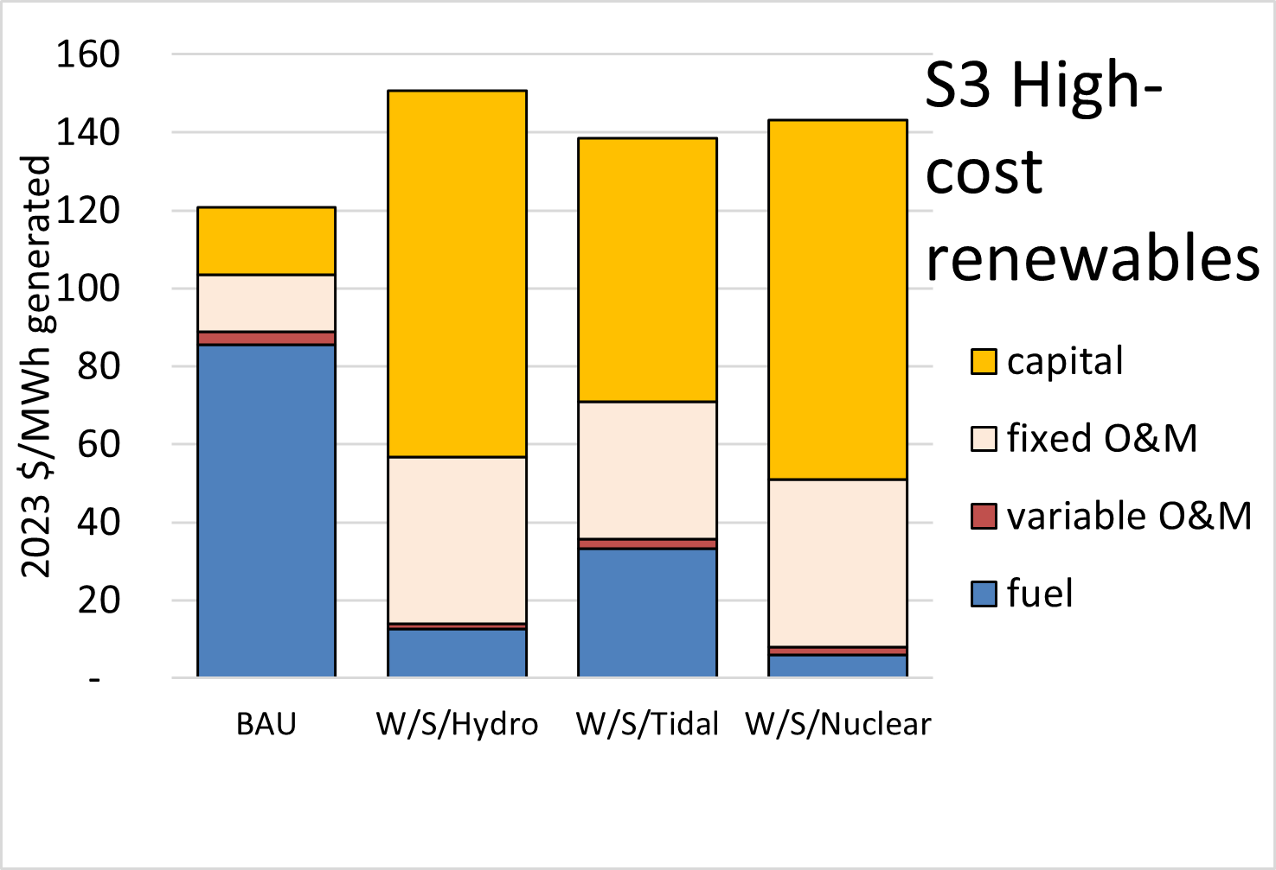
Base vs. S3: High-cost renewables
S3: Capital costs (CAPEX) of Susitna-Watana, Tidal, & Nuclear are 20% higher than Base. Interest rate is 6% vs. 5% in Base.

Slide 47
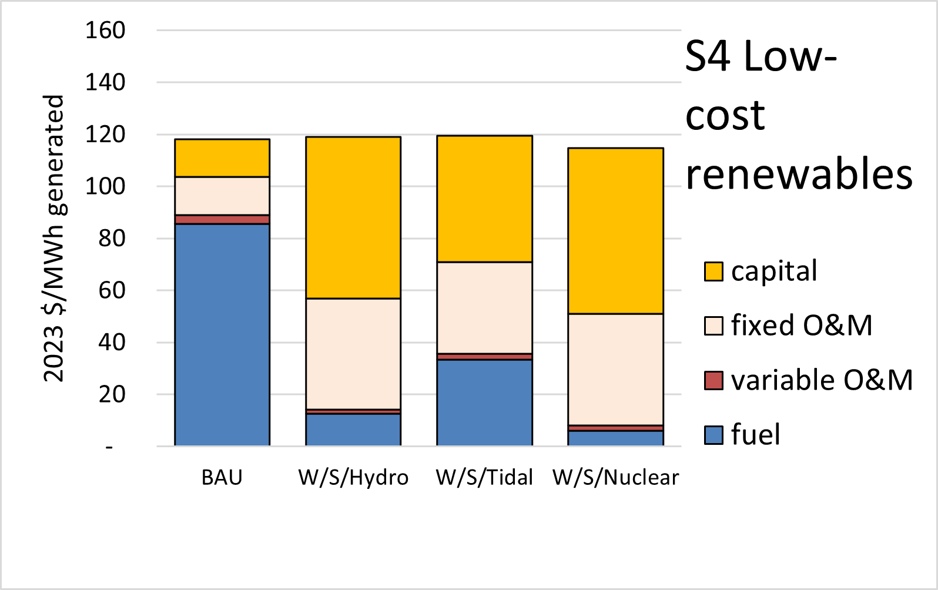
Base vs. S4: Low-cost renewables
S4: Capital costs (CAPEX) of Susitna-Watana, Tidal, & Nuclear are 20% lower than Base. Interest rate is 4% vs. 5% in Base.

Slide 48
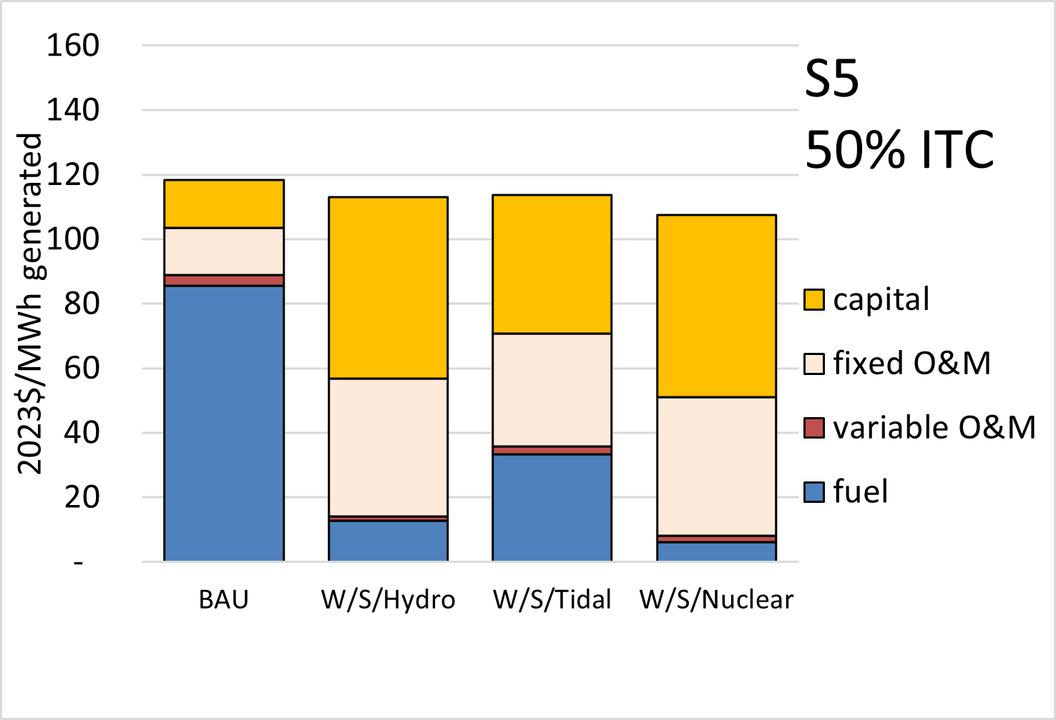
Base vs. S5: 50% ITC
S5: The investment tax credit (ITC) percentage is 50%, vs. 30% in Base.
Notes:
Under the Inflation Reduction Act, a 50% ITC is available if projects can meet the “Energy Community” (10% bonus) and domestic content (10% bonus) requirements.
It appears that most or all potential Alaska project locations would qualify as “Energy Communities”, but this is not certain.
Also, the IRA specifies that the ITC will phase out beginning in 2032 unless the U.S. has failed to achieve a 75% reduction from 2022 levels in power system carbon emissions.
(https://www.nortonrosefulbright.com/en-us/knowledge/publications/20e136f1/inflation-reduction-act-provides-major-tax-incentives-for-public-power )
So, a 50% ITC is not a sure thing, especially as one looks further into the future. But it is certainly not unreasonable.

Slide 49
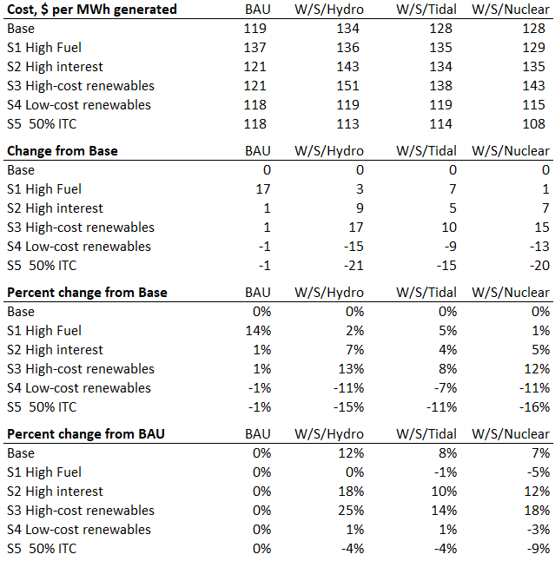
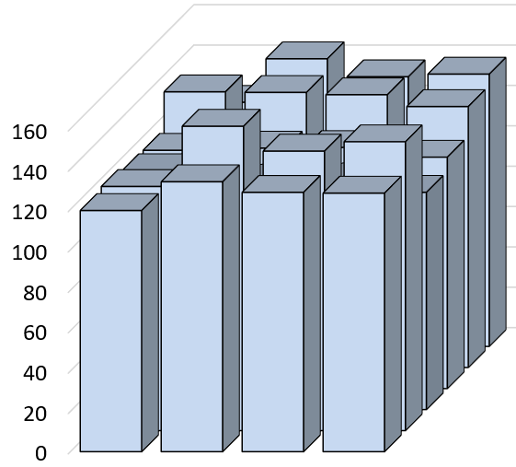

Recap of Sensitivity Cases
S1 High Fuel: Fuel costs are 20% higher
S2 High interest: Debt interest rate is 6% (vs 5%)
S3: High-cost renewables:
Major projects CAPEX is 20% higher, interest rate = 6%
S4: Low-cost renewables:
Major projects CAPEX is 20% lower, interest rate = 4%
S5: 50% ITC: 50% credit vs. 30% in Base
Notes:
Taken together, these sensitivity cases demonstrate that the calculated G&T cost of service for these illustrative low-carbon scenarios could easily be 20% higher or 20% lower than they would be under the BAU scenario. Costs will likely be quite different in 2050 than any projections made today. Given the tremendous uncertainties, one reasonable conclusion might be that the future cost of a low-carbon power system is in the same ballpark as the cost of continued reliance on fossil fuels.

Slide 50

What does this mean?
Notes:
Phylicia
What are we say and what are we not saying: if you follow current trends and other available alaskan forecasts - this is where the Railbelt ends up in 2050. We are not saying that this is a prediction of the load in the future, but perhaps our best estimate at the moment given the information we have.
This amount of increase in load has significant impacts for generation planning, if you need to plan for the amount of load doubling.
These results also demonstrate that electrification can have significant impacts to our grid, and these technologies should be included in the planning process. Additionally these forecasts should be updated as new information becomes available and situations changes - such as affordability of natural gas.

Slide 51
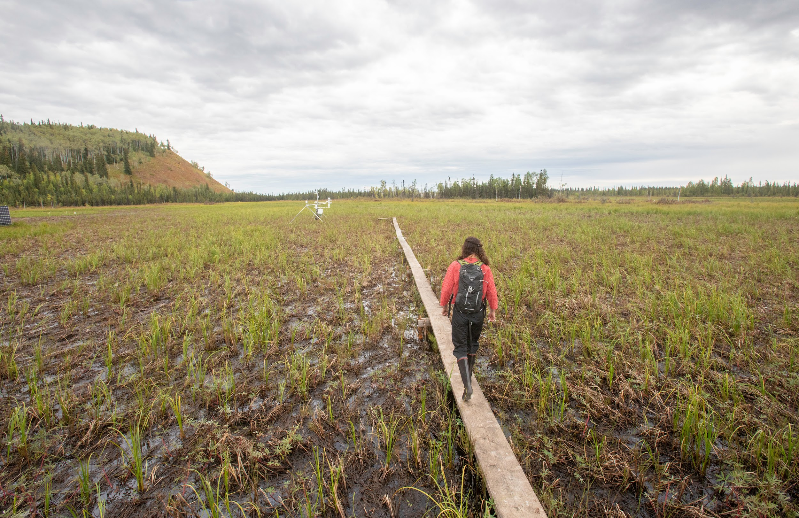
Focus on the Challenges and Opportunities
A future low-carbon Railbelt will operate significantly differently than today or the Business-as-Usual Scenario.
System stability is more difficult to achieve in low-carbon scenarios. Improvements in the inverter technology of batteries, and wind and solar energy will be essential for future Railbelt grid stability.
There is great uncertainty in future costs. The cost of service for the low-carbon scenarios differs by -9% to 25% from the Business-as-Usual scenario depending on varying fuel costs, capital costs, and interest rates.
This study did not evaluate the cost-effectiveness of near-term renewable additions. The cumulative cost of achieving high levels of renewable penetration is non-linear, due to increased transmission and storage requirements. From now until at least 2030, low-carbon projects will qualify for investment tax credits ranging from 30-50%.
Notes:
Instead of focusing on the numbers, let’s focus on the challenges and opportunities. The items on this list are both challenges and opportunities. A future low-carbon Railbelt is going to operate significantly differently the Railbelt today or a future Railbelt that still primarily runs on natural gas and coal generation. The scenarios that we looked at jumped to 2050, where in reality a transition to these low carbon systems would happen incrementally and in steps where at each addition of new generation the system will slowly shift operation practices as the new technologies are tested and system operators learn the limitations and benefits of each technology operating specifically in the Railbelt.
This is important as system stability will be more difficult to achieve in any of these low-carbon scenarios. The stability and reliability of the Railbelt grid in a low-carbon future will depend on advances being made in inverter–based technologies.
What is important to keep in mind for all the economic results is that there is great uncertainty in costs, including fuel costs, capital costs, and interest rates. Varying these costs resulted in the low-carbon scenarios in this study differing -9% to 25% from the Business-as-Usual. Estimating costs 25 years into the future is difficult and there is inherent uncertainty.
Conversely, this study did not evaluate the cost effectiveness of near-term renewable energy projects. The cumulative cost of achieving high levels of renewable penetration is non-linear, due to increased transmission and storage requirements. From now until at least 2030, low-carbon projects will qualify for investment tax credits ranging from 40-50%.

Slide 52
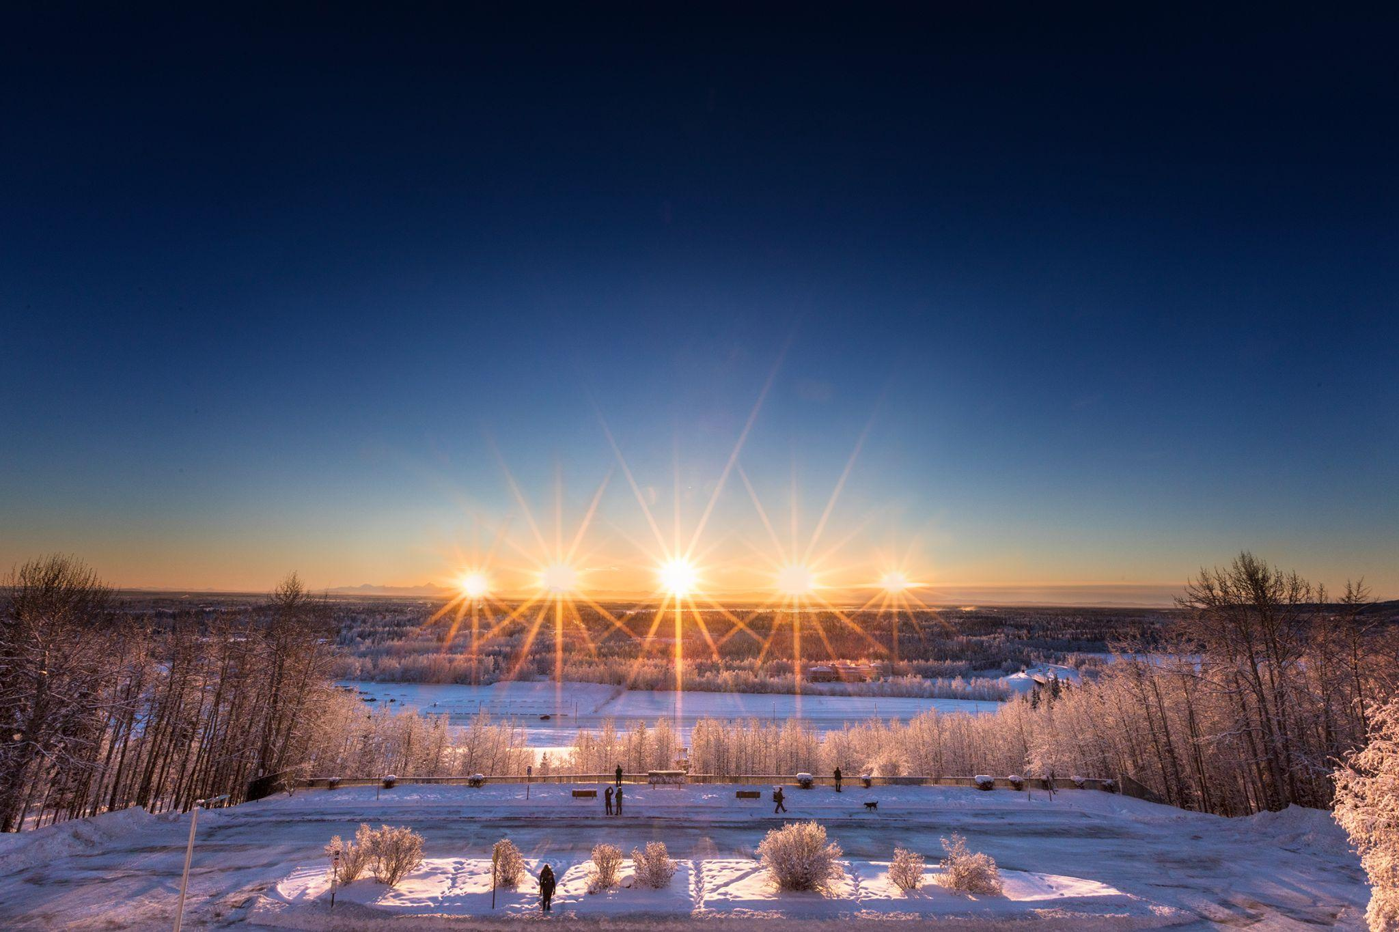
Next Steps Under Consideration
Focus on finding lower cost scenarios
Focus on achieving higher levels of decarbonization
Explore how electrification can lower consumer costs and carbon emissions
Explore connections between policy, emerging technology, and future scenarios
Dig deeper into stability issues and solutions with high levels of renewables
Dig deeper into the impact of natural gas supply pathways on scenario development
Notes:
Jeremy

Slide 53
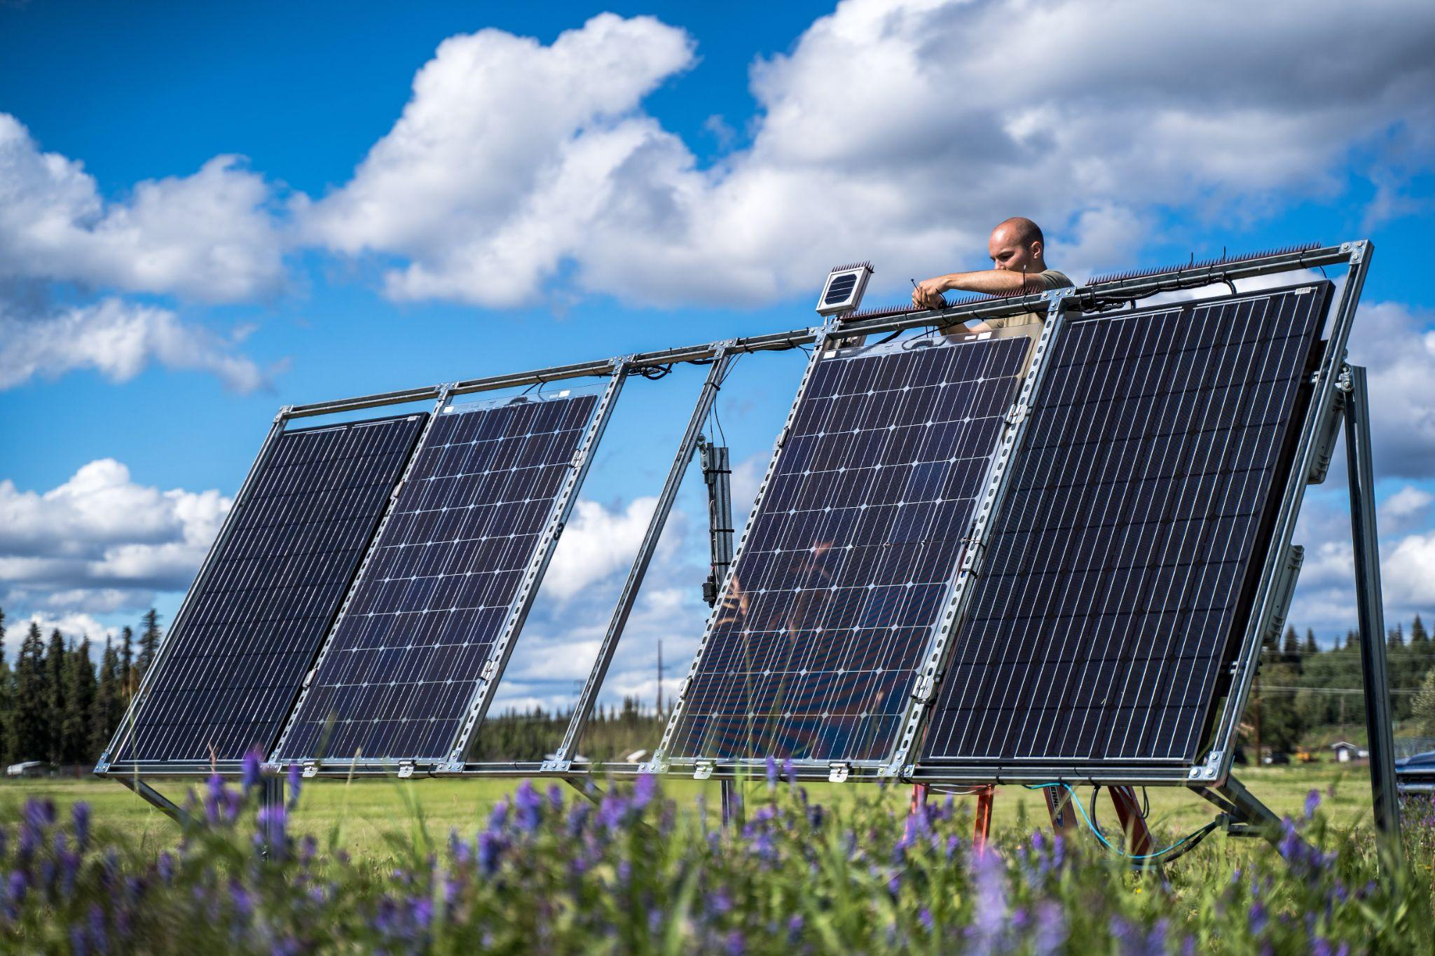
Questions?

Slide 54
Technical Backup Slides

Slide 55

Dynamic IBR Model Overview
“All models are wrong, some are useful.”
-- George Box, British Statistician
Completely accurate
Less accurate
Highly accurate
Easier to use
More difficult to use
Pos. Seq. UDM IBR Models
EMT IBR Models
Pos. Seq. Generic IBR Models
Important to understand how the models are wrong and how it impacts the conclusions drawn from the analysis (conservative v. optimistic)

Slide 56
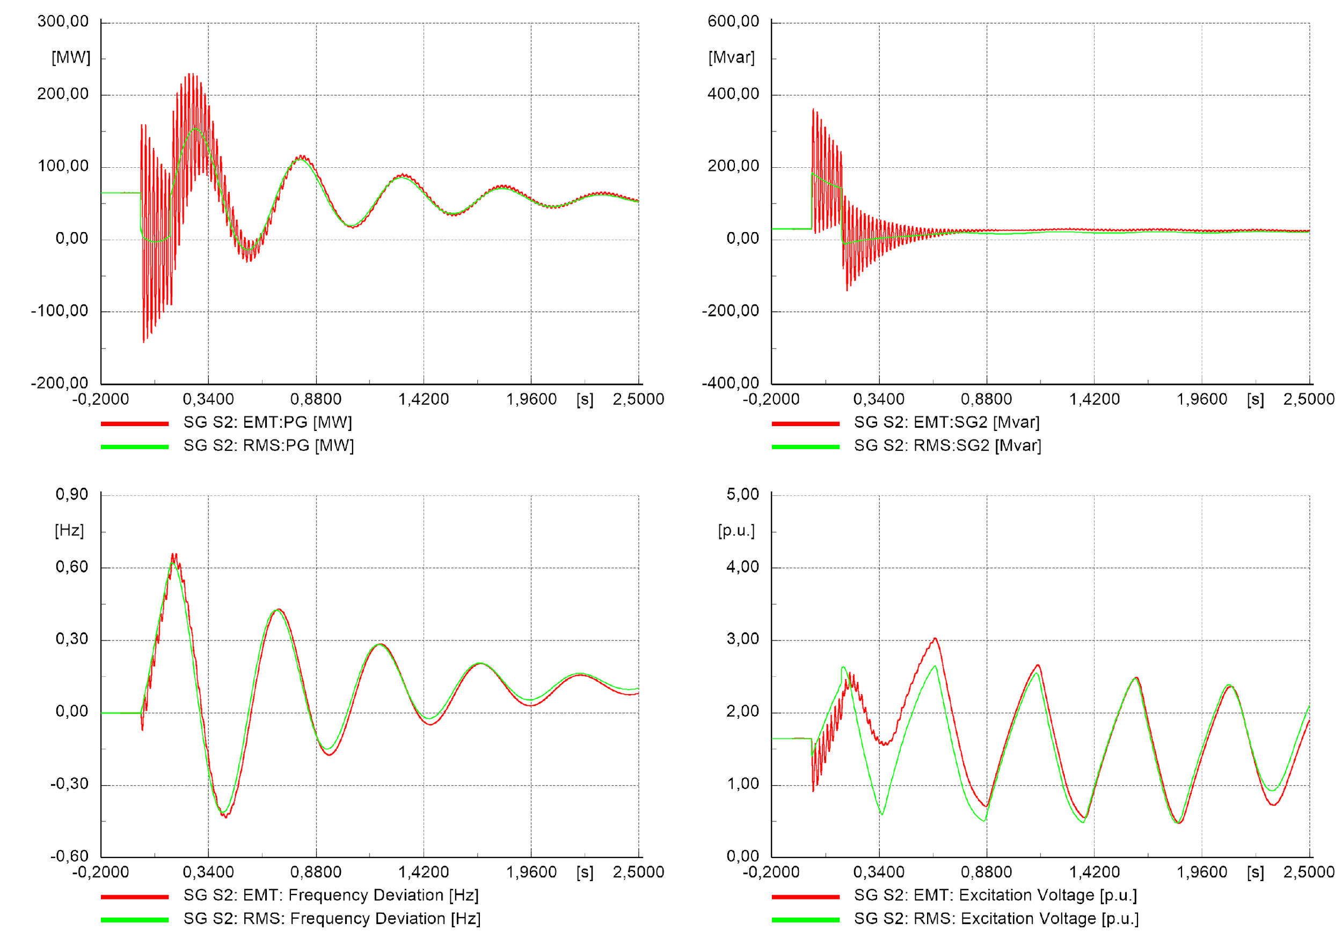
Modeling & Simulation Tools with IBR
Positive Sequence Tools
Looser model-product relationship
Milli-second time-steps
Suitable for many system-wide studies:
  Contingency analysis
  System transfer limit analysis
  Voltage, angular, frequency stability
Suitable for some plant-studies:
  Reactive capability
  Plant-level volt/VAr dynamic response
  Plant-level frequency dynamic response
Many equipment details are omitted or simplified
Transport delays are generally not able to be represented
Fewer software dependencies
EMT Tools
Close model-product relationship
Micro-second time-steps
Suitable for specialty studies:
  Weak grid control stability
  Inverter interactions
  Sub-synchronous phenomena (SSR, SSTI, SSCI)
  Switching & lightning transients, insulation coordination
  Transformer in-rush, motor starting
Highly detailed – small differences matter… (i.e. breaker contact opening)
Impedances, even very small ones, may be necessary to model
Transport delays can be accurately represented
Complex software & compiler dependencies
DIgSILENT RMS-EMT Model Benchmarking

Slide 57
Weak Grids: Challenges & Risks
Challenges
Risks
Controls Stability
Small-signal instability – oscillatory behavior
Large-signal instability – ride-through failure
Equipment interaction – neighboring plants, SVC, STATCOM, etc
AC Power Transfer
Exceeding a voltage stability limit with high power transfer
Power Quality (Harmonics)
Current distortion – power electronic sources
Voltage distortion – equipment tolerance
Short-Circuit Current
Protection scheme risk – over-current, negative sequence elements
Low Inertia
Frequency stability -- system-level
RoCoF tolerance – equipment challenges, UFLS speeds
Power system swing behavior – shifting eigenvalues and damping
Equipment trips
Generation Owner Risks
Inadequate Performance/Margin
Compliance
Protection mis-operation
System & Transmission Operator Risks
System Collapse or Load Shedding

Slide 58
A Note on Risk Metrics
Simple short-circuit ratio (SCR)
Typically calculated as a single resource radially connected to an equivalent grid
Many variants:
WSCR, CSCR, ESCR, etc
~/~
Zgrid
V
~/~
However, this simple (often very useful) approach breaks down (becomes useless) for:
More than one IBR nearby (how close is “nearby”??)
Complex topologies with multiple resources
Local load (how much load, how “local”?)
~/~
~/~
Notes:
This section presents an initial foray into the relationship between our proposed dynamic impedance analysis method and more conventional stability screening methods that often use a variant of a short-circuit ratio (SCR) calculation.
This slide also highlights the limitations of most SCR methods. The simple SCR approach works best in a situation like the one depicted at the top of this slide, where there is a single IBR connected to a grid comprised of synchronous machines that can be represented collectively as a Thevenin equivalent.
While these interconnection situations were prevalent early in the renewables industry, it no longer reflects the much more complex reality of many IBRs connected near to each other IBRs and amidst loads in networked grids, as depicted in the bottom half of the slide. In this complex case, most SCR methods will force practitioners to make difficult assumptions around how close and how similar IBR resources are, how to account for integrated load, and how all of these assumptions can shift under varying transmission contingencies that must be evaluated.
There are some advanced variants of the SCR method than can quantify these closeness of IBR with interaction factor metrics, these methods can be complicated to apply.
As we will see, the proposed dynamic impedance method can capture these complexities of multiple resources with different characteristics on complex network topologies as a means of screening for stability, much as the SCR methods were intended to do, but are no longer practical for doing so.

Slide 59
Methods
Case Selection
Disturbance Selection
Cases (models) are made for select “high stability risk” hours of the year:
Low and High Load:
  Summer Valley (SV) - lowest load of year (this is in summer)
  Winter Peak (WP) - highest load of year (this is in winter)
Synchronous Ratio: The total MVA rating of committed synchronous machines online relative to the total MW output of IBR generation. The minimum synchronous ratio (MSR).
Minimum Synchronous Ratio with Highest Flows (MSRHF) over the Interties.
Critical elements were selected for simulating select “high stability risk” contingencies:
Loss of Kenai Intertie: fault at line from Dave’s Creek to Quartz
Loss of Alaska Intertie: fault on the single-circuit line from Teeland to Douglas
Largest loss of generation in the Southern region
Largest loss of generation in the Central region
Largest loss of generation in the Northern region
Scenario Development
Resource Assessment
Load Forecast
Generation Analysis
Transmission Analysis
Economic Analysis
Notes:
The critical stability snapshots are specific hours of the year, pulled from the dispatch. These target hours are those considered challenging from a system operations point of view, because in the event of contingencies the system might suffer large impacts or even collapse.
The lower the synchronous ratio, the higher the stability risk. The snapshot with the lowest synchronous ratio was selected for analysis, and called

Slide 60
Summary of Stability Mitigations
Type | BAU | Hydro | Nuclear | Tidal
BATTERIES (MVA) for Steady State Voltage Stability | 50 | 365 | 788 | 140
Capacitors (MVar) for Steady State Voltage Stability | 0 | 91 | 185 | 75
Reconductored Lines (miles) Steady State Thermal Stability | 1.9 | 121.5 | 231 | 224.2
Transformers (MVA) Steady State Thermal Stability | 20 | 22 | 40 | 30
Transformers (MVA) Steady State Voltage Stability | 0 | 1 | 1 | 1
Batteries (MVA) for Dynamic Stability | 0 | 442.6 | 328.69 | 250
Synchronous Condensers (MVAr) for Dynamic Stability | 0 | 0 | 90 | 358.42
Consider putting this into a plot

Slide 61
Type | Area | BAU | Hydro | Nuclear | Tidal
BATTERIES (MVA) for Steady State Voltage Stability | Northern | 30 | 80 | 224 | 40
 | Central | 15 | 105 | 548 | 50
 | Southern | 5 | 180 | 16 | 50
Capacitors (MVar) for Steady State Voltage Stability | Northern | 0 | 22 | 15 | 10
 | Central | 0 | 15 | 145 | 60
 | Southern | 0 | 54 | 25 | 5
Reconductored Lines (miles) Steady State Thermal Stability | Northern | 0 | 12.4 | 6.8 | 20.8
 | Central | 1.9 | 33.3 | 105.2 | 30.9
 | Southern | 0 | 75.8 | 119 | 172.5
Transformers (MVA) Steady State Thermal Stability | Northern | 5 | 9 | 13 | 11
 | Central | 15 | 12 | 25 | 17
 | Southern | 0 | 1 | 2 | 2
Transformers (MVA) Steady State Voltage Stability | Northern | 0 | 0 | 0 | 0
 | Central | 0 | 0 | 0 | 0
 | Southern | 0 | 1 | 1 | 1
Batteries (MVA) for Dynamic Stability | Northern | 0 | 224 | 107.24 | 0
 | Central | 0 | 47.6 | 21.45 | 0
 | Southern | 0 | 171 | 200 | 250
Synchronous Condensers (MVAr) for Dynamic Stability | Northern | 0 | 0 | 0 | 0
 | Central | 0 | 0 | 0 | 263.42
 | Southern | 0 | 0 | 90 | 95

