Slide 1
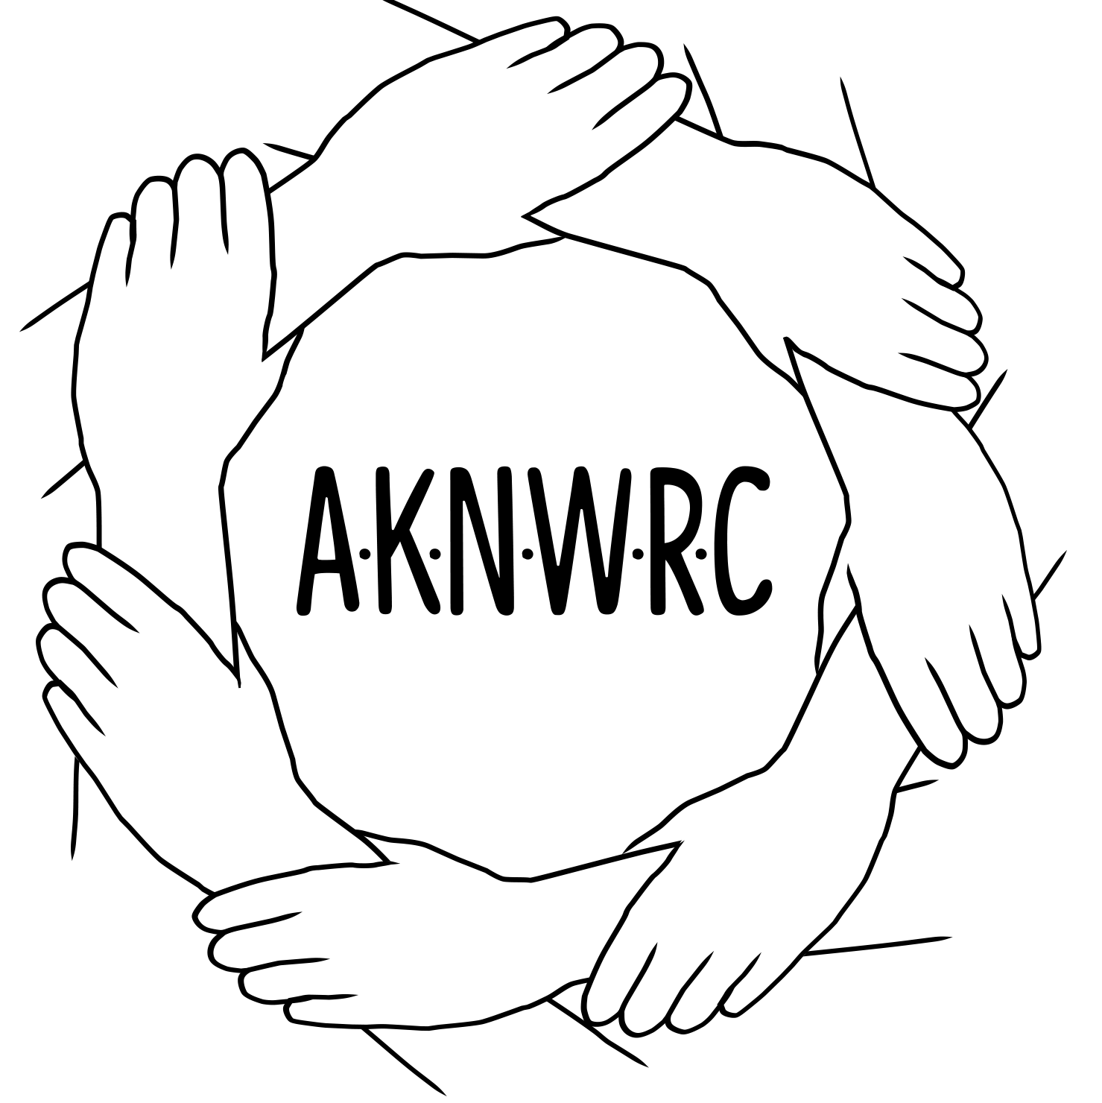
The Power of Tribal Consultation:
Impacts For Change
Michelle Demmert, Law and Policy Director
August 2, 2022

Slide 2
Memorandum of January 26, 2021 Tribal Consultation and Strengthening Nation-to-Nation Relationships Memorandum for the Heads of Executive Departments and Agencies
Consultation. My Administration[Biden] is committed to honoring Tribal sovereignty and including Tribal voices in policy deliberation that affects Tribal communities. The Federal Government has much to learn from Tribal Nations and strong communication is fundamental to a constructive relationship.
Reaffirms Executive Order 13175 of November 6, 2000 (Consultation and Coordination With Indian Tribal Governments)
Reaffirms Presidential Memorandum of November 5, 2009 (Consultation), requires each agency to prepare and periodically update a detailed plan of action to implement the policies and directives of Executive Order 13175.

Slide 3
Significance of Tribal Consultation
Provides critical opportunity for government-to-government dialogue and for Indian tribes to identify barriers and implement solutions that will enhance their capacity as governments to protect their citizens.
Feedback opportunity on what works/doesn’t work in how funds and programs are administered.
Raise awareness on current, outstanding and/or emerging issues.
Help to design a legal framework for change and removal of barriers, inequity, etc.

Slide 4
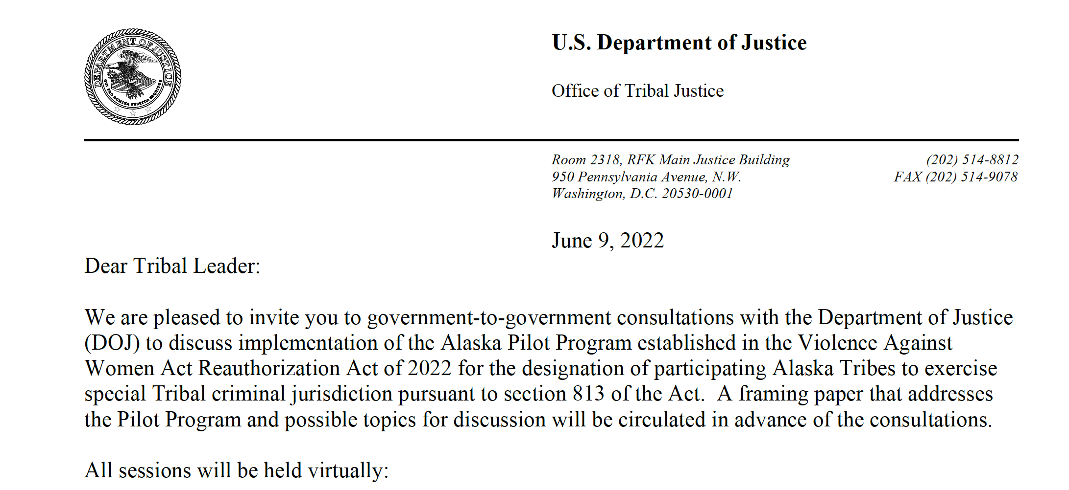
Government-to-Government Consultation Set: Pilot Project

Slide 5
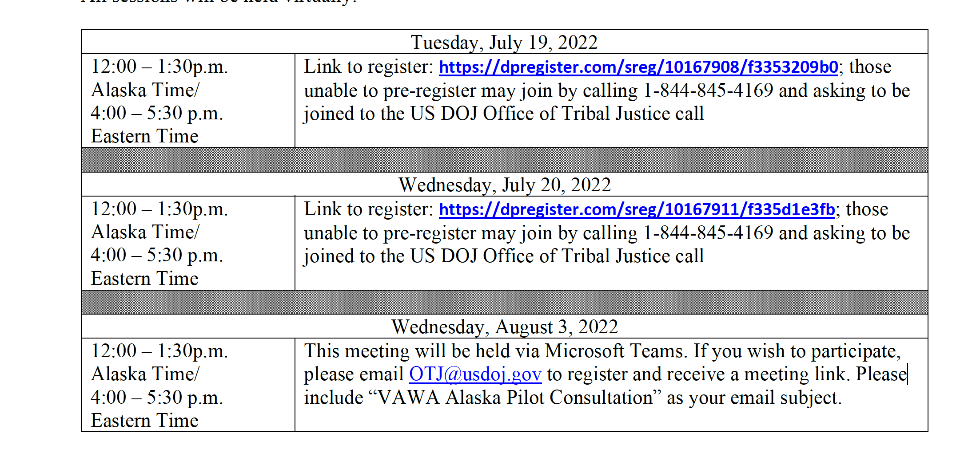
Pilot Project Consultation Dates
Notes:
Registration is not yet open
A Framing Paper has not been distributed yet.

Slide 6
The purposes of the Alaska Tribal Public Safety Empowerment Subsection are:
to increase coordination and communication among Federal, State, Tribal, and local law enforcement agencies; and
to empower Indian Tribes to effectively respond to cases of domestic violence, dating violence, stalking, sex trafficking, sexual violence, and missing or murdered Alaska Natives through the exercise of special Tribal criminal jurisdiction.

Slide 7
What are priority issues for your community?
Financial Support: We need to build our infrastructure
Technical Assistance from Alaska-based providers with knowledge of our communities
An Alaska Intertribal Working Group
Resources:
Tribal Court Personnel
Law Enforcement
Advocates

Slide 8
Alaska Native Women’s Resource Center Ph: 907-328-3990 P.O. Box 80382 Fairbanks, Alaska 99708
Follow us!
https://www.facebook.com/aknwrc
Mailing list: https://bit.ly/2XjV6Dr
Website: www.aknwrc.org
This project was made possible by Grant #90EV-0454-01-00 from the Administration on Children, Youth and Families, Family and Youth Services Bureau, U.S. Department of Health and Human Services. Its contents are solely the responsibility of the authors and do not necessarily represent the official views of the U.S. Department of Health and Human Services.

