Slide 1
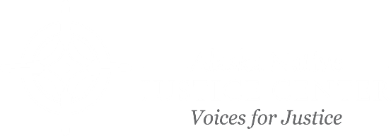
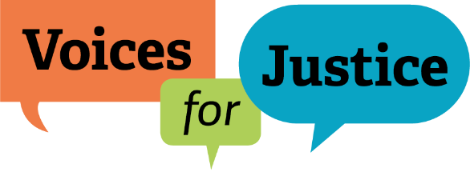
The Violence Against Women Act 2022 Reauthorization
Alex Cleghorn
Sr. Legal and Policy Director

Slide 2
VAWA 2022 – how did we get here?
1959 – Alaska Statehood & Public Law 280
1971 – ANCSA
1978 – Supreme Court decision in Oliphant

Slide 3
Public Law 280
A federal law passed in 1953
Applied to Alaska at statehood
Changed state and federal criminal and civil jurisdiction in ‘Indian Country’

Slide 4
Public Law 280
Allowed to exercise State jurisdiction in Indian country
Impacts federal Public Safety and Justice funding
Public Law 280 did not
Terminate tribes
Extinguish tribal sovereignty
Take away tribal jurisdiction

Slide 5
ANCSA
Extinguished all Indian reservations in Alaska (except MIC)
Impacted Alaska Tribes' territorial jurisdiction
ANCSA did not
Terminate tribes
Extinguish tribal sovereignty

Slide 6
Oliphant?
"Indian Tribes do not have inherent jurisdiction to try and punish non-Indians."
Oliphant v. Suquamish Indian Tribe, 435 U.S. 191 (1978)

Slide 7
Alaska Specific Federal Legislation Attempts
2009 | S.797 Tribal Law & Order Act (TLOA) (Includes Alaska Native Tribal Law Enforcement Demo Project – alcohol and drug crimes in core township/5-mile radius. Not “Indian Country”)
2010 | TLOA enacted. Alaska Tribes eligible for COPS grants and federal law enforcement training
2010 | S.3740 Alaska Safe Families & Villages Act (Demo project in “project area”; AG selection & certification; civil jurisdiction re drug/alcohol over Natives and non-Natives; civil sanctions listed)
2013 | VAWA Sec. 910 keeps Alaska Tribes out of key provisions (SDVJ)
2013 | S.1474 Alaska Safe Families & Villages Act. Grant program to support tribal-state IGA to enforce state laws; repeal VAWA 2013 sec. 910.
2014 | S. 1474 repeals VAWA 2013 Sec. 910.

Slide 8
Alaska Specific Federal Legislation Attempts
2015 -2017 | Discussions with Alaska Governor, AG, Alaska Delegation
2019 | HR.1585 (VAWA 2019) Rep. Young amendment: Expand Indian Country (village with 75% AN population); Pilot Project with 5 Tribes to cover all village lands.
2019 | AG Barr declares law enforcement emergency in rural Alaska
2019 | S. 2616 Alaska Tribal Public Safety and Empowerment Act. Adds civil jurisdiction over non-Natives, criminal jurisdiction over alcohol & drug crimes
2021 | VAWA discussion draft released for comment, includes Alaska Tribal Public Safety Empowerment provisions (revised from S.2616)
2022 | S.3623 VAWA 2022 introduced (60 Senators - filibuster-proof). Included in Omnibus Appropriations Act (H.R.2471). Becomes Pub. L. 117-103, Div. W

Slide 9
VAWA 2022 Reauthorization
Passed House and Senate on March 10, 2022​
President Biden signed on March 15, 2022​
Effective date of October 1, 2022​
Subtitle B – Alaska Tribal Public Safety Empowerment

Slide 10
VAWA 2022, Subtitle B-- Alaska Tribal Public Safety Empowerment

Slide 11
VAWA 2022, Subtitle B-- Alaska Tribal Public Safety Empowerment

Slide 12
VAWA 2022, Subtitle B-- Alaska Tribal Public Safety Empowerment

Slide 13
What is a "Village" under VAWA 2022?
Notes:
Village = the Alaska Native Village Statistical Area covering all of a portion of a Native village named/defined in ANCSA. § 812(7)
Tribal jurisdiction is tied to a defined geographical area– so how do we find out what that geographical area is and how is it useful?
Understanding tribal jurisdiction as federally defined in VAWA 2022 requires a few steps:
VAWA 2022 uses the term “Village” to recognize territorial jurisdiction as defined in the Alaska Native Claims Settlement Act (ANCSA)
ANSCA lists “Native villages” in two different sections of the Act
VAWA 2022 refers to Tribal Statistical Program Verification maps, maintained by the Census Bureau
- TSAP Verification maps can be found on the Census website at https://www.census.gov/geographies/reference-maps/2010/geo/tsap-verification-maps.html
- Each Regional Corporation has a folder containing subfolders for each Village in the Region

Slide 14
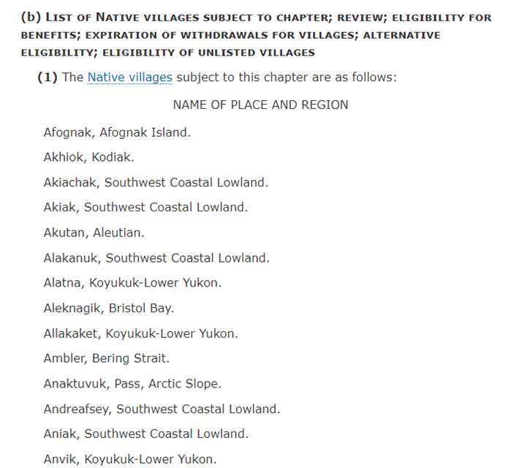
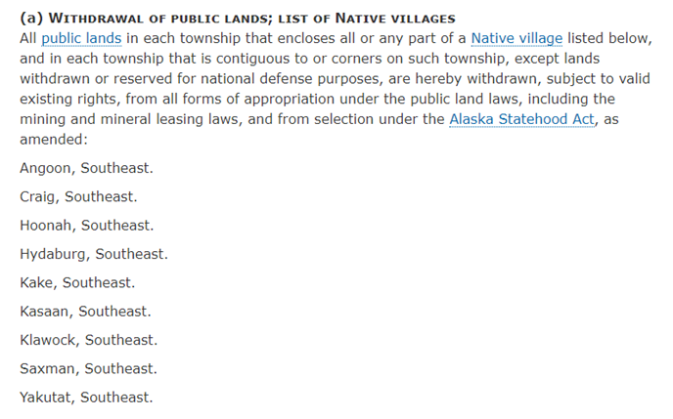
Which Villages are named in ANCSA?
43 U.S.C. § 1610
43 U.S.C. § 1615

Slide 15
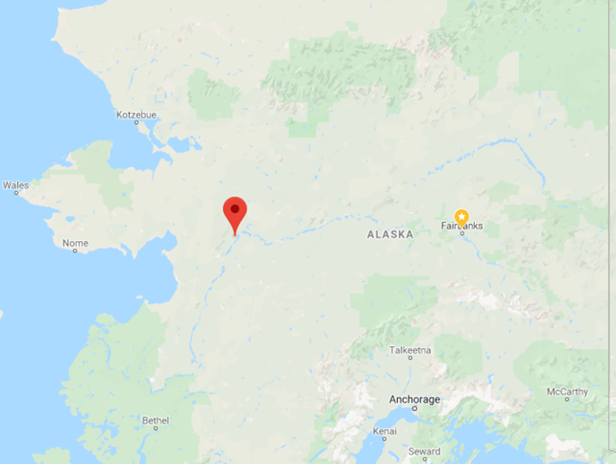
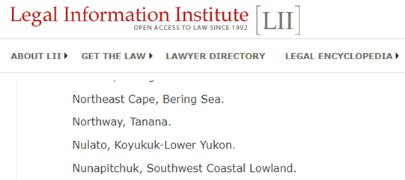
Example: Nulato Village Nulato is located on the west bank of the Yukon River, 35 miles west of Galena and 310 air miles west of Fairbanks. It lies in the Nulato Hills, across the river from the Innoko National Wildlife Refuge.
Nulato Village is a "Native village" listed in ANCSA, 43 U.S.C. § 1610 as "Nulato, Koyukuk-Lower Yukon."

Slide 16
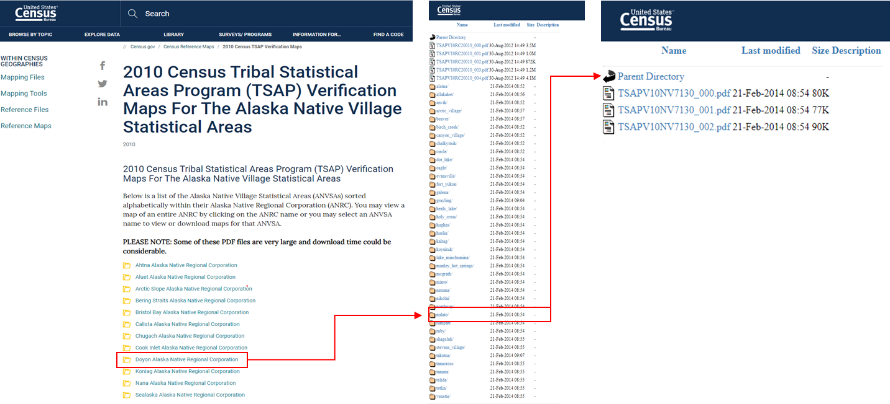
Identifying territorial jurisdiction using TSAP Verification maps

Slide 17
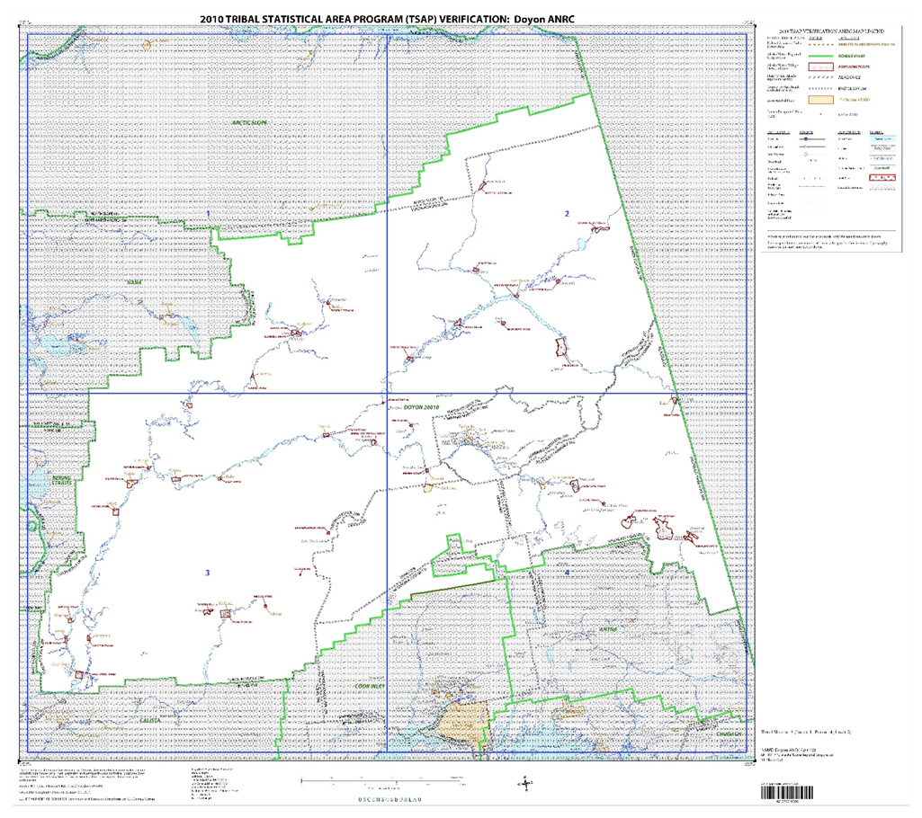
Notes:
This is the TSAP for the entire Doyon Region
The red dot represents Nulato's location within the Doyon region on the map

Slide 18
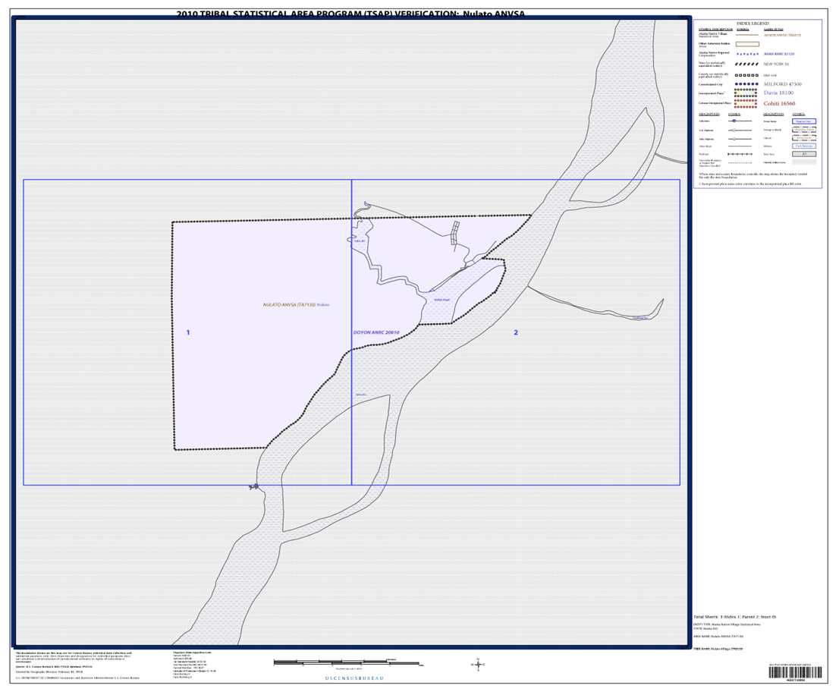

Slide 19
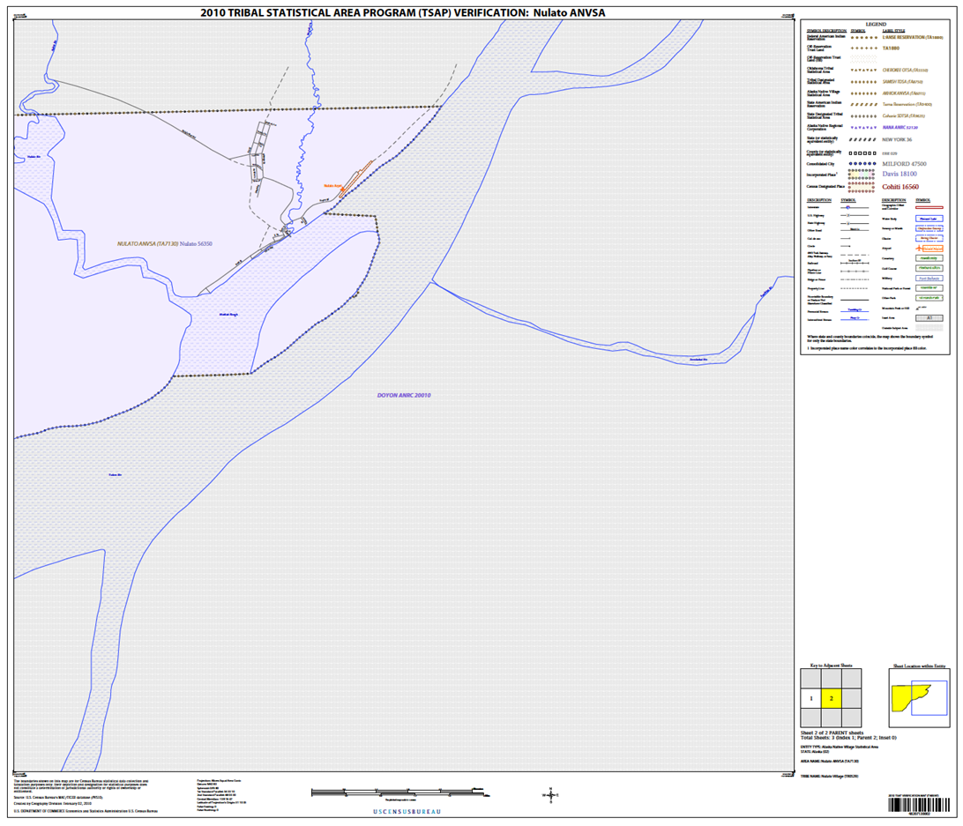
Notes:
At the Census Block level, the full map can be difficult to interpret, but as you Zoom in it becomes easier to identify the jurisdictional boundaries of a Village.

Slide 20
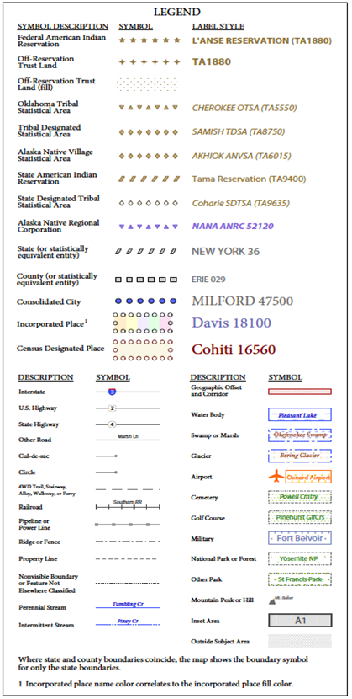
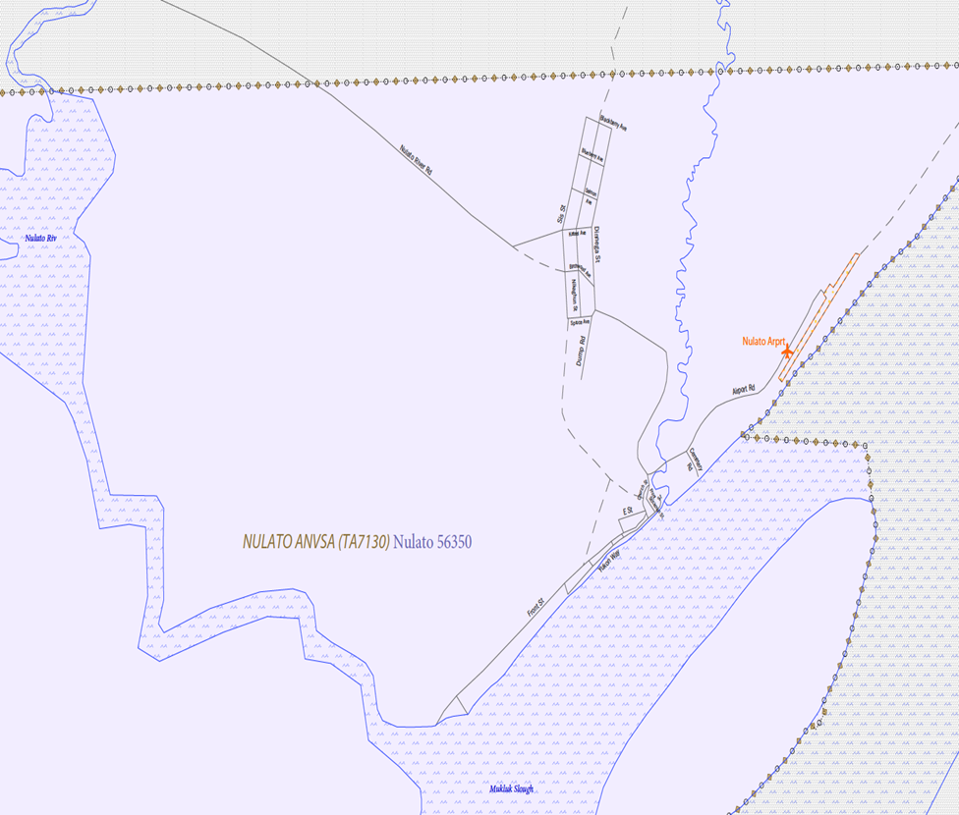

Slide 21
Statewide Support for Tribal Justice
ANJC assists Tribal justice systems, both emergent and established, build capacity to implement culturally-appropriate remedies and access resources to help break the cycles of victimization.
Benefits:
T/TA work plan – implementing VAWA 2022 and preparing for Pilot Project | Tribal DV Protection Orders - registering with state court
Culturally responsive T/TA | Tribal Model Law Drafting and Enhancing Victim Centered Tribal Courts
Support for opportunities to collaborate with the state | Better serve and protect victims and Improve Tribal court function

Slide 22
Small Group Questions
What is your Tribe’s goal?
What does success look like for your Tribe?
What resources are needed to reach your Tribe’s goal?
Tribe’s self- assessment:
Tribal Justice System: Readiness? Strengths, weaknesses? Organized?
Justice System partners: local (city?); State; Federal
Community scan – resource map; police resources

Slide 23
Thank you​
​
​
tribaljustice@anjc.net​
(907) 793-3550

