Slide 1
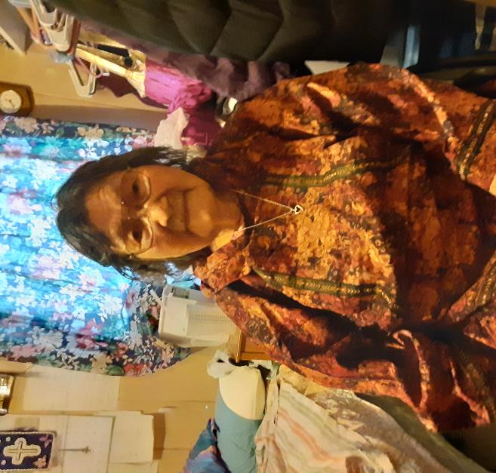
Guiding Our Tribal Courts with Traditional Values
By Darlene Daniel
Kongiganak Tribal Court Administrator
August 3, 2022
kong.tribalcourt @gmail.com
907-557-5222 or 907-557-2280

Slide 2
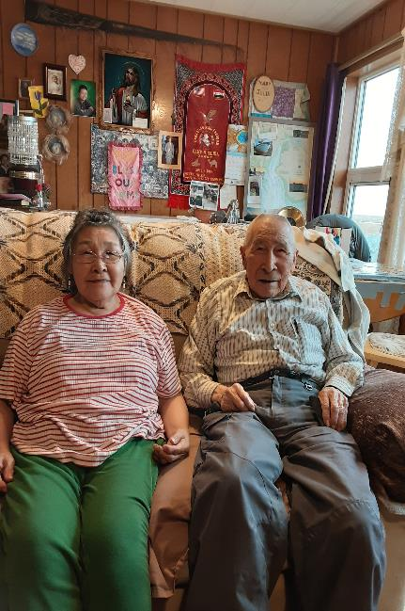
Traditional Elder (male or female) Judges were selected to share traditional knowledge for each different situation. They share cultural values for each different case, men share men’s ways and females share theirs as well. Most important value shared is Love, “Kenekngamteggen qanrutamteggen”, meaning “Because we love you, we are telling you.” The elders stress this throughout the court hearing, and it calms the person while they are talking to him/her.

Slide 3
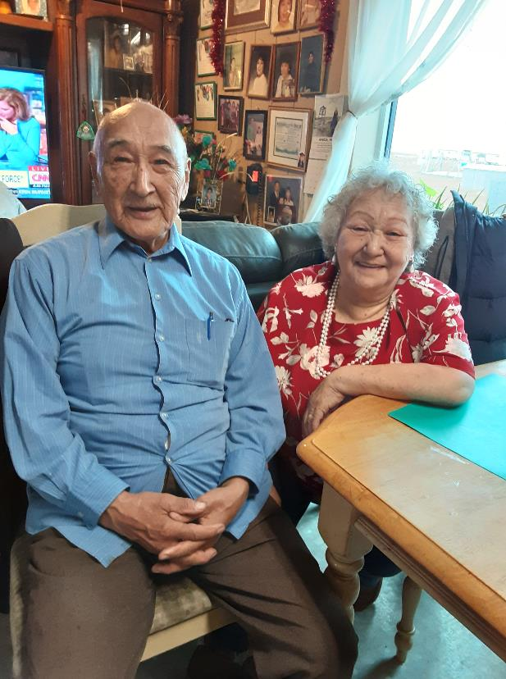
Traditional values instilled to our tribal court procedures to help our people heal.
Community service may consist of hunting moose, seals, or fishing to be given to the elders or widows in the community. It includes subsistence activities such as gathering berries or plants.
Traditional wellness consultants (male and female) counsel defendants in traditional ways to help overcome problems.
Attending Healthy Family workshops is recommended for healing.
In difficult cases the Chief Elder Judge is asked to speak to clarify any misunderstandings.

