Slide 1
38th Annual Alaska Tribal Court Conference
Cultural Support
Service Providers
Notes:
thank for invite and opportunity to present about the exciting opportunity for OCS to compensate Cultural Support Service Providers!
introduce self

Slide 2
What are Cultural Support Services?
Notes:
A Cultural Support Service Provider is an individual that will be compensated for providing Cultural Support Services, they may describe themselves many ways. It is not OCS’s role to qualify the individual as a “Cultural Service Provider,” this is done through collaboration between the Tribe, parent, and OCS.
“Cultural Support Services” are time spent between the Cultural Support Services Provider and parent during sessions.

Slide 3
Notes:
The Transforming Child Welfare Outcomes for Alaska Native Children Strategic Plan, hereinafter referred to as the “Plan,” was finalized in May of 2016. The guiding principles of the Plan‘s Vision and Mission are to keep Alaska Native children safe within their own culture and to align systems of care through the cultivation of a respectful government-to-government collaboration between the State of Alaska, Tribes, and Tribal Organizations. Workgroups were established to work on the following goals and priorities:
Respectful Government-to-Government Collaboration & Partnership
Tribal Self-Governance
Embrace & Implement the Spirit of the Indian Child Welfare Act
Child Welfare System Alignment
Community Engagement
Culturally Specific Services and Supports
As expressed in the Cultural Resource Guide that was published in 2018…
drop in chat: http://dhss.alaska.gov/ocs/Documents/Publications/pdf/CulturalResourcesGuide.pdf
“It is the expectation that all families involved in Alaska’s child welfare system be offered the ability to choose case plan services or activities that are available as close to their home as possible. Services and activities should be aligned with cultural and personal beliefs and selected based on that individual’s preference regarding what will have the maximum impact on their physical, psychological, emotional, and spiritual well-being.” (from page 9 of the Cultural Resource Guide)

Slide 4
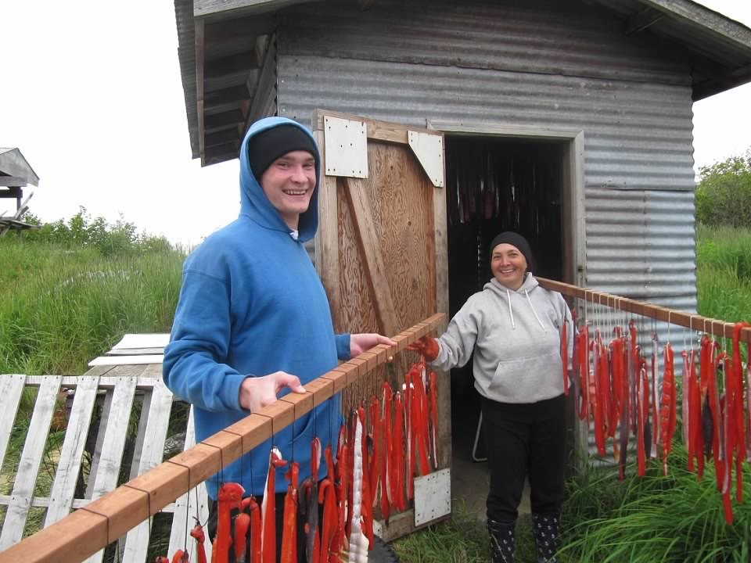
Who is considered a Cultural Support Services Provider?
Notes:
Cultural Support Service Providers are Elders, mentors, or other individuals who are identified as willing to provide cultural services to parents who have an active in-home or out-of-home OCS case plan.
Cultural Support Service Providers are selected through coordination between the Tribe, parent, and OCS.

Slide 5
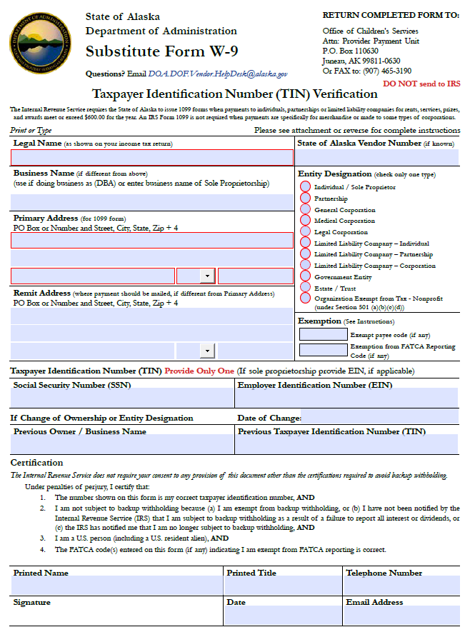
Once a prospective Cultural Services Support Provider completes a W9 form, please submit this form to
Kim,swisher@alaska.gov
ProvidePay@alaska.gov
Notes:
Newly identified Cultural Support Service Providers will complete a W9 and notify the Statewide ICWA Coordinator and Provider Payments Unit. Provider Payments Unit will add the individual as a Provider in ORCA and notify the Statewide ICWA Coordinator. Once the Provider number is established in ORCA, the RFF can be created and approved for pre-authorization of services.
OCS has authorized up to $60 per session for up to 10 sessions. If payment for services to a provider exceed $600 per year, the State of Alaska is required to issue a 1099 tax document, so before reaching that $600 limit we would like the opportunity to speak with the provider to make sure they are comfortable going beyond that amount.

Slide 6
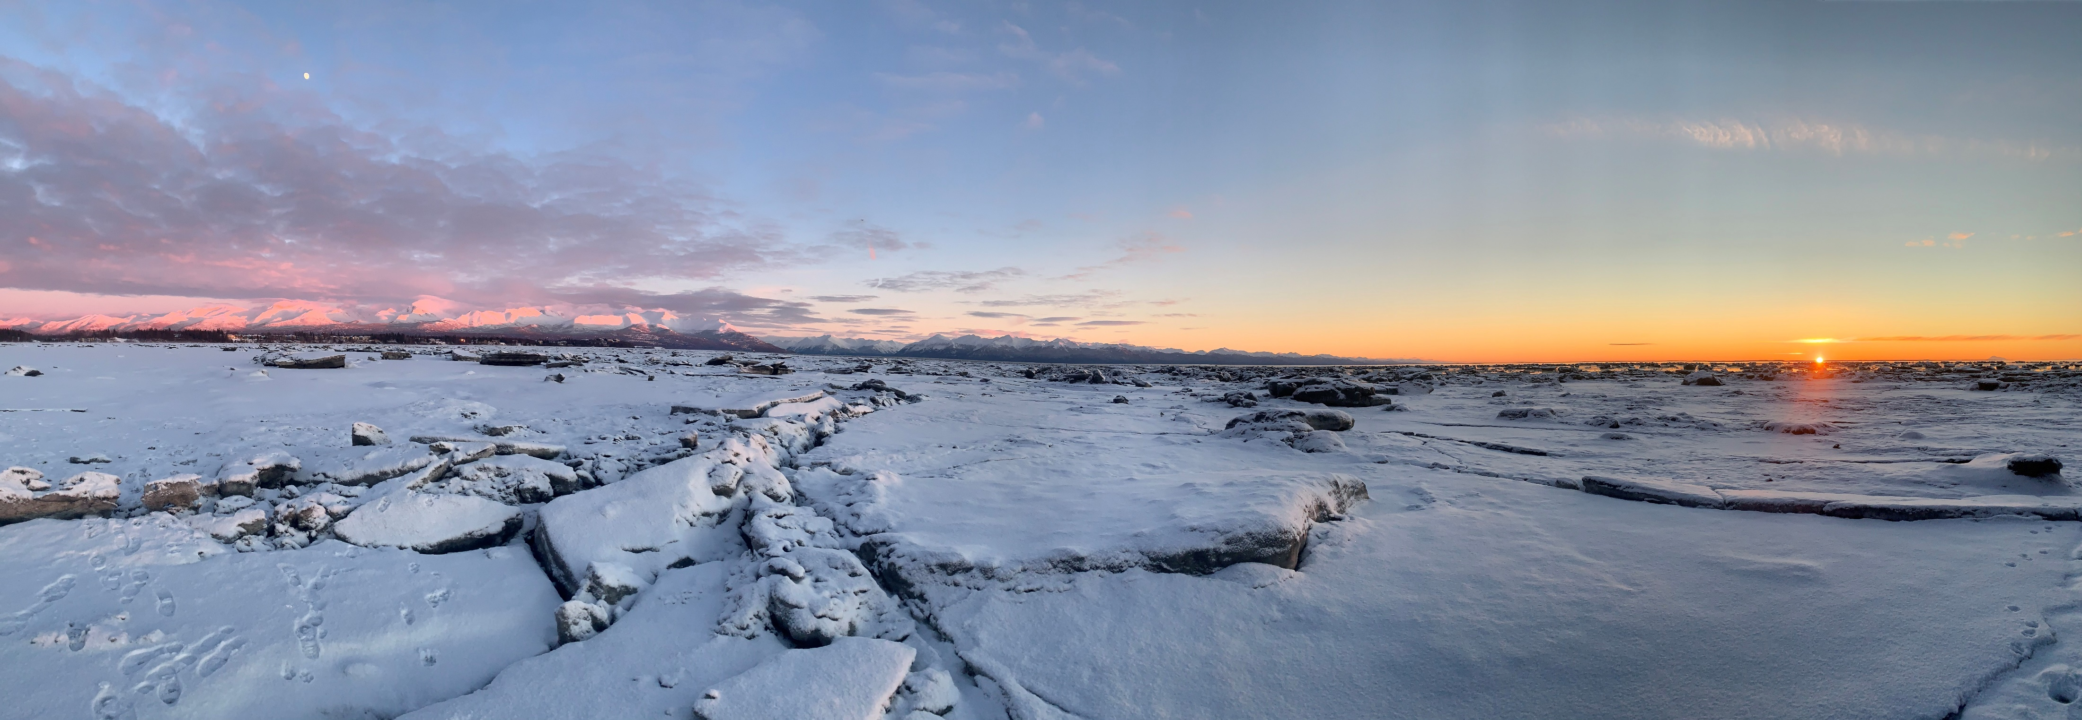
All parents with an active in-home or out-of-home OCS case plan are eligible to engage in services with a Cultural Support Services Provider that has been identified in collaboration between the Tribe, parent, and OCS.
Notes:
Who are eligible? (read slide)

Slide 7
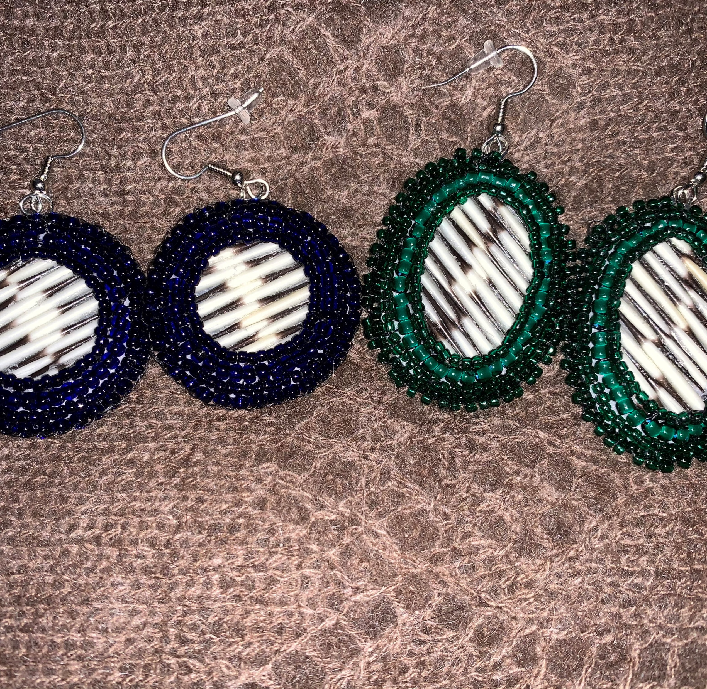
Adding Cultural Services to the parent's case plan to initiate services
OCS Case Planning Policy 2.9
Notes:
Case planning meetings with the parent and Tribe are an opportunity to explore adding cultural services to the parent’s case plan.
Understanding the traditional values and cultural activities in a community and engaging the parent in a conversation about their level of involvement or interest in those activities will help in the development of a meaningful case plan. If the family is living outside of their home community or region, encourage exploration of traditional activities that could be modified or replicated in the local environment. (from page 10 of the Cultural Resource Guide)
Reference case planning policy 2.9.3…
C. Each case plan will be written using language that the parent/guardian/custodian can understand and include services they request to meet their identified needs.
1. The needs assessment for each individual will include an exploration of the five protective factors: parental resilience, concrete supports in times of need, social connections, knowledge of parenting and child development and social and emotional competence of children; and
2. The identification of desired services will include an exploration of the available traditional wellness practices, cultural activities and Tribal services (see the Cultural Resources for Alaska Families guide located in Statewide Forms folder).

Slide 8
Notes:
Working with local Tribal and ICWA staff, OCS caseworker, and parent will meet to identify services to meet the needs of the parent so healing can occur that will lead to reunification.
Page 21 of the Cultural Resource Guide

Slide 9
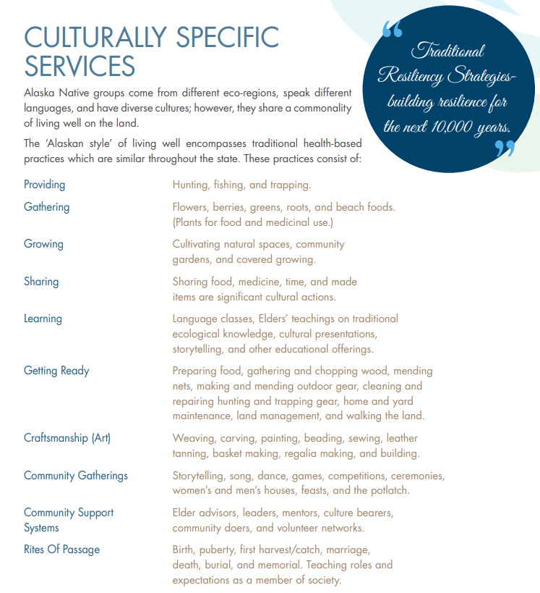
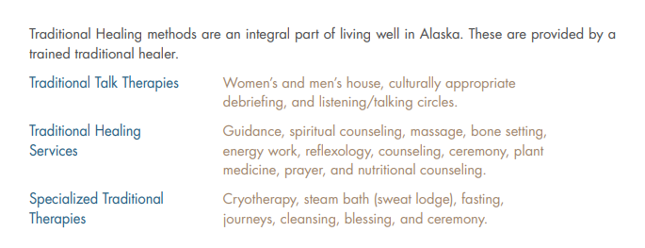
Notes:
For more information on what services may be offered by a Cultural Services Support Provider, see the examples included on pages 17-18 of the Cultural Resource Guide.
Might be a shift in how define “services.” These services serve the health and well being of the person engaging in them.
It is the intent and expectation of OCS to embrace the cultural services identified as legitimate and appropriate for that individual. Nature and culture have much to offer as we strive to increase wellness and resiliency; the utilization of Cultural Support Services provides OCS staff an opportunity to discover those resources and partake in our state’s rich bounty. (from page 9 of the Cultural Resource Guide)

Slide 10
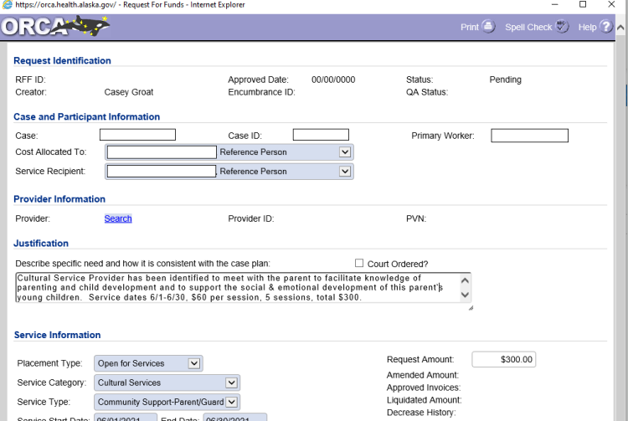
Submitting the RFF for pre-authorization of services
Service Category: Cultural Services
Notes:
Leah
Once a Cultural Support Services Provider has been identified to work with a parent on activities described on the parent’s case plan, the PS Specialist or Regional ICWA Specialist submits a Request for Funds in ORCA for pre-authorization of services.
OCS has authorized up to $60 per session for up to 10 sessions. If payment for services to a provider exceed $600 per year, the State of Alaska is required to issue a 1099 tax document, so before reaching that $600 limit we would like the opportunity to speak with the provider to make sure they are comfortable going beyond that amount.

Slide 11
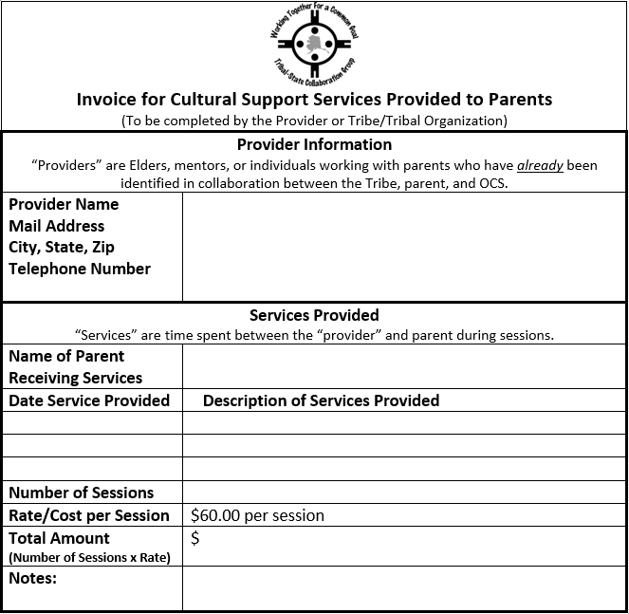
Notes:
After services are provided the Cultural Support Services Provider submits this invoice form to the Regional ICWA Specialist or Statewide ICWA Coordinator. Providers can submit invoices following each service or at the end of each month that services are provided.
The Regional ICWA Specialist or Statewide ICWA Coordinator will submit the invoice to Provider Payments Unit who will then issue payment to the Cultural Support Services Provider.

Slide 12
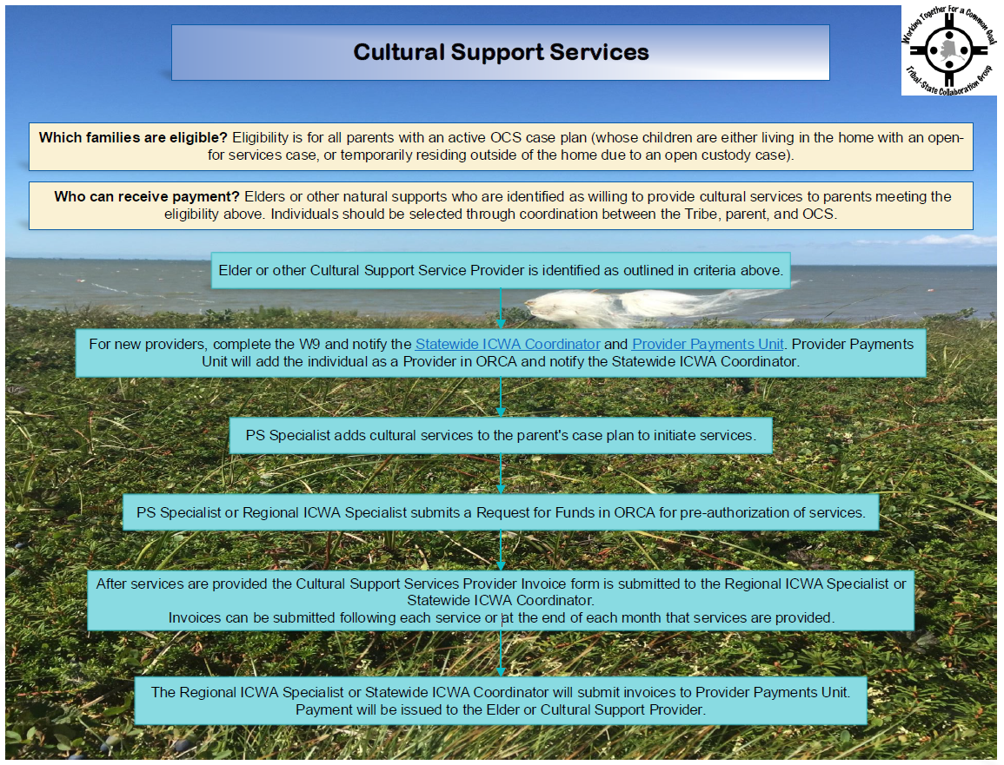
Notes:
This beautiful flow chart captures the process that we have covered In this training including what are Cultural Support Services, who is eligible to engage in Cultural Support Services, the process of identifying and establishing a Cultural Support Services Provider in ORCA, the importance of including culturally relevant services on the parent’s case plan, obtaining pre-authorization of services through submitting a RFF, and issuing payment to the Cultural Support Services provider after invoices are processed.
Also, on this video:

Slide 13
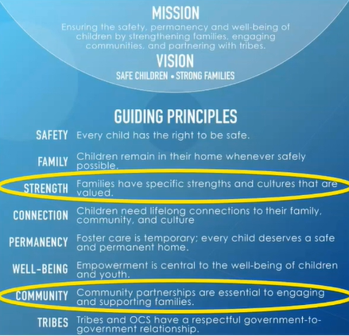
Notes:
As stated in our Guiding Principles: Families have specific strengths and cultures that are valued, and community partnerships are essential to engaging and supporting families!
Thank you for finding ways for the parents served by the Office of Children’s Services to build and maintain healthy connections to family, community, culture, and the land through the identification of culturally relevant services and activities!

Slide 14
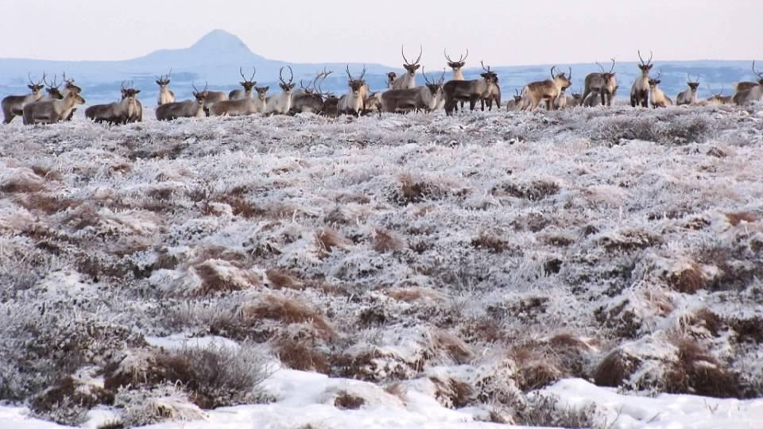
Questions?

Slide 15
Thank you for joining me!
Leah Warburton, Northern Region ICWA Specialist
leah.warburton@alaska.gov
907-451-2062
Kim Swisher, LMSW, OCS Deputy Director
kim.swisher@alaska.gov
907-269-8018

