Slide 1


Chickaloon Tribal Police Department
Justice director/ donna Anthony

Slide 2
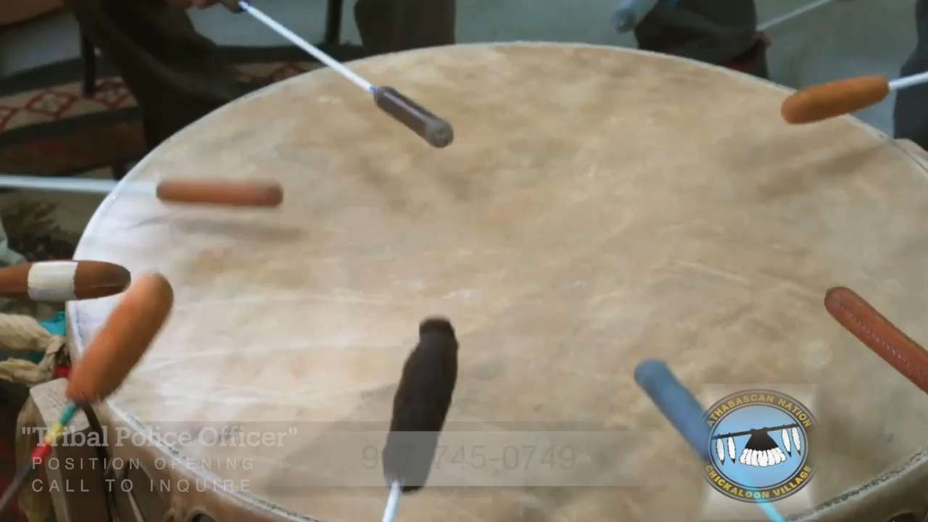

Slide 3

Agenda
Introductions of Staff
Purpose of Meeting
Mission
Vision
History
Current Status
Strengths
Course of Action

Slide 4
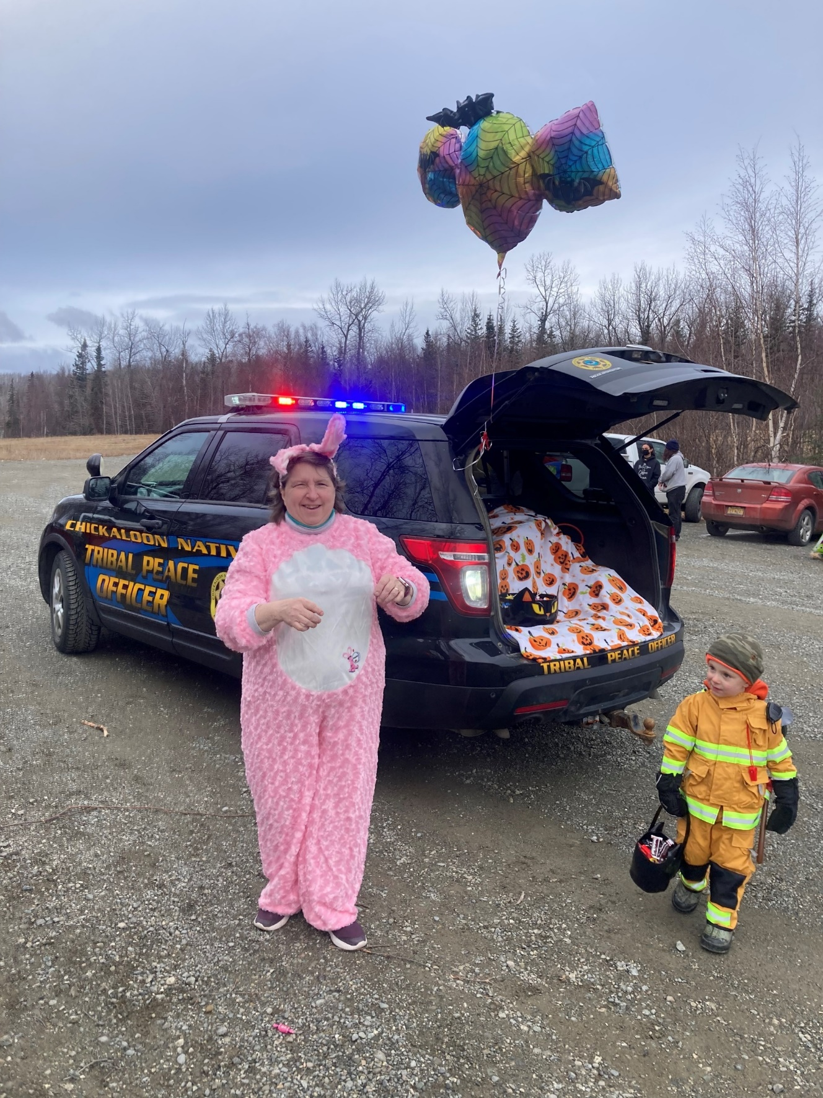
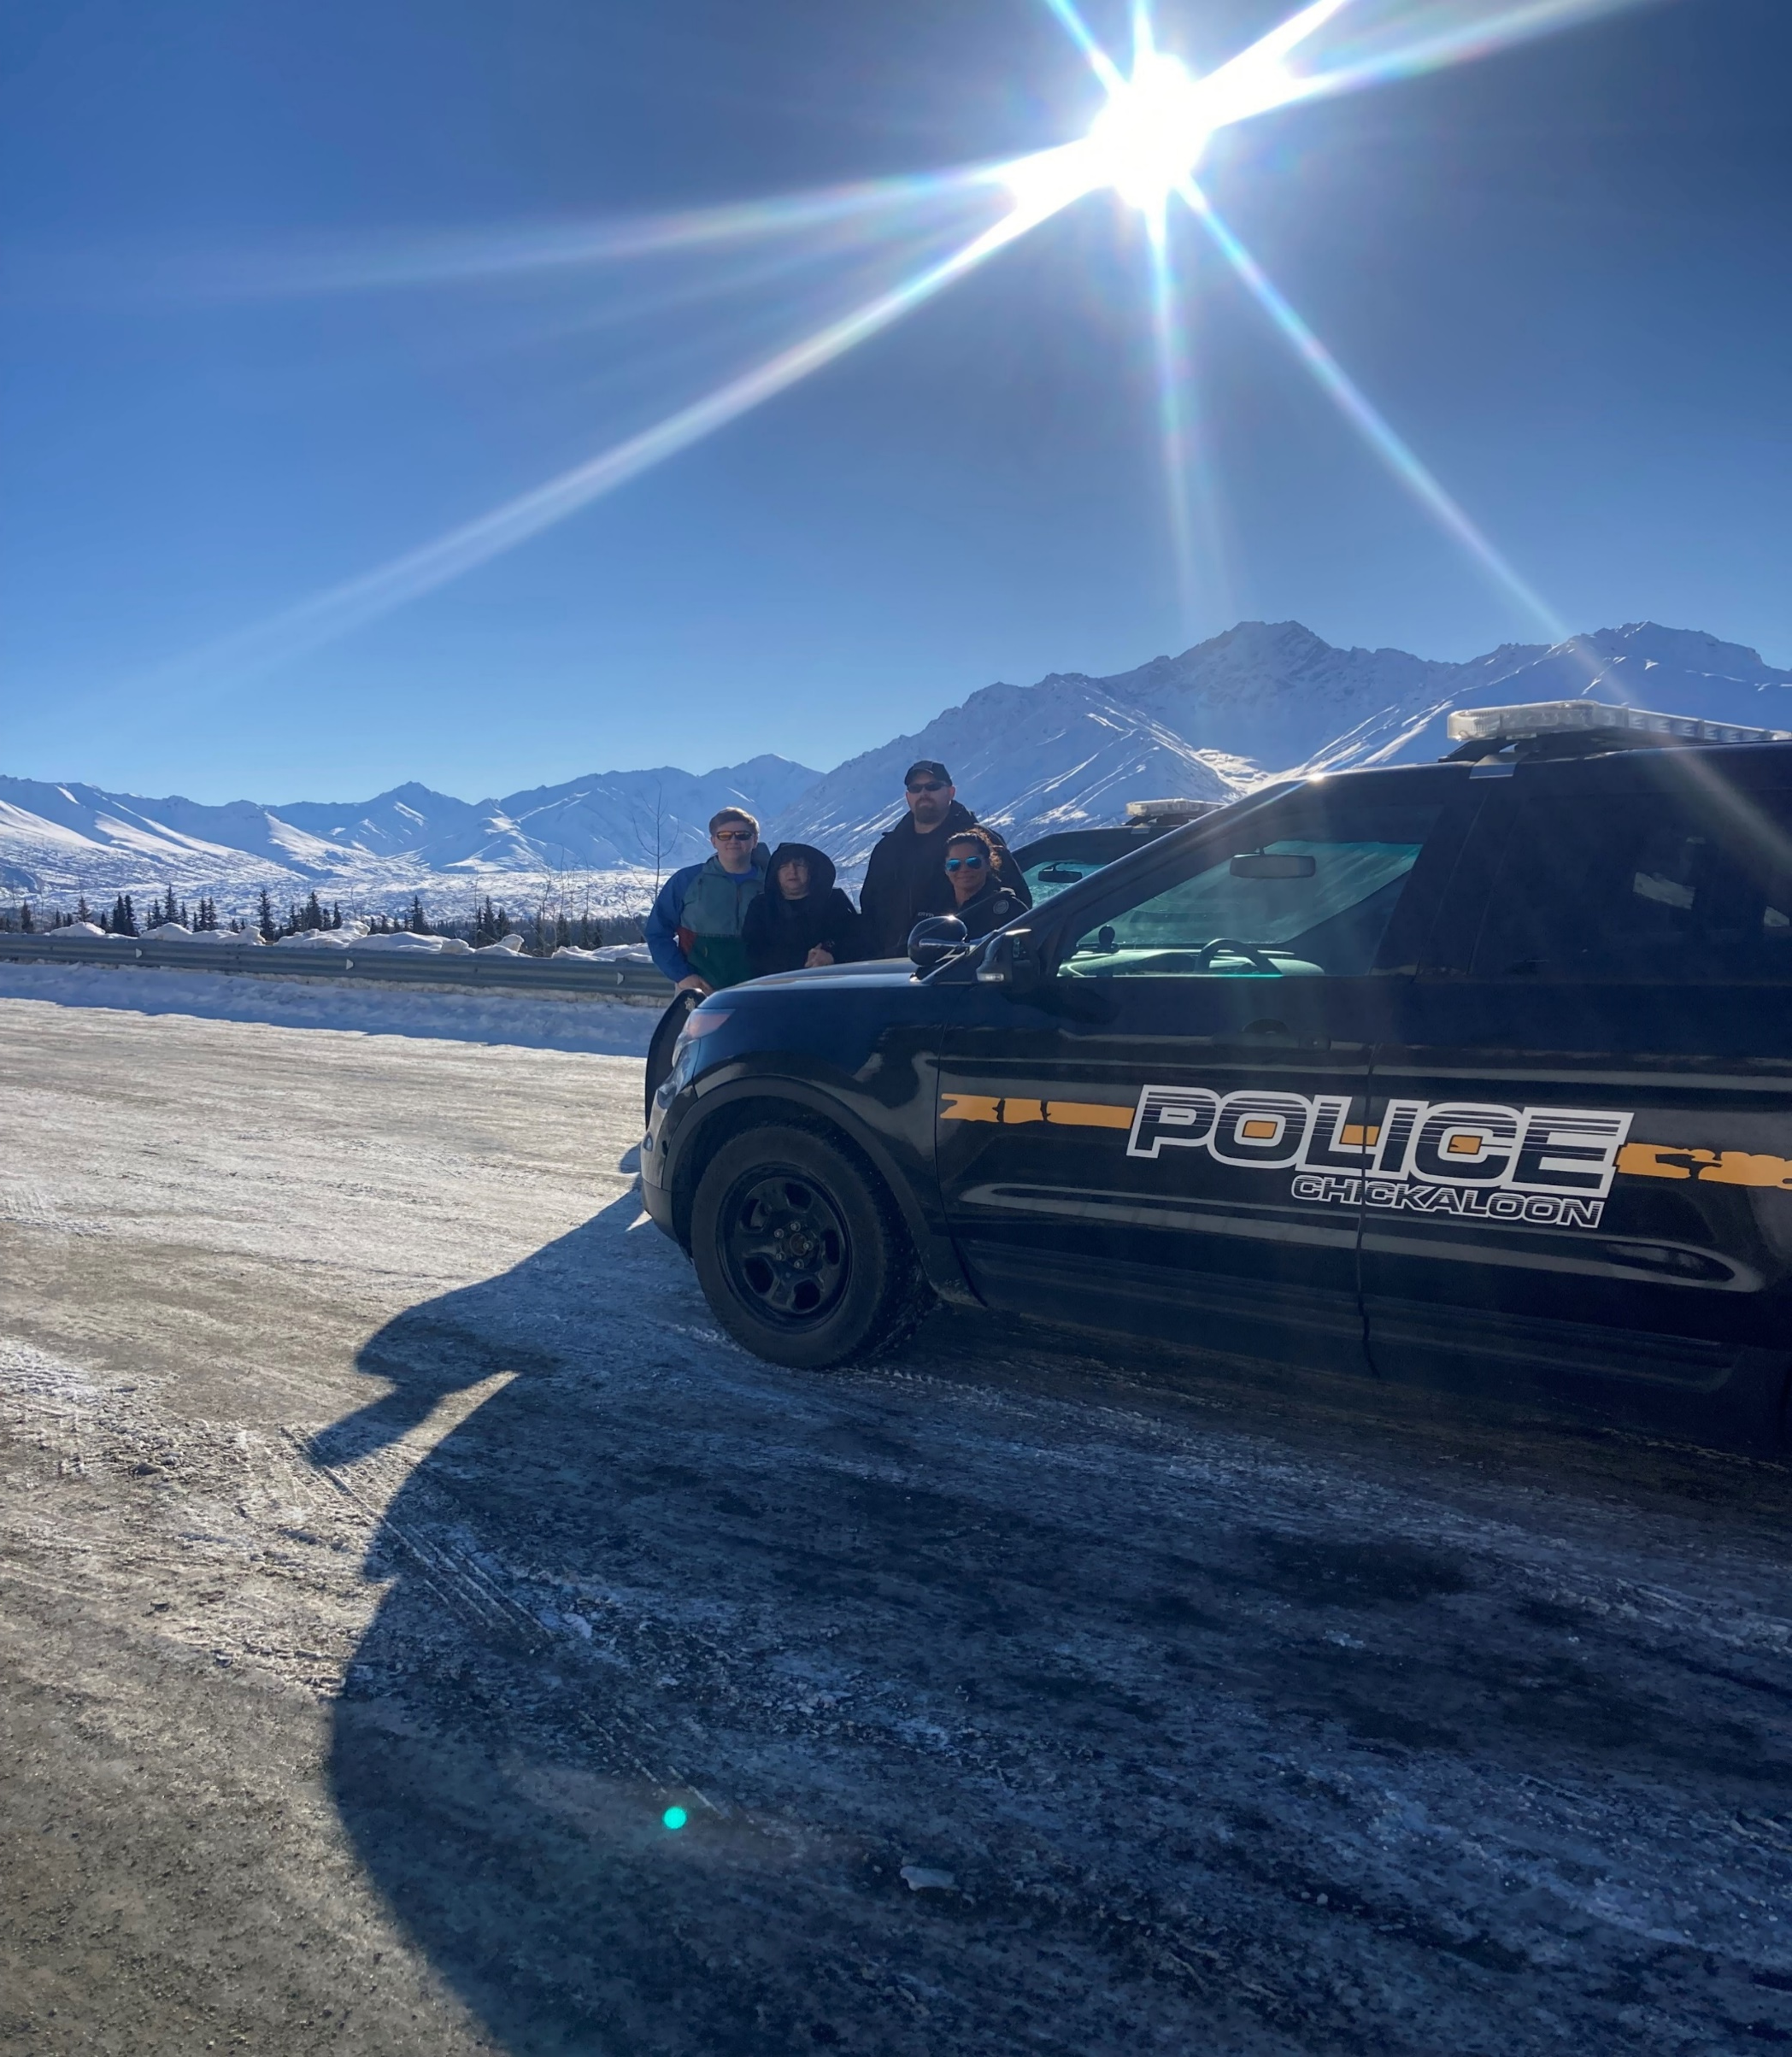
Paralegal/Tribal Court Administrator
Shelia Olson

Slide 5
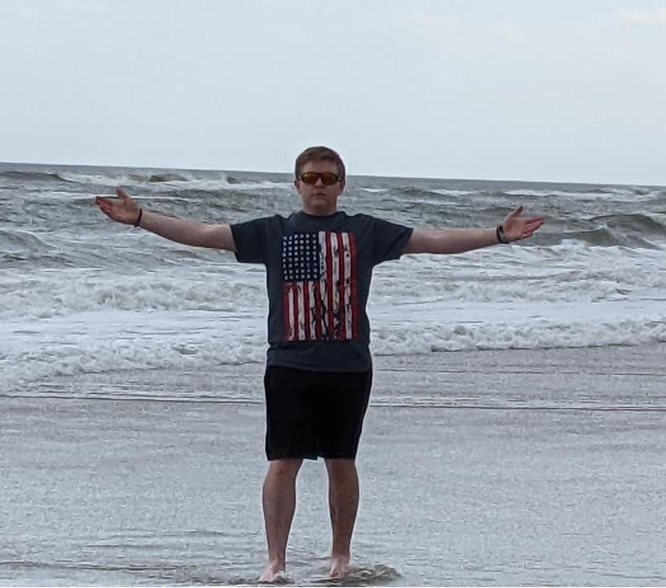

Login Ling, Family Advocate

Slide 6
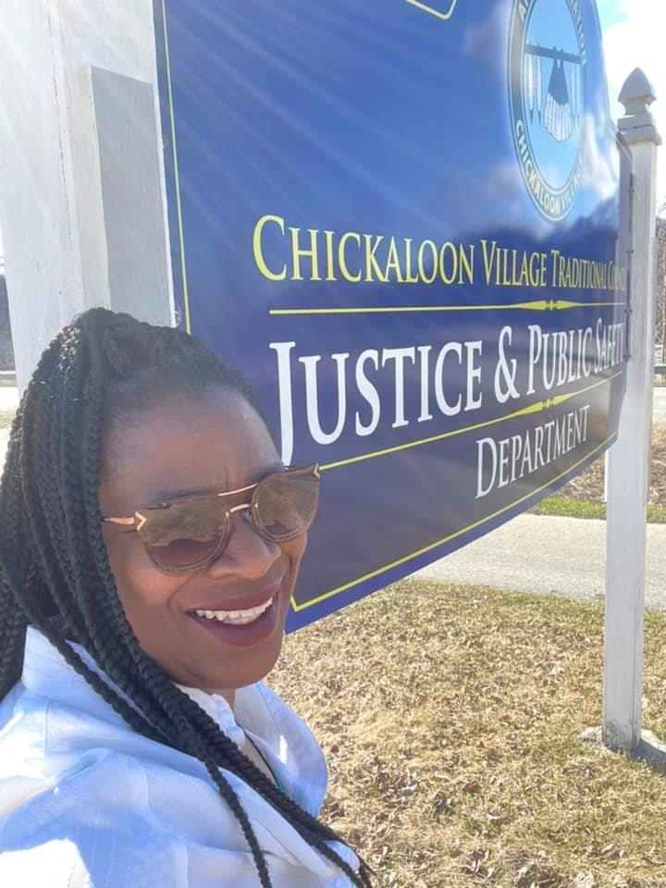
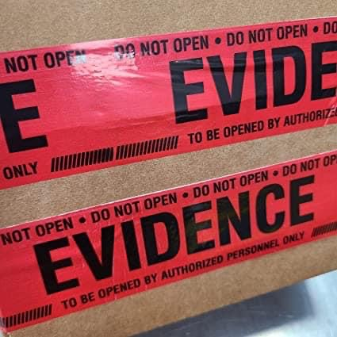
Terri Larson, Court Clerk/Evidence Custodian

Slide 7
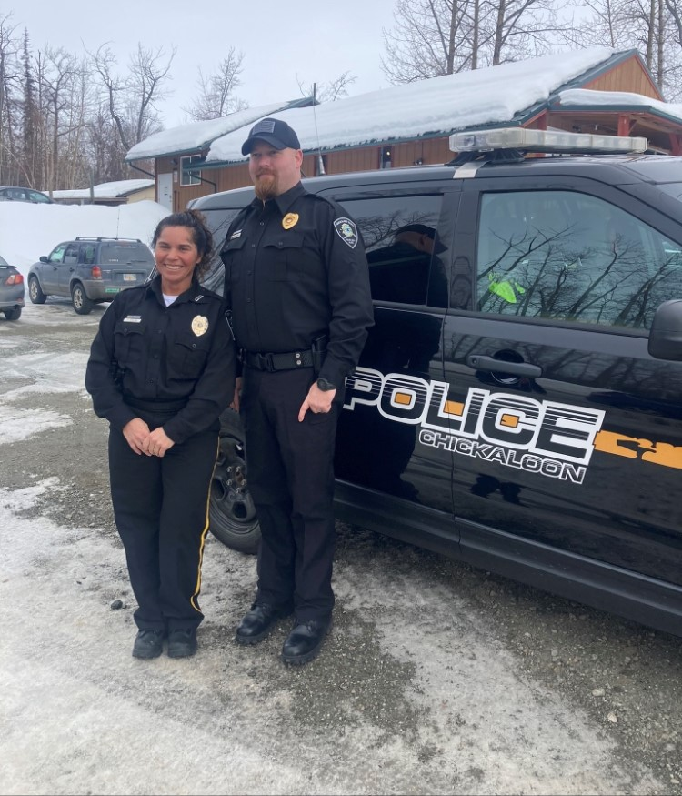
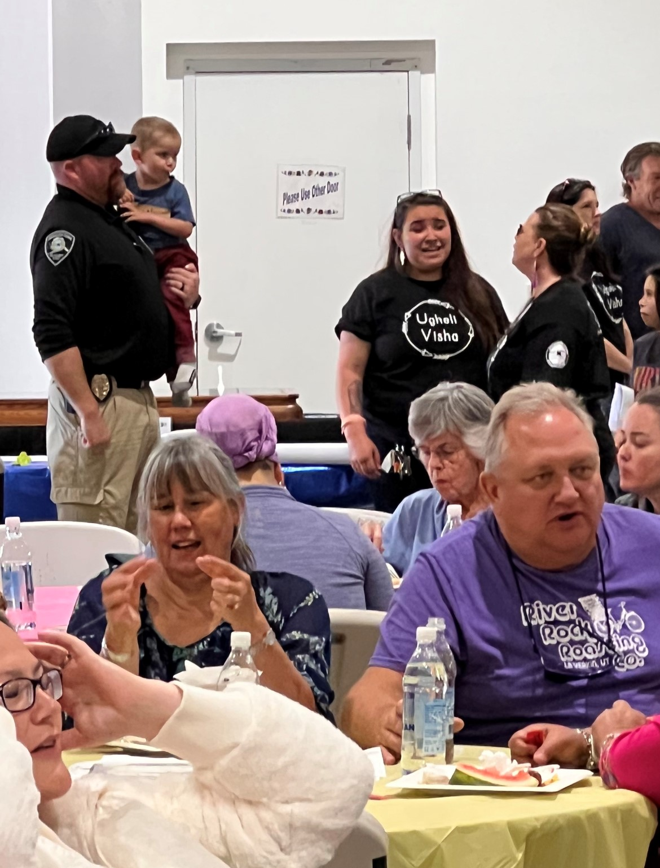
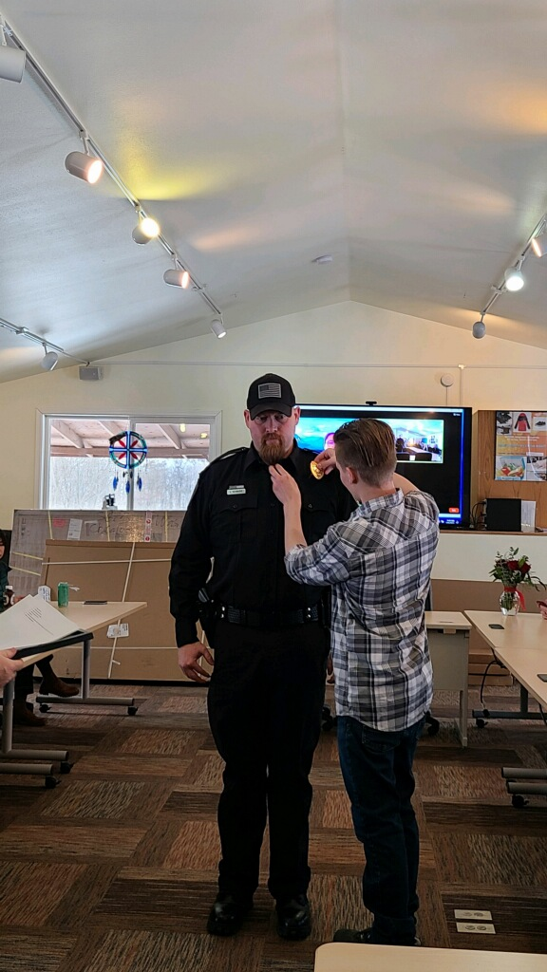
Ofc. Luke Howard

Slide 8
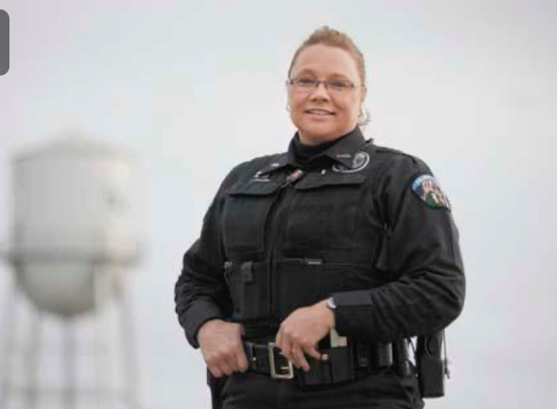
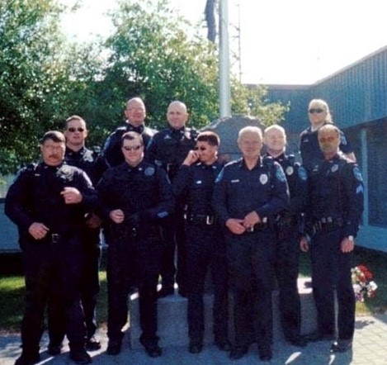
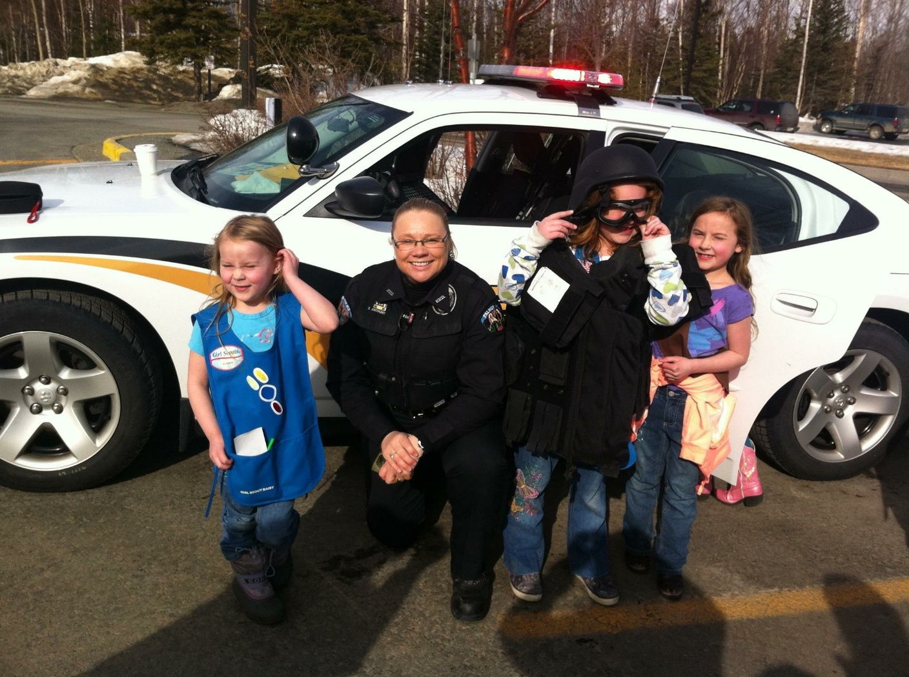
Training and Experience
Justice Director/Chief of Police
Donna Anthony
Deputy Anthony, SRO, High School Prom
Officer Anthony, PPD, Girl Scouts

Slide 9
Court: Family advocate Youth Court Wellness Court Civil/Criminal Court Law Enforcement Police Officers -Reserves -Explores Fish & Wildlife Officers Search and Rescue Dispatch | Corrections Misdemeanor Detention Facility- Youth/Adult Department of Juvenile Justice Drug /Alcohol rehab programs DV programs Elder support Emergency Management Partnership with Mat-Su Emergency Management Planning Training

Slide 10
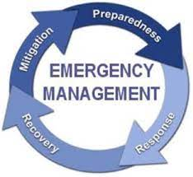
Louis Friend, Emergency Management Planning
The Emergency Management Planning role at Chickaloon Native Village is to prepare plans, conduct trainings, search for funding to prepare and guide us through emergency events that may impact our citizens, community, and geographic area.
These activities are part of the Justice and Safety Department’s commitment to strengthen and support Chickaloon Village goals and long-range planning as well as our continued growth, care of Elders, children, and community,
Lou brings to this position several years of emergency management training, instruction, and participation in emergency events in the Matsu Valley. He completed our SCERP (Red Book), Pre-disaster mitigation plan and successfully applied for the generator grant at our Moose Creek Campus.
Moving forward, Emergency Management Planning will seek to apply for grants that could secure Chickaloon Village generators and emergency supplies, present training classes in Emergency preparedness.

Slide 11

Purpose of Meeting
To develop the Tribal Police Model in Alaska

Slide 12

Mission
The mission of the Chickaloon Tribal Police Department is to uphold Tribal, State and Federal laws; to protect life and property, and to promote and preserve peace within the Community through safe, humane, and effective law enforcement.
CVTC Officers contribute to the overall mission by performing their duties with professionalism, integrity, fairness, timeliness, and by displaying high moral and ethical conduct.
It is our responsibility to keep the peace not only by enforcing the law, but also by working proactively to foster public trust with our entire community.

Slide 13
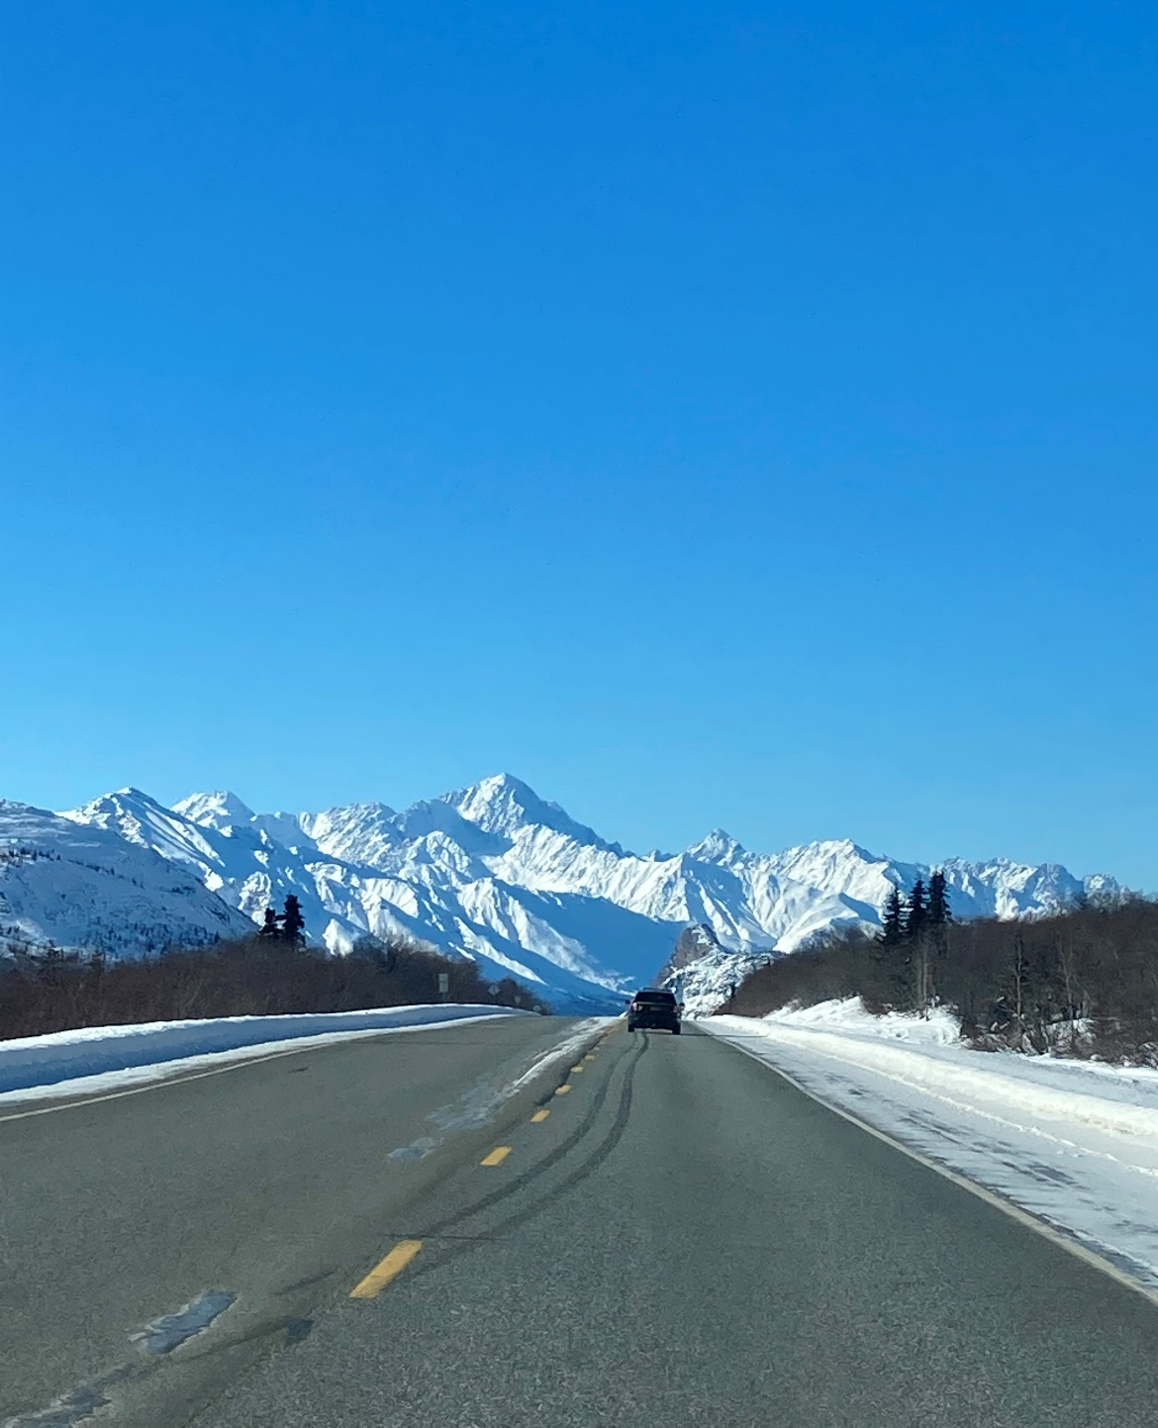
Vision of the Justice Dept.
Expand our Tribal Court System
Set up a model for Tribal Police in Alaska
Dispatch contract options for Tribes with Palmer Police Dispatch Center (ALMAR)
Fingerprint Machine
Access to APSIN/NCIC –background checks, ICWA, Housing, accident and criminal investigation.
A working relationship with The Alaska State Troopers/ Alaska Court System, State District Attorney, BIA, MMIP Task Force and the US Attorney’s office.
Building a Tribal Detention facility
Become a Training facility for all 229 Federal Recognized Tribes in Alaska.
Mentoring our youth through the Youth court Program and Explore Program.

Slide 14
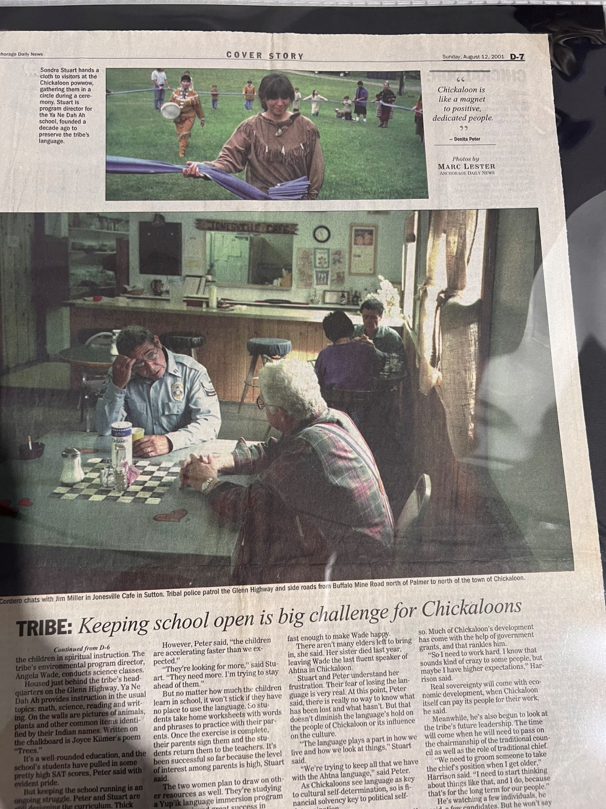
History
Started a certified police department back in the 1980’s with an FBI Law Enforcement ORI number.
Tribal Police Officers attended a Certified Police Academy in Fairbanks and Sitka.
Tribal Police Officers were certified police officer under Alaska Police Standard Council though a MOU with the Alaska State Troopers.
Chickaloon Tribal Police Department received several DOJ-COP grants to help with Tribal and State cases.
In February 2020, a letter came out that Alaska Police Standards Council will no longer recognize Tribal Police having any State Authority. (No power to arrest or send cases to the District Attorney’s office)
We still have DOJ-COP Grants, but NO State of Alaska police authority, except tribal, due to a letter from Alaska Police Standard Council written in 2020.

Slide 15
Current Status
Working on the new Tribal Police Model for Alaska to obtain State & Federal Authority. (US 18 Code-Indian Law)
Currently, police officers who have State Authority can arrest, serve emergency orders, Trespassing order, investigate sexual assaults, Domestic Violence, Murder, Drugs cases, Human Trafficking, Missing Person, etc. At this time, Tribal Police in Alaska have no reservations & no state or Federal authority to investigate serious crimes or forward the charging documents to the District Attorneys office. (There is hope with VWAW 2022 Sec 813 Tribal Jurisdiction in Alaska)
When Tribal Police Officer takes a police report and it’s not a misdemeanor, we must call the Alaska State Trooper to finish the case with our tribal members at this time. The State of Alaska is not sharing “concurrent jurisdiction” with the tribal governments.
So, how do we work together in the future to help our people?

Slide 16

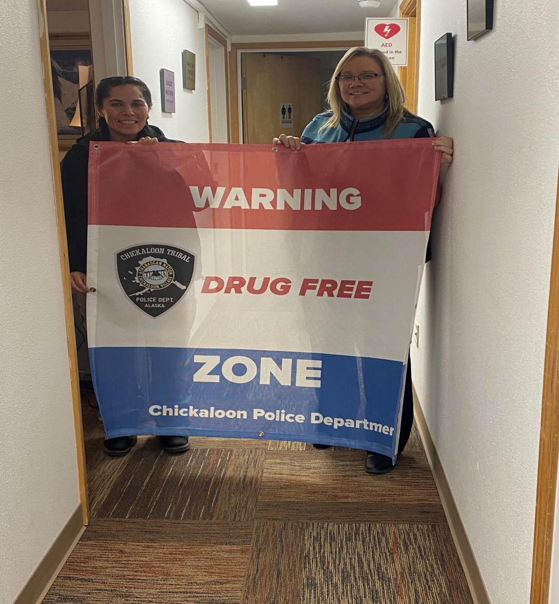
Strength’s
Motivated Justice Department Team
Support from our Tribal Council
Support from other tribes, RulCap, Denali Commission and the Alaska Native Justice Center
Good community service
Applying for grants and attend training
Hiring the right people for the positions

Slide 17
Chickaloon Tribal Police Officers (TPO) Model Program
STEP 1
Application process
Oral board
Background check- F3 Personal History Statement (APSC recommended Greg Russell to conduct background)
Phycological Evaluation- Mark Smedley, Ed.D.
Physical Exam- Health Questionnaire
Polygraph - Offered by Commander Shane LaCroix at Palmer Police Department
Send application to U.S. Indian Police Academy-Bureau of Indian
Officer will attend a 16-week Police Academy (FLETC) New Mexico.
Dispatch contract with Palmer Police Dept
MOA agreements to help with Field Training (FTO). We would partner up with Palmer PD, AST or Anchorage Police, if available.
STEP 2
After the academy officers will attend Criminal Investigation 6-week Glynco, GA and obtain the Special Law Enforcement Commission (SLEC Card)
Partnership with the BIA, US Marshals, FBI on human trafficking & MMIP Task Force
School Resource Office Training (SRO) –Youth programs
STEP 3
Attend the 2-week Alaska State Trooper Academy in Sitka January of 2023. (State of Alaska Certification) MOU agreement with AST & PPD –Agency Assist.
Chickaloon Tribal Officers would be trained in tribal, state laws and federal laws.
STEP 4
ETT or higher medical training, due to the delay of medical response. Training provided by Palmer Fire Training Dept.

Slide 18
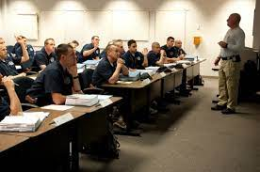
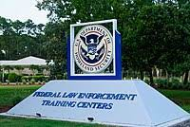
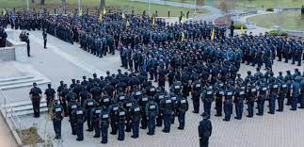
Federal Law Enforcement Training Center (FLETC)
Artesia, New Mexico
16-Week Academy

Slide 19
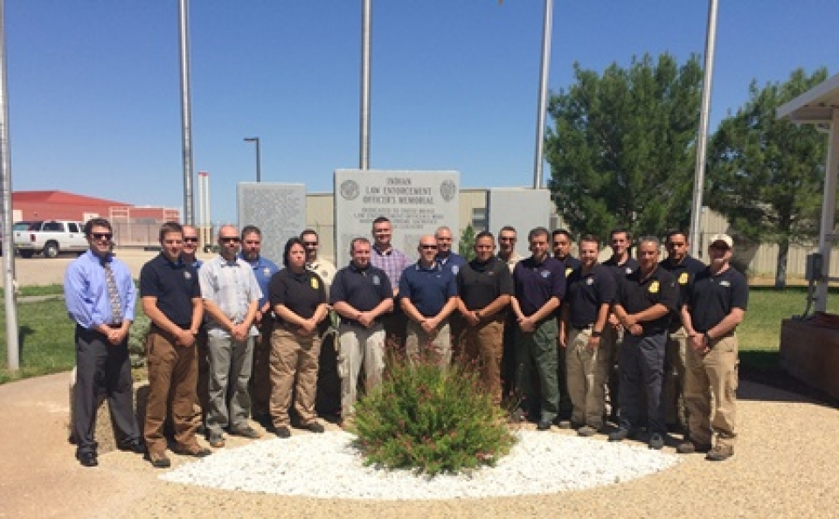
Indian Country Criminal Investigation Training Program – Federal Law Enforcement Training Center
The course is put on as part of a coordinated effort by the BIA, FBI, and the National Indian Country Training Coordinator, and trains participants that work for Tribes all over the Country.

Slide 20
18 USC Ch. 53: INDIANS From Title 18—
CRIMES AND CRIMINAL PROCEDURE PART I—CRIMES
1151.Indian country defined.
1152.Laws governing.
1153.Offenses committed within Indian country.

Slide 21
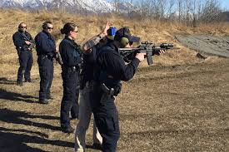
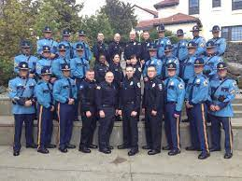
APSC 2-Week Recert at AST Academy in Sitka

Slide 22

Course of Action
Tribal Engagement Program discuss options for records management system, integrated automated fingerprint identification system, uniform crime reporting, national crime information center, national incident-based reporting system.
Work with Legislators to add Tribal Police Officers under the State Statue or Special Commission from the Commission for a pilot program for TPO’s.
Set up a “Alaska Tribal Police Association.” Setting a standard and monitored by ANJC.
Tribal Police would be able to work cases in the Tribal court, State Court and Federal Court.
Set up a Tribal Police FTO program working with our state, local and federal partners.
Work with our State and Federal Prosecutors
Build Tribal Detention Facility in Alaska.
Continue to build the Tribal Court System and Tribal Programs
BIA- Special Law Enforcement Commission (SLEC Card)
Work with Department of Interior (DOI)

Slide 23
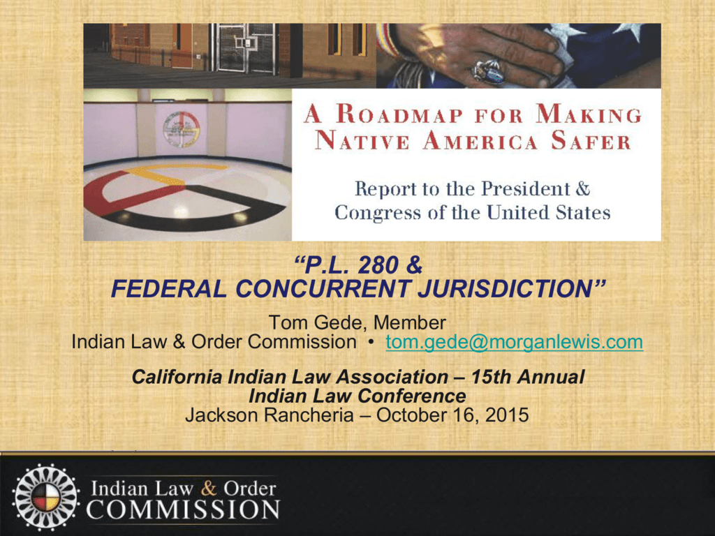
Why do you have to change the state statue for this Department to work?
CVTC Officers will better serve the local community through shared concurrent jurisdiction. Concurrent jurisdiction means that more than one agency has the power to resolve serious issues that arise in the community.
This change in statute will allow CVTC Officers to share policing responsibilities within the community and provide timely response assisting in investigating local, more serious crimes beyond simple misdemeanors. CVTC Officers will have achieved the necessary training and experience to respond accordingly and provide the much-needed back-up for state and local law enforcement officers.
How does this work? 911 calls/MOU’s

Slide 25

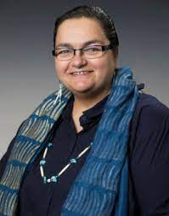
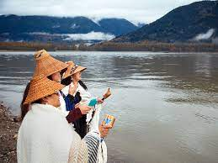
Tribal Court
  Court Grants
  Denali Commission (Victim Service/Advocate)
  Office of Tribal Justice (Judges)
  Office of Tribal Justice (Clerk Court, Court Administrator & Bailiff)
  DOJ/BJA Court (Court and Justice Director)

Slide 26
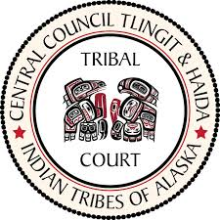



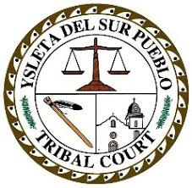


Will Non-Tribal members be judged by a Tribal Court for criminal cases?
No! CVTC’s Traditional Tribal court is for domestic relations cases or trespass cases involving Tribal citizens.

Slide 27
Chickaloon Tribal Court
Assistance to Tribal Citizens of Chickaloon Native Village
Administrator
Clerk
Victim Services
Court Advocate
ICWA
Guardianships
Tribal Adoptions
ICWA Cases
Adult & Children helped with day-to-day care
Keeping Tribal Children in Tribal Family
Collaboration with ICWA Program Manager
Protective Orders
Conservatorships
Adult & Children kept economically safe
Tribal Citizens kept safe from physical and/or monetary harm

Slide 28

Tribal Court Orders and Alaska State Court Standards
Acceptance and Recognition depends on type of case on how it is accepted by state court

Slide 29

Funding-DOJ Grants
  1. 2019-Equipment
    COPS ORI:AK005ZZ
  2. 2019 COPS HIRE Grant
    COPS ORI:AK005ZZ
3, 2017- COPS HIRE GRANT
COPS ORI:AK005ZZ
4. 2021-DOJ/BIA Grant
COPS ORI; AK00577

Slide 30

Priorities
Human Trafficking Task Force (Education for youth & parents) Working with FBI & Myhouse
Mat-Su Valley Drug Endangered Children Task Force
Drug Enforcement (Work with AST Drug Task Force & DEA)
School Resource Officers/ DARE Program
Work with US Marshal (Sex offender/warrants)
Traffic/Accidents (Agency Assist from AST)
EPW-Extra patrol Watch/ Elder Welfare checks
Emergency Planning with MSB
Search & Rescue
EMT Training (Work with Sutton and Chickaloon Fire/EMS)
Youth Court -16 Weeks
Working partnership with our HSS on ICWA Cases and Tribal Opioid Response
Training Facility for other Tribal Agencies (FTO and Court)
Youth Court and the Explore Program
Tribal Police Reserve Program
What do we need? Letters of support.

Slide 31

Discussion

Slide 32
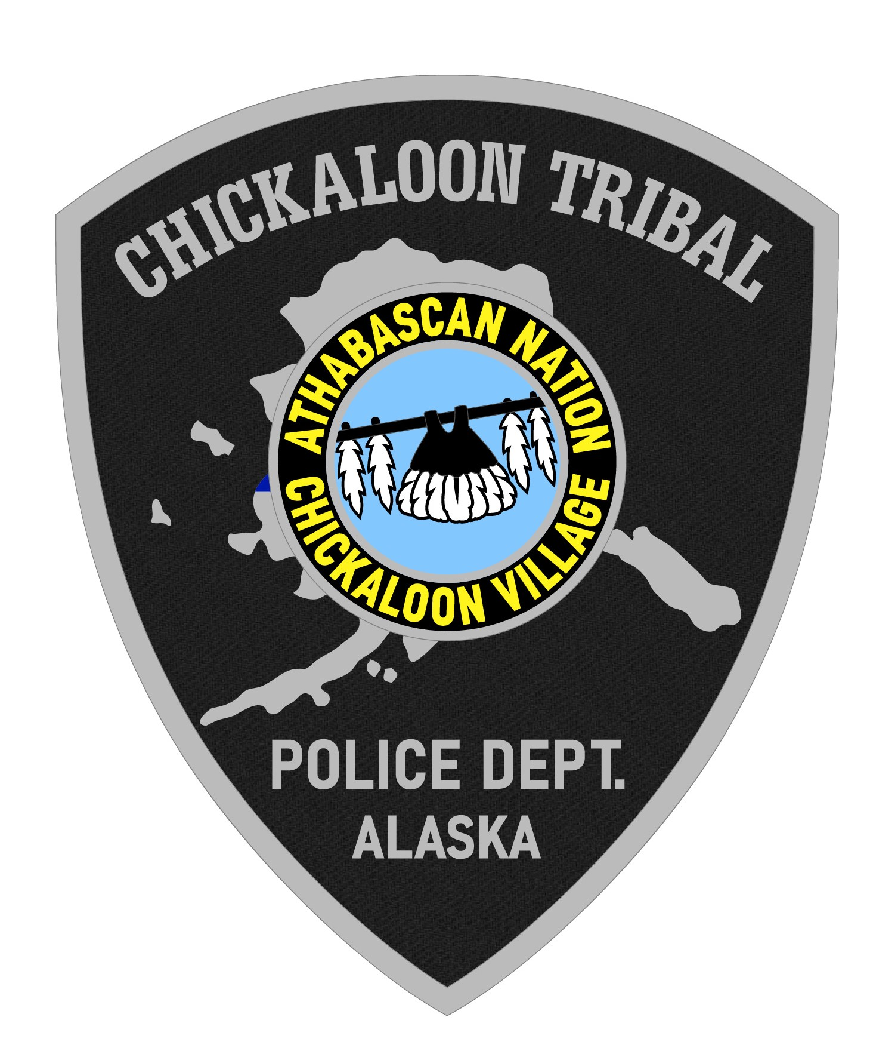
Contact Information
Justice Department
Donna Anthony, Justice Director
Office 907-745-0700
Email: dlanthony@chickaloon-nsn.gov

